Slide 1
Activities
Ian

Slide 2
Services for RE3/1 & RE4/1 HV, LV OF and cooling all connectorised
Resistivity vs Transmission
Cryogenic Solenoid for Open days
Repair of RB chamber gas system from inside.
PRPC, higher density, flat pack chamber and rpc prediction performance, evaluate.
HGCAL, contacts
Gas Recuperation by cryogenic
MEX shipping “all” for a lab. NIM, gas etc
Oil on HPL play time
Cooling for with CSC job @ CERN
Safety tour
Gas system for Lyon

Slide 3
Sewrvices for RPC Upscope
RE3/1 & RE4/1
HV
LV

Slide 4
Resistivity vs Transmission

Slide 5
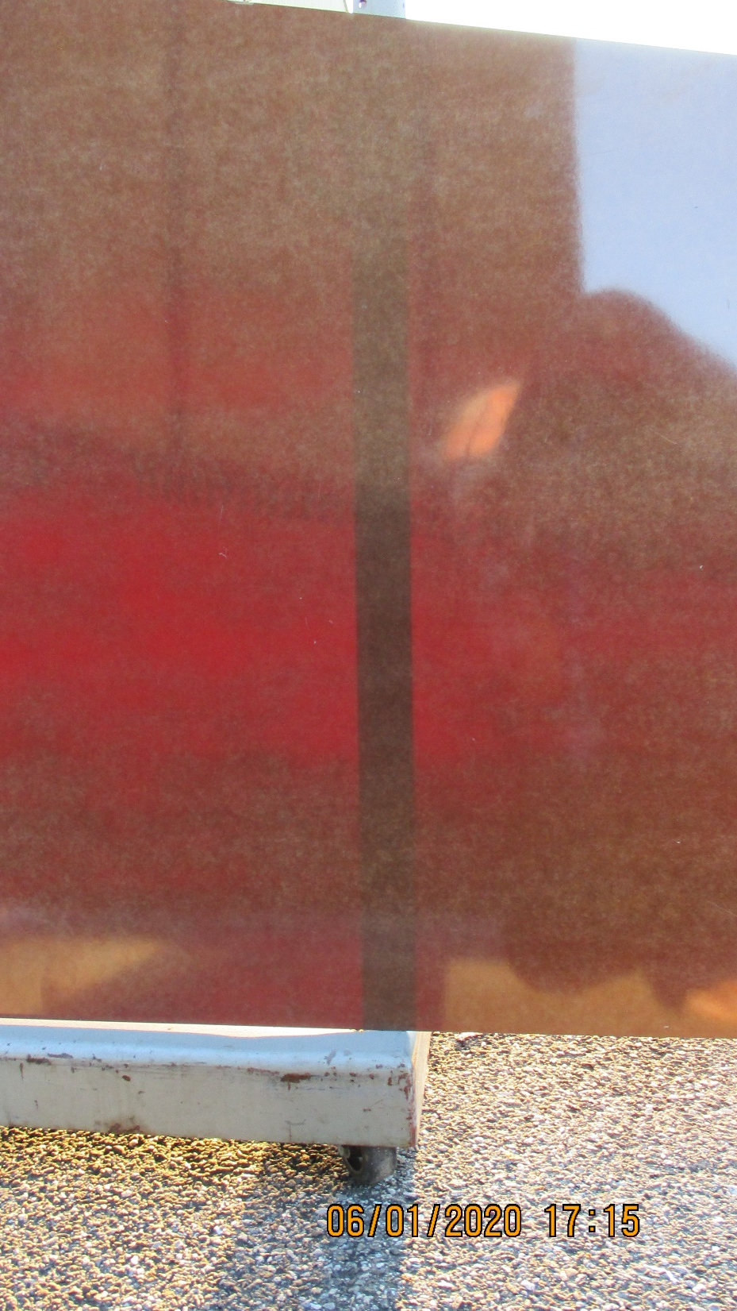
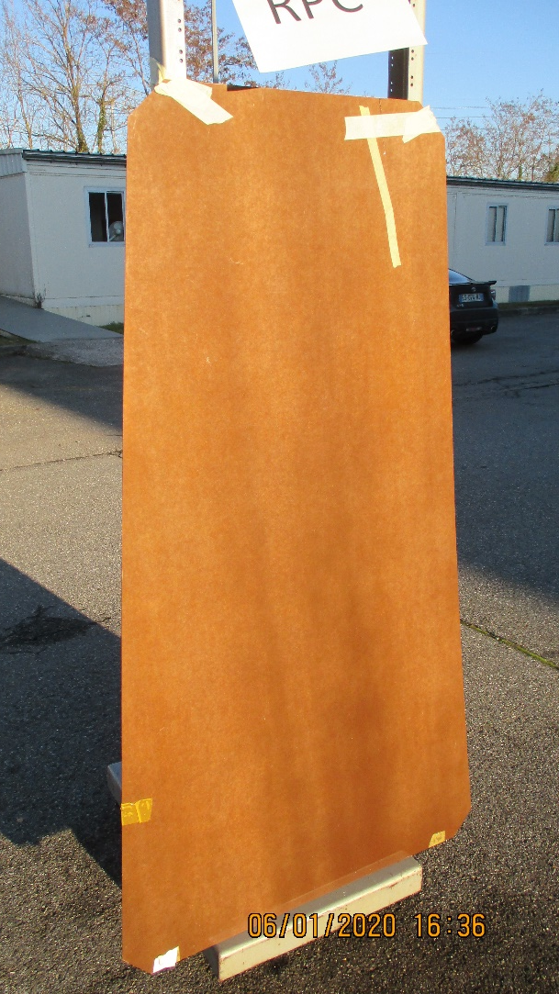

Slide 6
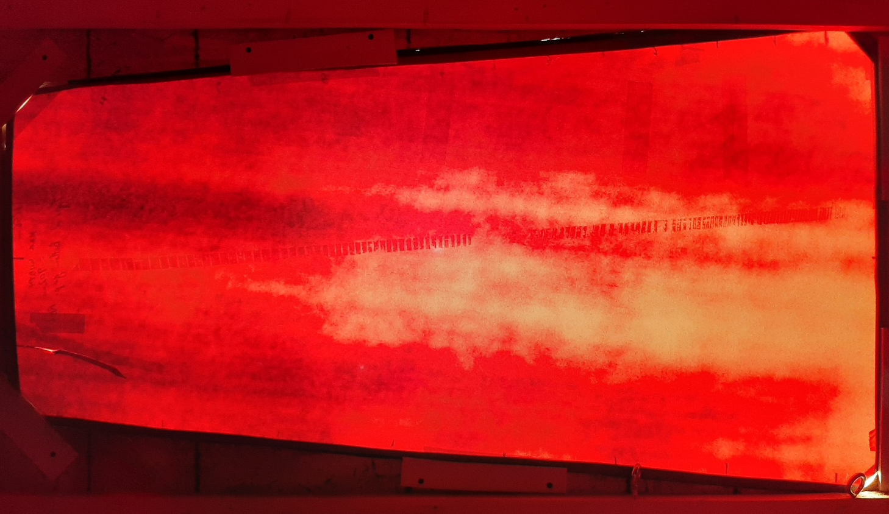
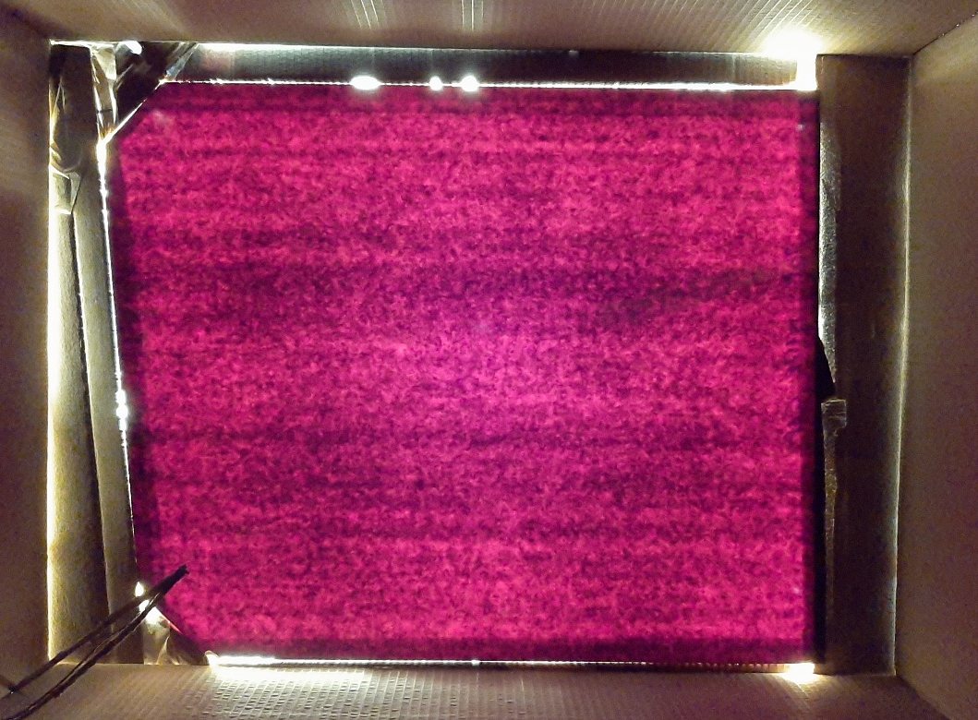
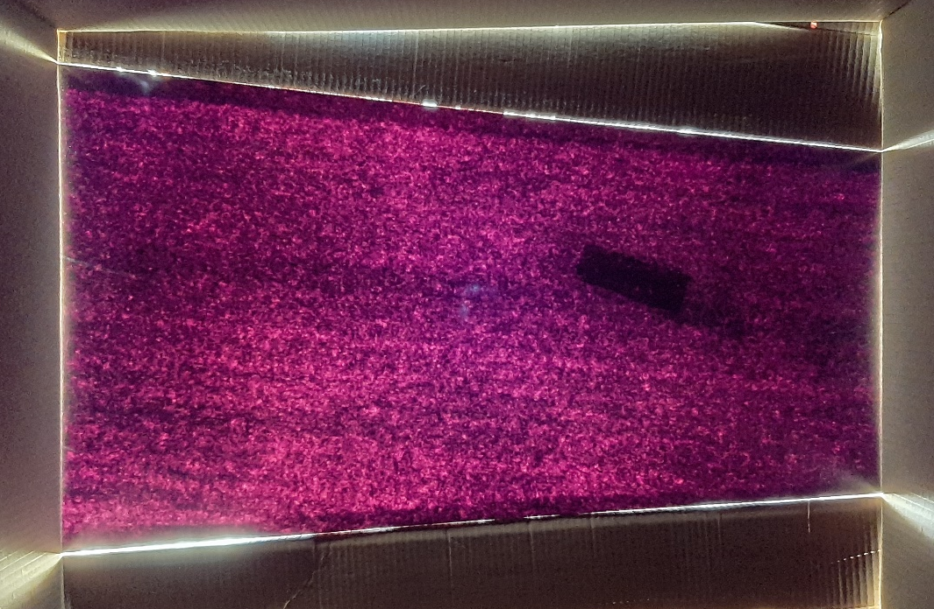
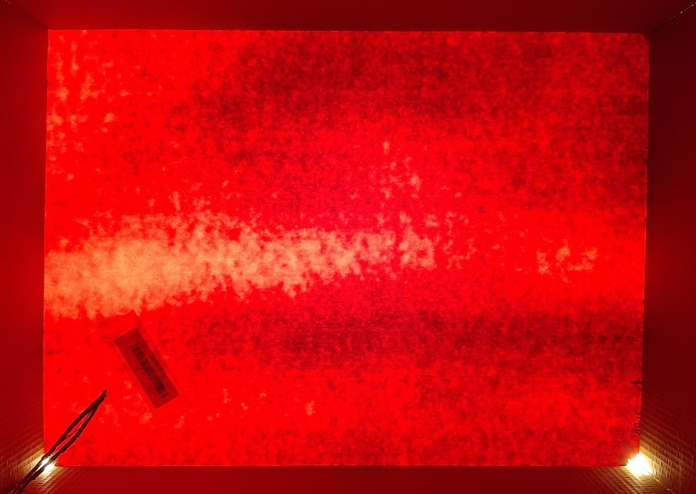
Similar lighting from the Sun and Samsung Camera. Old production on the RHS and new on the left

Slide 7
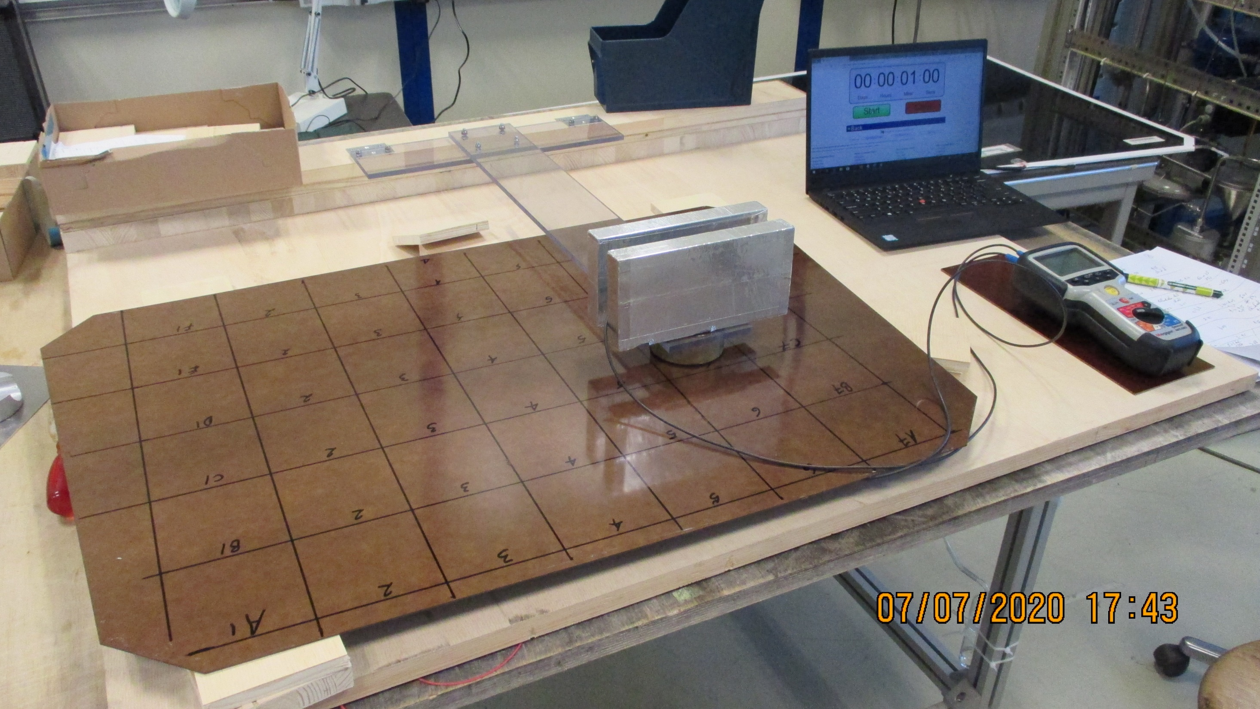
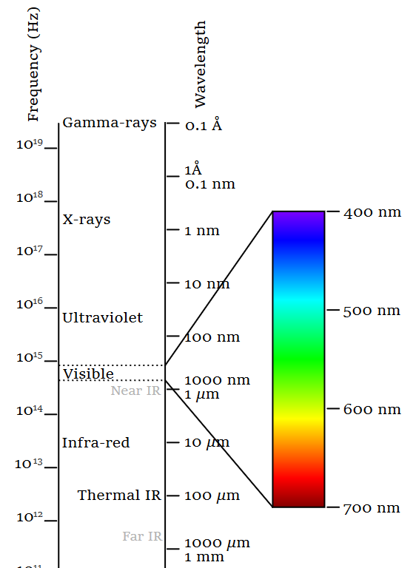
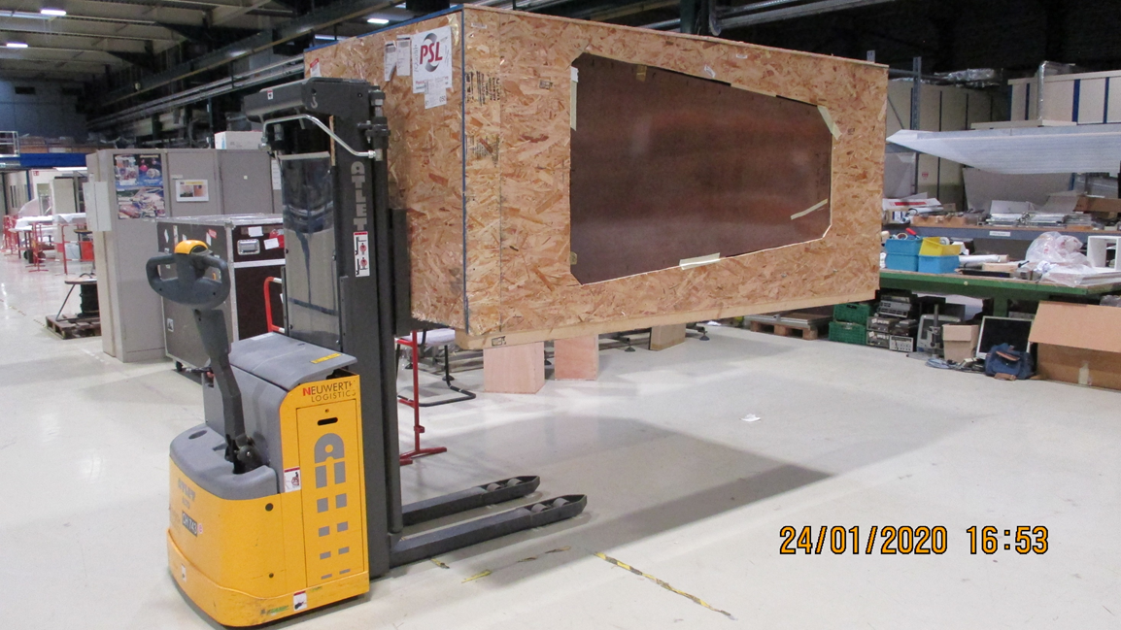
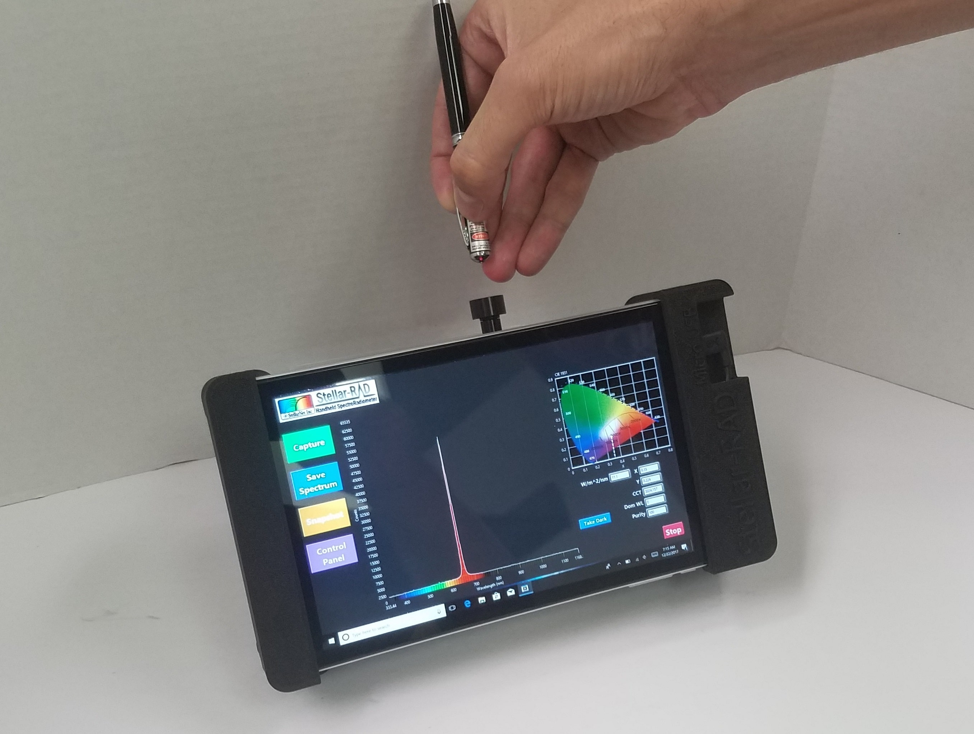
Resistivity vs Transmission
Radiometer

Slide 8
Cryogenic Solenoid for Open days

Slide 9
We can build a large (~200mm diameter x 250mm long) coil, simulating the CMS solenoid , using few windings and run a few amps through it. A large analogue meter will indicate the current.
The “B” field will be shown by compasses or similar set around the coil and to indicate B field change hanging steel piece or steel on a spring.
The coil is then immersed in liquid nitrogen , or the vapour of same, and the current will increase and the “B” field increase.
Explaining that this increase in field is “for Free” and that the field increase allows the particle ID through sagitta measurements to improve. The latter may be illustrated by long thin elastic levers (representing particle trajectory) with a small steel ball on the end that will deflect in the B field. Great care will be required in order to find the correct stiffness and ball size, perhaps the coil axis should be vertical ?
.

Slide 10
Repair of RB chamber gas pipes from inside.

