Slide 1
Activities
Ian

Slide 2
Services for RE3/1 & RE4/1 HV, LV OF and cooling all connectorised
Resistivity vs Transmission
Cryogenic Solenoid for Open days
Repair of RB chamber gas system from inside.
PRPC, higher density, flat pack chamber and rpc prediction performance, evaluate.
HGCAL, contacts
Gas Recuperation by cryogenic
MEX shipping “all” for a lab. NIM, gas etc
Oil on HPL play time
Cooling for with CSC job @ CERN
Safety tour
Gas system for Lyon

Slide 3
Sewrvices for RPC Upscope
RE3/1 & RE4/1
HV
LV

Slide 4
Resistivity vs Transmission

Slide 5
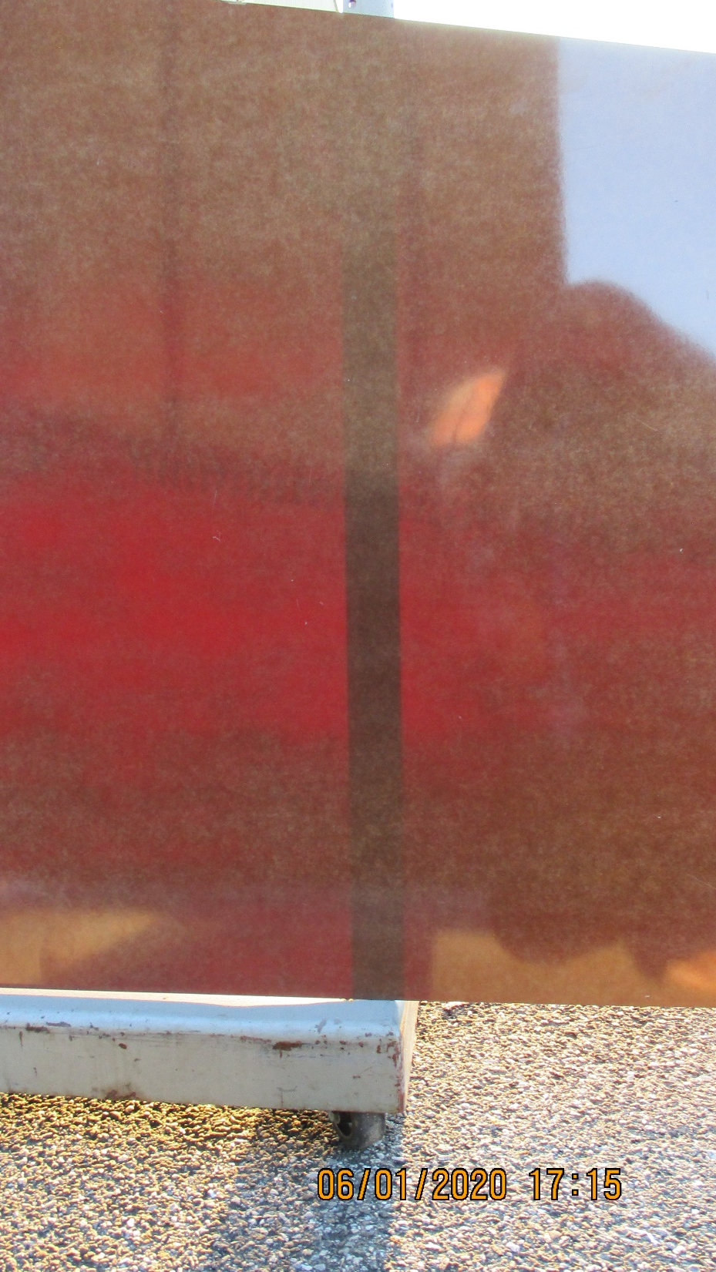
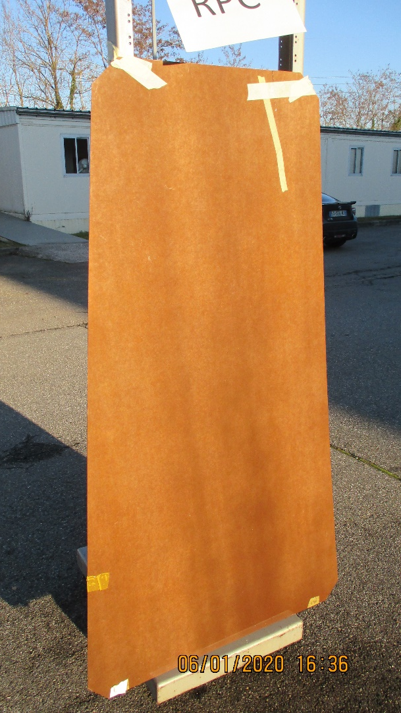

Slide 6
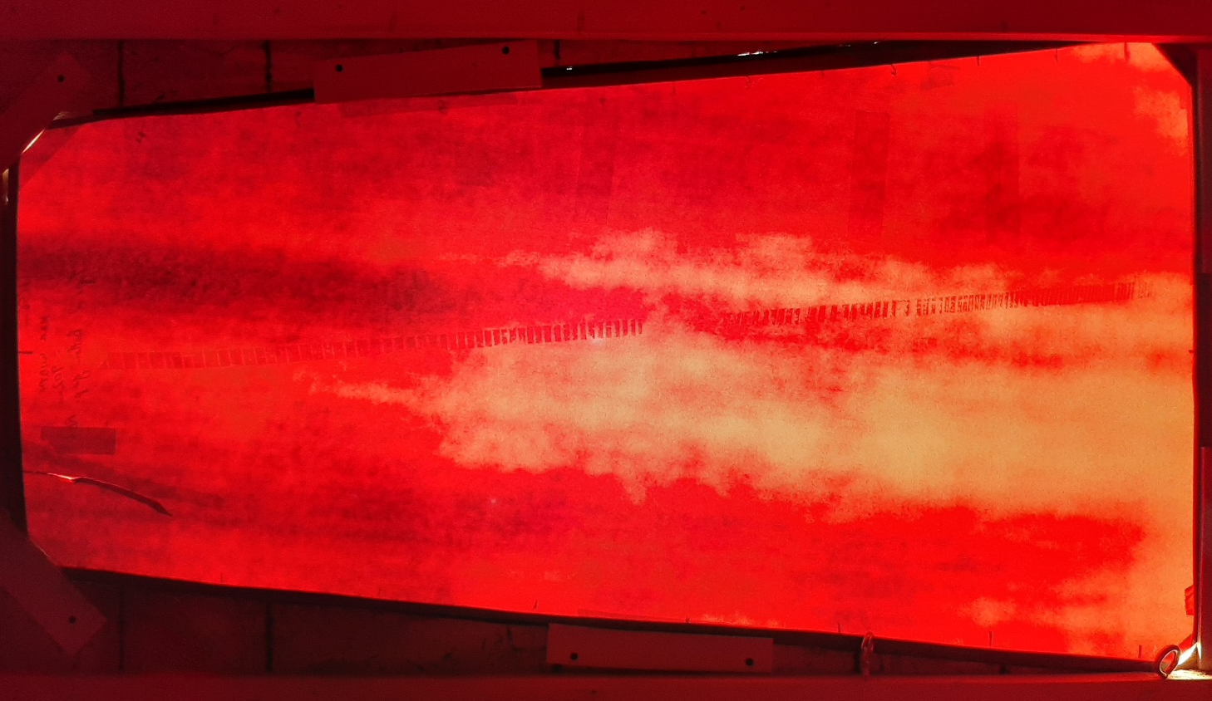
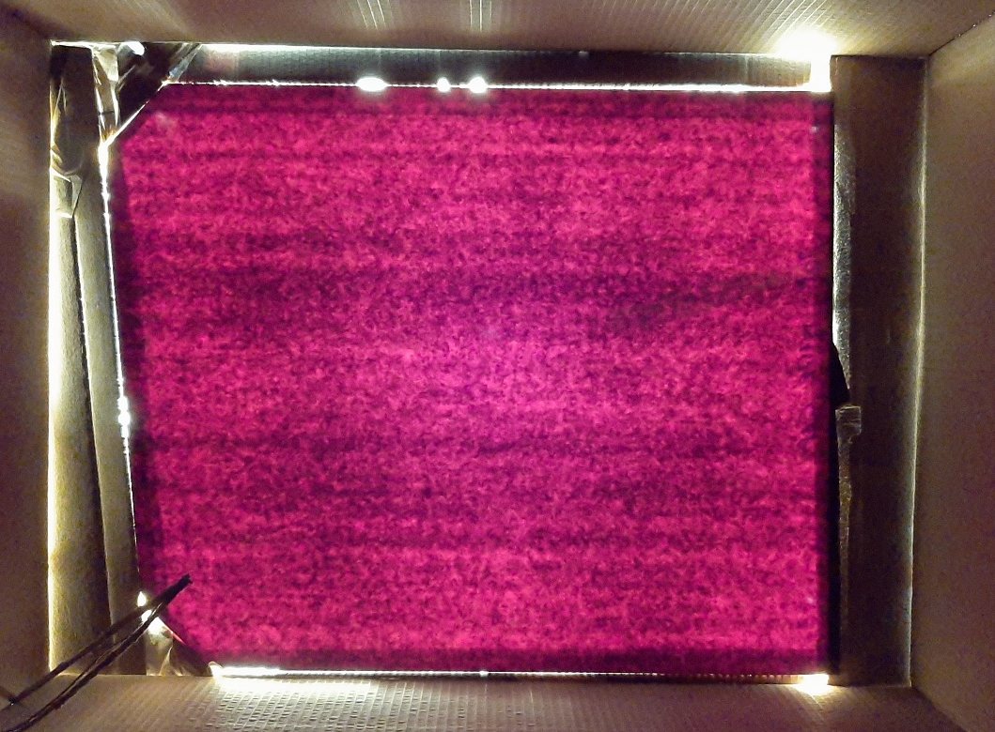
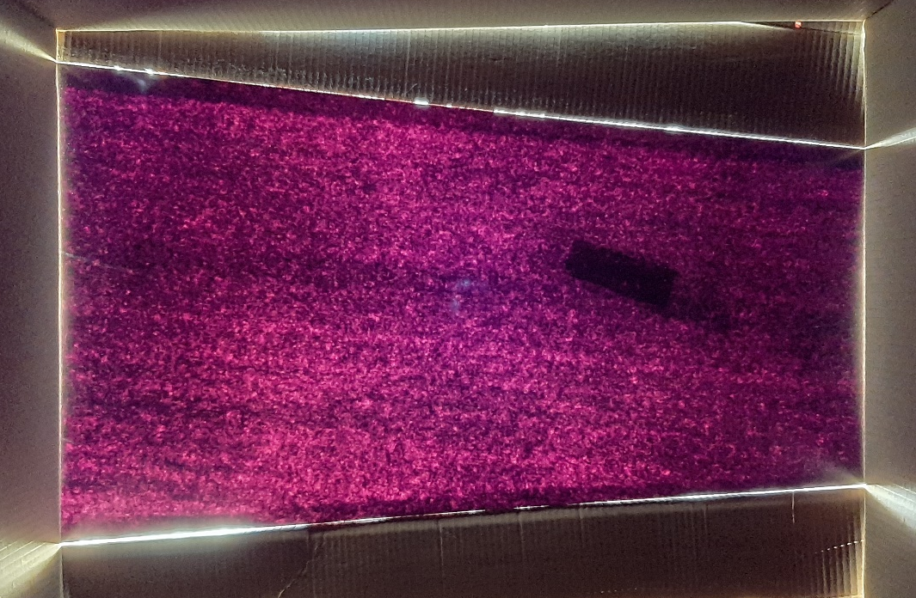
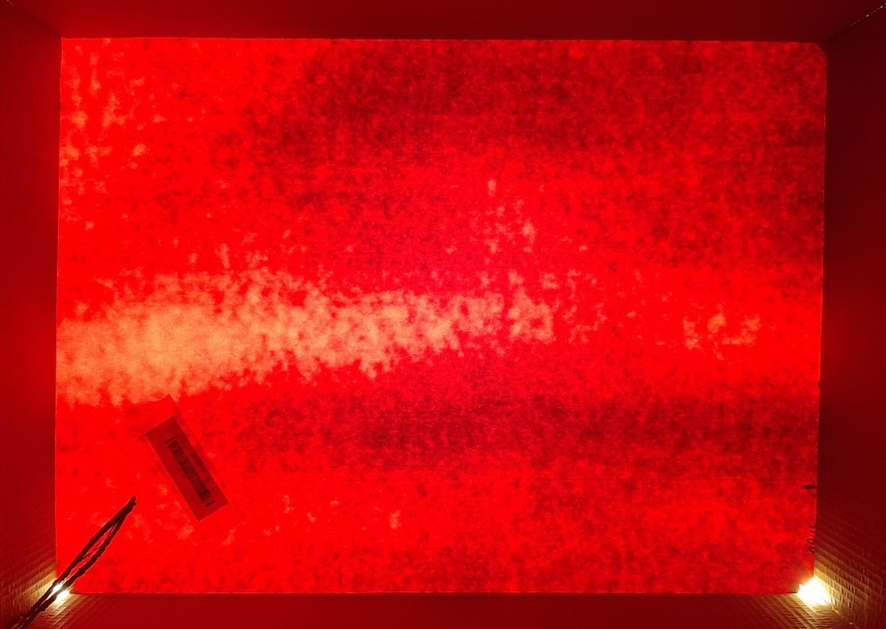
Similar lighting from the Sun and Samsung Camera. Old production on the RHS and new on the left

Slide 7
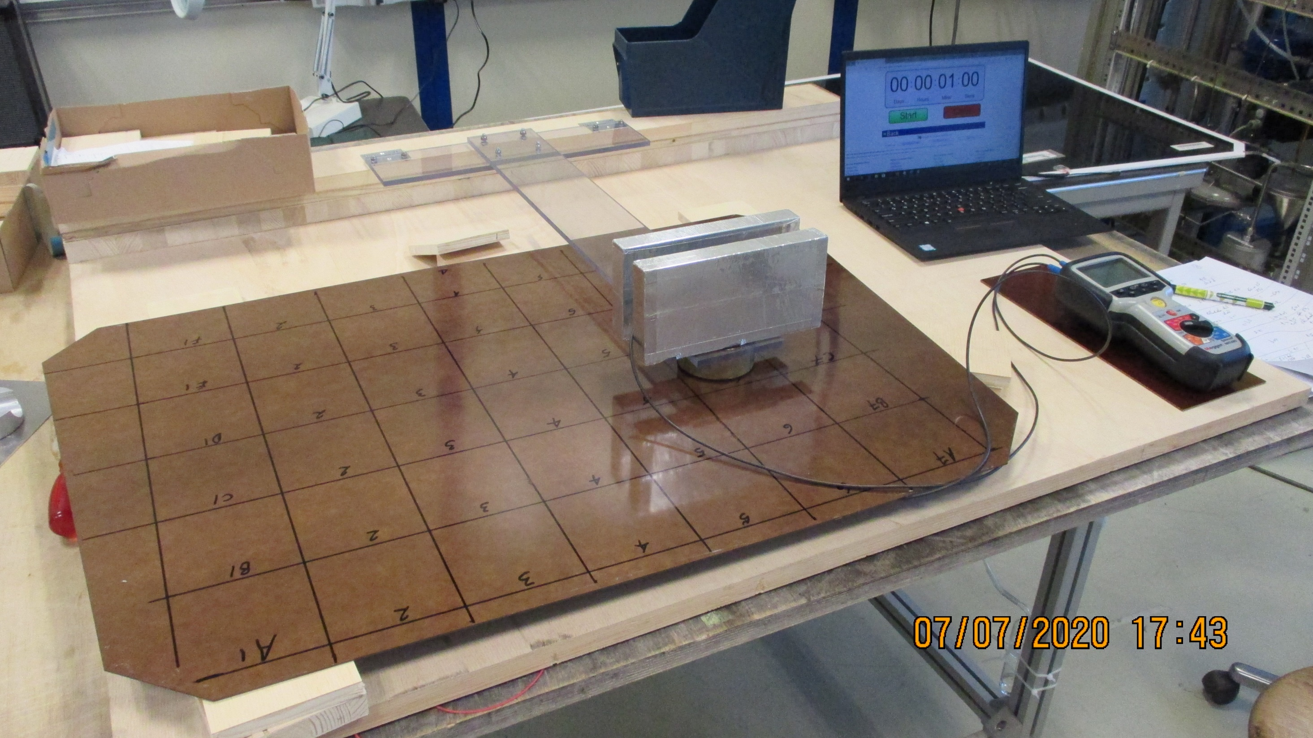
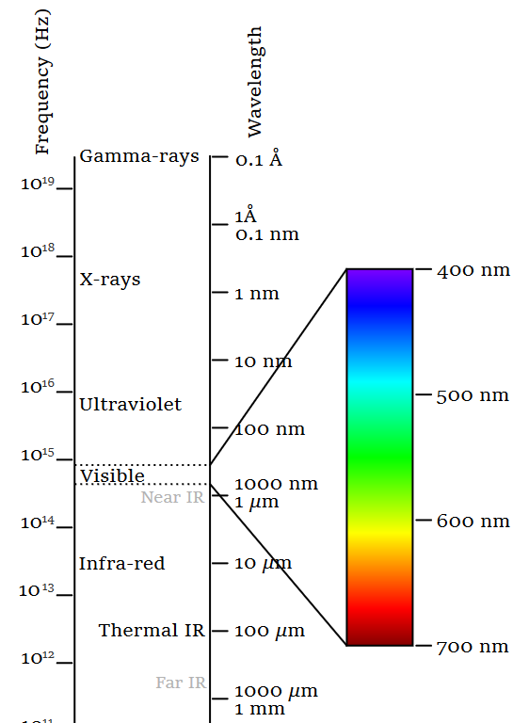
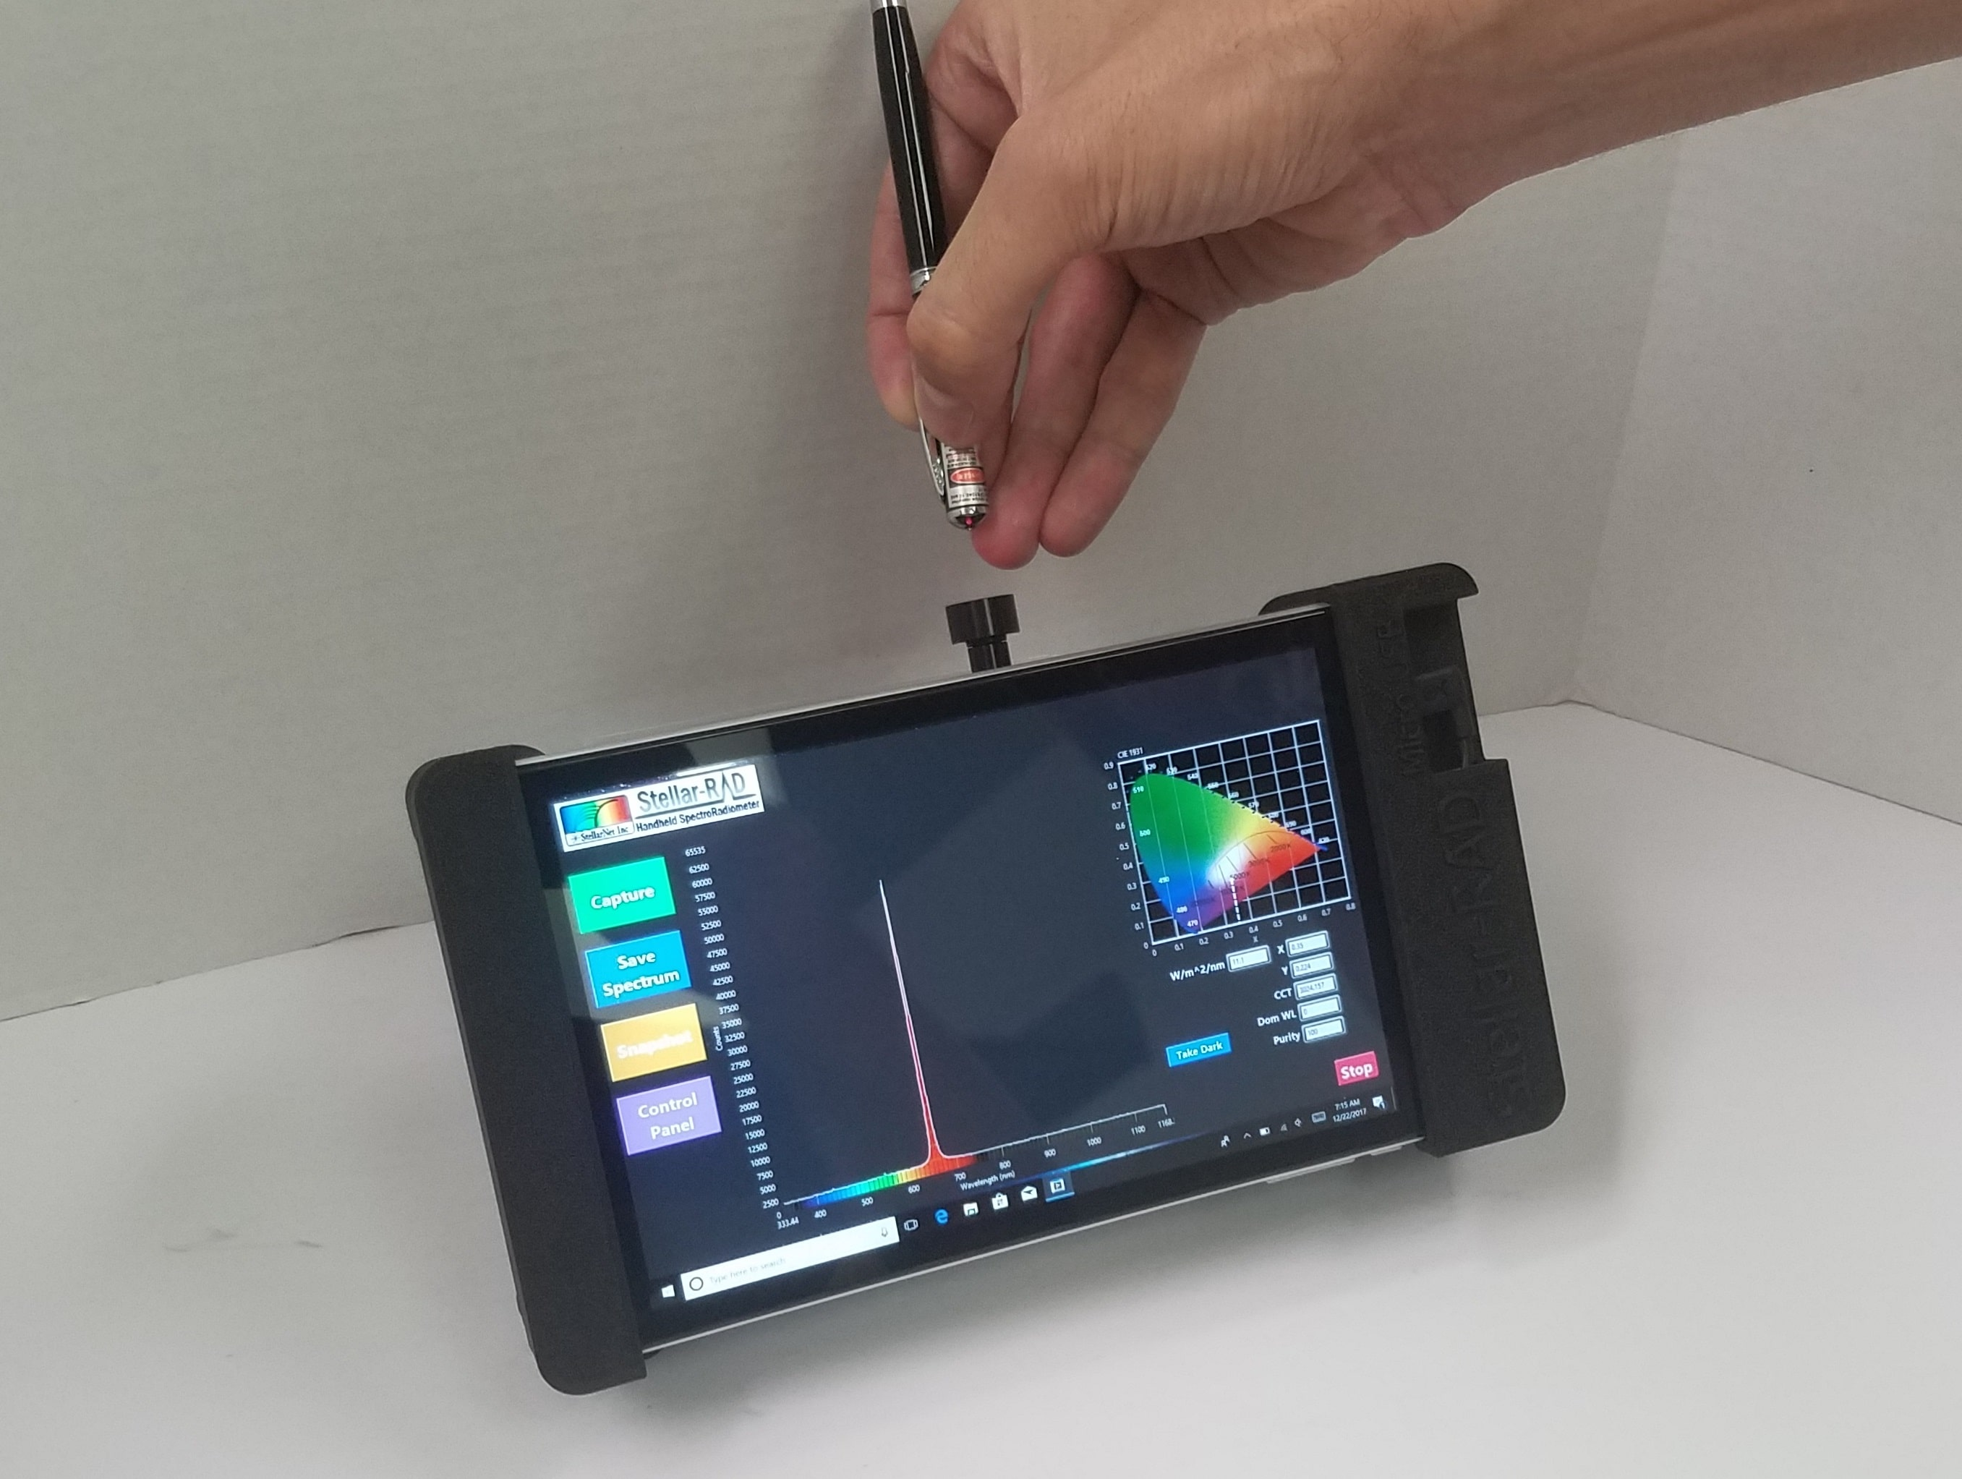
Resistivity vs Transmission
Radiometer

