Slide 1



Malter effect mechanism study in PNPI and MEPhI (Sarov)
G. Gavrilov, M. Buzoveria
28.11.2017

Slide 2

Study of Malter effect appearance mechanism
To remind: CF₃•, F•, O• are produced in avalanche at dissociation energy 3 ÷ 6 eV
e⁻ + CF₄ → CF₃• + F• + e⁻; | (1)
e⁻ + CF₄ → CF₃• + F⁻; | (2)
e⁻ + CF₄ → CF₂• + 2F• + e⁻; | (3)
e⁻ + CО₂ → CO• + O• + e⁻; | (4)
e⁻ + CО₂ → CO• + О⁻; | (5)
e⁻ + CО₂ → CО⁻ + O•. | (6)
Presence of O• stimulates additional generation of F• which provides etching of Si and other organics
O• + CF₃• → COF₂• + F•; | (7)
O• + CF₂• → COF• + F•; | (8)
e⁻ + COF₂ → COF• + F• + e⁻; | (9)
O• + COF• → CO₂↑ + F• . | (10)
4F• + Si → SiF₄↑;
4F• + SiO₂ → SiF₄↑ + O₂↑;
Si+ CF₃• + F• + 2O → SiF₄↑ + CO₂↑.
Si deposits cleaning by F•
To provide an effective cleaning from silicon and organic deposits a high current about of 20-40 μA is needed, that takes
Etching rate can be accelerated with adding O2 in the gas mixture.
This “thin film” or “finger traces” model is well tested at recover of the LHCb muon chambers

Slide 3
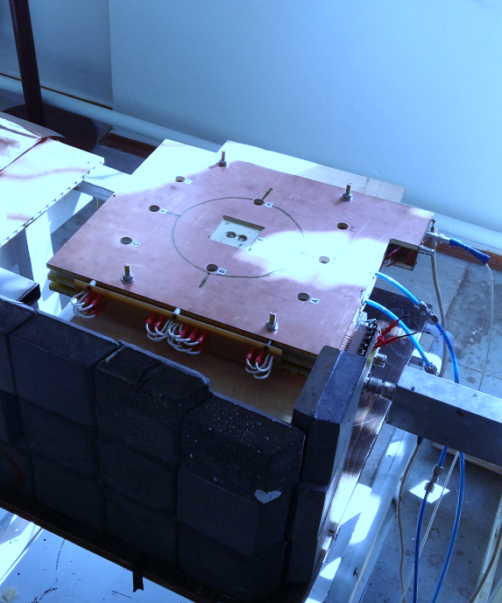
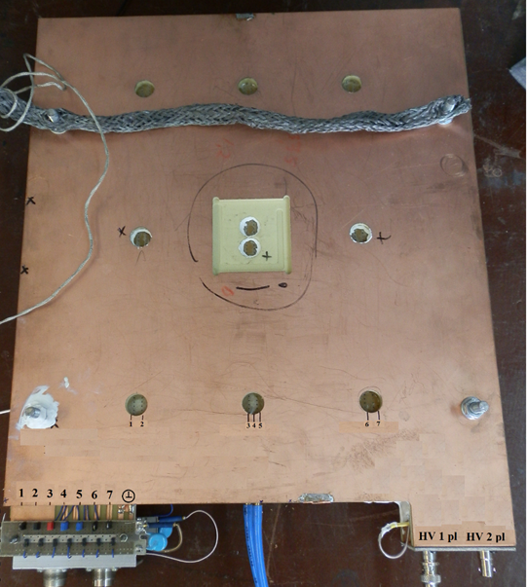


Study of Malter effect appearance mechanism
New aging tests are necessary:
due to hard radiation conditions at future HL-LHC
due to first manifestations of Malter effect in CSC
to find eco-friendly solution for CF4 outlet reducing
Small scale CSC prototype module for aging study
2 planes, each with 7 controlled anode wires;
50 μm gold-coated anode wire;
285 x 340 mm² sensitive area, 1670 cm³ gas volume;
S = 3 mm ;
L = 4.5 mm ;
Identical geometry and construction materials to CSC ;
Strip resistance control at specially ;
cut strips on the cathode plane ;
Gas flow during aging test was 4 sccm ;
that is ∼ 3.5 Volume per day ;
No gas recirculation was applied.
BUT
* Readout from anode wires only ;
* - HV applied to the cathode.

Slide 4
Targeting aging tests in PNPI
First local aging test under ⁹⁰Sr irradiation was performed with compact CSC prototype module fed by standard CSC gas mixture;
1.36 C/cm accumulated charge is obtained, that is 7× of the expected charge after 3000 fb⁻¹ at HL-LHC. The absence of amplitudes degradation matches with the previous tests in 1999 -2001;
Strip-to-strip resistance dropped during the aging test from 5×10¹³ Ω up to 5×10⁷ Ω;
Despite of the strong oxidation and Si coating on cathodes surface, no Malter current manifestation have been found;
Test results can be a benchmark for the future study of the eco-friendly gas mixtures;

Slide 5
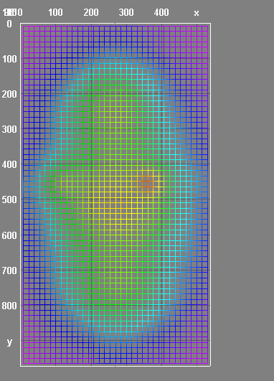
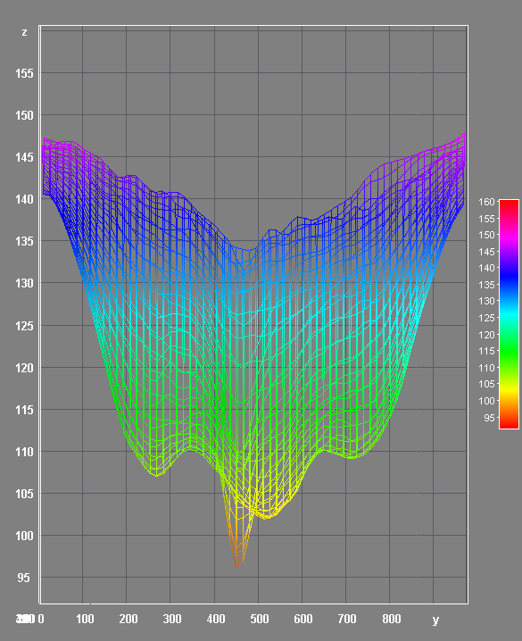
Study of Malter effect appearance mechanism
Irradiation zone on the anode plane π×3.7/2×2.0/2 ≈ 5.8 cm ²
Work point set HV=3750 V GG=5×10⁴ Ionization current at work point is 17 μA per 6 cm² or
1 μA per 1 cm of wire length
1.45×10⁶ Hz per 1 cm of wire length
This kind of aging test is actual for longevity evaluation of the CSC modules in extremal conditions and upper estimate of the anode wires aging.
Irradiation zone is a generator of the radicals and ions, which diffuse around in the gas volume of the CSC prototype.
The CSC-CMS comparable damages of the cathode surface in the aged CSC prototype can be found only in the intermediate zone in the not irradiated area.
Along anode wires

Slide 6
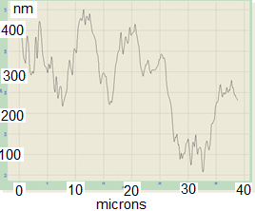
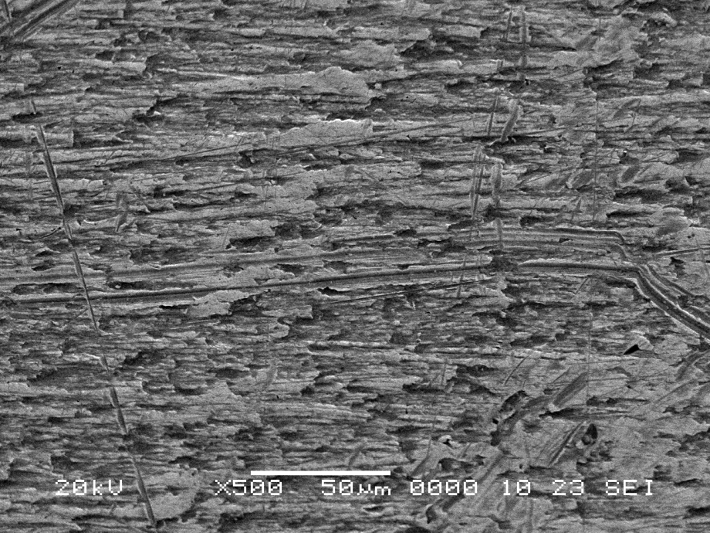
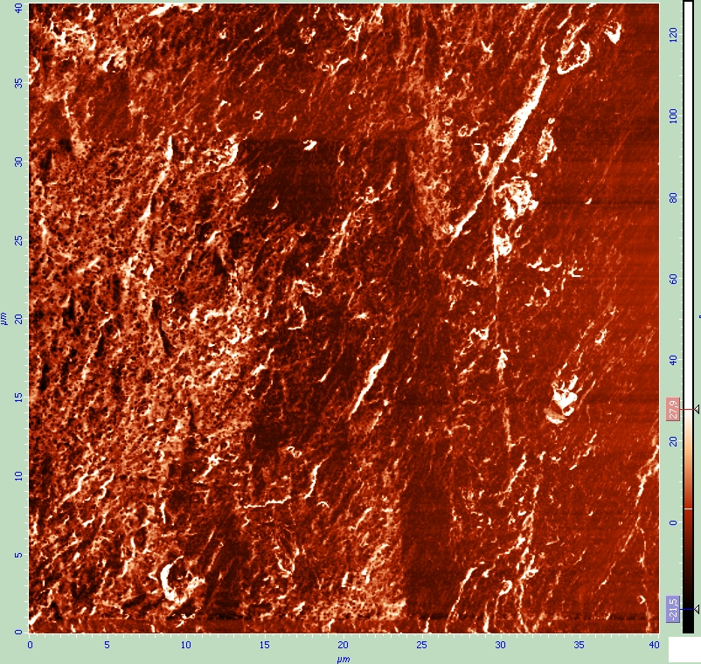
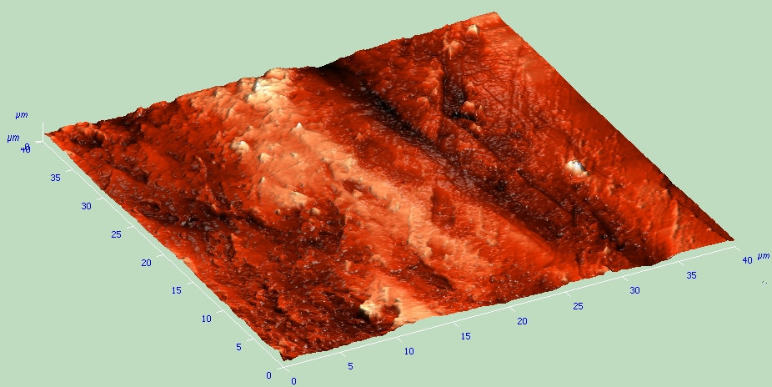
SEM image of the copper foil surface of not irradiated FR4
Roughness profile has a depth of 0.4 μm
Force microscopy of original FR4

Slide 7
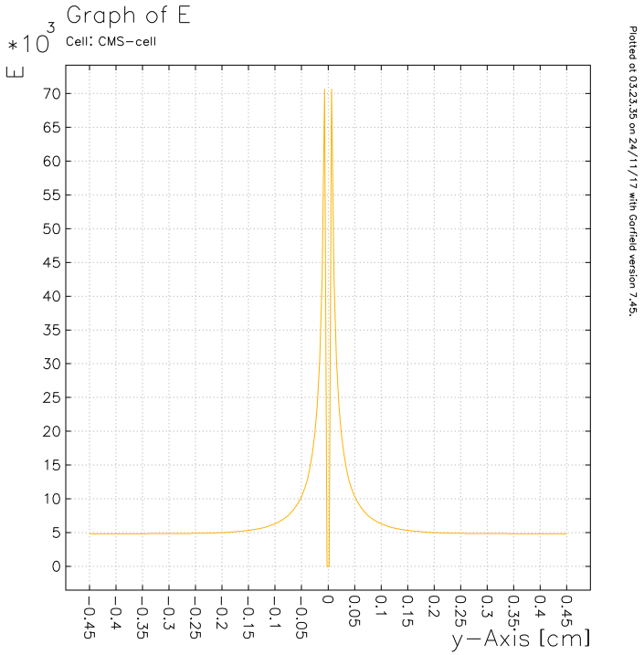
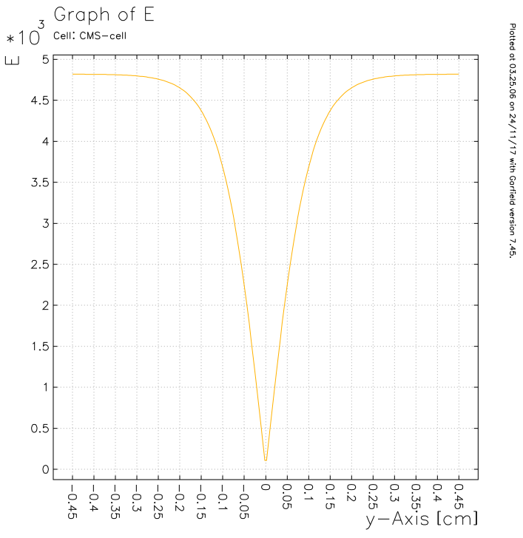
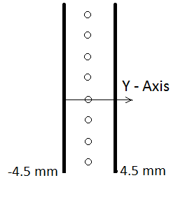
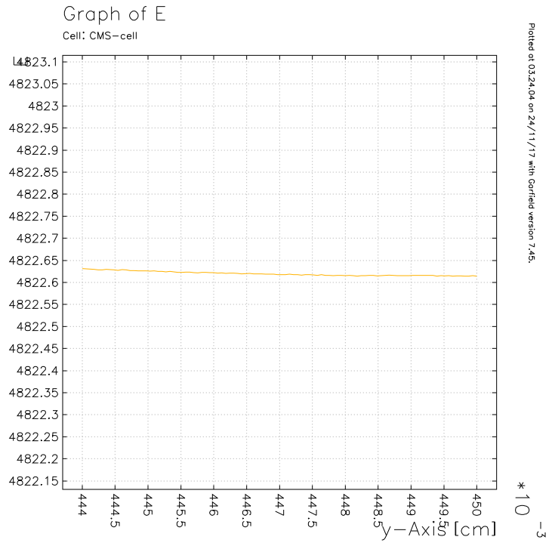
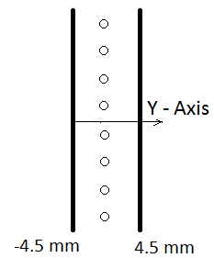
Study of Malter effect appearance mechanism
Field structure in vicinity of the cathode plane:
HV = 3600 kV
…60 μm apart from the cathode plane
HV = 3600 kV
The electric field strength on the CSC cathode planes is ~ 5000 V/cm

Slide 8
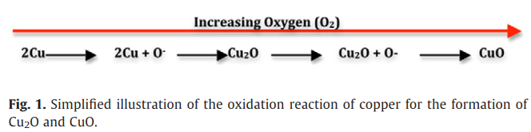
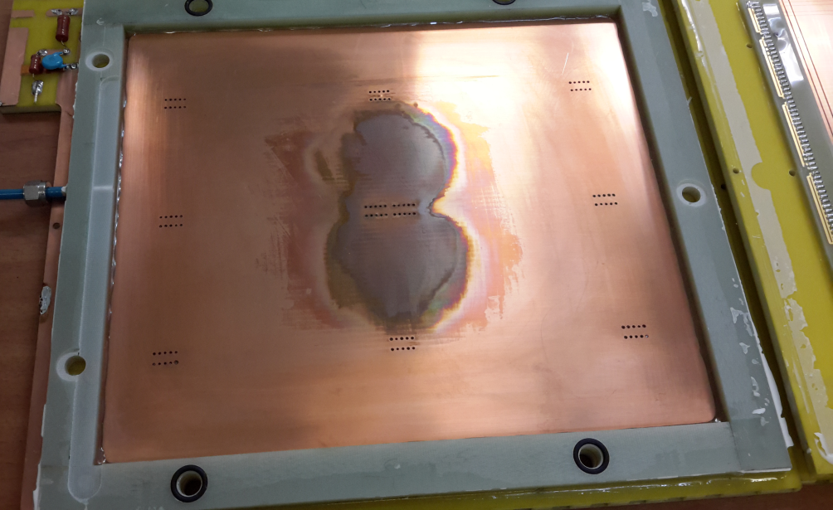
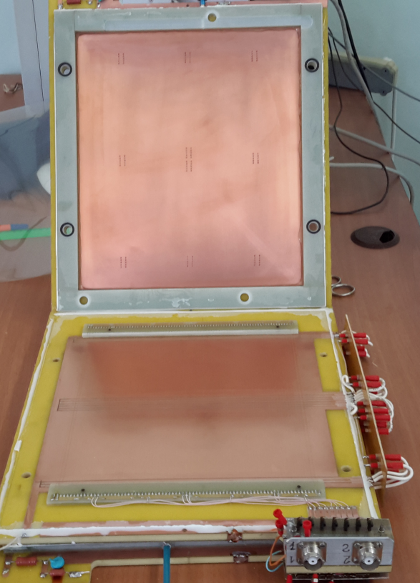
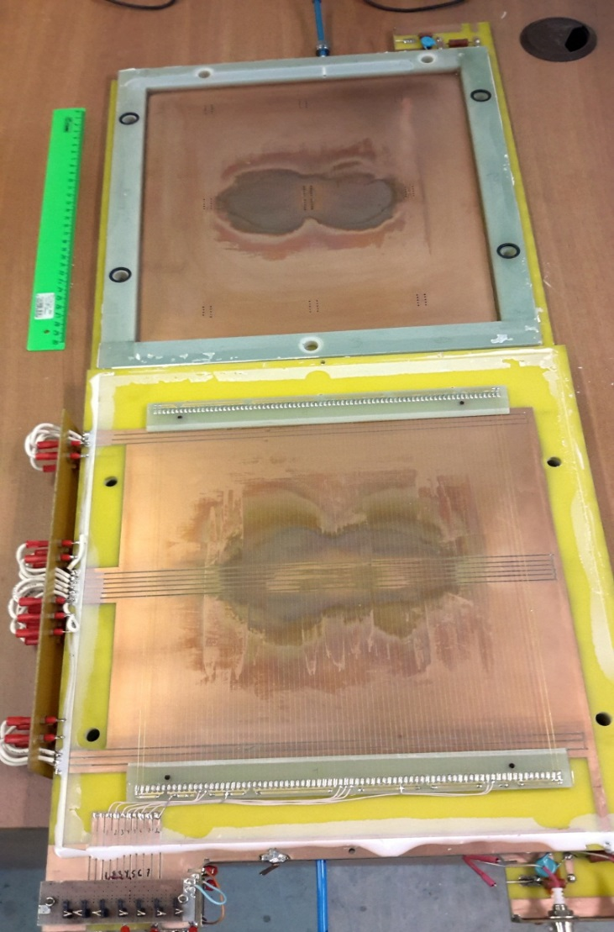
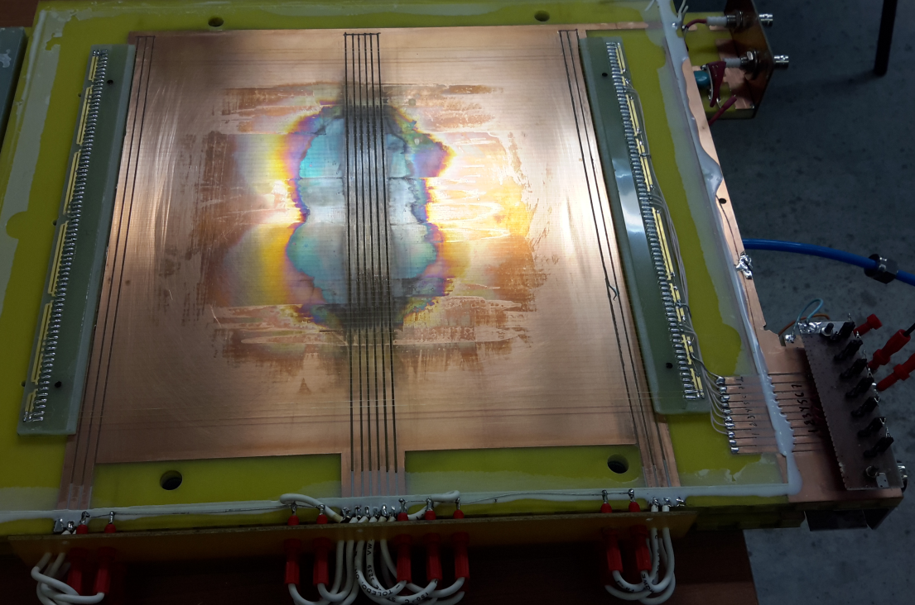
Photos of the disassembled detector after accumulation of Q=1.36 C/cm
with 40%Ar+50%CO₂+10%CF₄
10³ – 10⁸ Ωm ⋅cm
0.01 – 1 Ωm ⋅ cm
080
Q= 0.0 C/cm
Q=1.36 C/cm
Upper cathode plane
Irradiated spot
Damaged (toughed by oxidation) zone is >>10 times bigger of irradiated spot (~6 cm2)
Irradiated zone
Main source of cathode aging are the radicals from O₂
Bottom cathode plane

Slide 9


Aging results from GIF (1999)
Cu
F
O
Only left half of the CSC module was irradiated.
Accumulated charge 0.3 C/cm
Oxidation touched both parts of the module
Si
D. Acosta et al. NIMA 515 (2003) 226–233

Slide 10
Targeting aging tests in PNPI
Second aging test under ⁹⁰Sr irradiation was performed with compact CSC prototype module fed by 36.6%Ar+61.75%CO₂+1.65%CF₄ gas mixture
0.39 C/cm accumulated charge is obtained
Strip-to-strip resistance dropped during the aging test from 2×10¹³ Ω up to 1×10¹¹ Ω
At accumulated charge ~0.3 C/cm exceeding HL-LHC an appearance of Malter currents was observed
Dedicated studies of the cathode surface are ongoing

Slide 11
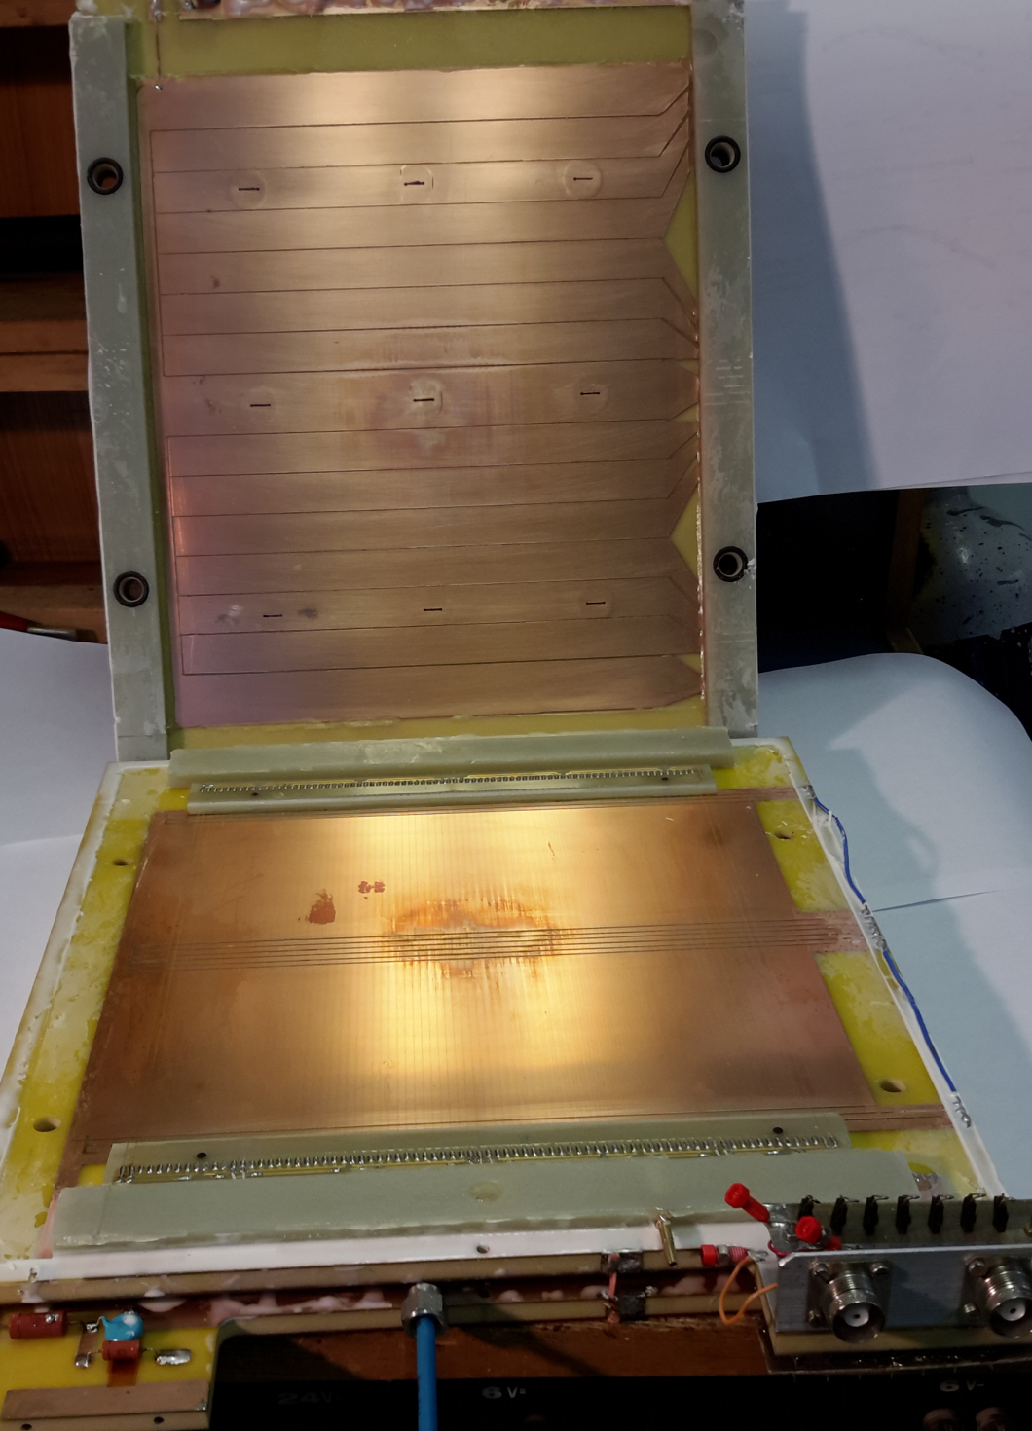
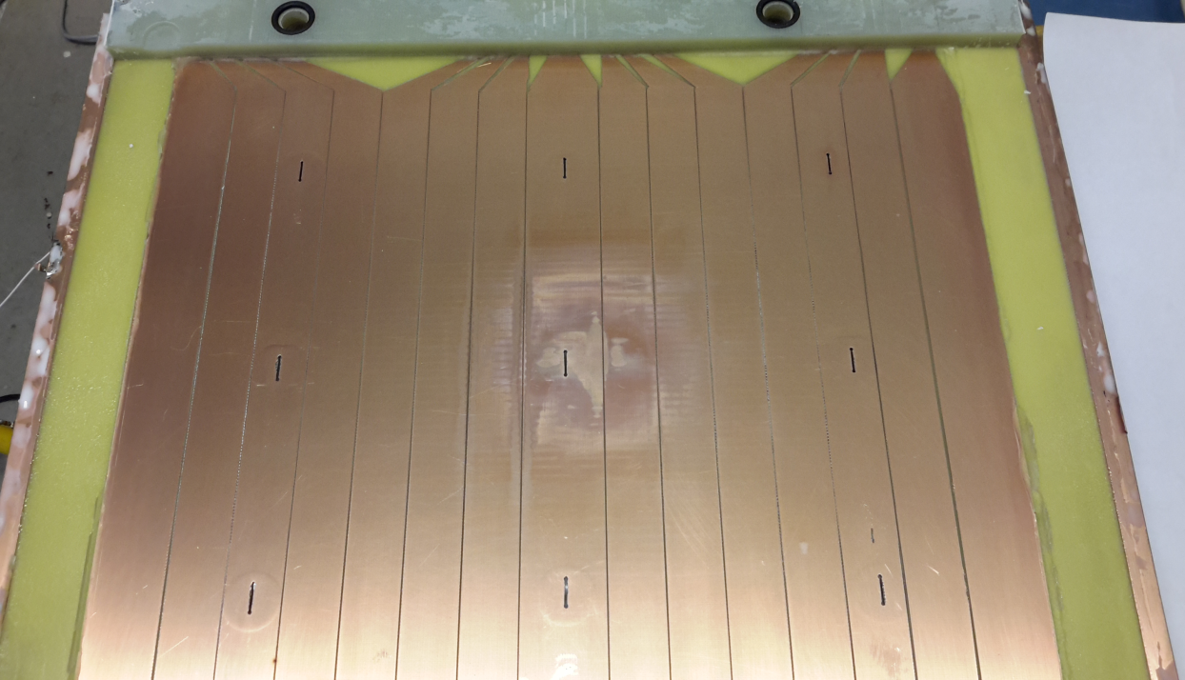
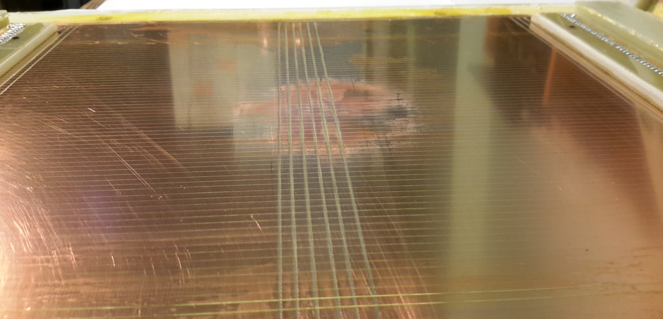
Photos of the disassembled detector after accumulation of Q= 0.39 C/cm aged with 36.6%Ar+61.75%CO₂+1.65%СF₄
Q= 0.39 C/cm
Damaged zone is just
few times bigger
of irradiated spot 8 cm²
Malter current ~100 μA was obtained at the end of the tests !
Irradiated spot
Irradiated zone
Upper cathode plane
Bottom cathode plane

Slide 12
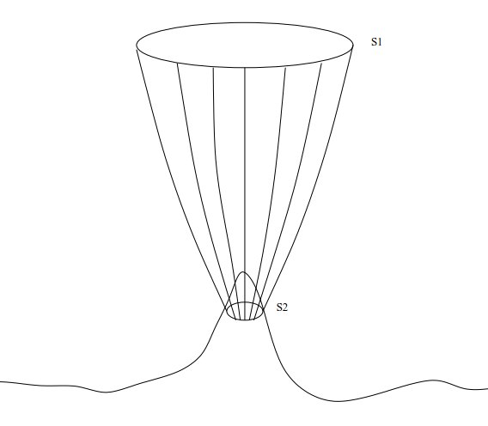
Study of Malter effect appearance mechanism
Due to irradiation, the copper foil on the cathode oxidizes and becomes uneven and rough covering the area bigger of the irradiated zone:
For the test with 10%CF₄ (Q_{total} ≈ 27 C) the damaged (or oxidized) area is 580 cm² that is ~100 times bigger of the irradiated zone
For the test with 1.6%CF₄ (Q_{total} ≈ 10 C) the damaged (or oxidized) area is 56 cm² ~ 7 times bigger of the irradiated zone
To extrapolate the cathode foil damage after CSC prototype aging tests on “uniformly” irradiated CSC modules the samples from
not irradiated zone have to be considered
Positive ions current and polarised polymers flow is S2/S1 times bigger on the peaks
Ions current density through the peak is
j = j_{i} × S/πr² ,
S- peak surface area, r – peak radii, j_{i} - ions flux density.
For cylinder peak j = j_{i} × 2h/r (h – height)
For conical j = j_{i} × ℓ/r (ℓ - length of slope)

Slide 13
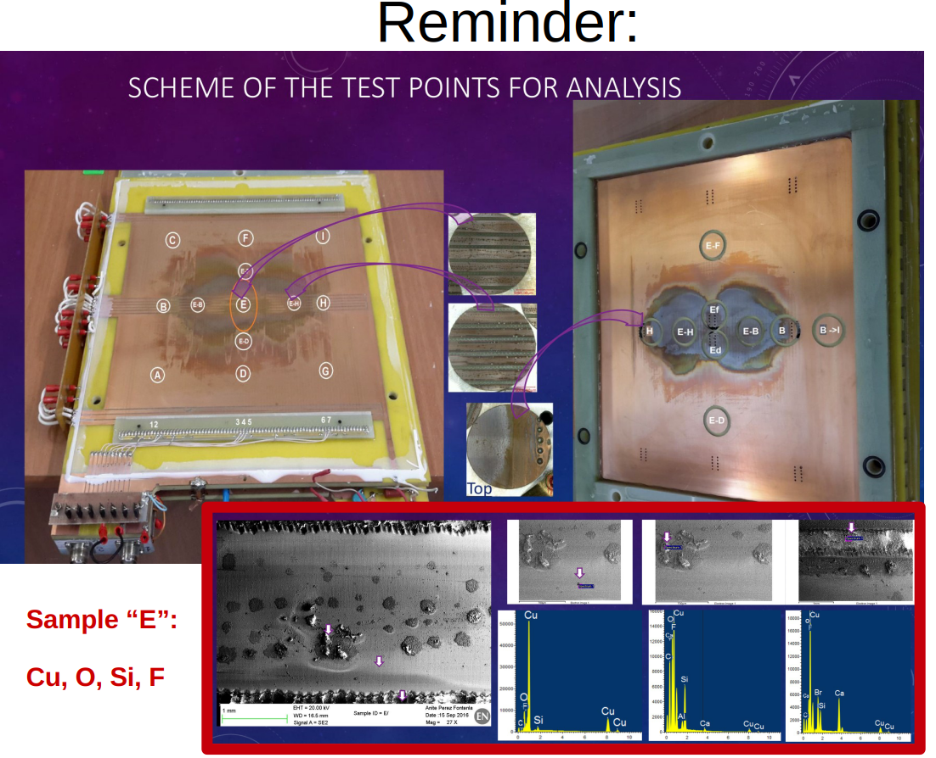
Study of Malter effect appearance mechanism

Slide 14
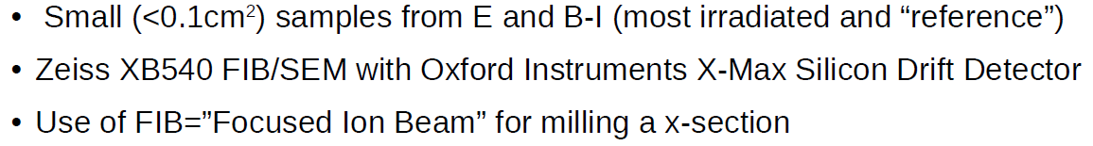
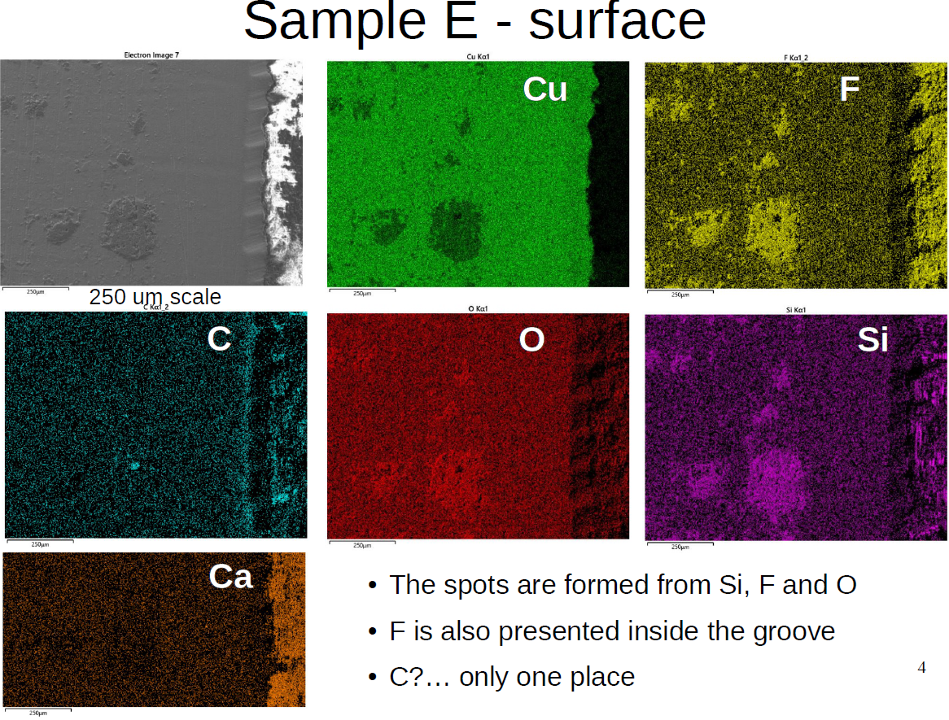
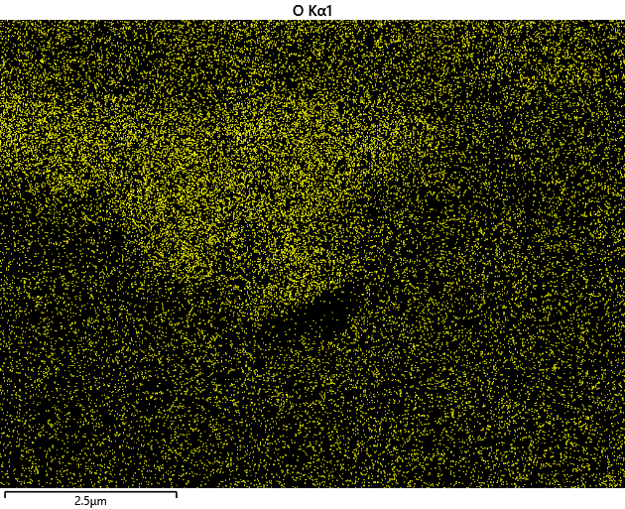
CSC CMS prototype longevity test in PNPI
FIB cross section – 5 μm depth milling of sample E
FIB – Focused Ion Beam
EDS mapping and SEM image of sample E small FIB cross section – zoomed 1.
O
O
EDS – Energy Dispersive X-ray spectroscopy

Slide 15
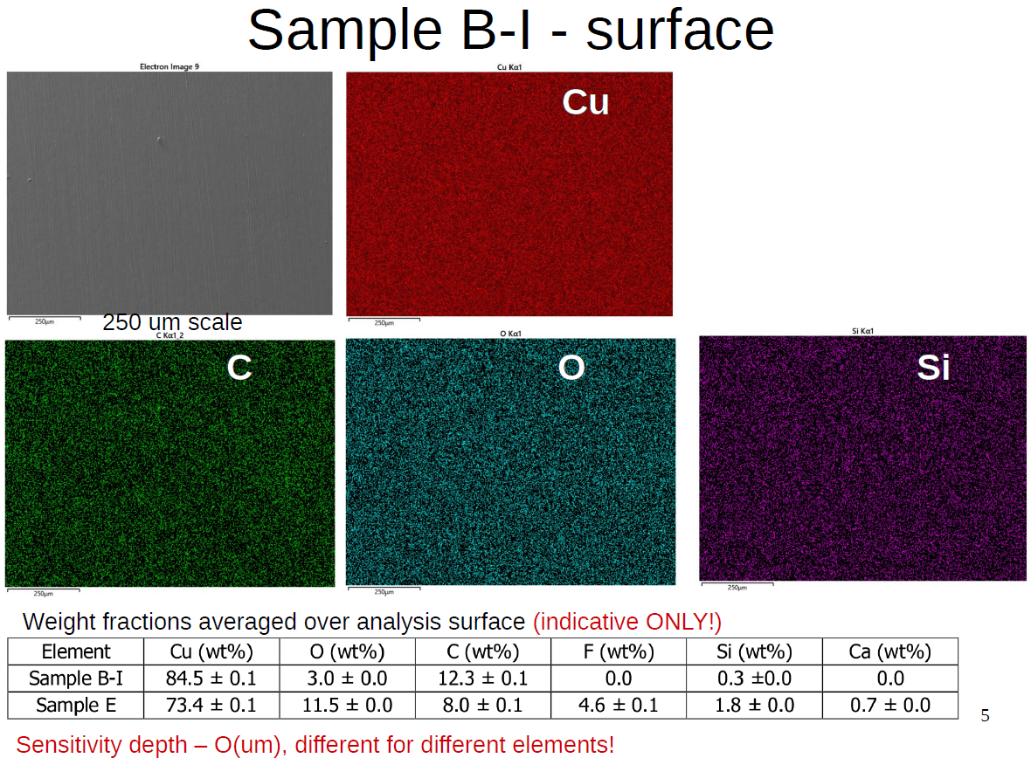
CSC CMS prototype longevity test in PNPI

Slide 16

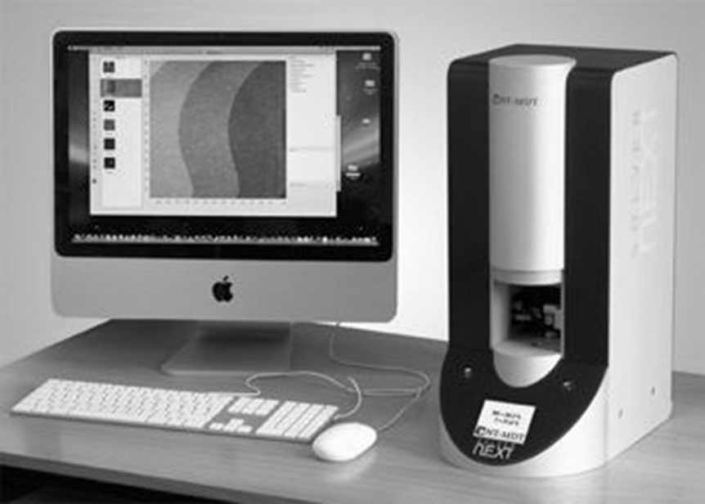
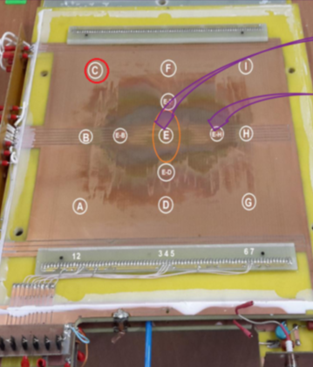
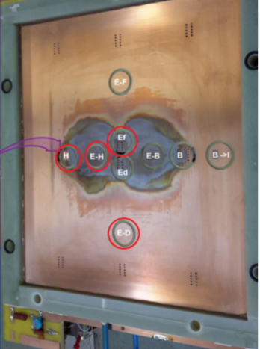
Study of Malter effect appearance mechanism
The physicists from National Research Nuclear University MEPhI ( Sarov) took participation in the study of the samples from the aged CSC Prototype, too …
Cathode FR4 samples from the points E-D, E-D, H, E^{f} were analysed with
Atomic Force Microscope microscopy with “Solver Next”;
Nuclear scanning microprobe analysis.
«Solver Next»

Slide 17
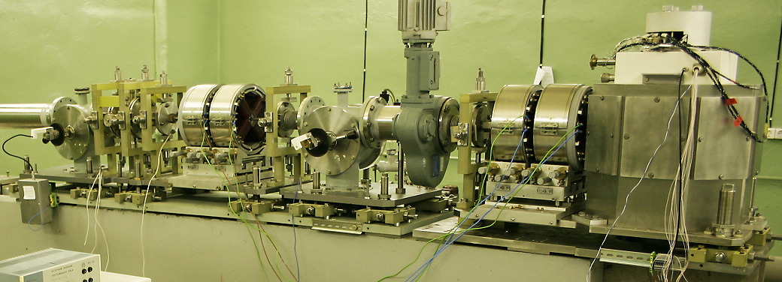
Nuclear scanning microprobe setup (EGP-10)
- E=14 MeV H⁺ beam with not less of ±300 µm spot on the target
− Scanning rate from point-to-point 200 µs.
− Time of positioning less of 40 µs.
1
2
1 – Ions optical focusing system; 2 – beam-sample interaction chamber

Slide 18
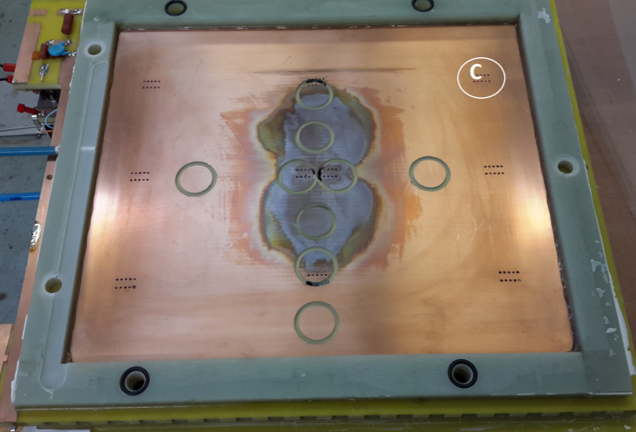
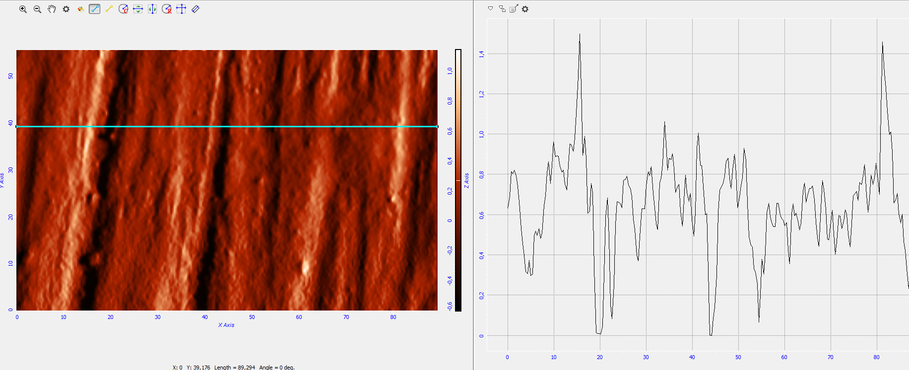
Reference point C
Force microscopy analysis of the surface structure
Evaluation of surface roughness
Detection of micro damages on the surface - blisters

Slide 19

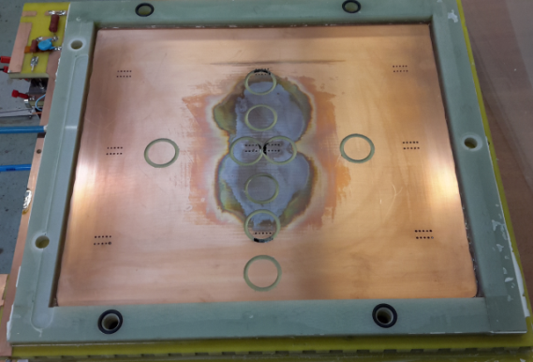
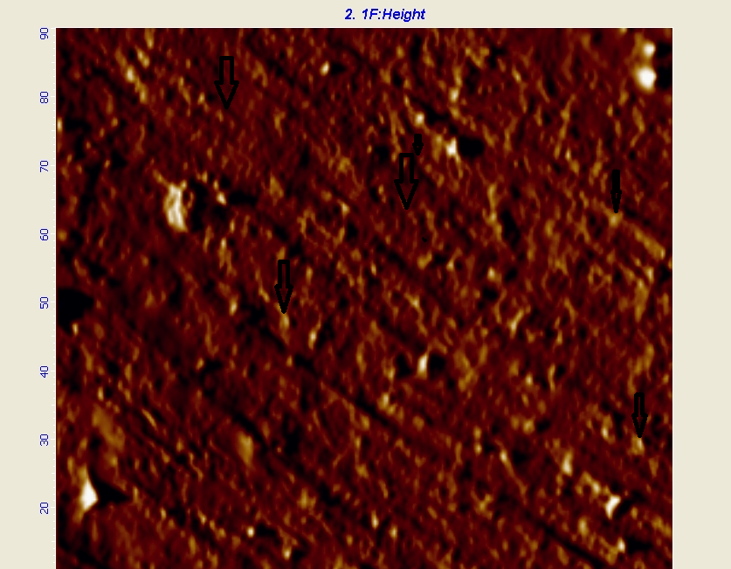
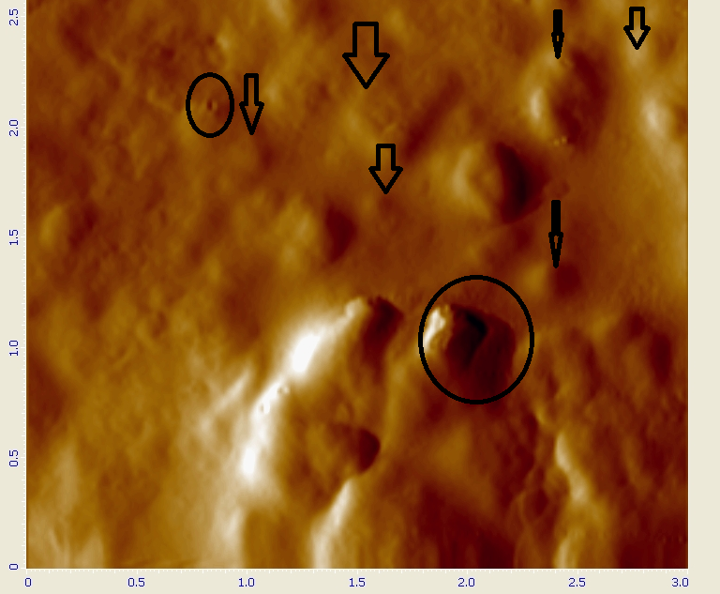
Sample E-D from intermediate zone
The blisters are often formed on the traces of machining, along the boundaries of structural formations. This photo is typical for the described case. Vesicles (blisters) are formed along the fibres
E-D
90 ×90 μm
3 × 3 μm

Slide 20

Sample E-D
Roughness varies greatly even within the same sample and increase toward the irradiation zone
90 × 90 μm areas
Surface profile along ~120 μm line
Roughness
0.12 μm
1.0 μm

Slide 21

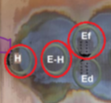
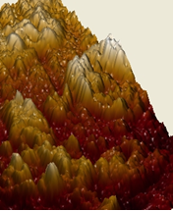
Sample E-H
E-H
3 × 3 μm
A crater after blister explosion

Slide 22

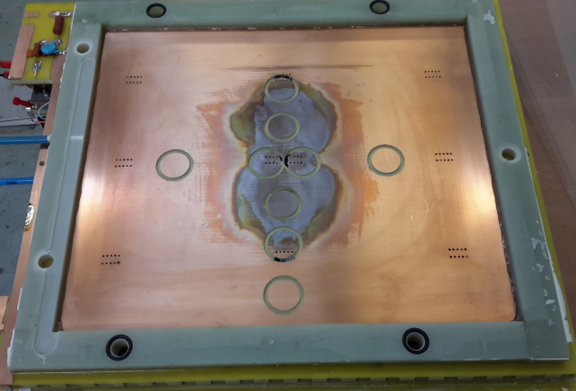
Sample E^{f}
Ef
Sample H
H

Slide 23
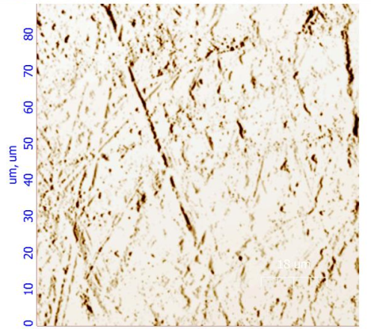
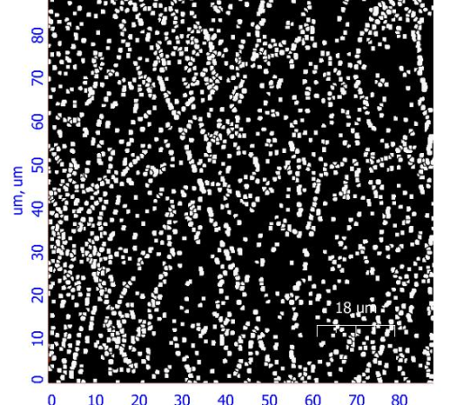
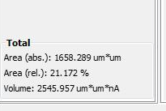
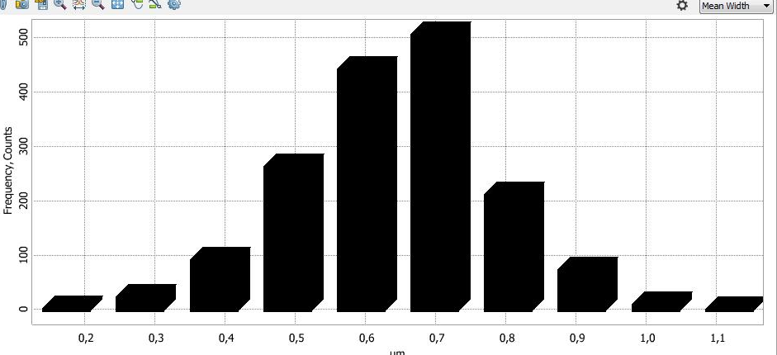
Sample C - porosity evaluation procedure
a
b
c
а
d
«Grain analysis» program
б
image preparation for processing;
pore release;
result;
resulting histogram.
с

Slide 24
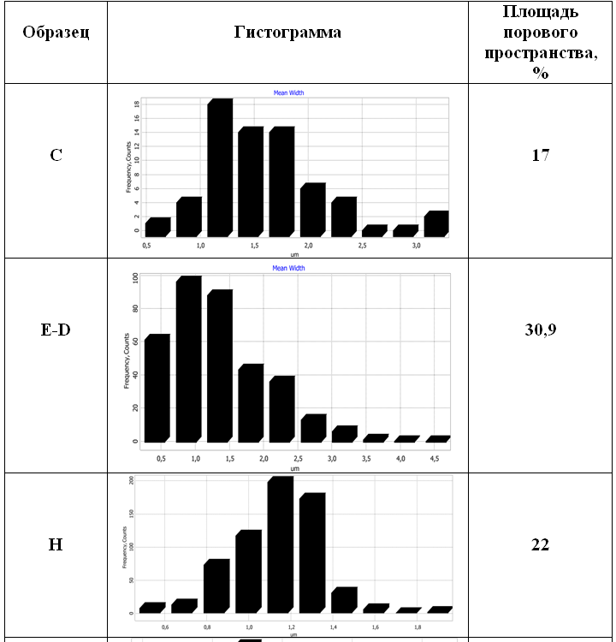
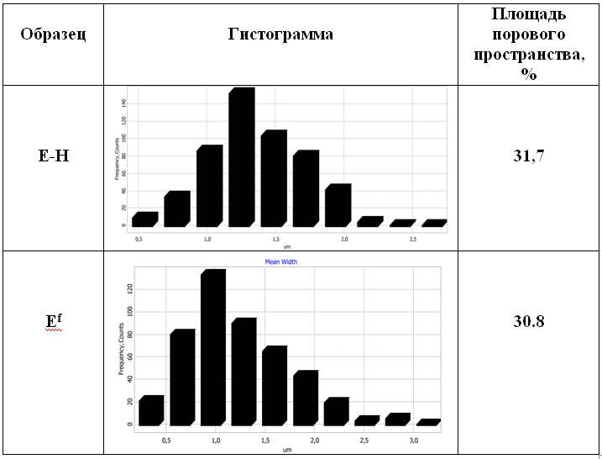

Porosity distribution in the samples
Histogram
Area of porous space, %
Area of porous space, %
Sample
Sample
Histogram
18
140
500
100
120
200
Most of porous has diameter 1.0-1.5 μm
In the “reference” point C the porous size is smaller then in the rest samples - 0.7 μm

Slide 25
Nuclear scanning microprobe analysis of the samples
Vary of concentration of the Oxygen in the Cooper foil with a depth of the analysed layer
for different samples
E^{f}
E-H
Oxygen concentration changes from 90% at the 3 μm surface layer up to 0% on the 6-10 μm depth in the cooper foil
H
E-D

Slide 26
Summary & Outlook
Oxygen radicals and molecules play a key role in the damage of the cathode copper causing the blisters grow and roughness increase
At early stage of Сu oxidation (Cu₂O - cuprous oxide ) when surface resistance is high an appearance of Malter current is very probable
While the cooper oxidation continues up to the conductive CuO - cupric oxide - the probability of Malter effect decreases
An accurate surface resistance measurement is needed for the samples of aged CSC prototypes
More systematic study of the damaged cooper foil with an atomic force microscopy and microzond is planned

Slide 27
Backups

Slide 28
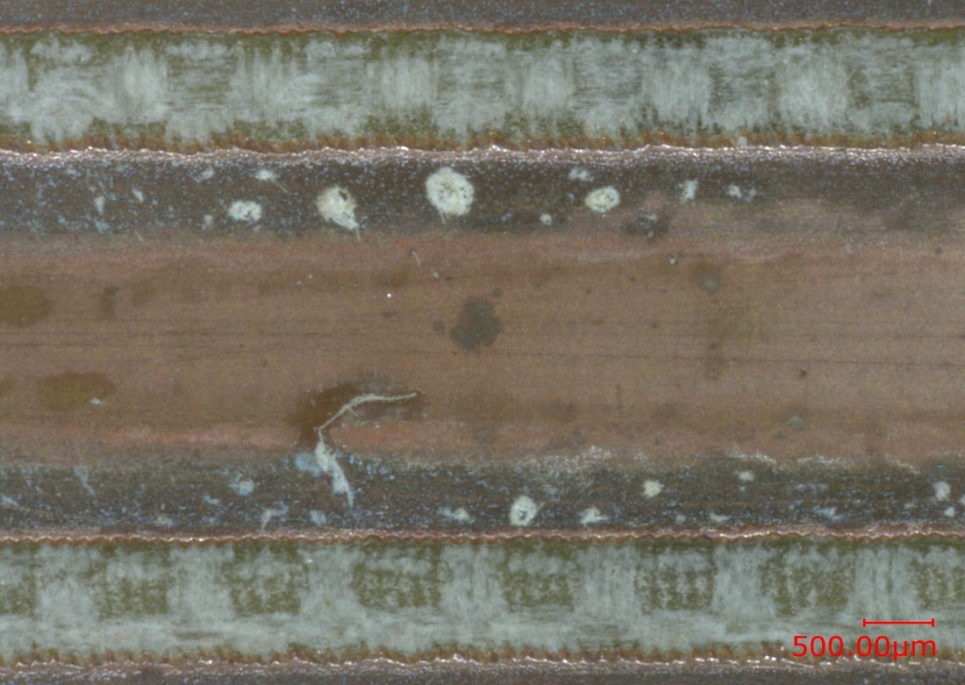
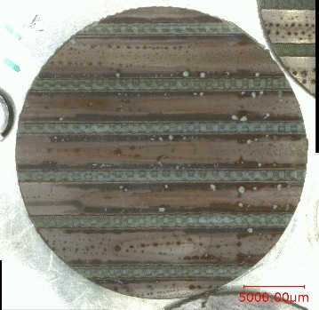
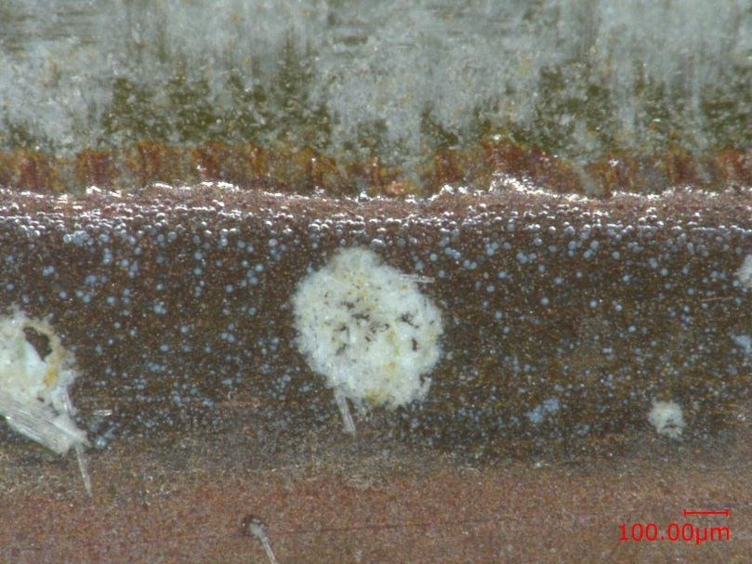
Optical microscope image
Backups
Sample E-H
Optical microscope image
SEM image
SEM image

Slide 29
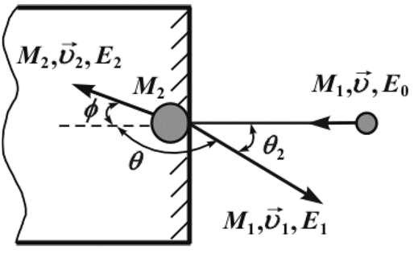
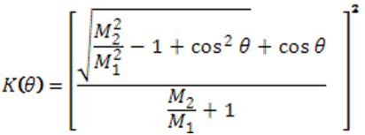
Nuclear scanning microprobe analysis with EGP-10
Considering the kinematics of the collision (that is, the conservation of momentum and kinetic energy), the energy E₁ of the scattered projectile is reduced from the initial energy E₀: E₁ = K(θ) × E₀ , where K(θ) is known as the kinematical factor,
To measure backscattered energy the Si surface barrier detector is used.
Ions which reach the detector lose some of their energy to inelastic scattering from the electrons. Number of electron-hole pairs produced in the detector is dependent on the energy of the ion.
θ = 180 - θ2 ;

Slide 30



L. De Los Santos Valladares et al., Crystallization and electrical resistivity of Cu2O and CuO obtained by thermal
oxidation of Cu thin ﬁlms on SiO2/Si substrates, Thin Solid Films 520 (2012) 6368–6374

Slide 31





Flora M. Li et al., Low temperature (<100 °C) deposited P-type cuprous oxide thin ﬁlms: Importance of controlled oxygen and deposition energy, Thin Solid Films 520 (2011) 1278–1284
Copper forms two types of oxides: cuprous oxide (Cu₂O) and cupric oxide (CuO), each with unique material properties as highlighted in Table 1. Cu₂O is a highly transparent, yellow, p-type semiconductor, while CuO is typically an opaque, more conductive material. Although Cu₂O is the native oxide of copper, it is often difﬁcult to form pure Cu₂O ﬁlms and requires precise control of the stoichiometry. Even moderate excess of oxygen and/or reaction energy tends to favour the formation of CuO instead of Cu₂O. Fig. 1 provides a simpliﬁed illustration of the oxidation pathway to form Cu₂O and CuO from copper.

