Slide 1
HGCAL LV cable optimisation
Ian
15 April 2019

Slide 2
Define LV power requirements,
Define a granularity
Define an “allowable” power lose 20- 50%
Obtain cable section
Obtain other clients needs in the choke point. It fits or not…
Look at cable cooling.
Other cable insulation technologies.
Reiterate from 2 and/or 3
Mock-up with real cables and check for power loss temp increase
This of course does noty factor in the Nos of rack/module space.

Slide 3
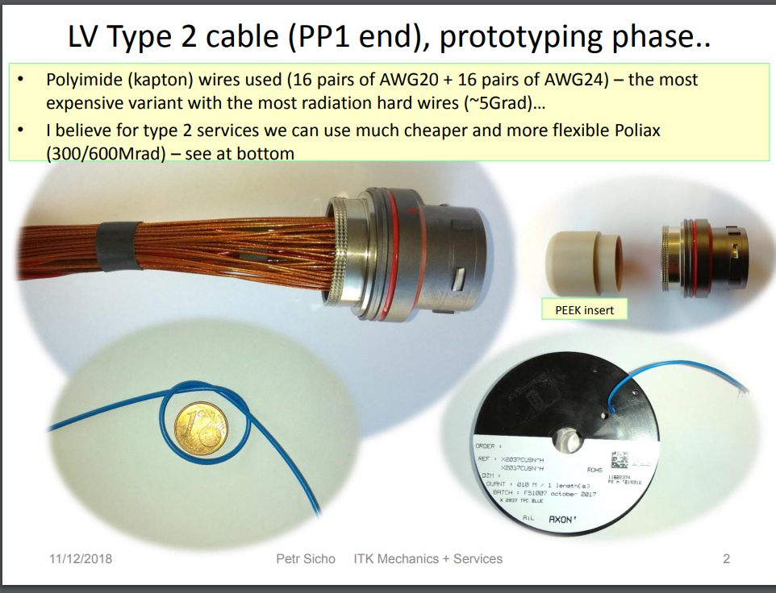
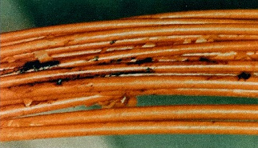
https://hackaday.com/2018/04/04/kapton-miracle-material-with-a-tragic-history/
https://www.interconnect-wiring.com/blog/disadvantages-kapton-insulated-wire/
https://indico.cern.ch/event/774777/contributions/3222709/attachments/1756321/2847648/ITK_Pixel_T2_and_PP1_Petr.pdf
http://www.iasa.com.au/folders/Safety_Issues/Aircraft_Wire/RAFKapton.html
https://uwspace.uwaterloo.ca/bitstream/handle/10012/3052/Saeed_Thesisfinal.pdf?sequence=1
ATLAS PIXEL
Arcing Kapton

Slide 4
Irradiated Kapton
https://www.researchgate.net/publication/226926161_Physical_and_chemical_response_of_70_MeV_carbon_ion_irradiated_Kapton-H_polymer
Aging
https://www.researchgate.net/publication/260541844_Electrical_Aging_of_the_Insulation_of_Low-Voltage_Machines_Model_Definition_and_Test_With_the_Design_of_Experiments
Monitor of aging
https://www.researchgate.net/publication/260541844_Electrical_Aging_of_the_Insulation_of_Low-Voltage_Machines_Model_Definition_and_Test_With_the_Design_of_Experiments

