Slide 2
The new rapid prototyping machine at the CERN polymer lab: capabilities and limits
Presented by P. Fessia
S. Clement, E. Fornasiere, R. Gauthier, M. Goncalves Lopes, S. Izquierdo Bermudez, L . Lambert TE-MSC-MDT
P. Fessia TE-MSC-MNC
A. Cherif, A. Gerardin, S.Langeslag, S. M. Marcuzzi EN-MME-MM
M. Brugger EN-STI-EET
The VSC-STT team for the chemical analysis

Slide 3
Summary
The machine target
The technology
The materials
  Offer
  Properties
    Mechanical RT and 77K
    vs. temperature
    Electrical properties
Properties after irradiation
Dimensional capabilities
Example of pieces

Slide 4
Targets set in procuring a polymer based Rapid Prototyping machine.
Provide a CERN wide service covering the largest number of possible applications
Good mechanical strength: in one or more material provide relevant ultimate strength and relevant ultimate strain
Compatibility with typical CERN used resins
(I.E. Epoxy)
Provide a
selection of materials with assessed properties for an informed choice
Capability to withstand medium temperature (100º C) in use and high temperature during assembly
(200º C)
Best Radiation Resistance as possible
(components to be used till at least 2-3 MGy)
Not for esthetical models:
We have another machine for this
Other people around CERN have bought other machines. Here the key are the guaranteed performance
The polymer lab has not the resources to take care of this type of problems
Plenty of company to do it and better then what we can
Reduce time from design to implementation providing quick functional test option
Keep good mechanical properties in cryogenic condition
Capability to build thin walls < 0.5 mm
Provide a tool to quickly build parts for definitive repair and temporary fixes for CERN accelerator complex
Provide good electrical insulation
(good material dielectric strength, no porosity in thin walls)
Precision best as possible,
but better than 0.15 mm

Slide 5
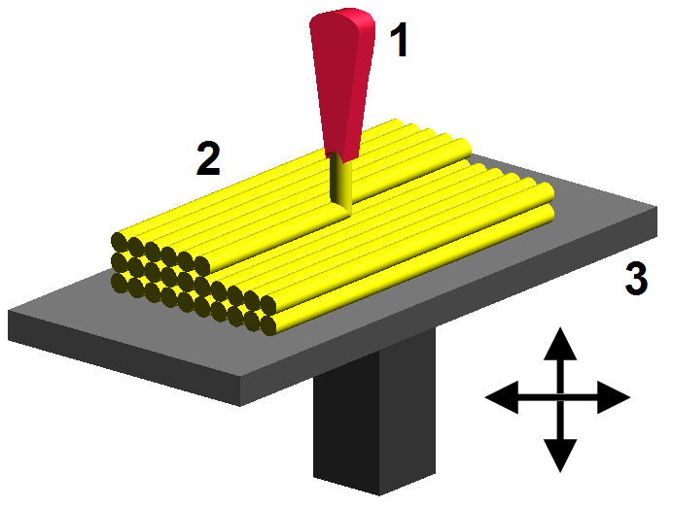
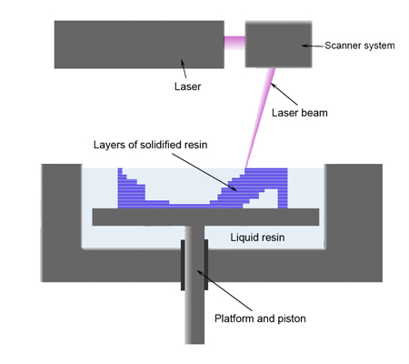
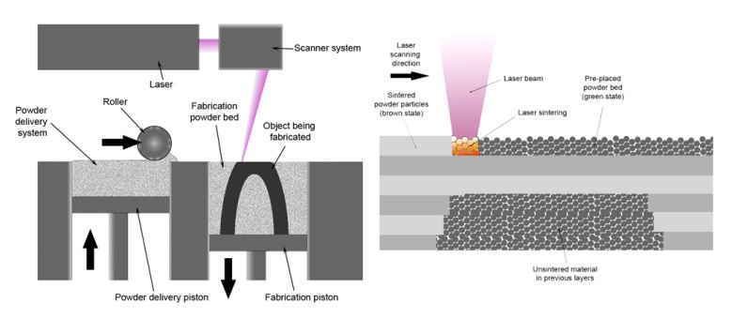
Manufacturing Techniques
Fused Deposition Modeling (FDM)
  Fortus 400mc, Fortus 900mc
  Ultem, PPSU, ABS, PC
Stereolithography (SL)
  Viper SLA, iPro 8000
  Epoxy resins, Accura, Blue Stone
Selective laser sintering (SLS)
  Formiga P 100, Eosint P 395, P 760
  PA-12 based material

Slide 6
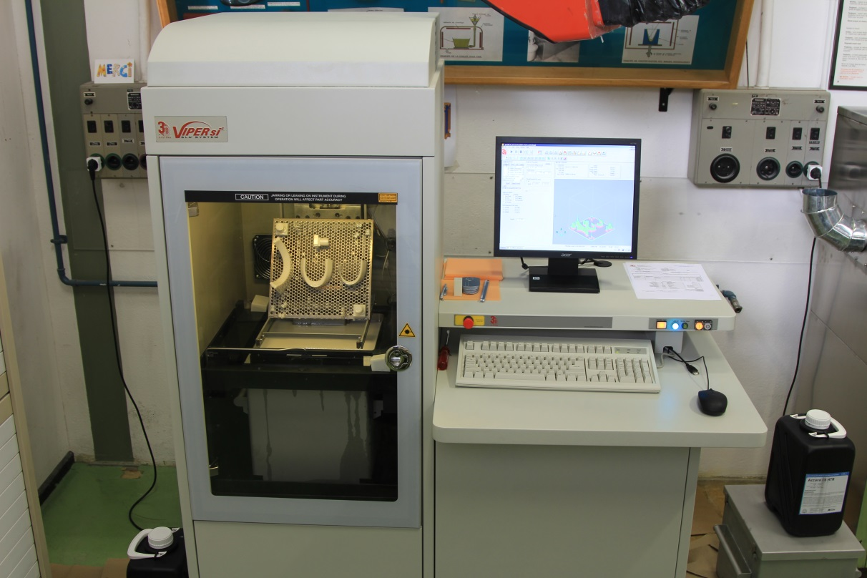
SLA® Viper si² system

Slide 7
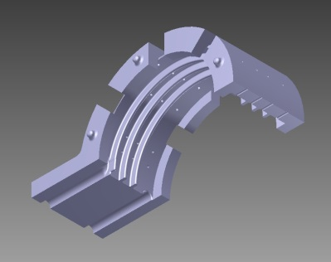
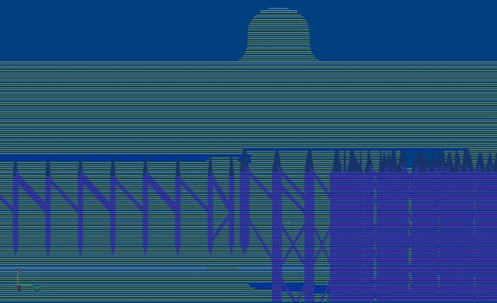
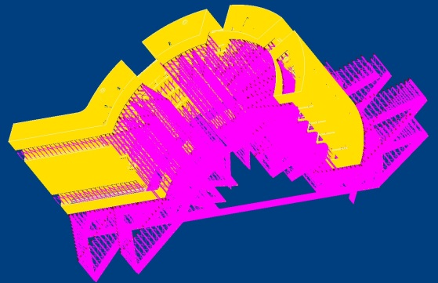
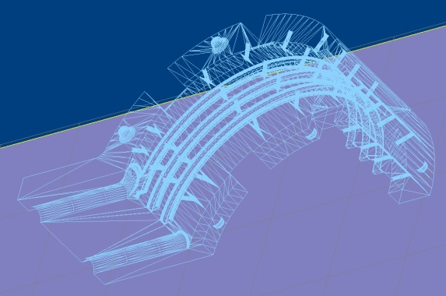
Part Preparation Process
CAD
Design Software
3D Lightyear
Preparation Software
SLA
Build Software
Create CAD files
Export
Prepare (Scale, Copy,…)
Prepare build file
Set build parameters
Simulate
Build
Create supports
Build file (.bff)
STL file (Representation of a solid model using triangles)

Slide 8
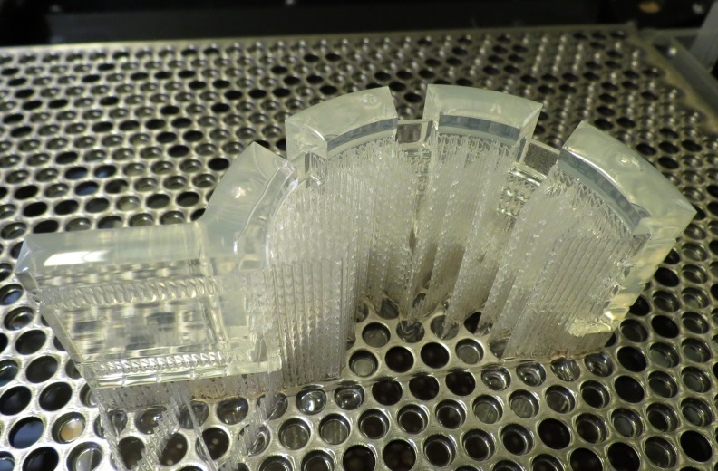
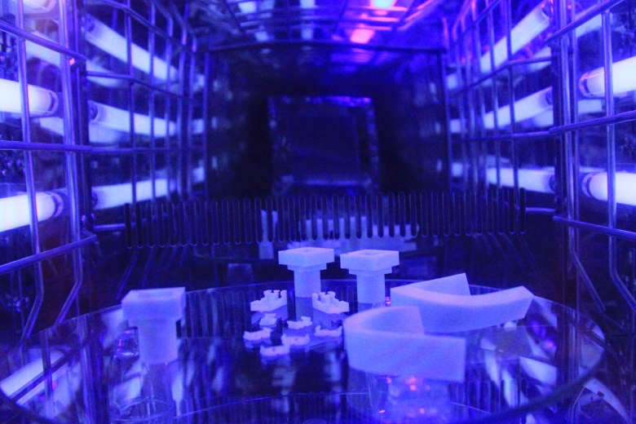
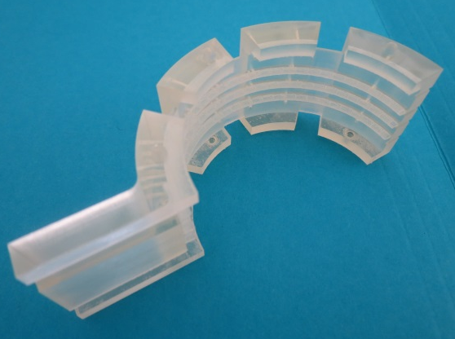
Part Preparation Process

Slide 9
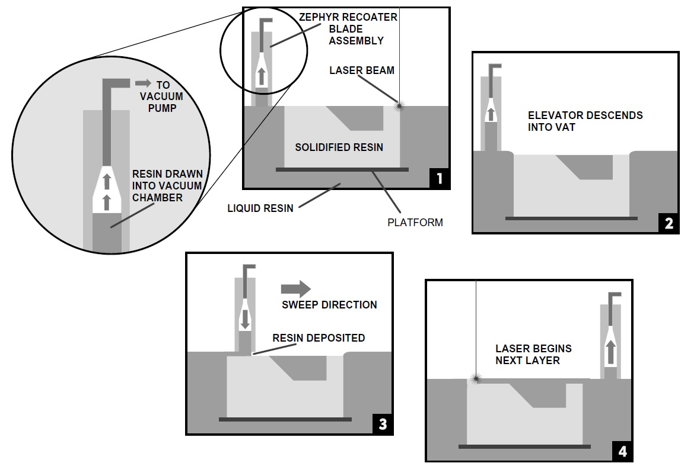
Stereolithography Process
http://www.3dsystems.com/3d-media/3d-printing-process-sla
videos

Slide 10
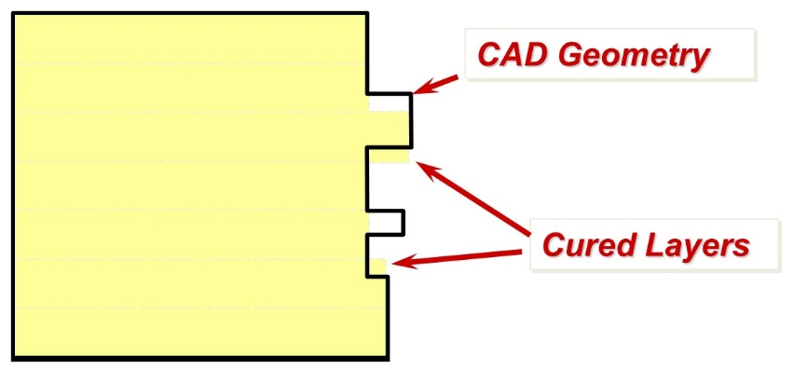
Machine limitations and discretization
Platform size: 250x250x250 mm;
X and Y plane limited by laser beam diameter (~0.075 – 0.300 mm);
Z axis limited by layer thickness
  Fast 0.15 mm (25)
  Exact 0.1 mm (25,48HTR,BS)
  HR 0.05 mm (25,48HTR)
  (Due to overcuring it should be minimum 3x the layer thickness)
The machine has to be calibrated for each resin and for each build style

Slide 11
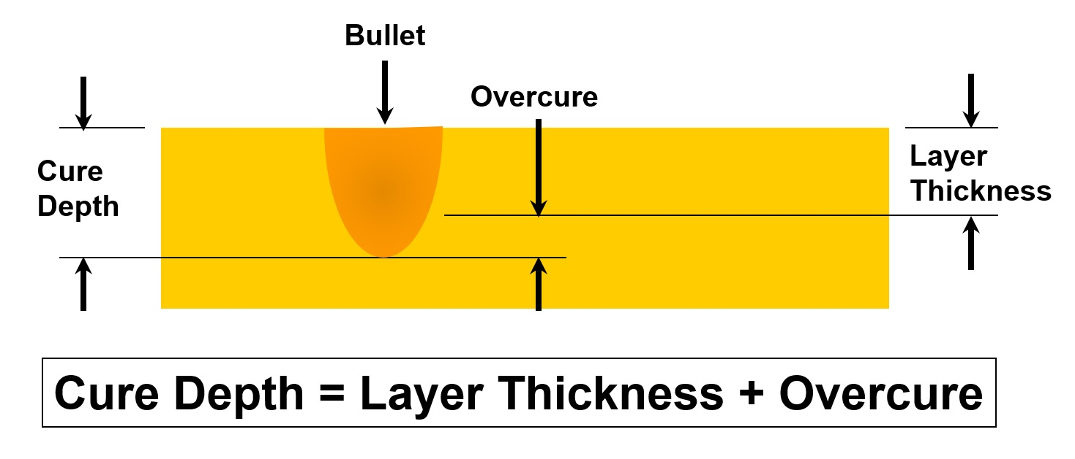
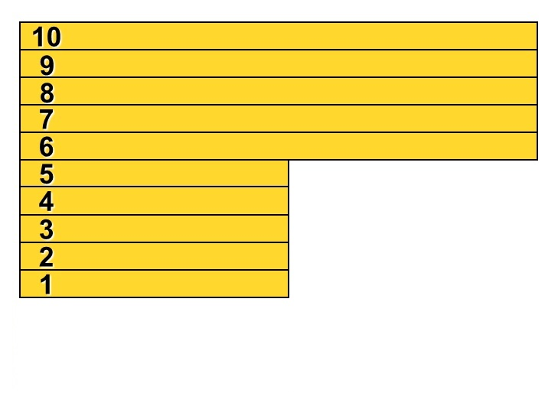
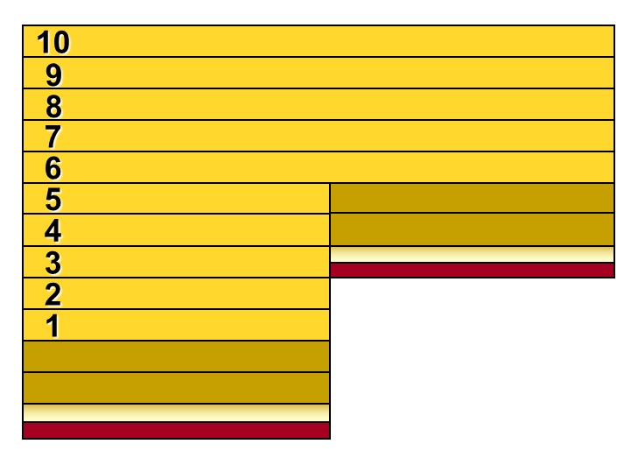
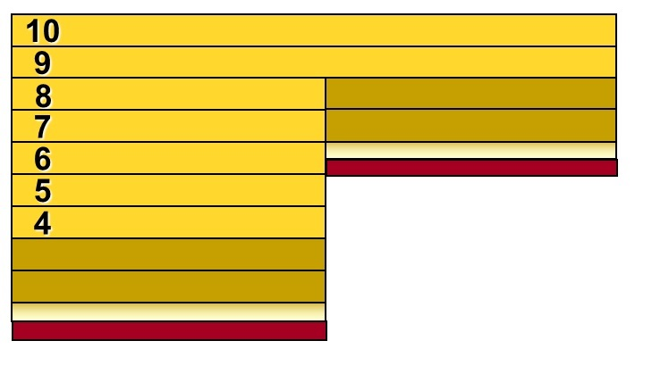
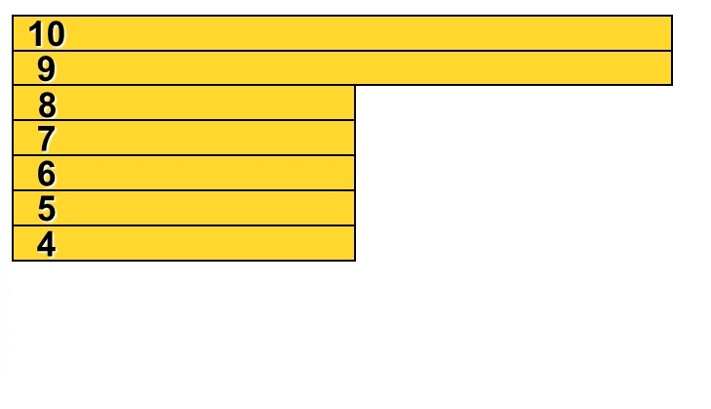
Cure Depth & Overcure
Auto Calculate Z Correction Off
Auto Calculate Z Correction On

Slide 12
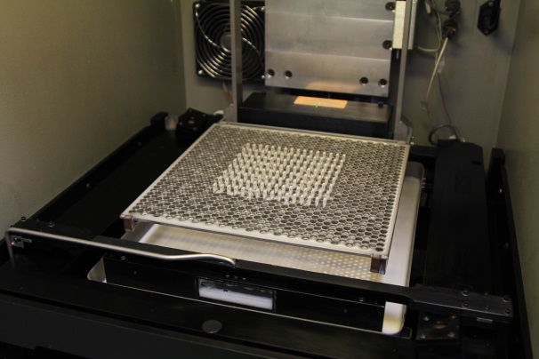
High resolution limited to 150X150X250 mm because of laser shape shift to from circular to elliptical

Slide 13
Materials

Slide 14
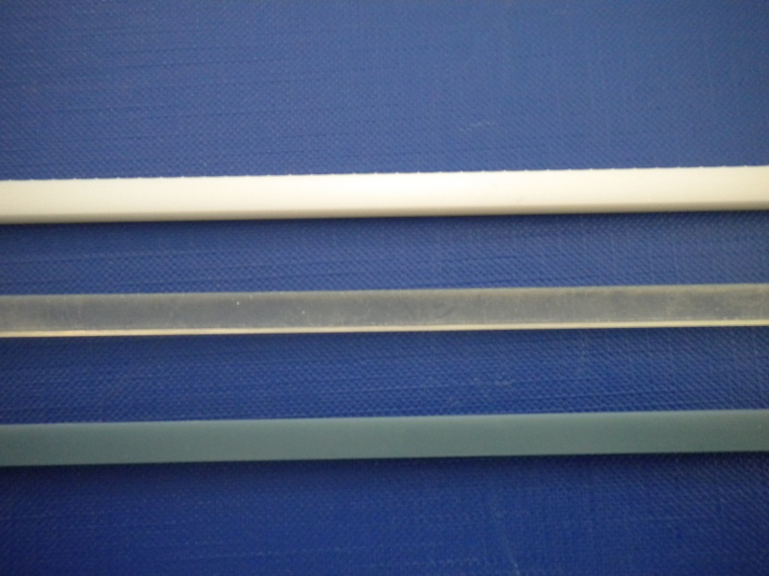
Offer of base materials
 | Accura 25 | Accura 48HTR | Accura Bluestone
Color | White | Transparent Brownish after additional post curing | Blue
Purpose description | High flexibility, possibility to build pieces for snap fit assemblies, easiest processing leading to best dimensional control (3 resolutions available) and lower costs | Medium temperature application, intermediate mechanical properties, low moisture absorption, possibility to build pieces allowing visualization of what it happens inside (flows) | High temperature, highest modulus, smaller ductility, slower and more complex production leading to higher production costs
Charge | Pure resin | Pure resin | Nano powder filled

Slide 15
Mechanical Properties RT
Tensile test
Flexural test
 | Accura 25 | Accura 48HTR | Accura 48HTR + H.T. | Accura Bluestone | Accura Bluestone + H.T.
Ultimate tensile strength [MPa] | 45±2 | NA | 73±3 | NA | 70±7
Fracture tensile strain [%] | 6.8±0.7 | NA | 3.1±0.15 | NA | 0.9±0.1
Ultimate flexural strength [MPa] | 73±1.5 | 99±2 | 114±3 | 107±7 | 120±4
Fracture flexural strain [%] | 17±3 | 6±0.2 | 6.5±0.5 | 2±0.5 | 2±0.2
Tensile E modulus [MPA] | 2200±100 | NA | 3300±100 | NA | 9300±600

Slide 16
Mechanical Properties 77K
Flexural test
Tensile test
 | Accura 25 | Accura 48HTR | Accura 48HTR +HT | Accura Bluestone | Accura Bluestone +HT
Ultimate tensile strength [MPa] | 70±8 | NA | 85 | NA | 190±25
Fracture tensile strain [%] | 0.9±0.3 | NA | 1.2 | NA | 0.07±0.02
Ultimate flexural strength [MPa] | 145±27 | 115±20 | 127±7 | 87±1 | 105±3
Fracture flexural strain [%] | 1.9±0.35 | 1.8±0.2 | 2±0.1 | 0.53±0.03 | 0.8±0.03
Tensile E modulus [MPA] | 8000±650 | NA | 7500±300 | NA | 15600±300

Slide 17
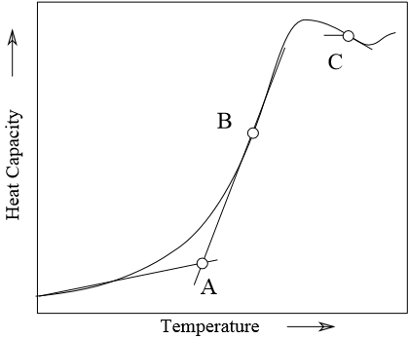
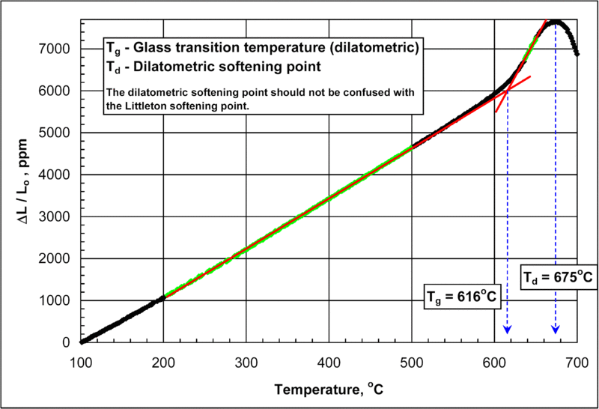
Behaviour vs. temperature
-
+
 | Accura 25 | Accura 48HTR |  | Accura Bluestone
 |  |  | With thermal post curing |  | With thermal post curing
Heat deflection at 0.45 MPa [ºC] | 58 | 65 | 130 | 65 | NA
Heat deflection at 1.82 MPa [ºC] | 55 | 57 | 110 | 65 | 267
Glass transition temperature Tg [ºC] | 60 | 62 | 132 | 71 | NA
Thermal expansion coeff T<Tg m/m- ºC | 107 × 10⁻⁶ 0-20 ºC | 115 × 10⁻⁶ T<50 ºC |  | 45 × 10⁻⁶ 0-20 ºC
Thermal expansion coeff T>Tg m/m- ºC | 151 × 10⁻⁶ T75-140 ºC | 165 × 10⁻⁶ T>120 ºC |  | 100 × 10⁻⁶ 90-150 ºC
Compatible with SnAg and SnPb soldering process
Compatibility with high temperature resin curing temperature to use as component in vacuum impregnated assembly and to build moulds
The glass transition is the reversible transition in amorphous materials from a hard and relatively brittle state into a molten or rubber-like state
The heat deflection temperature is determined by the procedure outlined in ASTM D648 or ISO 75. The test specimen is loaded in three-point bending. The outer fiber stress used for testing is either 0.45 MPa or 1.82 MPa, and the temperature is increased at 2 °C/min until the specimen deflects 0.25 mm.

Slide 18
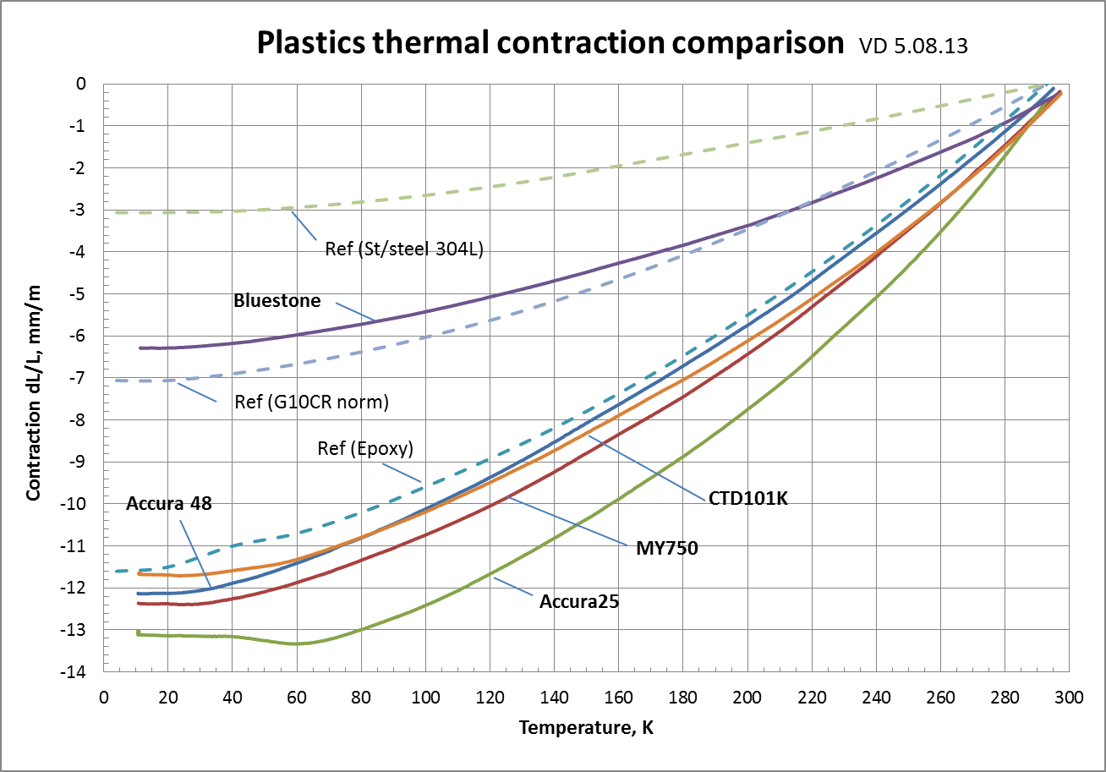
Thermal contraction

Slide 19
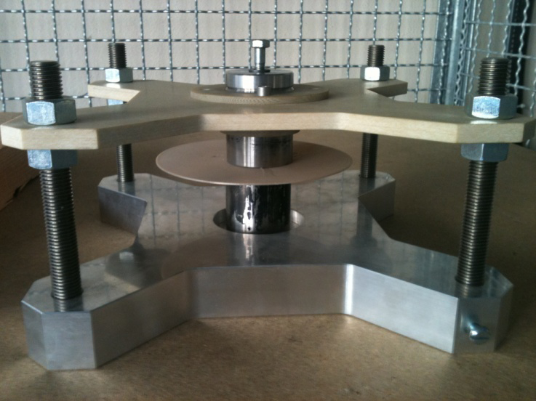
Electrical Properties
Ø150 mm Disc
Thickness 1.05 mm ±0.05
Ramped Voltage till 20kV, 500 V/s
Material | N of samples | N of test | Discharges
Accura 25 | 5 | 10 | 0/10
Accura 48 | 5 | 10 | 0/10
Accura Bluestone | 5 | 6 | 1/6 (crack in sample)

Slide 20
Radiation resistance I
?

Slide 21
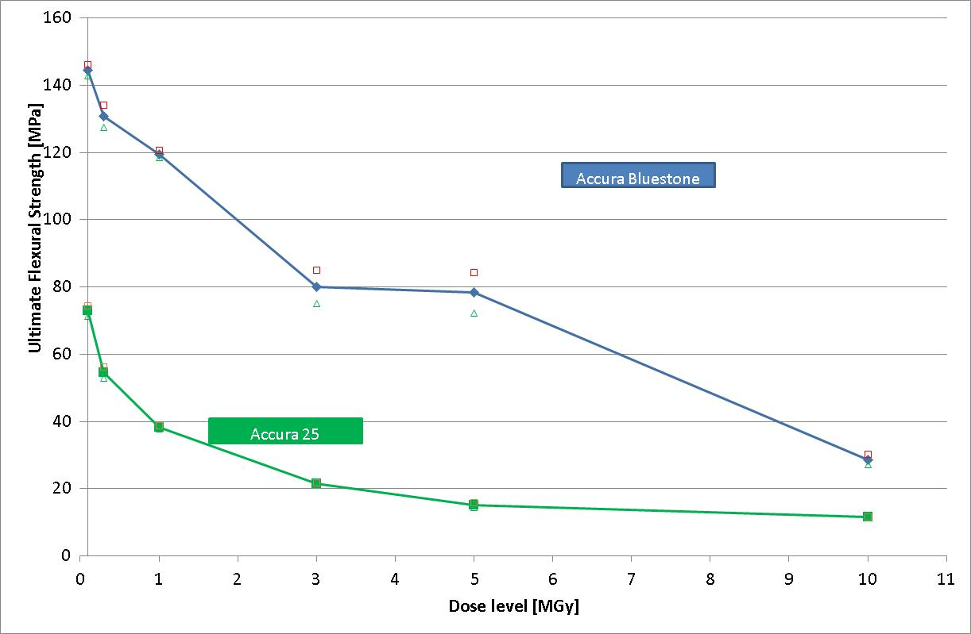
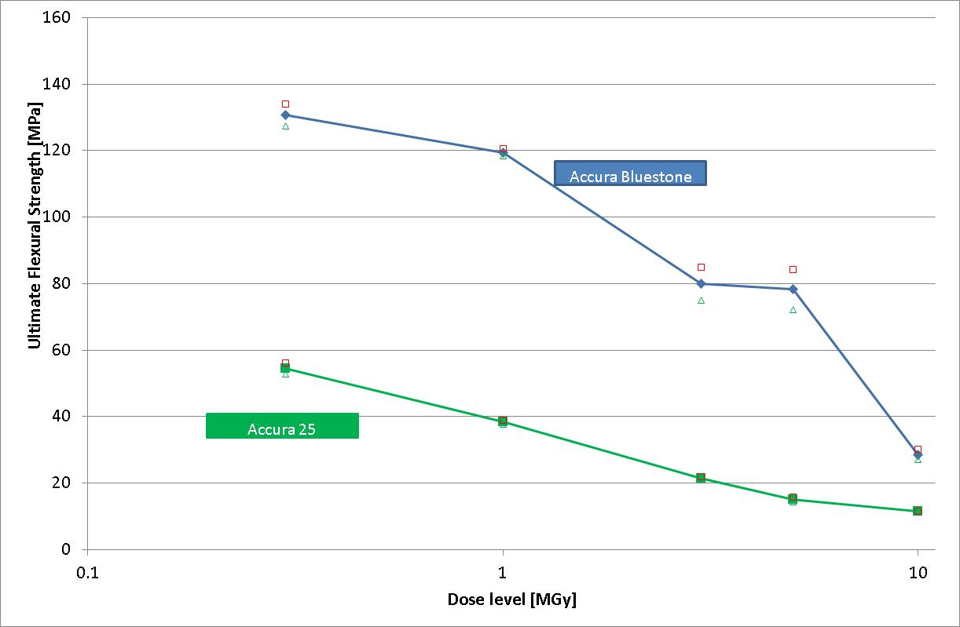
Radiation resistance II

Slide 22
Dimensional capabilities
All pieces in EXACT mode
(0.1 mm thick layer)

Slide 23
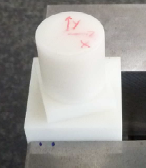
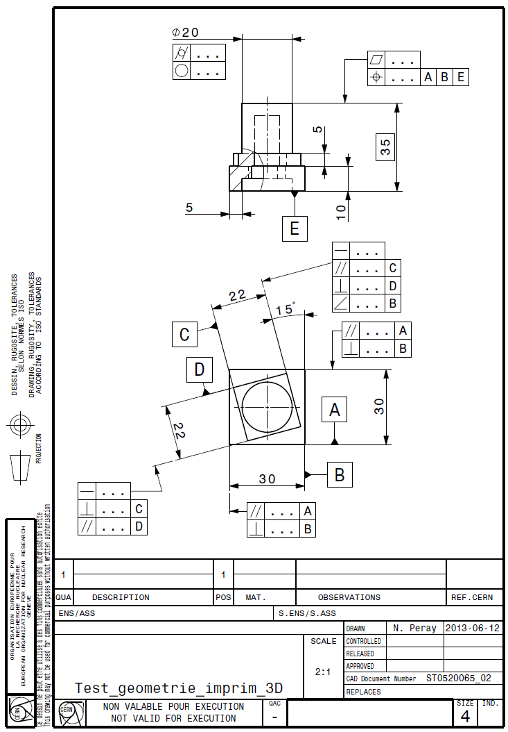
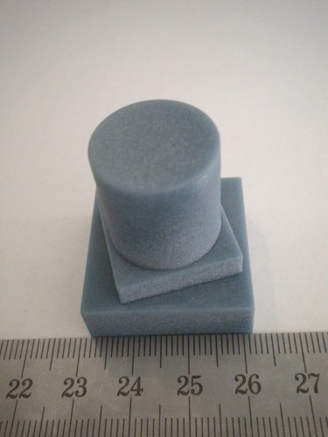
Dimensional capability checks
0.128±0.03
0.022±0.06
0.07±0.01
0.037±0.05
-0.08±0.002
0.00±0.004
-0.26±0.09
-0.16±0.06
-0.08±0.01
-0.04±0.02
0.01±0.002
0.008±0.003
0.02±0.015
0.025±0.01
0.025±0.003
0.16±0.1
0.09±0.03
0.025±0.05
0.04±0.02
0.02±0.02
0.17±0.06
0.02±0.003
0.15±0.1
0.027±0.01
0.25±0.06
0.07±0.03
0.053±0.03
0.04±0.001
0.012±0.02
0.024±0.003
0.02±0.002
0.02±0.015
0.007±0.004
0.015±0.001

Slide 24
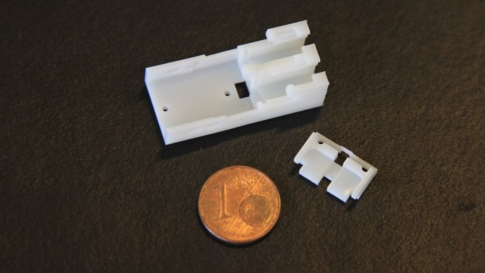
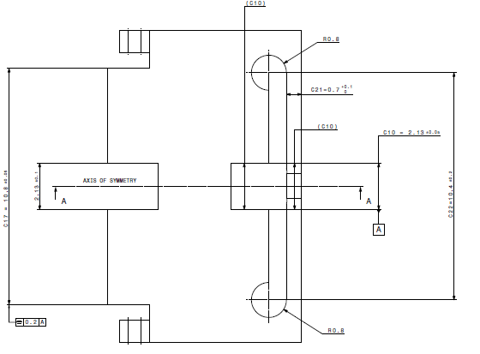
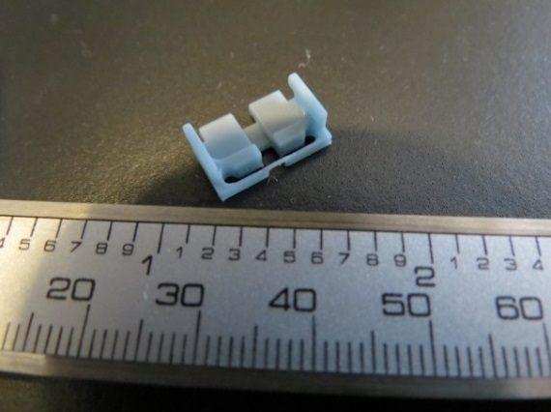
-0.045±0.02
S 0.014±0.013
-0.025±0.01
S 0.02±0.015
planarity 0.01 to 0.08
planarity 0.01 to 0.04
Orthogonal planes 0.01 to 0.05
Orthogonal planes 0.01 to 0.04

Slide 25
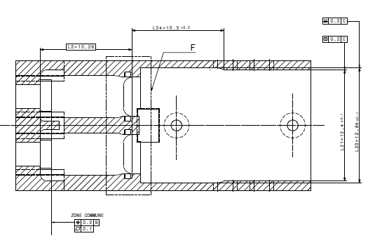
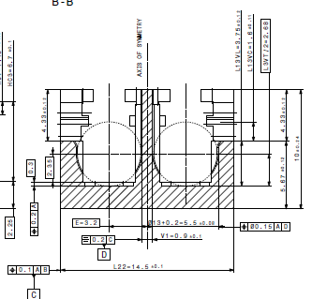
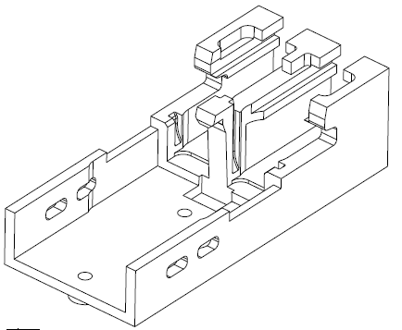
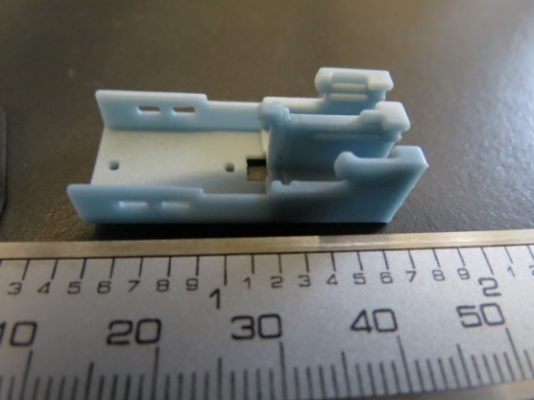
Symm. 0.2±0.1
0.03±0.04
0.04±0.05
Symm. 0.2±0.01
-0.01±0.01
-0.04±0.02
0.1±0.06
0.025±0.02
Symm. 0.2±0.1
Symm. 0.21±0.01
Orthogonal planes 0.01 to 0.09
Orthogonal planes 0.01 to 0.1

Slide 26
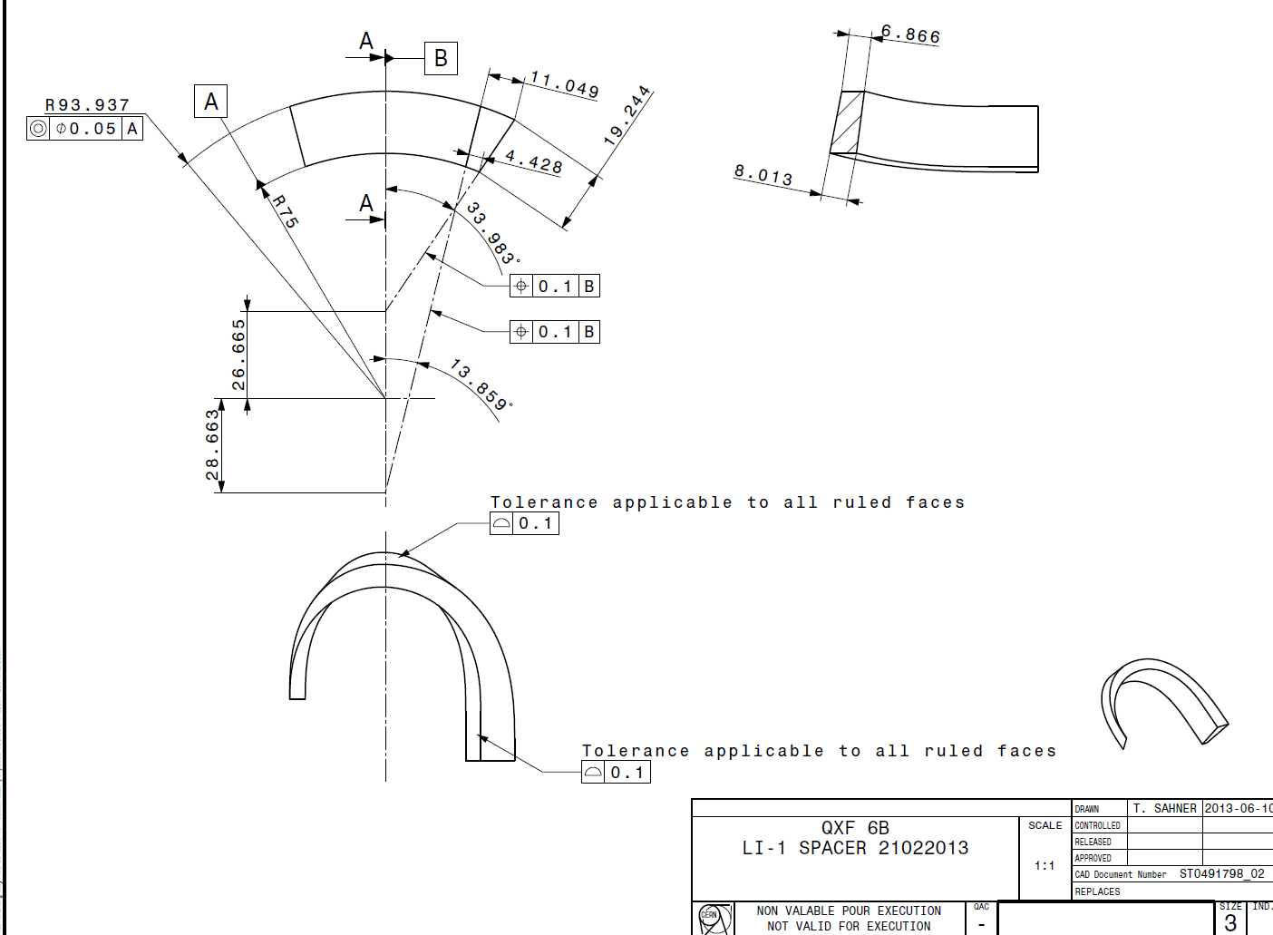
0.14
1.4
0.08
0.7
-0.01
2.8
-0.03
0.7
-0.1/+0.1
-0.03/0.03
-0.1/+0.05
-0.04/0.01

Slide 27
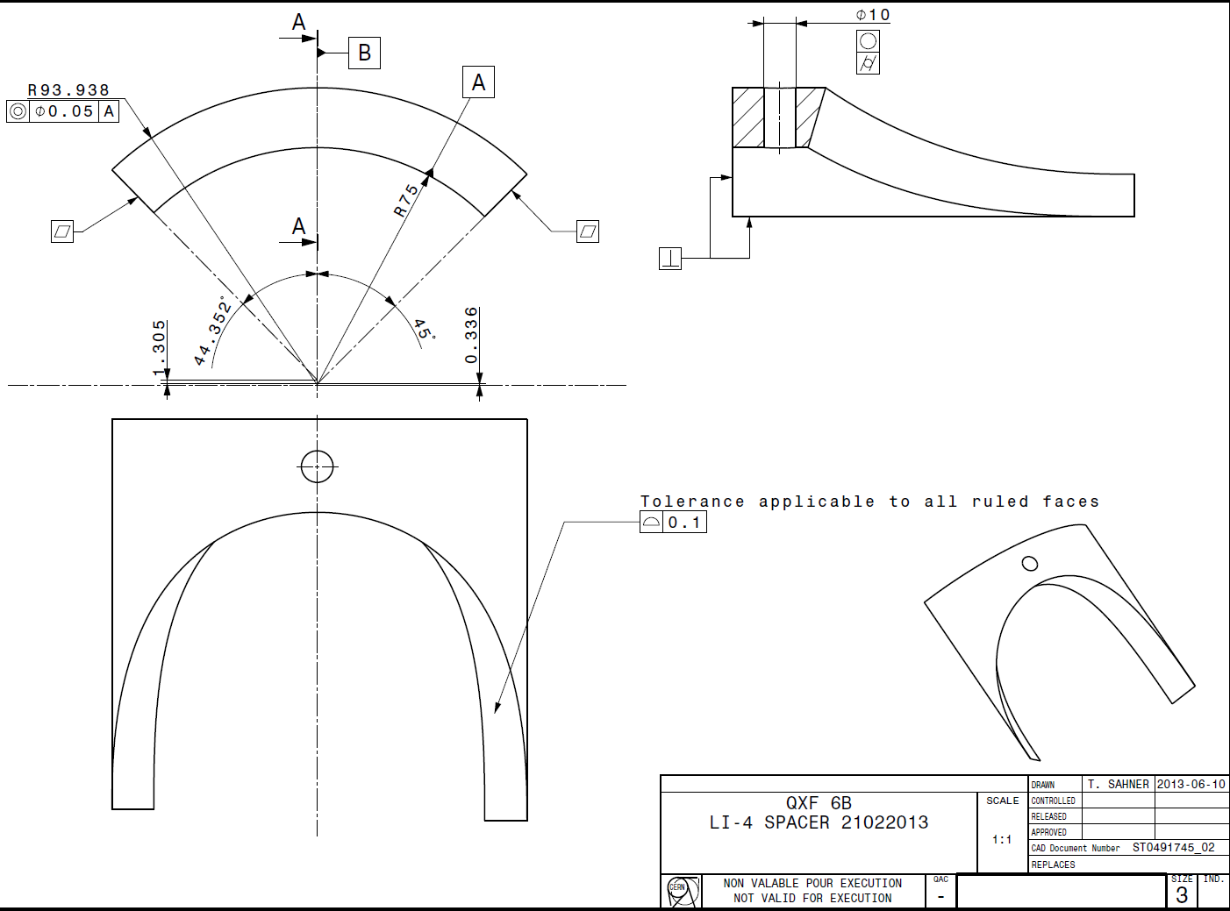
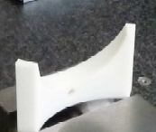
1
0.9
0.027º
-0.71º
+0.1/+0.8

Slide 28
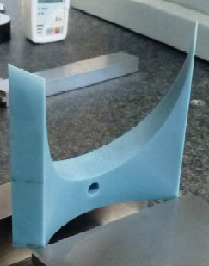
-0.12
-0.04
0.032º
0.039º
+0.04/+0.26

Slide 29
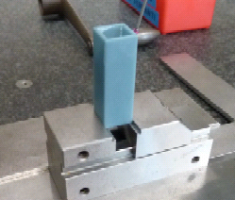
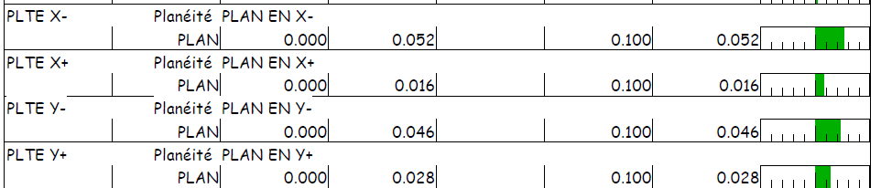
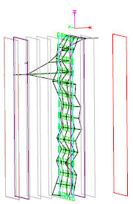
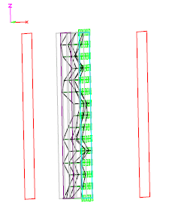
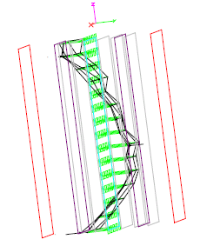
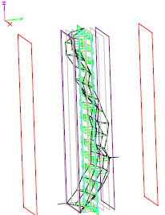
Study of influence environmental vibration
Piece built progressively switching on sources of vibrations (vacuum pumps and smoke extraction system) and then switching them off progressively

Slide 30
Observations
Dimensional precision depends on the resin used. Accura bluestone allow achieving precision errors 1/3->1/4 of the Accura 25
The shape errors depends on the machine and software capability
Typical errors are (on dimensions of 30 mm)
  Accura 25: 0.15->0.2 mm
  Accura Bluestone: 0.02->0.04 mm
Today we think that we can do better:
Measured pieces were produced before the last intervention on the machine that fixed an hidden problem in the mirror system and CERN got in beta test an improved precision setting for the ACCURA 48 HTR

Slide 31
Summary
+
Work. temp. | Reduce thermal contr. | Stiff. | Rupture at imposed strain | Rupture at imposed stress | Cryo mech. use | Rad. Res. | Prec. (in exact mode) | Snap fit ass. | Cost red.
BS | BS | BS | 25 | 48HTR | 48HTR | BS | BS | 25 | 25
48HTR | 48HTR | 48HTR | 48HTR | BS | 25 | 48HTR | 48HTR | 48HTR | 48HTR
25 | 25 | 25 | BS | 25 | BS | 25 | 25 | BS | BS
-

Slide 32
Examples of components built up to now

Slide 33
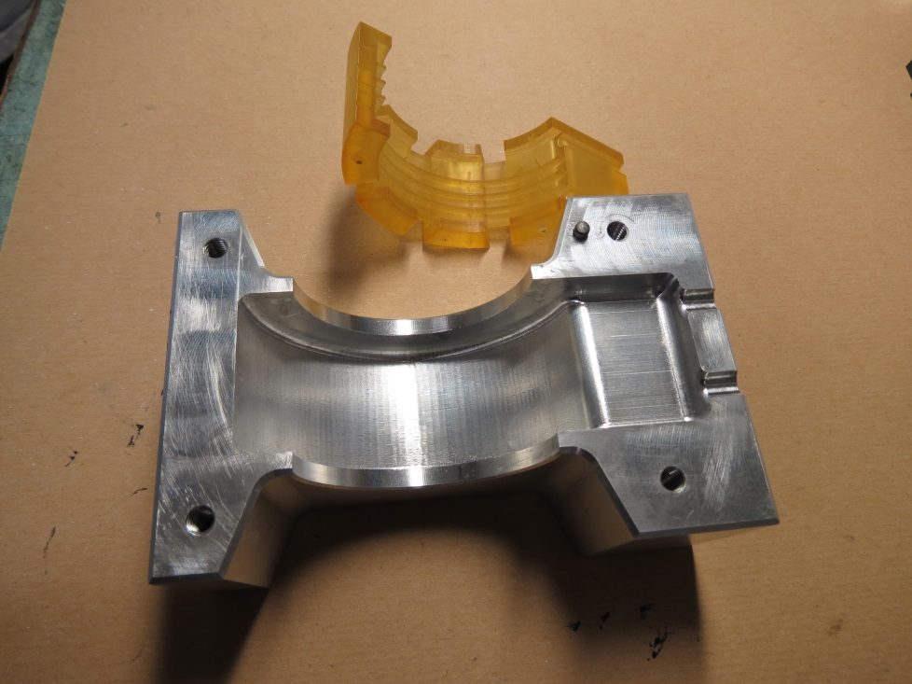
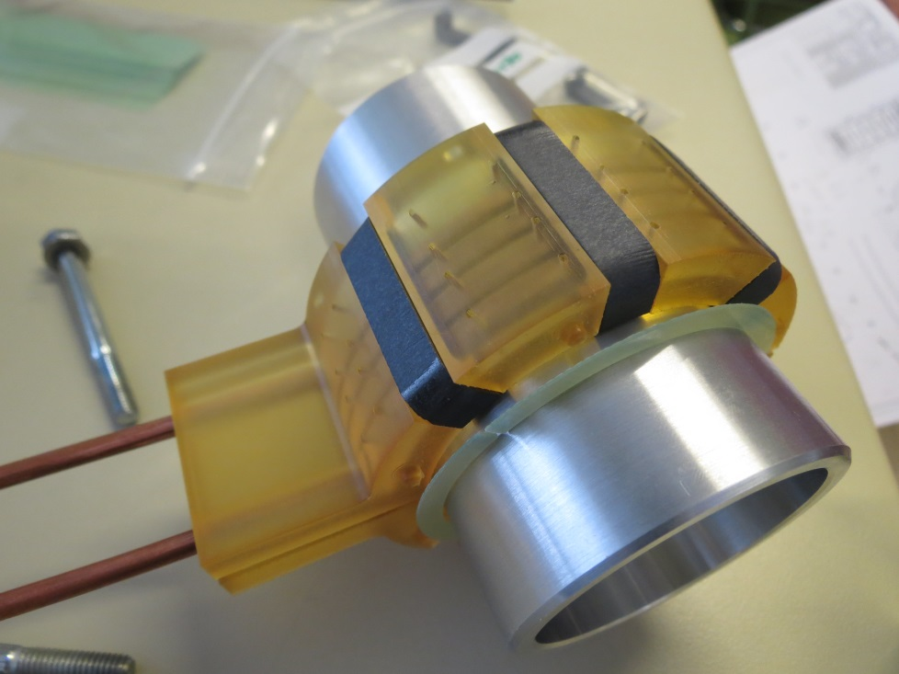
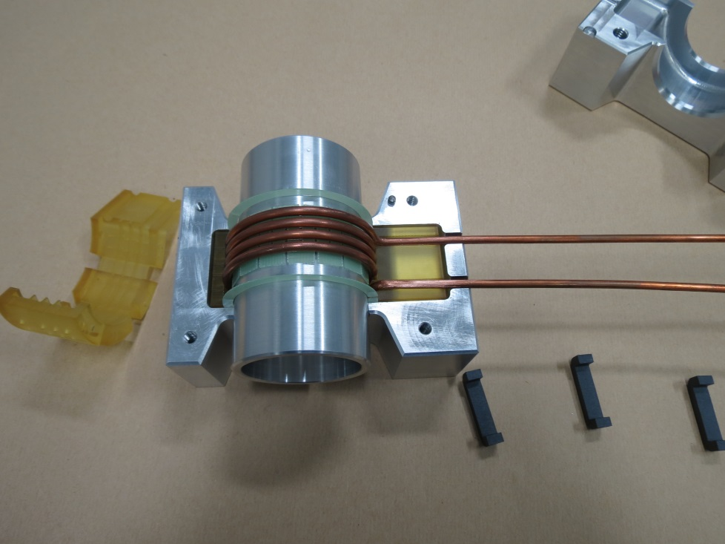
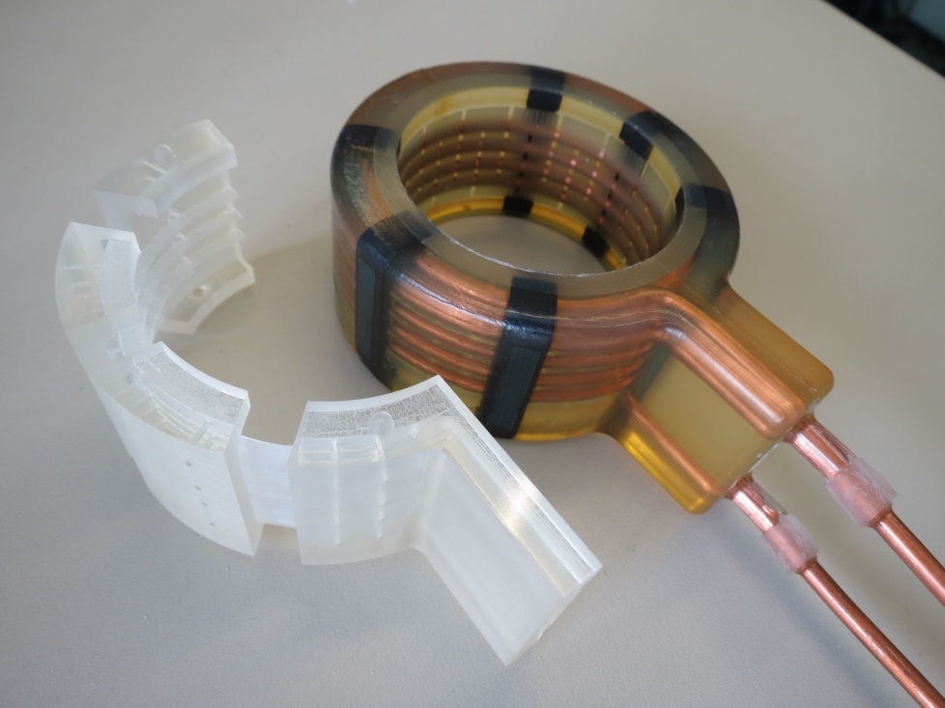
RF antenna

Slide 34


Bridge stave
4.5 mm

Slide 35

High Voltage connectors for the LHC Transverse Damper Amplifier

Slide 36

End spacer for SC coil test winding

Slide 37
Keep in mind
Supports are needed under the base. The surface finish of that surface could be worst. The same for surface with angles larger than 35º.
The minimum thickness along the z axis is 3 layers (0.15->0.3 mm)
Put together the max number of pieces on the same load plate. It will reduce time and costs.
Accept to choose the material that fits at best your application. Over specifying has a cost.
These epoxy resins, to be laser sensitive, are not halogen free
As many epoxies are not fire resistant.
Explain clearly what your piece is for and its working loads, just do not ask to build “something”. Without knowing people cannot help you.
Results to come
1) new tensile test at 77K on cylindrical samples to avoid breakage in the heads of samples. New cryostat just received by EN-MME
2) in 1 week heat deflection temperature under a load of 8 Mpa (data commercially not available)

Slide 38




Where polymer lab building 101

Slide 39






POLYMER LAB ACTIVITIES I
Vacuum impregnation with different type of resins
Non functional 3D printing mineral powder based
Sandwiches and special gluing
In situ leak repairs techniques

Slide 40





POLYMER LAB ACTIVITIES II
Leak detection shells
Scintillator silicon lenses
Special voltage insulators
Sealing with special shapes

Slide 41
Thanks
Thanks to the colleagues, sections (all TE-MSC sections) and groups (in particular EN-MME) that have supported the acquisition of this equipment providing financial support or expressing their interest

Slide 42


