Slide 1
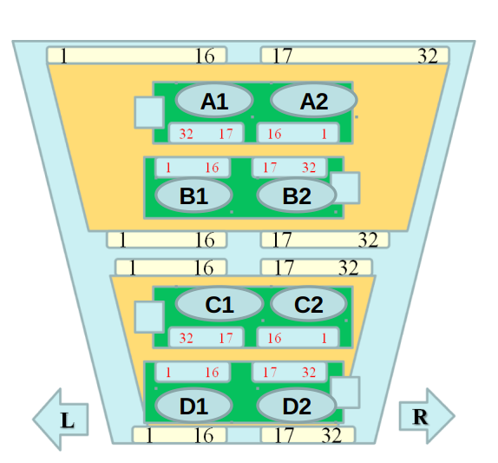
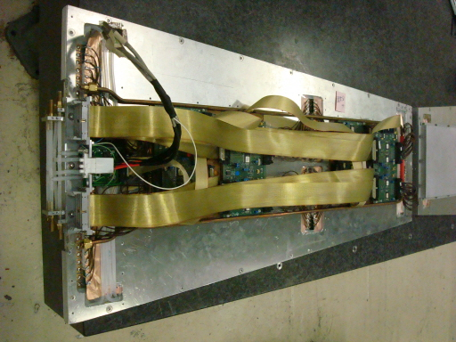
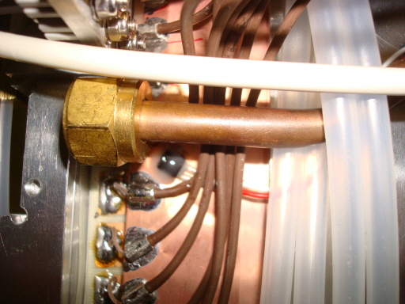
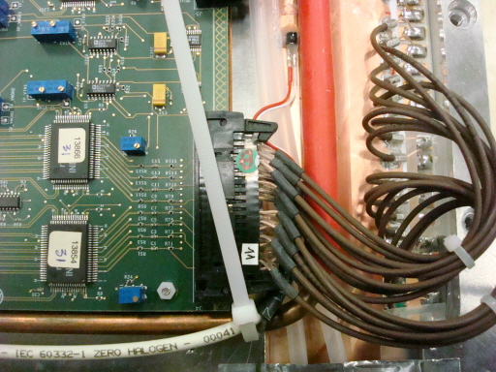
Assembly of RE1/1 chambers
KODEL, Korea university
Built 4 chambers in 2008-2009
10 degrees/4 aprtitions
Eta :1.8→2.1

