Slide 1
RE1/1 Additional Services
Chamber RE+1/1/1 - 4
The services are all there as planned;
HV, LV, Cooling and Gas.
Since the change to use the Link system in the towers we require;
Signal and DCS
Ian Crotty 7 August 2014

Slide 2
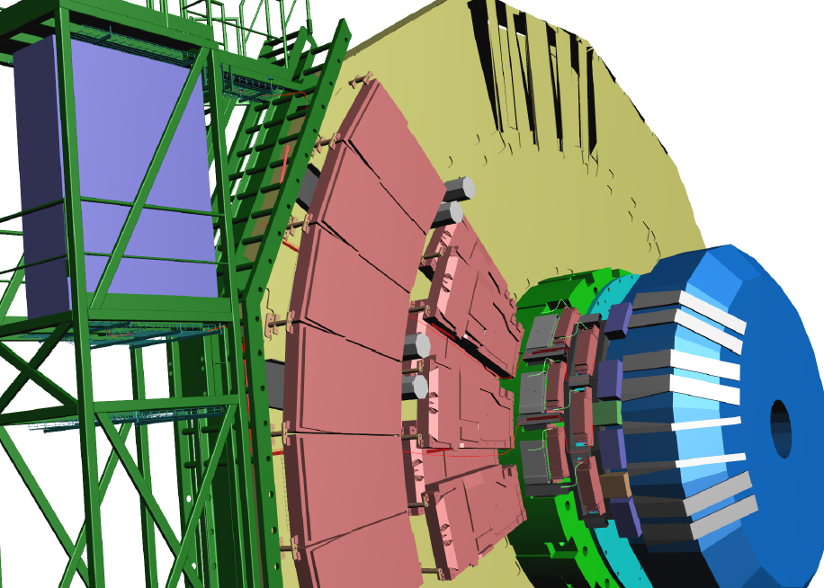
Routing as supplied by Integration
16 Signal Cables dia 10mm
4 DCS cables dia 5mm
Choice of Rack access from bottom or top
2 paths to reduce cable section over CSCs

Slide 3
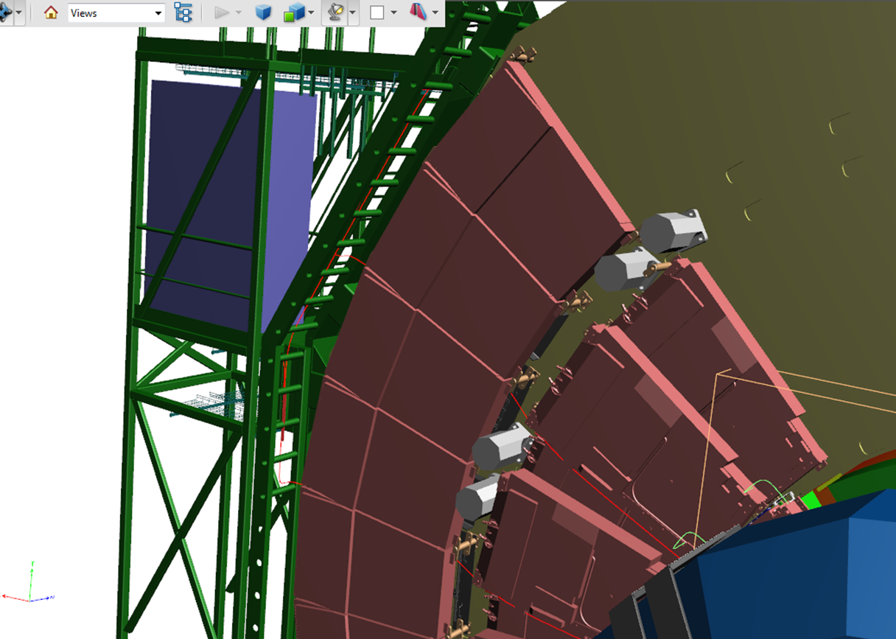
ME1/2 & 1/3
Removal of the floor above racks is necessary
Cables go over both the ME1/2 & 1/3. Going under 1/3 is not easy for this quantity. 2m slack will be stored under the green structure so chambers can be removed.
Access is not possible to the base of the rack X4J32 as the floor slot is insufficient

Slide 4
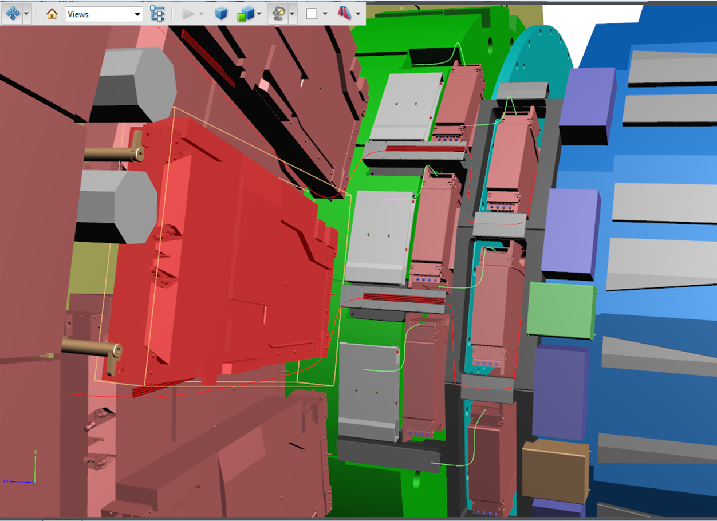
ME1/1
Thin red line represents the cable path
RE1/1/04
RE1/1/01

Slide 5
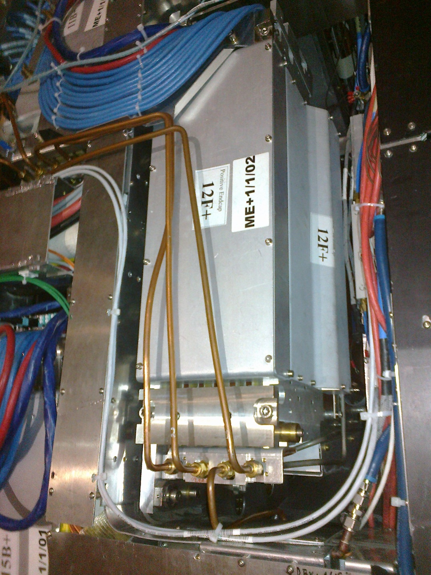
Modified routing
The 2 white DCS cables go beside the present very full cables paths
Obstruction of the ME1/1s is limited.
These cables can be readily disconnected at the RE1/1 end to allow full access for ME1/1 chamber removal.
This is not so true for the Signal cables as the connectors are fragile.
DCS cables already connected

Slide 6
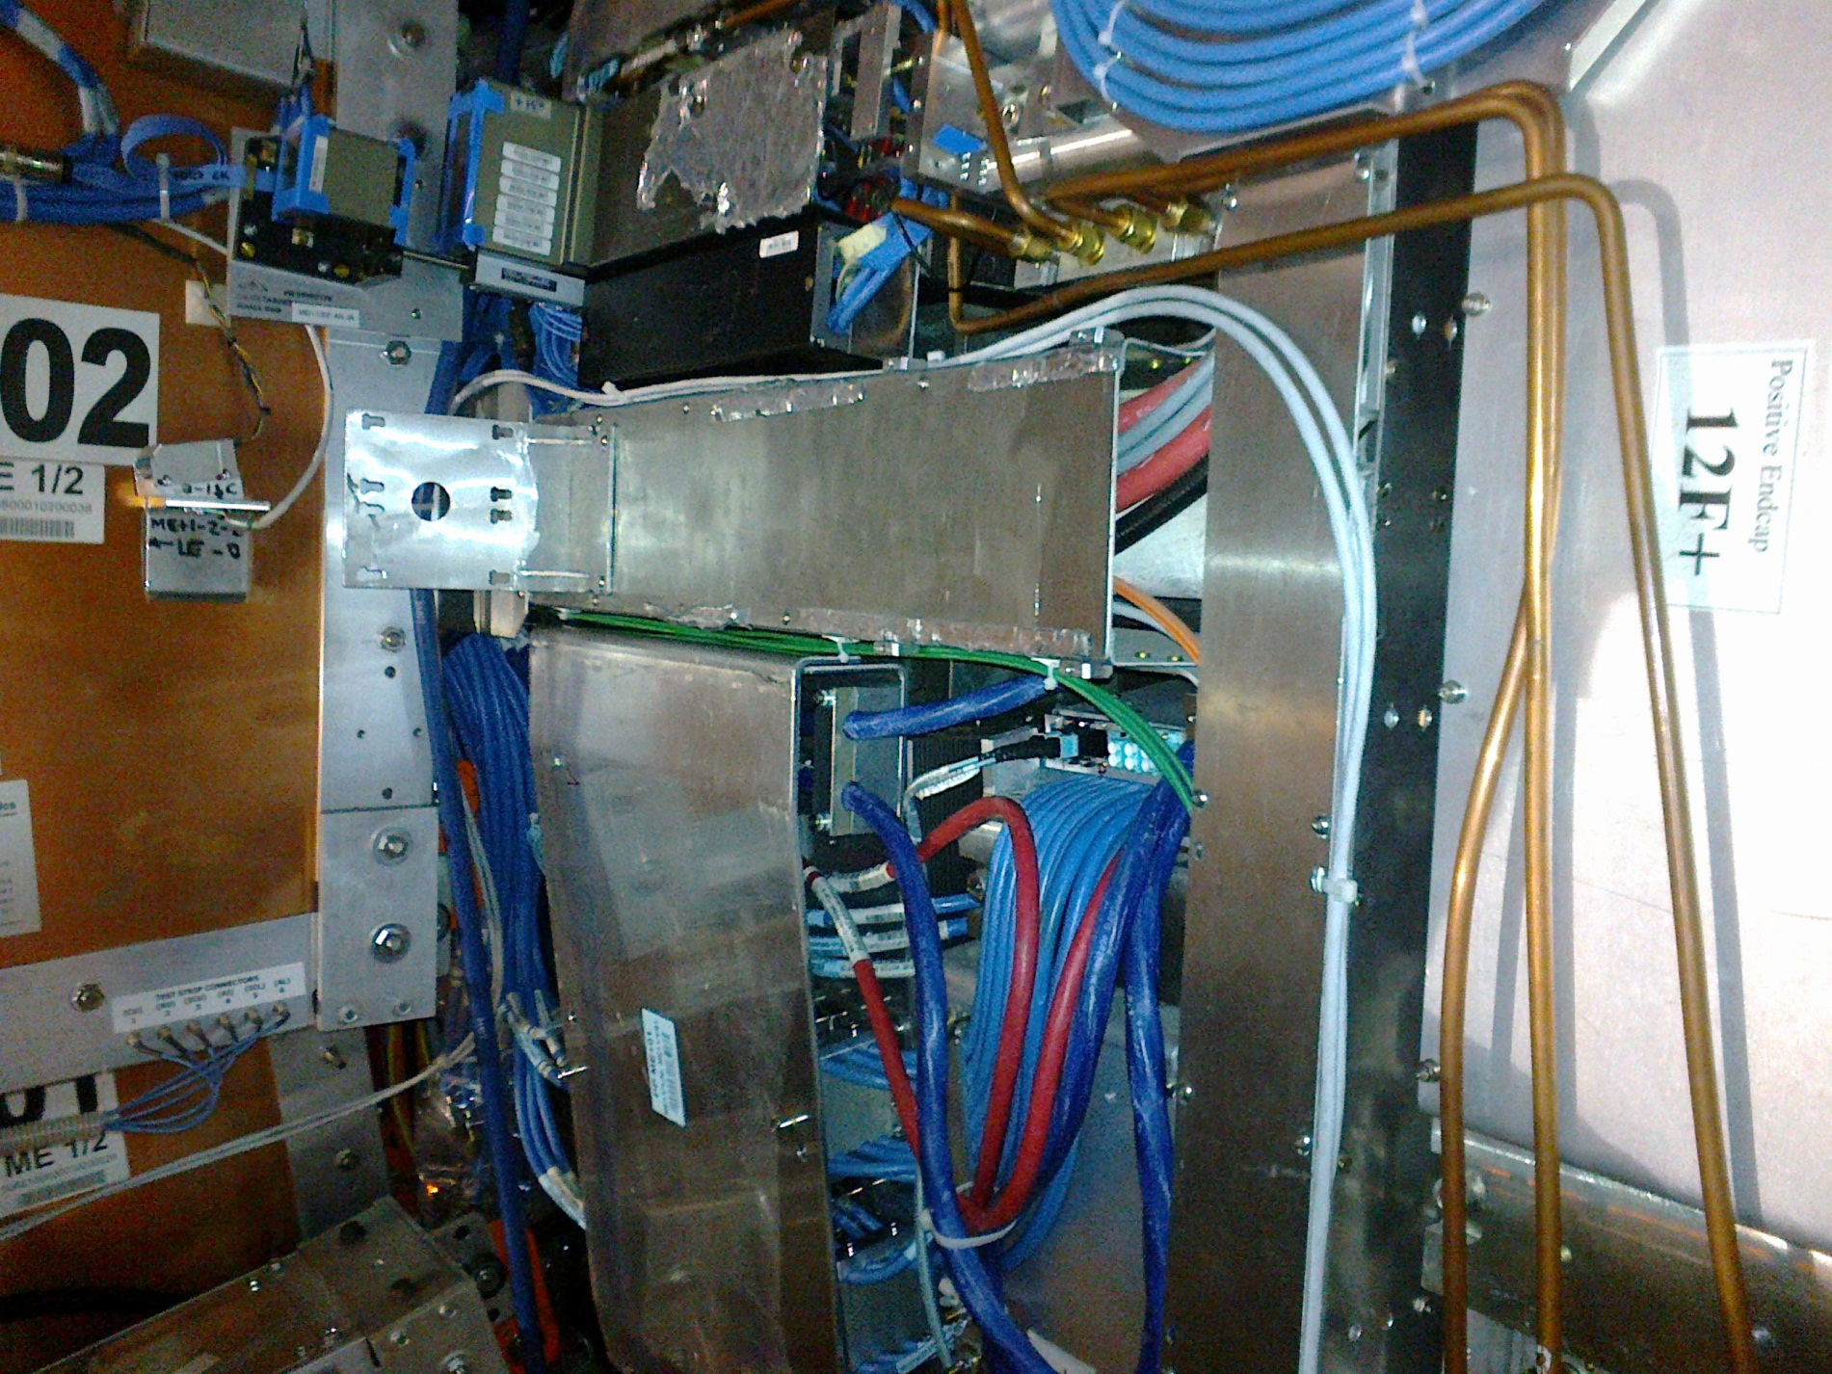
Alignment protection
Old CSC cables do not give a problem
Cables (DCS) show the route along side the alignment system, behind the N2 seal bracket and over the ME1/2

Slide 7
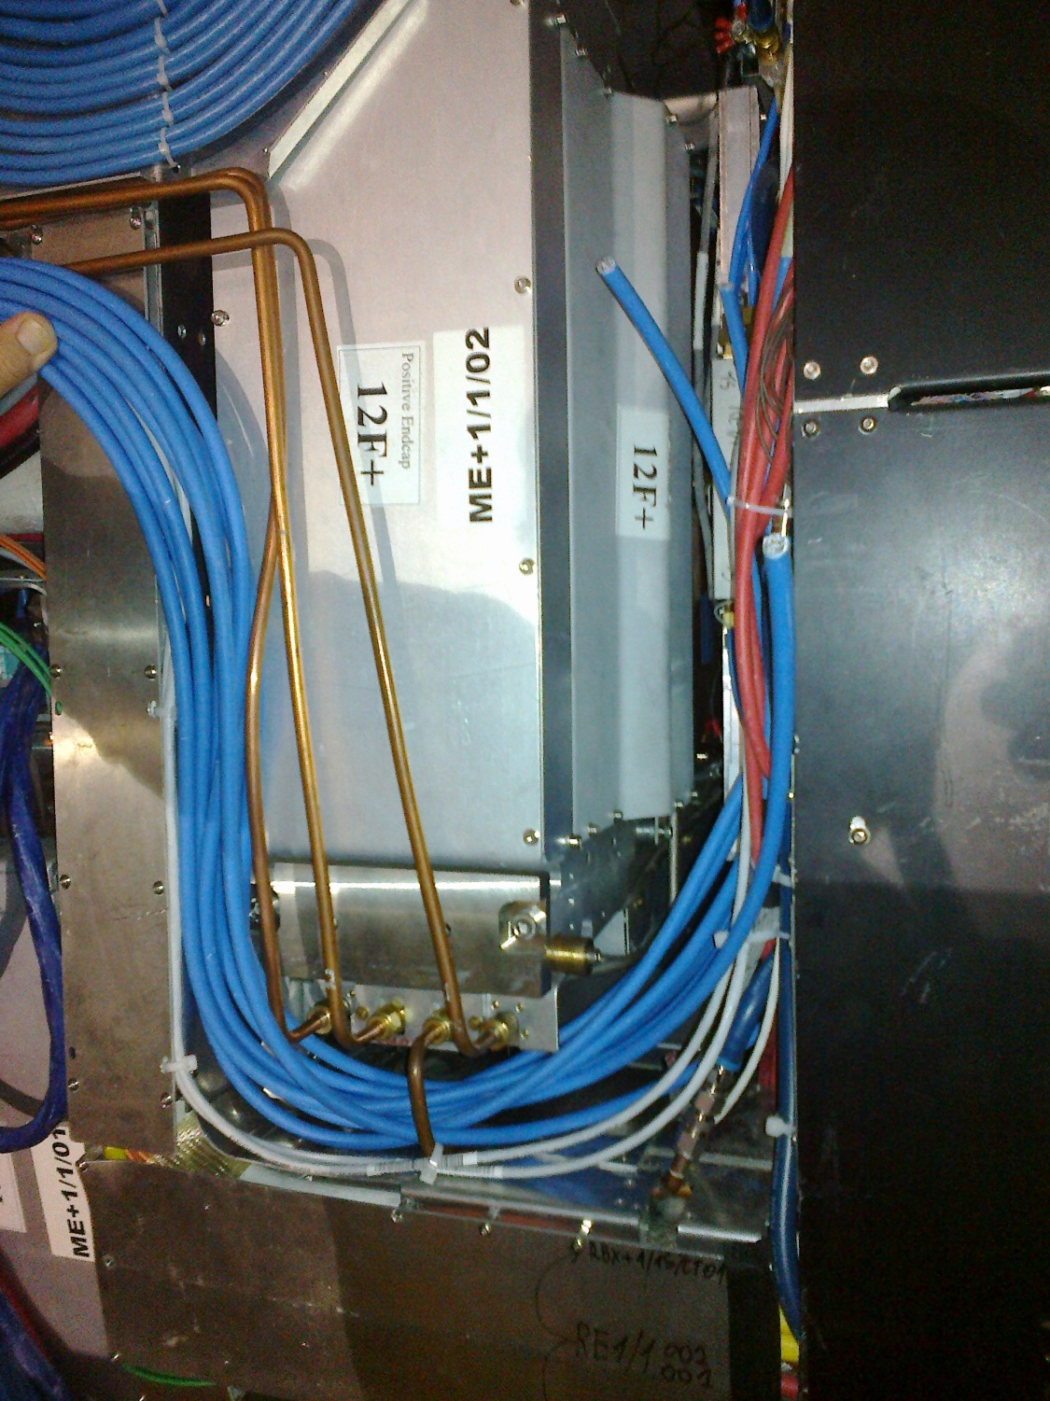
Cables for RE1/1/01 & 02
X8 Signal cables laid in place.
X2 DCS cables laid in place.
This work was carried out with
Victor Perelygine and verified by Alexandre Kurenkov

Slide 8
Remaining questions
Attaching the cables (x8) on to the ME1/2 & ME1/3s.
Will the alignment system (black box) remain in the ME1/1 nose area ?
If the alignment system stays then the cables can go lower down on the next slot.

Slide 9
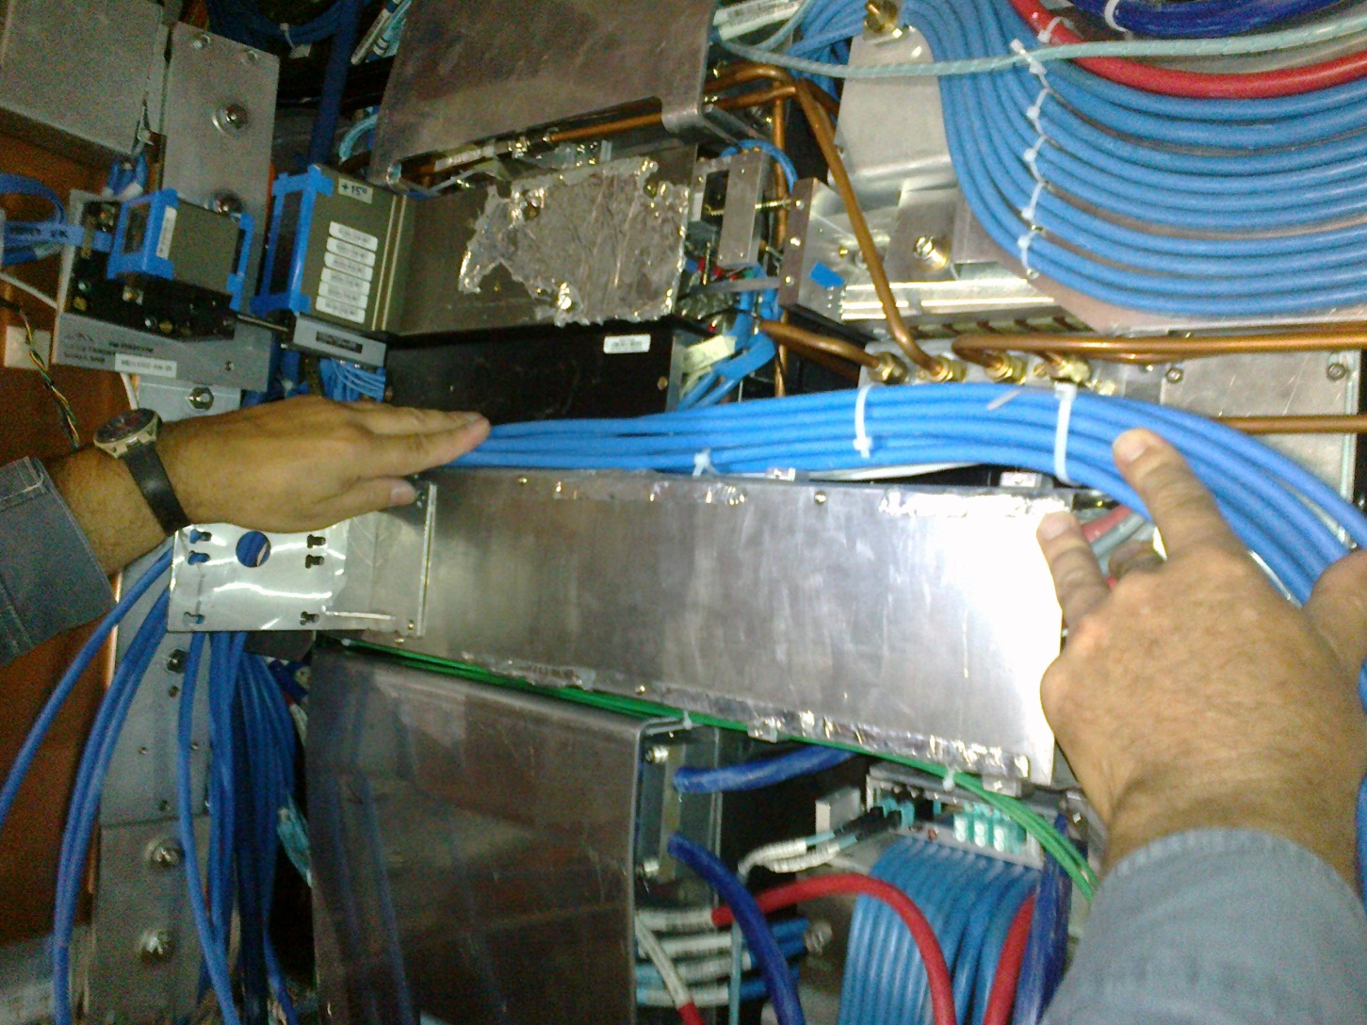
Photos

Slide 10
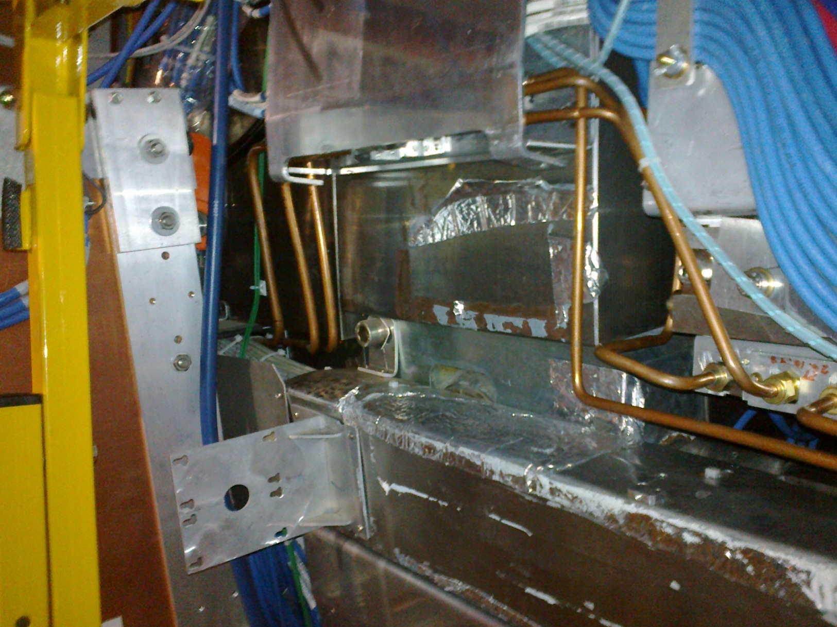
Space if alignment not present

