Slide 1
BaBar
Ian
4 Feb 2020

Slide 2
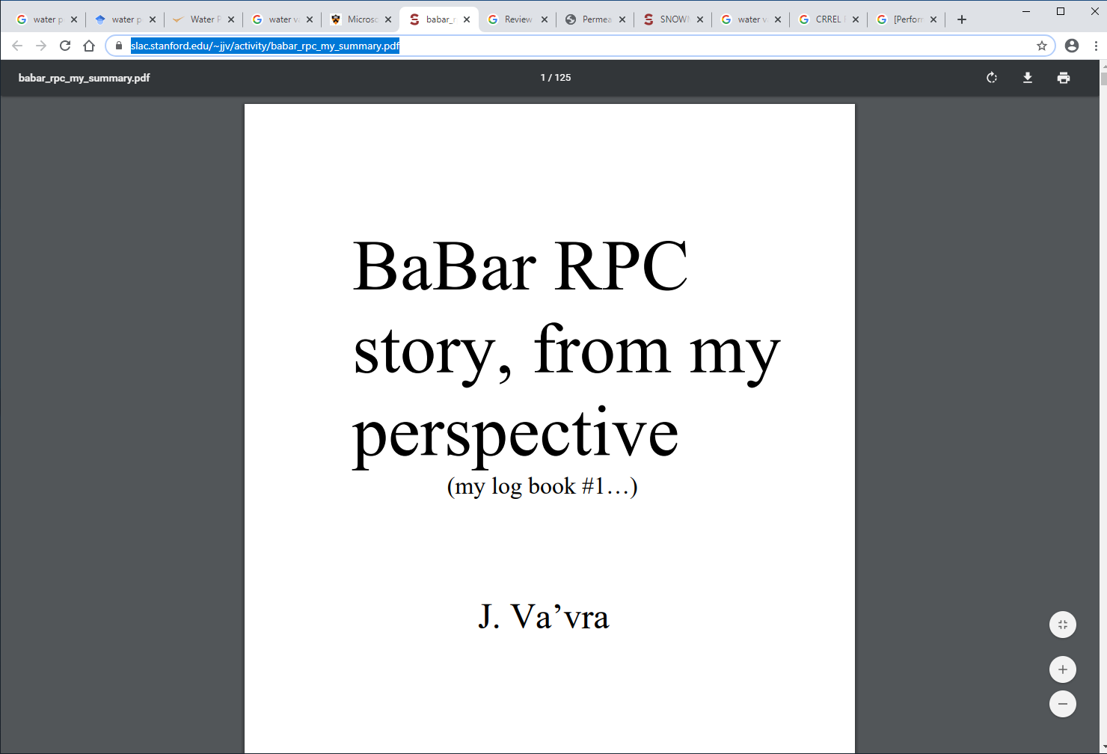
https://www.slac.stanford.edu/~jjv/activity/babar_rpc_my_summary.pdf

Slide 3
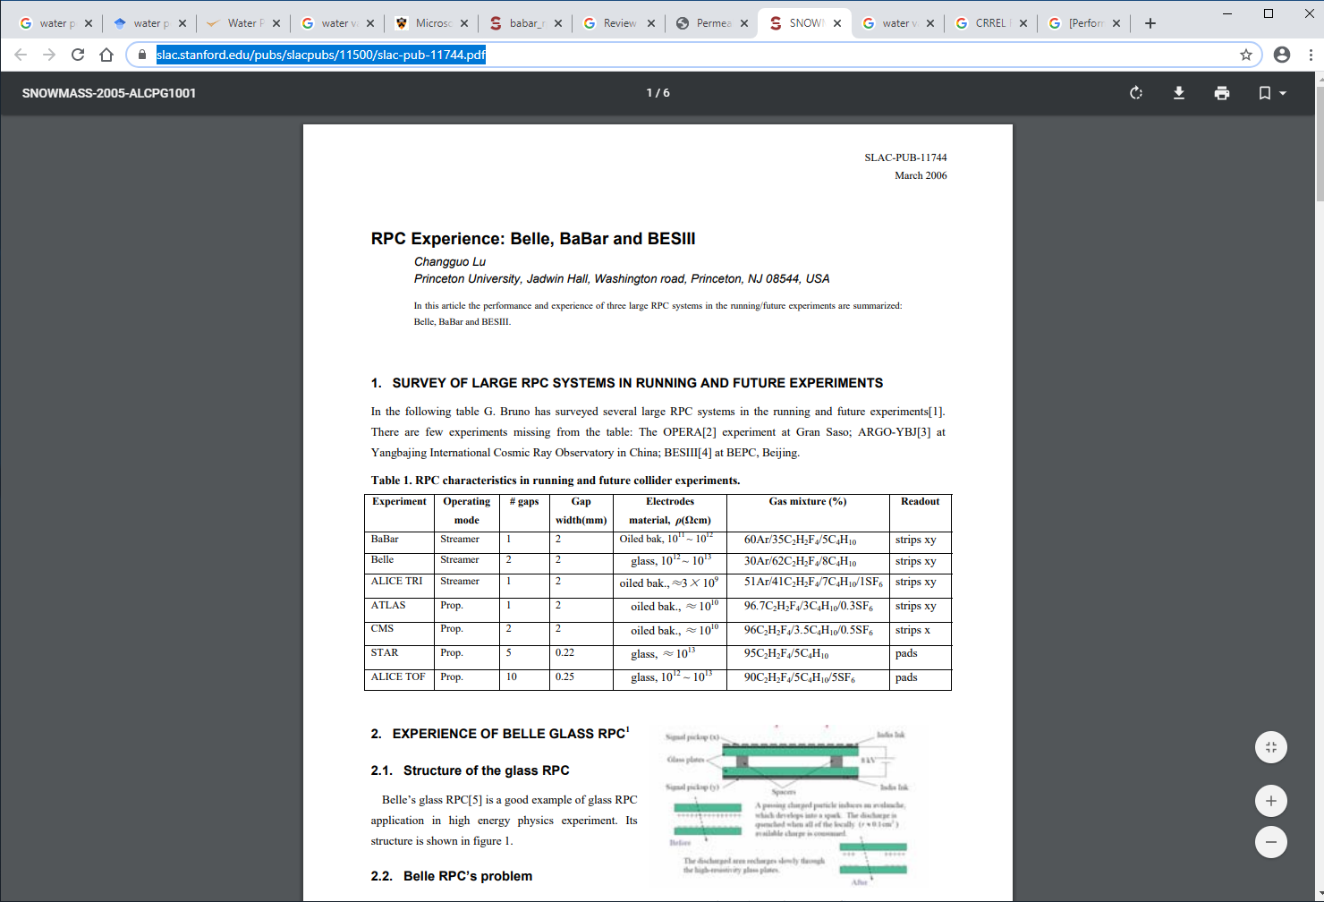
https://www.slac.stanford.edu/pubs/slacpubs/11500/slac-pub-11744.pdf

Slide 4
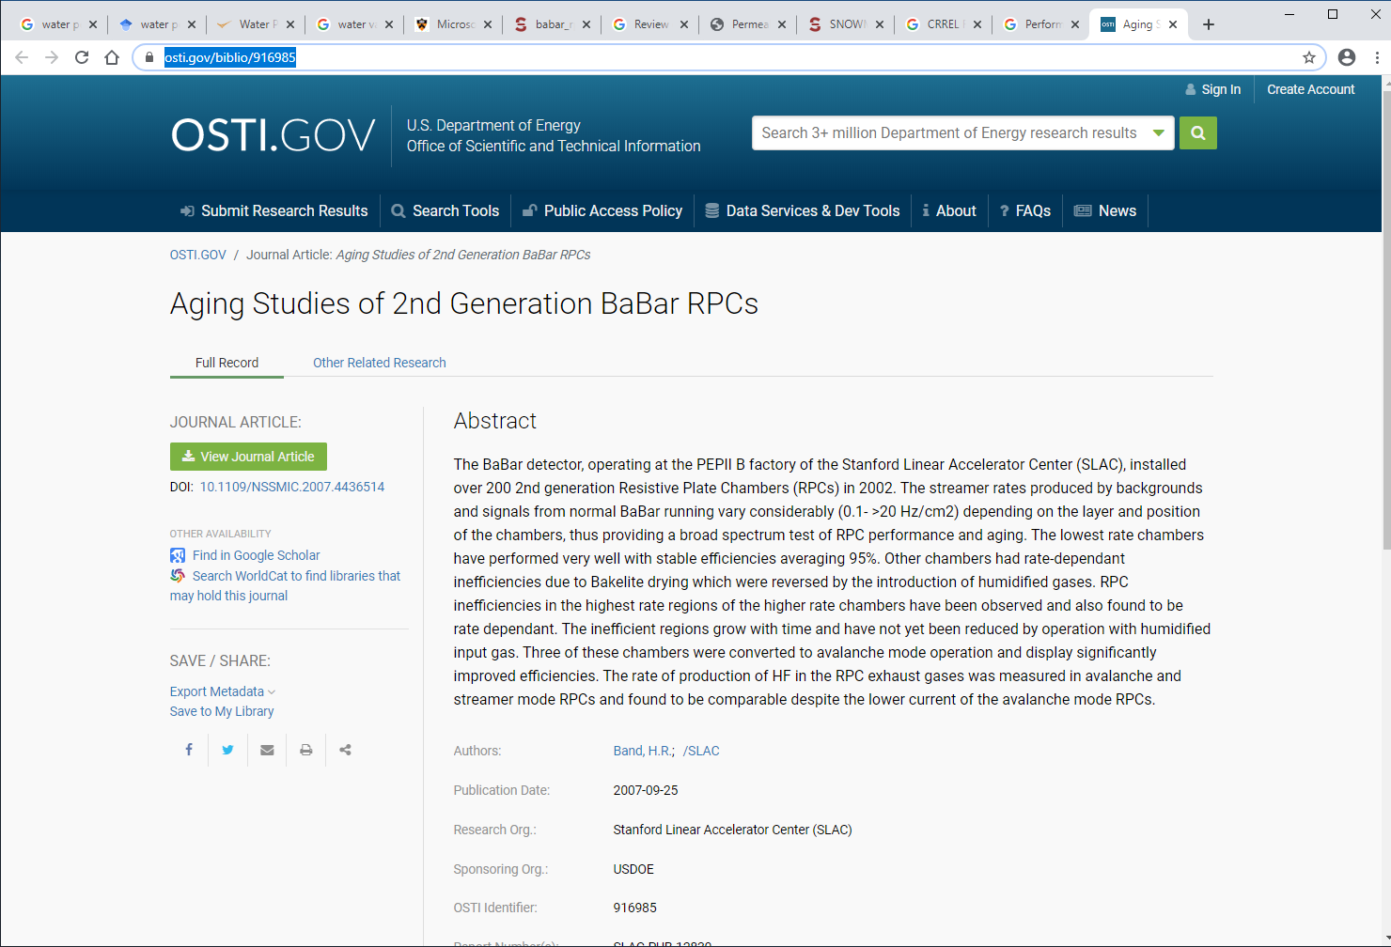
https://www.osti.gov/biblio/916985

