Slide 1
Pressurised RPCs using air as a primary gas
Ian
2 March 2020

Slide 2
The number of primary electron-ion pairs
Name Atomic Mass Atomic number (Z) Atomic Weight Mass Mass Volumique Relative density Electro Neg.
[g/mol] [g/litre] gas (wrt air)
Argon 40 18 39.95 1.78
iC4H10 58 2.506
R134a 102 4.275(5.28) 3.25
Air 28.97
Nitrogen 14 7 14
Oxygen 16 8 1.43
Carbon Dioxide 44.01 1.87
Xenon 131 54 131 5.89
Conclusion the number of molecules per unit volume or mass of R134a is approx. 3.5 wrt the air. Therefore as a first level guess the pressure required is approx. 3.5 bar.

Slide 3
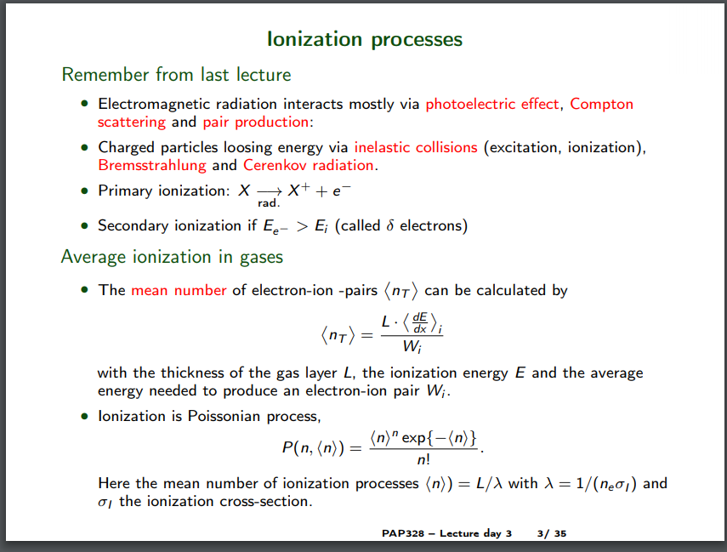
https://courses.helsinki.fi/sites/default/files/course-material/4515373/lecture_gas_det.pdf

Slide 4
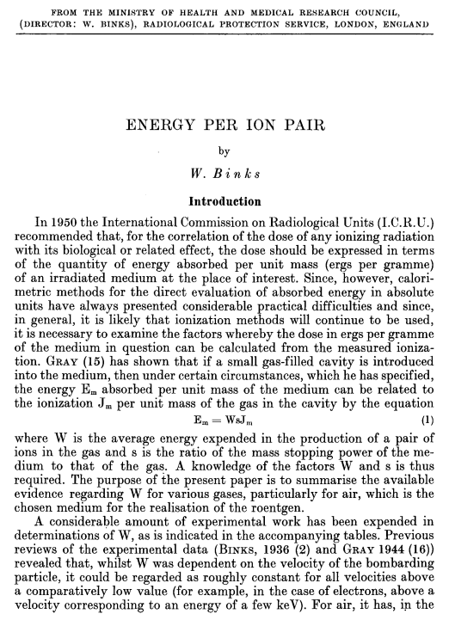
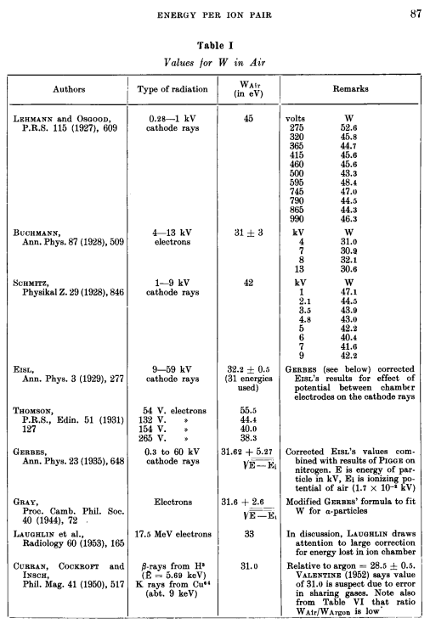
https://www.tandfonline.com/doi/pdf/10.3109/00016925409169759

Slide 5
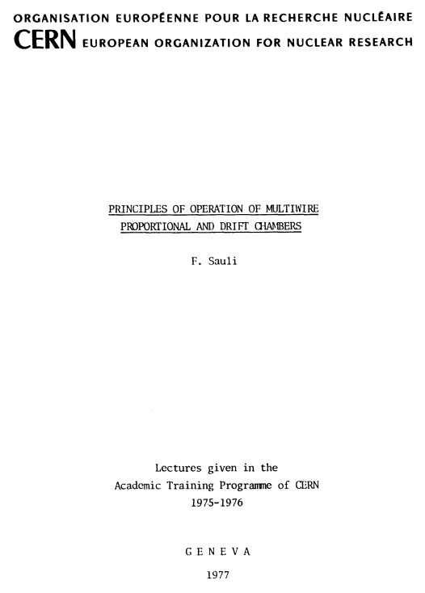
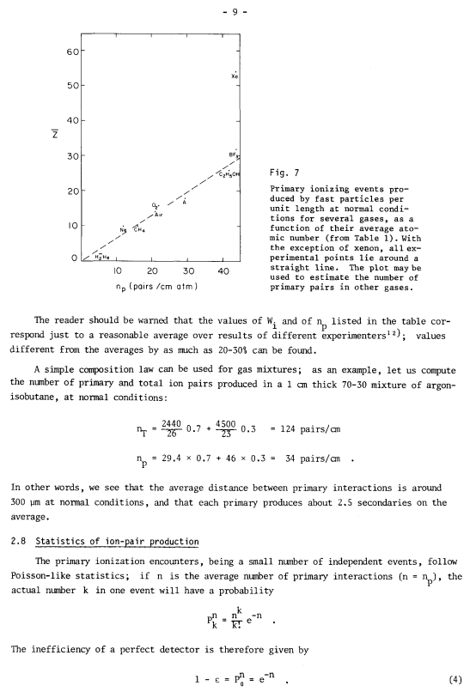
http://lhcb-muon.web.cern.ch/lhcb-muon/documents/Sauli_77-09.pdf

Slide 6
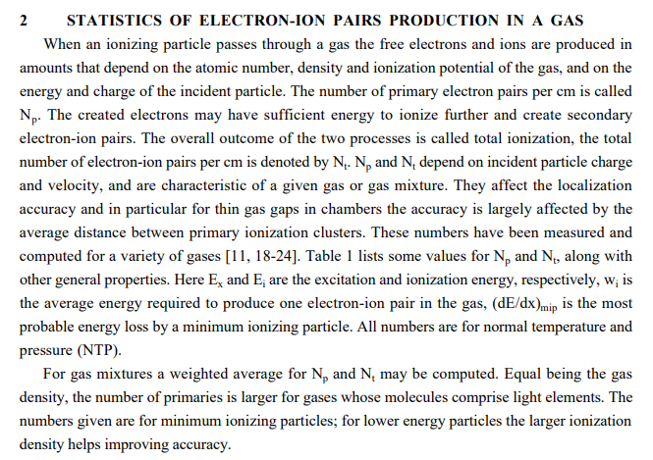

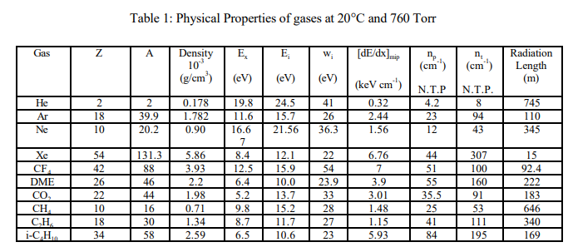
https://www.slac.stanford.edu/pubs/icfa/summer98/paper3/paper3.pdf
Properties of some gas mixtures used in tracking detectors
Archana Sharma
GSI-Darmstadt, Germany*

Slide 8
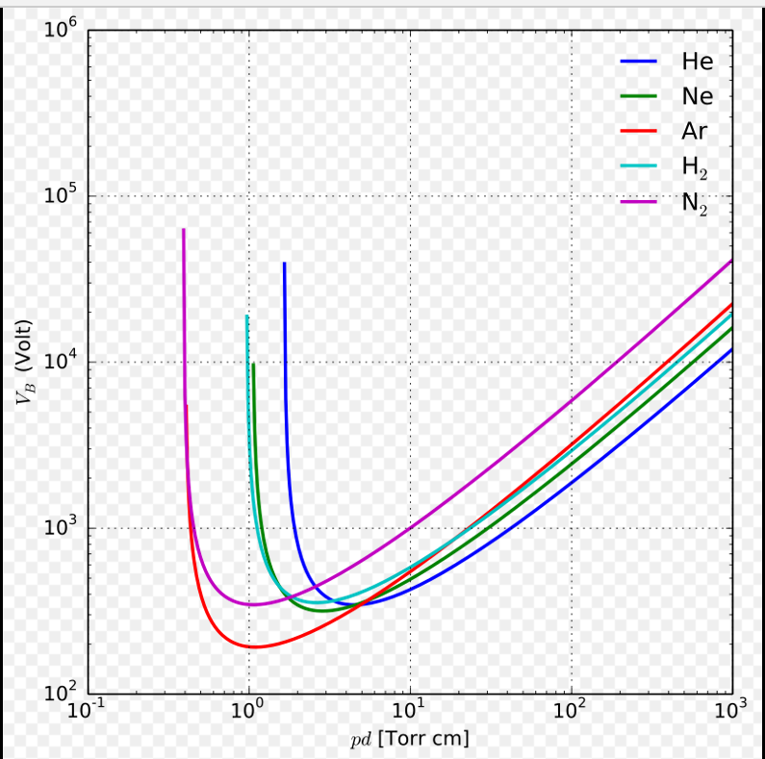
The pressure influences the operating voltage.
There is the equation for effective voltage wrt ptressure and temperature but it is (?) over limited range.
Need the Paschen curve for this
https://en.wikipedia.org/wiki/Paschen%27s_law
Townsend discharge
https://en.wikipedia.org/wiki/Townsend_discharge
Paschen curves obtained for helium, neon, argon, hydrogen and nitrogen, using the expression for the breakdown voltage as a function of the parameters A,B that interpolate the first Townsend coefficient.[1]

Slide 9
Pressure vessels

Slide 10
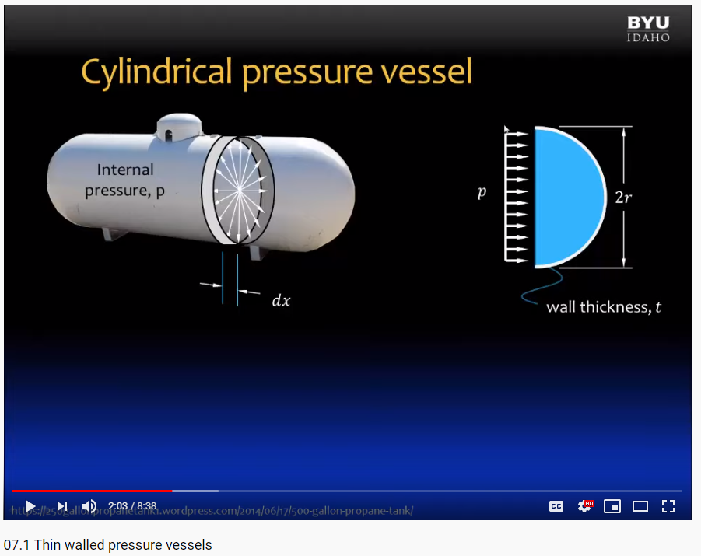
Pressure vessels
Thin shell, see theory
https://www.youtube.com/watch?v=Ja03J1RQ3Hw

Slide 11
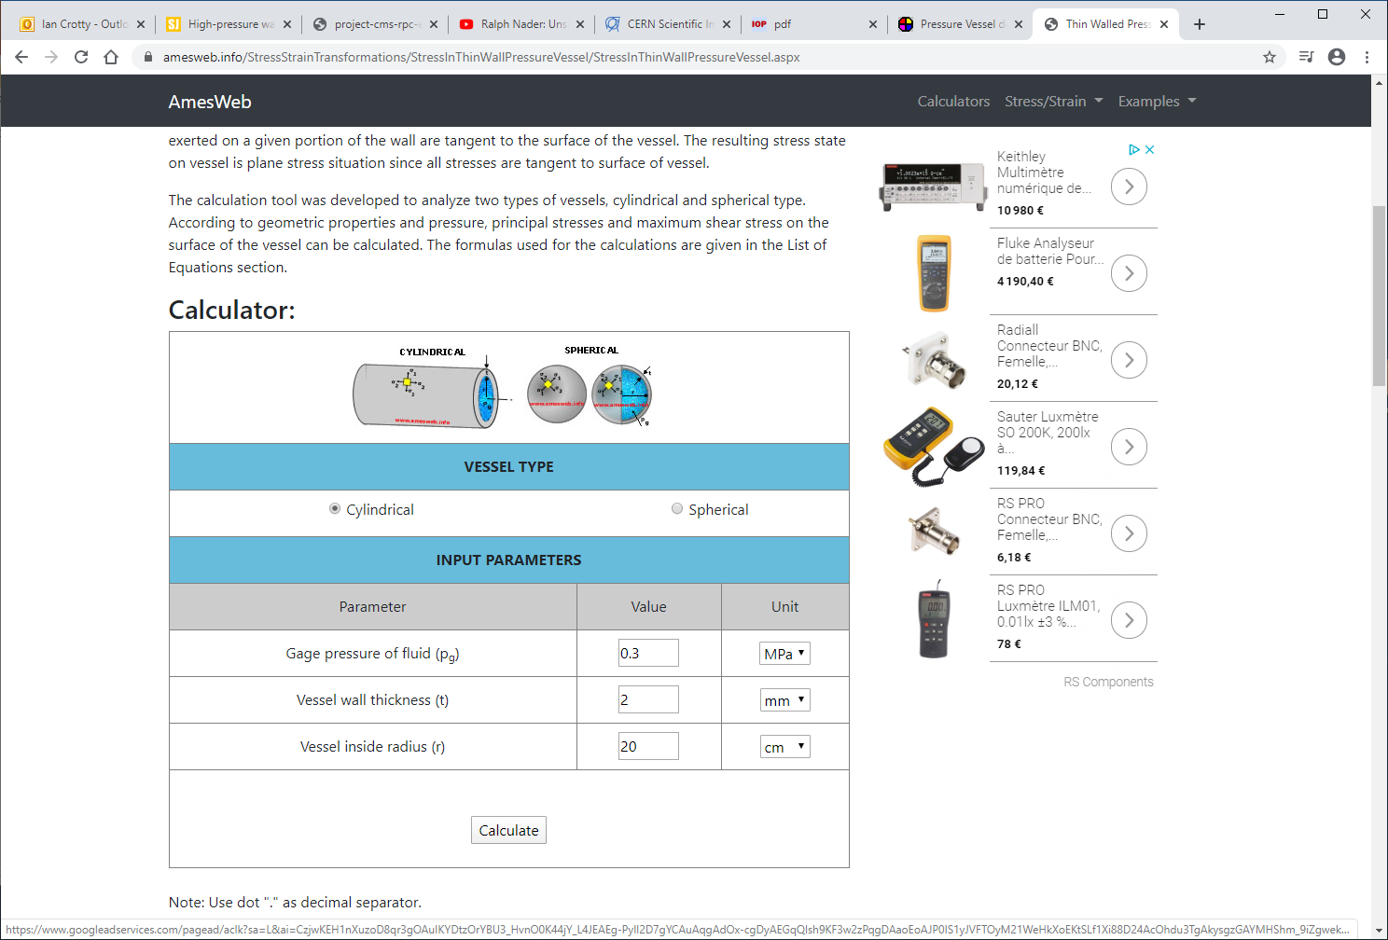
https://amesweb.info/StressStrainTransformations/StressInThinWallPressureVessel/StressInThinWallPressureVessel.aspx

Slide 12
Thin 1mm Alu sheet
Mill out the alu block for RPC gap
20mm
300mm
400mm

Slide 13
References
https://fr.wikipedia.org/wiki/1,1,1,2-T%C3%A9trafluoro%C3%A9thane
Gaseous radiation detectors. PAP328
https://courses.helsinki.fi/sites/default/files/course-material/4515373/lecture_gas_det.pdf

Slide 14
Contacts
Pressure vessels
Markus Brugger EN EA

Slide 15
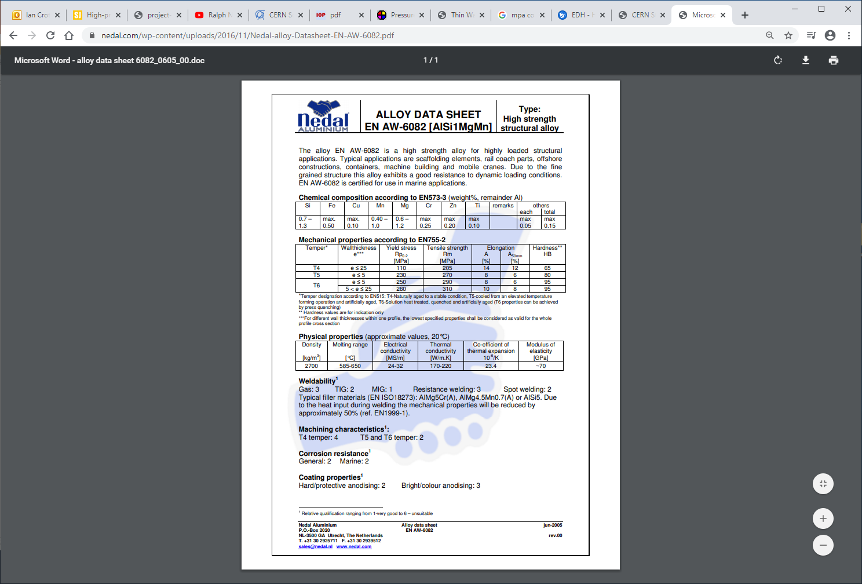
https://www.nedal.com/wp-content/uploads/2016/11/Nedal-alloy-Datasheet-EN-AW-6082.pdf

Slide 16
https://amesweb.info/StressStrainTransformations/PlaneStressPrincipalStressCal/PrincipalStressCalculator.aspx

Slide 17
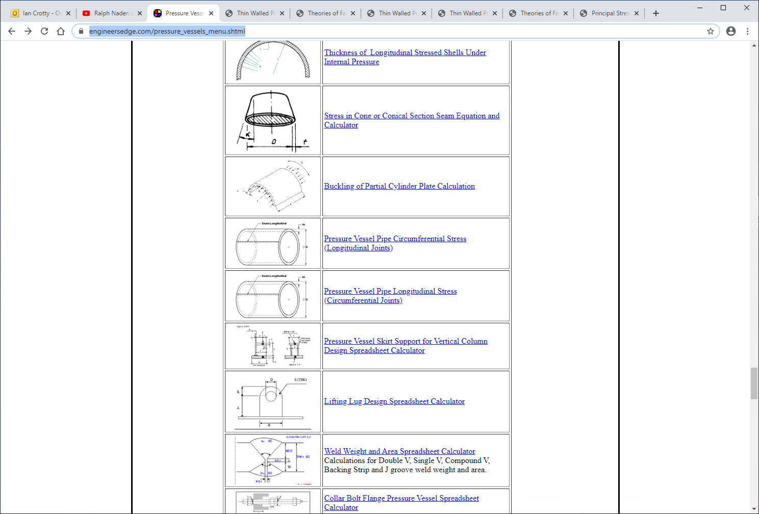
Very complete BUT in inches
https://www.engineersedge.com/pressure_vessels_menu.shtml

Slide 18
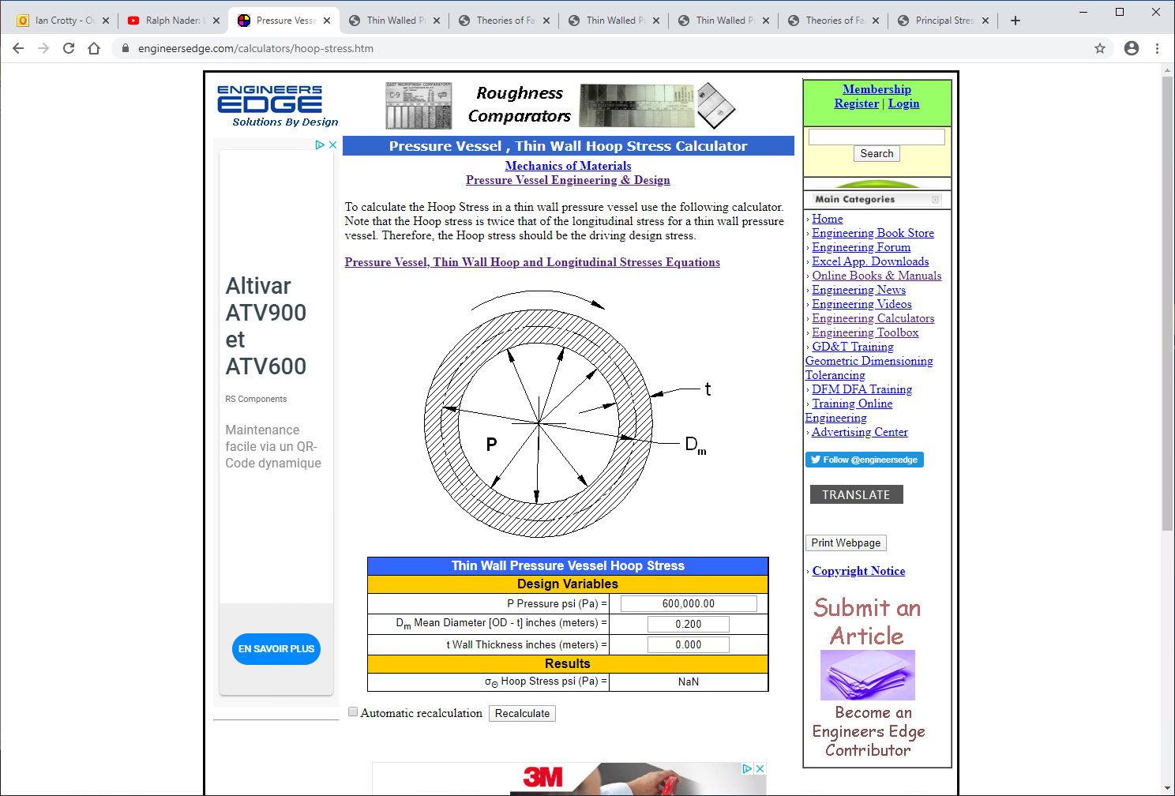
https://www.engineersedge.com/calculators/hoop-stress.htm

