Slide 1
Glass supply in Gex area
X2
Cessy
Gex

Slide 2
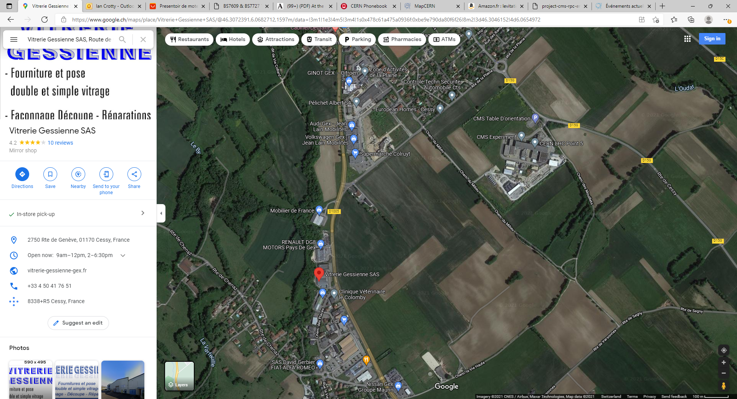

Slide 3
