Slide 1
HPL and gap packing.
OR is it worth the effort, time and money to protect your physics package, both before and after production ?
Ian
22 Feb 2022

Slide 2
Plenty of Rules and regulations !

Slide 3
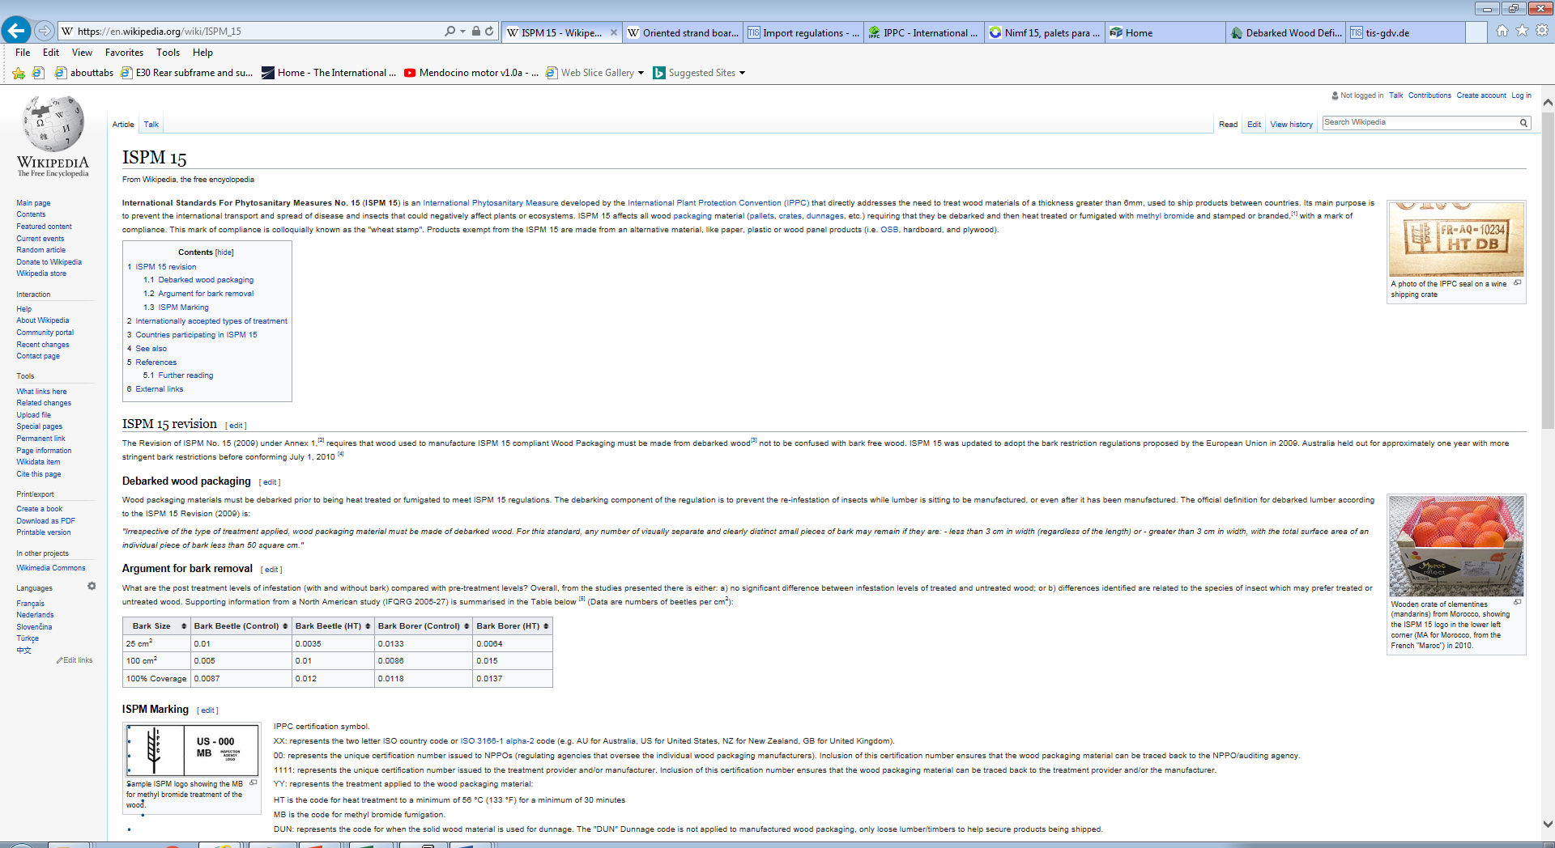
http://project-cms-rpc-endcap.web.cern.ch/rpc/Shipping/Shipping/Packaging/WoodPackaging.pptx
OSB
https://en.wikipedia.org/wiki/Oriented_strand_board

Slide 4
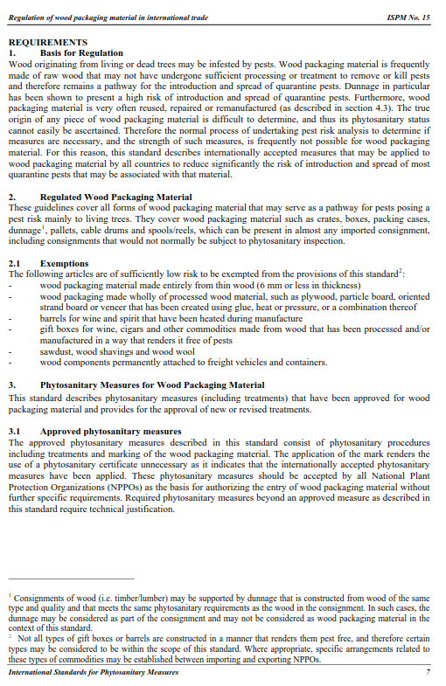
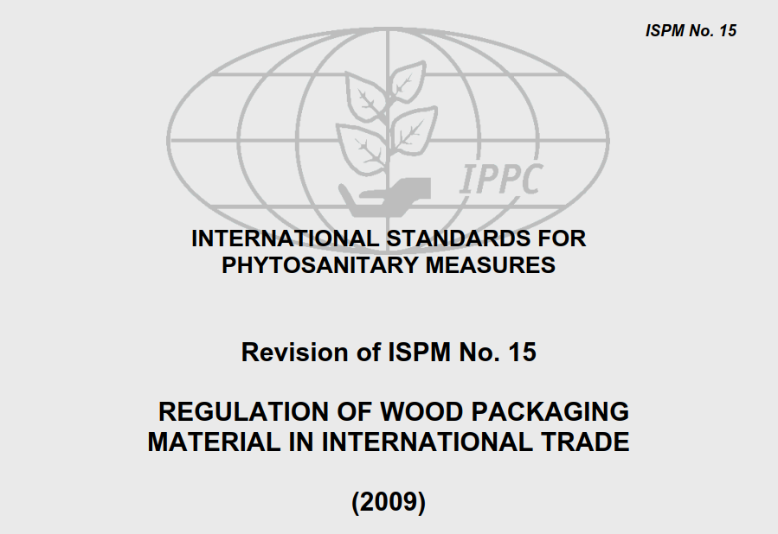
http://www.tis-gdv.de/tis_e/verpack/holz/export/ispm15.pdf
http://project-cms-rpc-endcap.web.cern.ch/rpc/Shipping/Shipping/Packaging/WoodPackaging.pptx

Slide 5
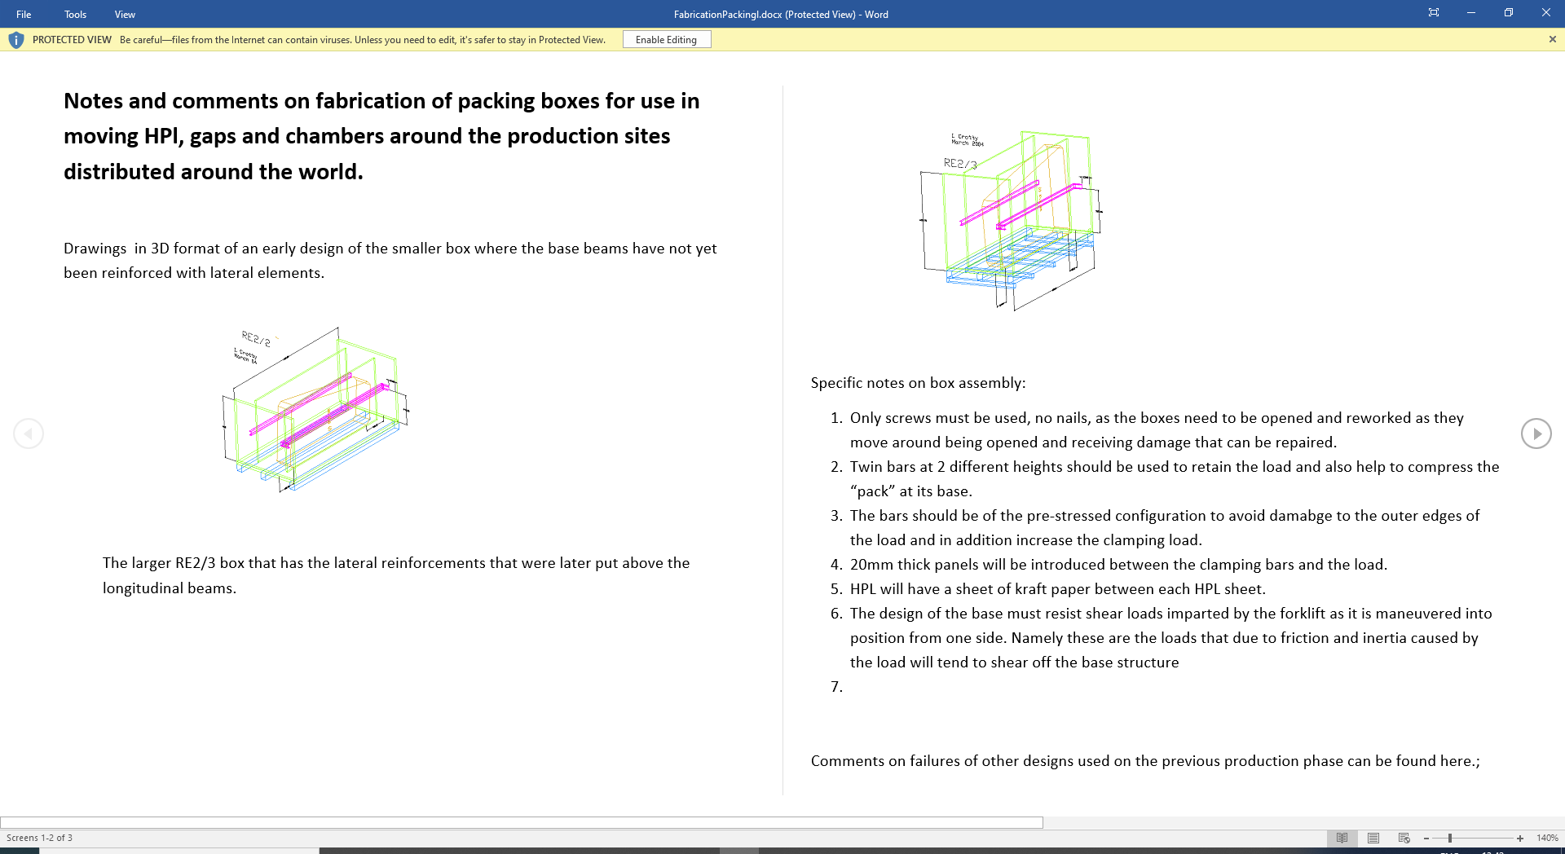
http://project-cms-rpc-endcap.web.cern.ch/rpc/Shipping/Shipping/Shipping/FabricationPackingl.docx

Slide 6
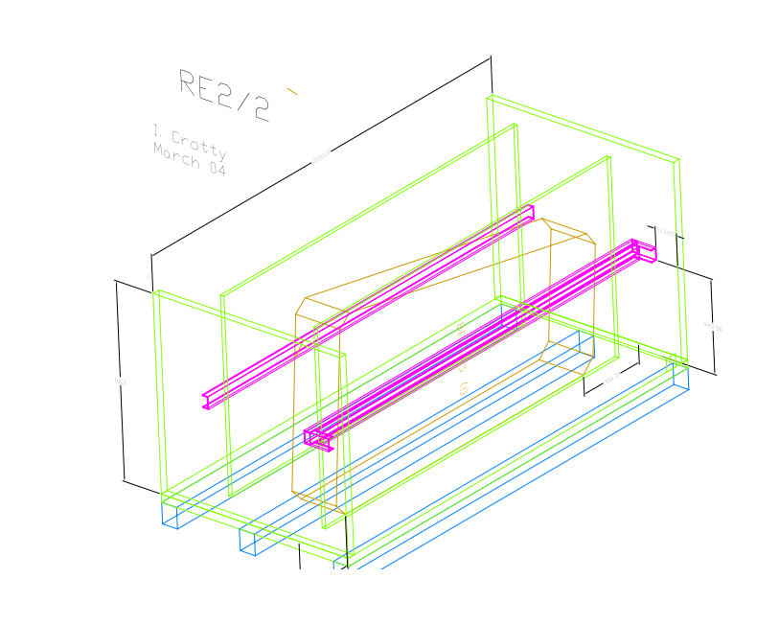
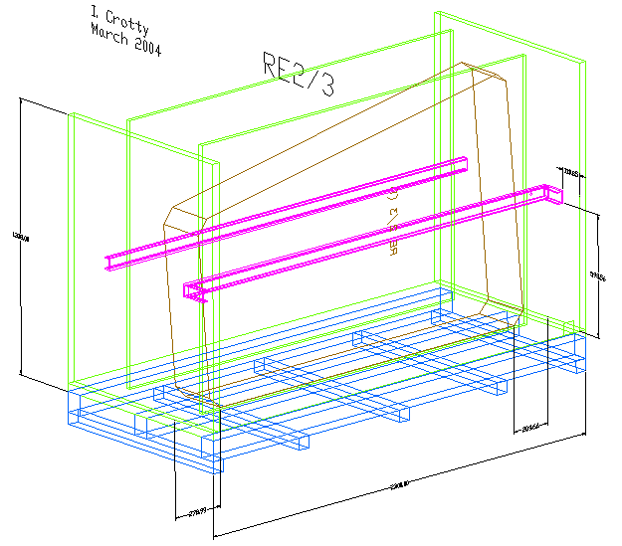
Early versions
Not yet with pre-stressed bars.
Can only be picked up from the ends.
http://project-cms-rpc-endcap.web.cern.ch/rpc/Production/Oil%20&%20Bakelite/Packing/Packaging/PackingRE22.pdf
http://project-cms-rpc-endcap.web.cern.ch/rpc/Production/Oil%20&%20Bakelite/Packing/Packaging/PackingRE23.pdf
Look here for drawing files (.dwg)
http://project-cms-rpc-endcap.web.cern.ch/rpc/Production/Oil%20&%20Bakelite/Packing/Packing/
http://project-cms-rpc-endcap.web.cern.ch/rpc/Production/Oil%20&%20Bakelite/Packing/Packing/Packing/

Slide 7
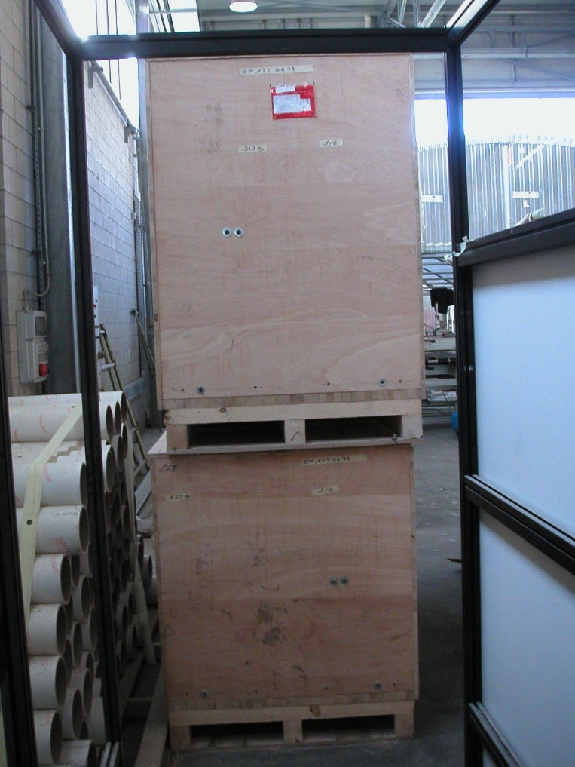
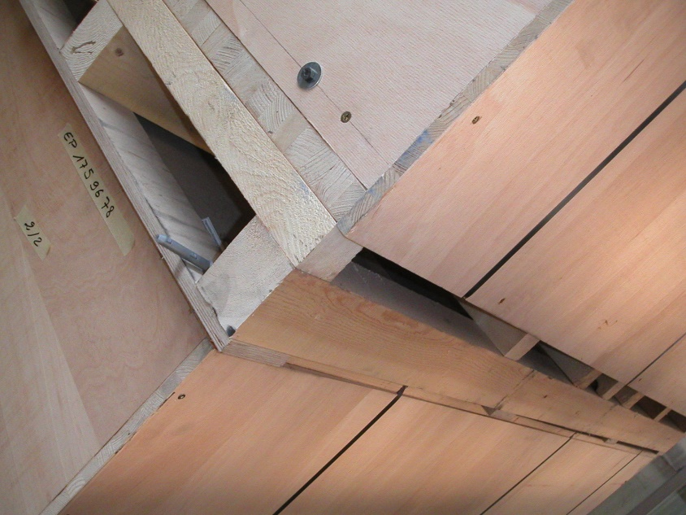
Shear plates from high quality plywood to resist the forces as the forks of the fork lift truck and the boxes are forced into alignment by the operator. GEM had the same problem.

Slide 8
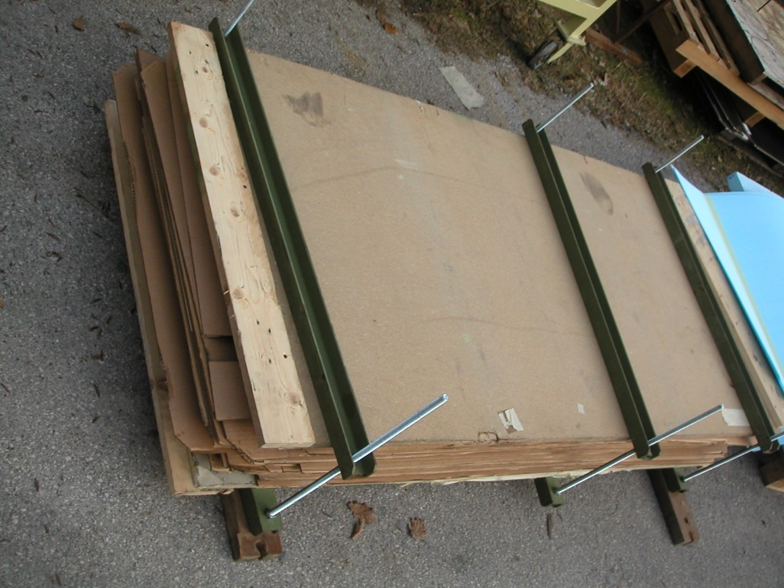
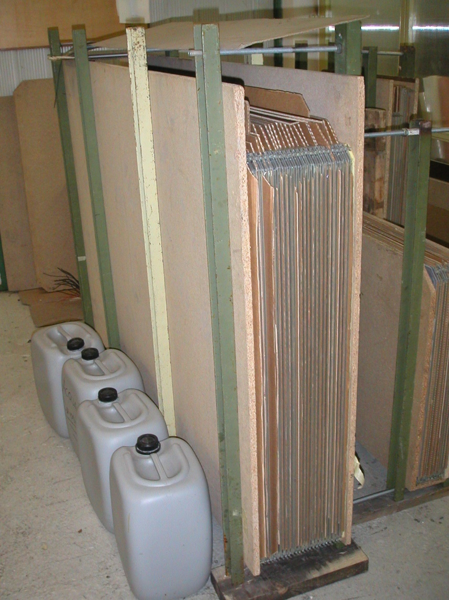
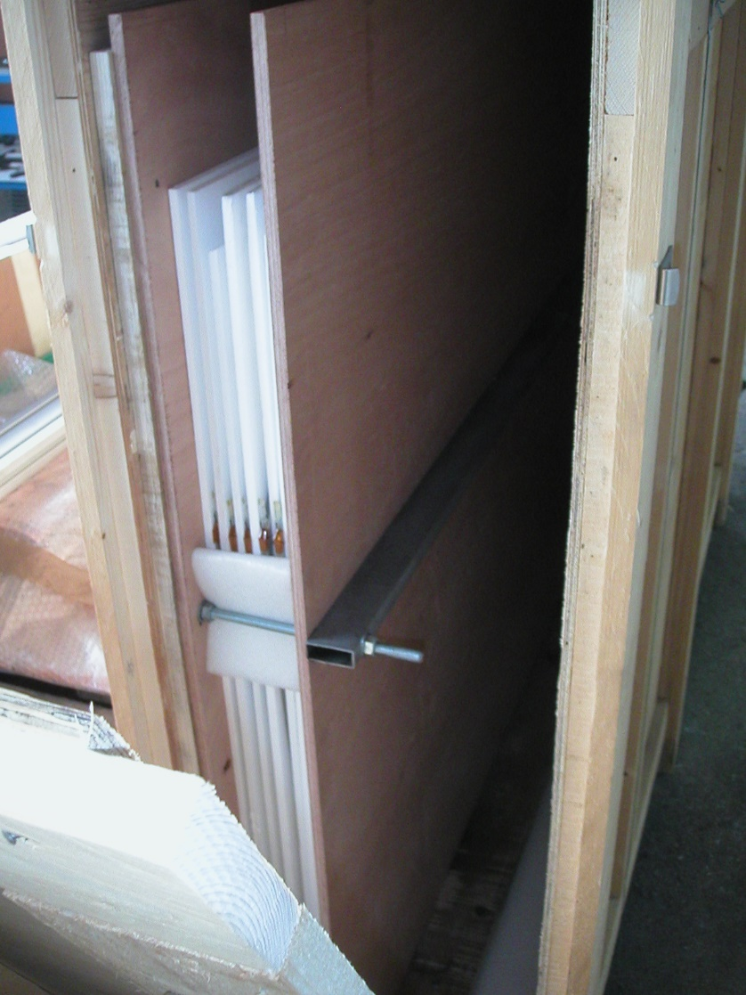
ATLAS and other experiments developed their own packing with clamping function.

Slide 9
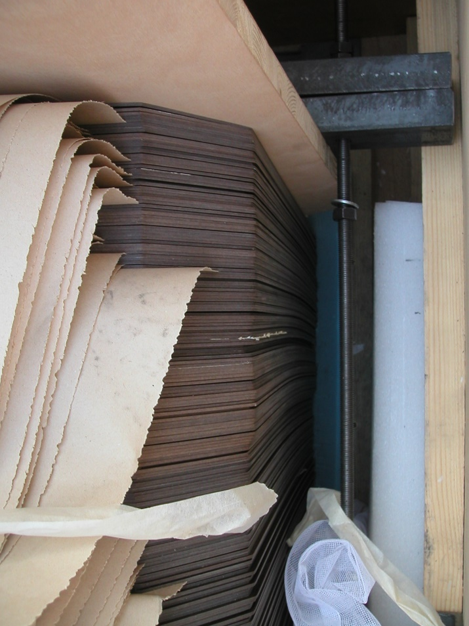
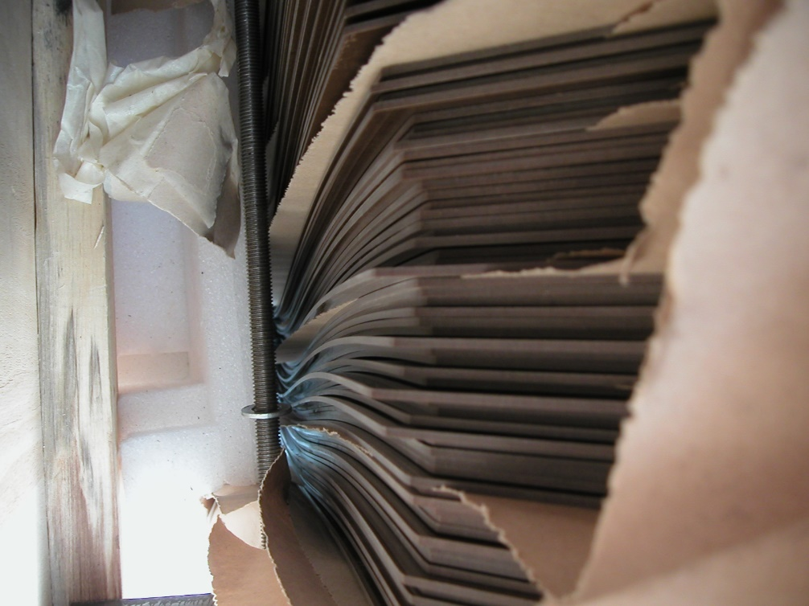
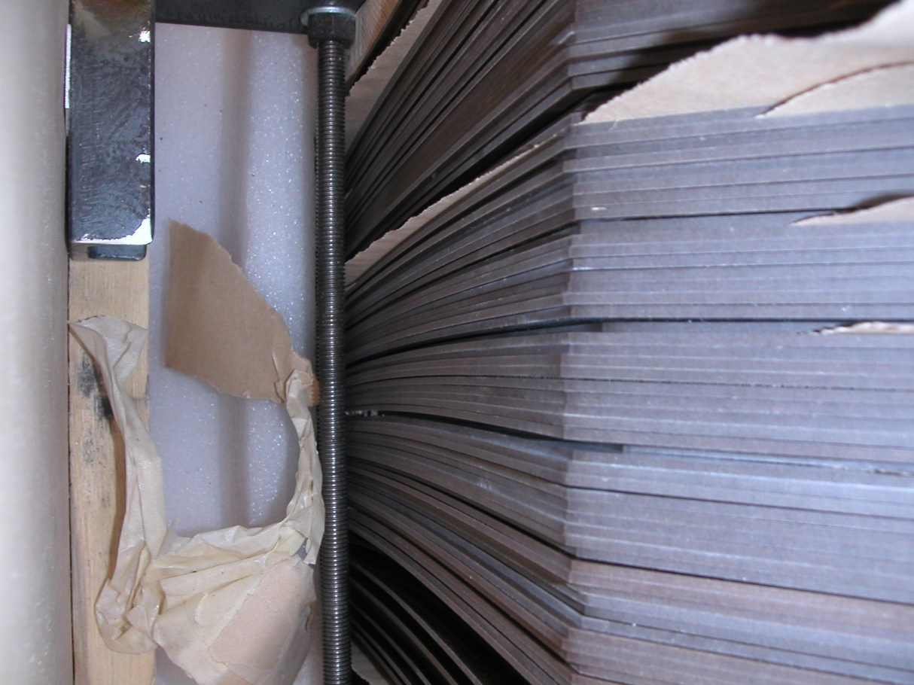
Clamping the HPL is necessary to stop or attenuate buckling under the self weight of the HPL. This will not help in producing flat gaps with minimal residual stress.

Slide 10
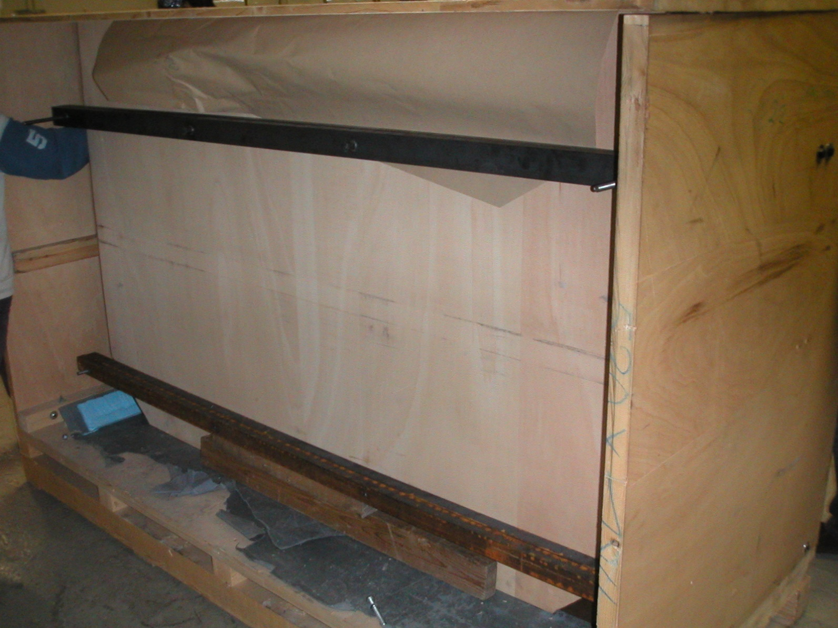
Final design used for RE with two pre-stressed bars. Pre-compression screws are visible here .
Twin bars at each level in front and behind the HPL pack protected with wood panel.

Slide 11
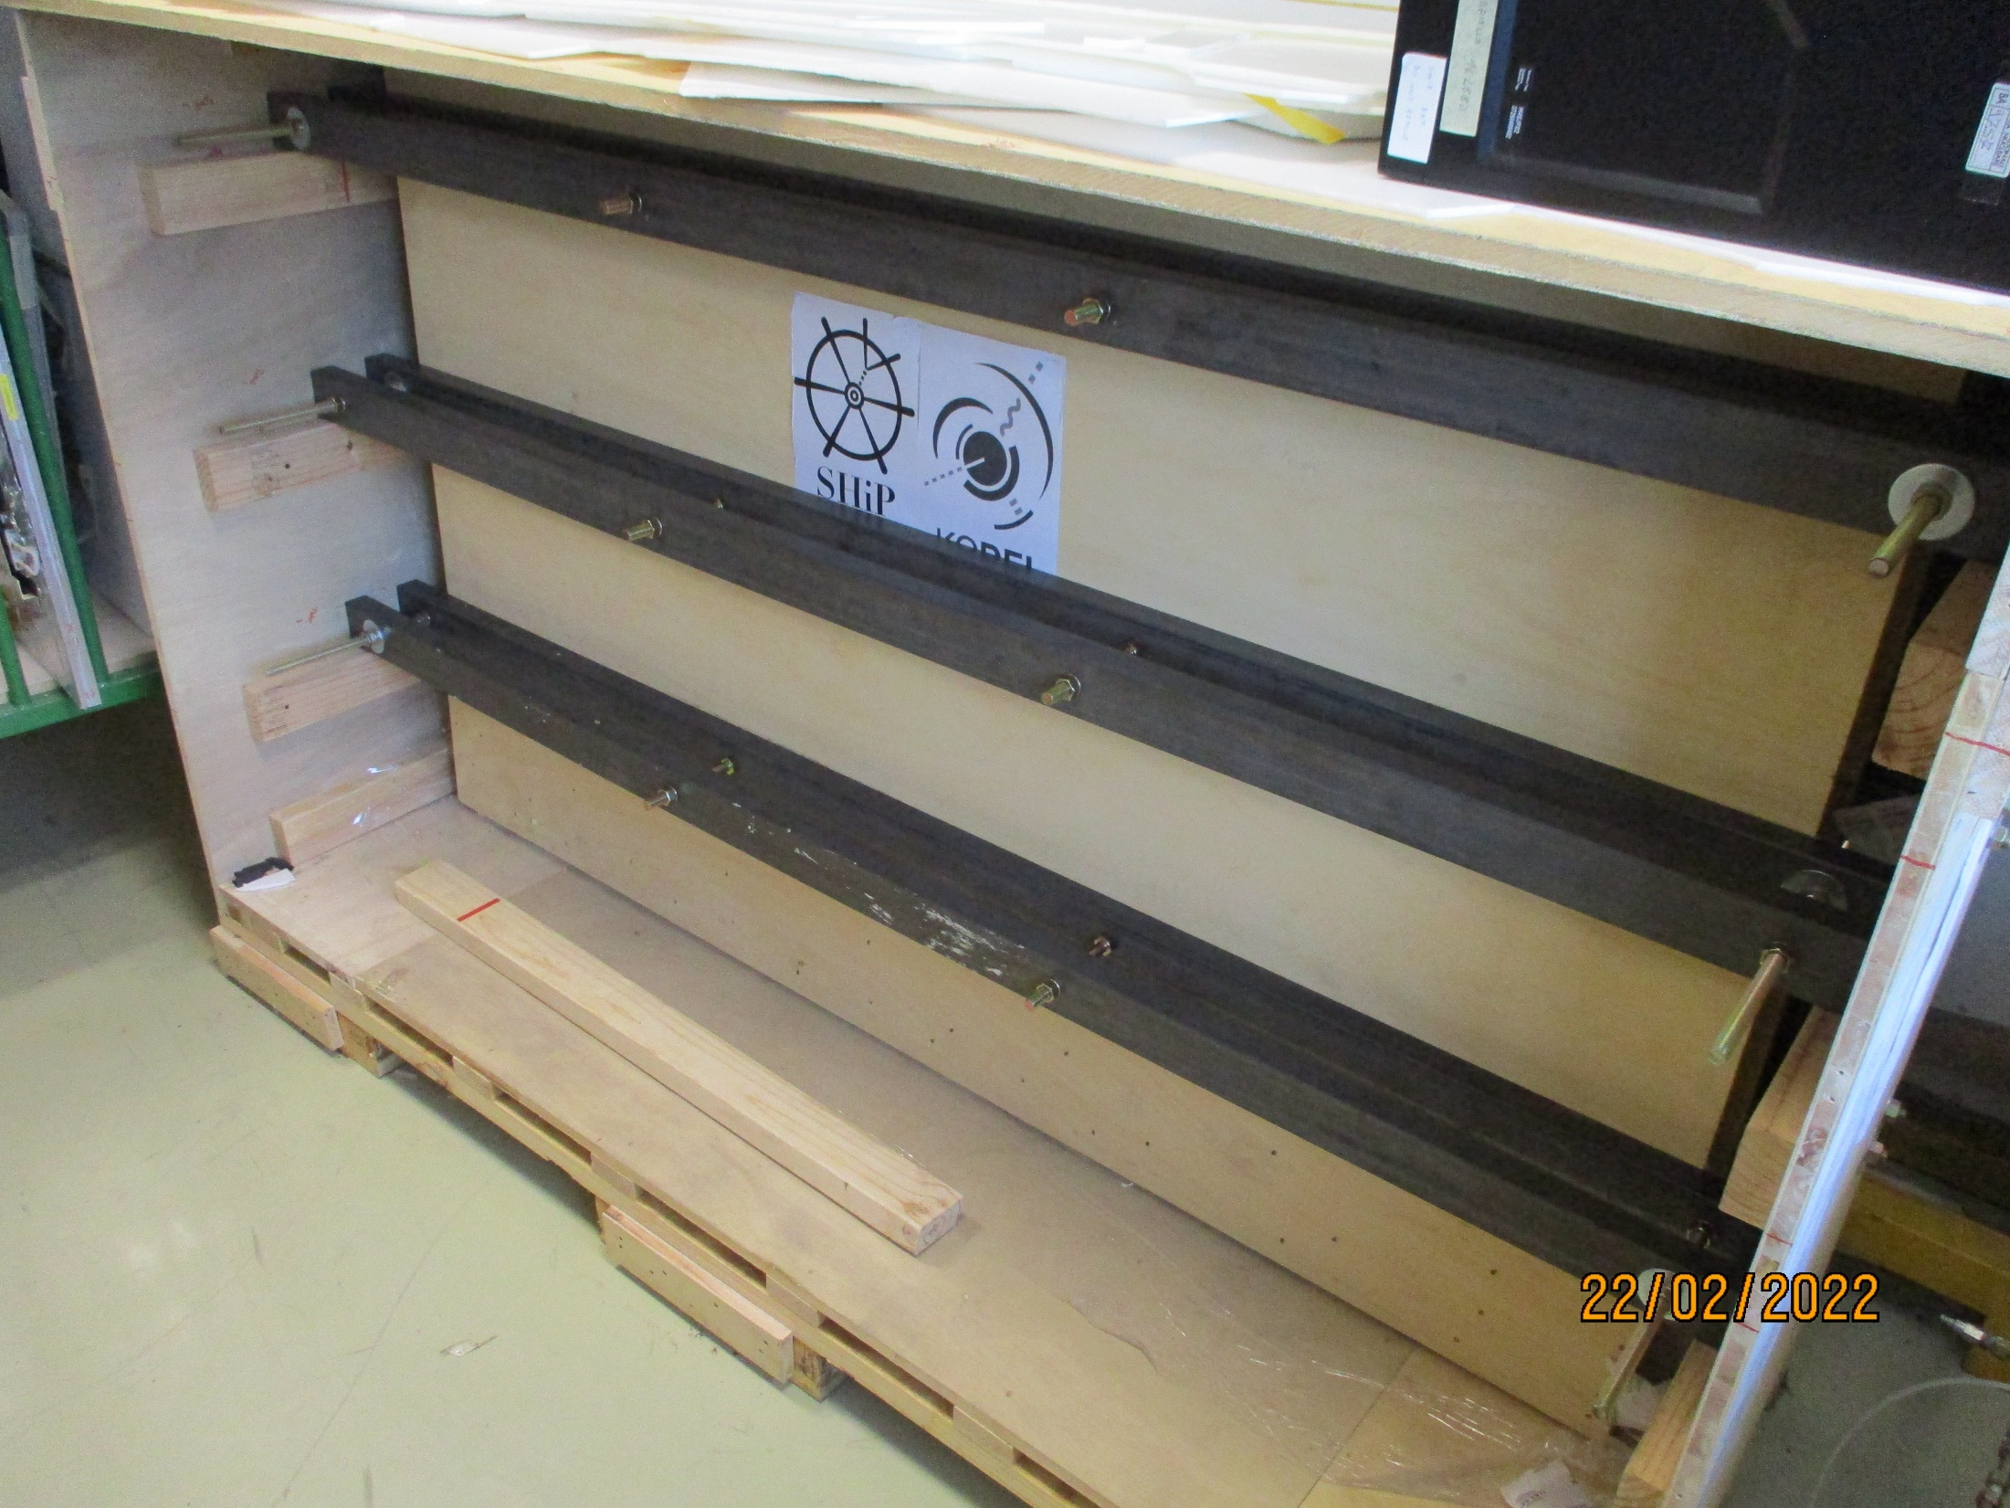
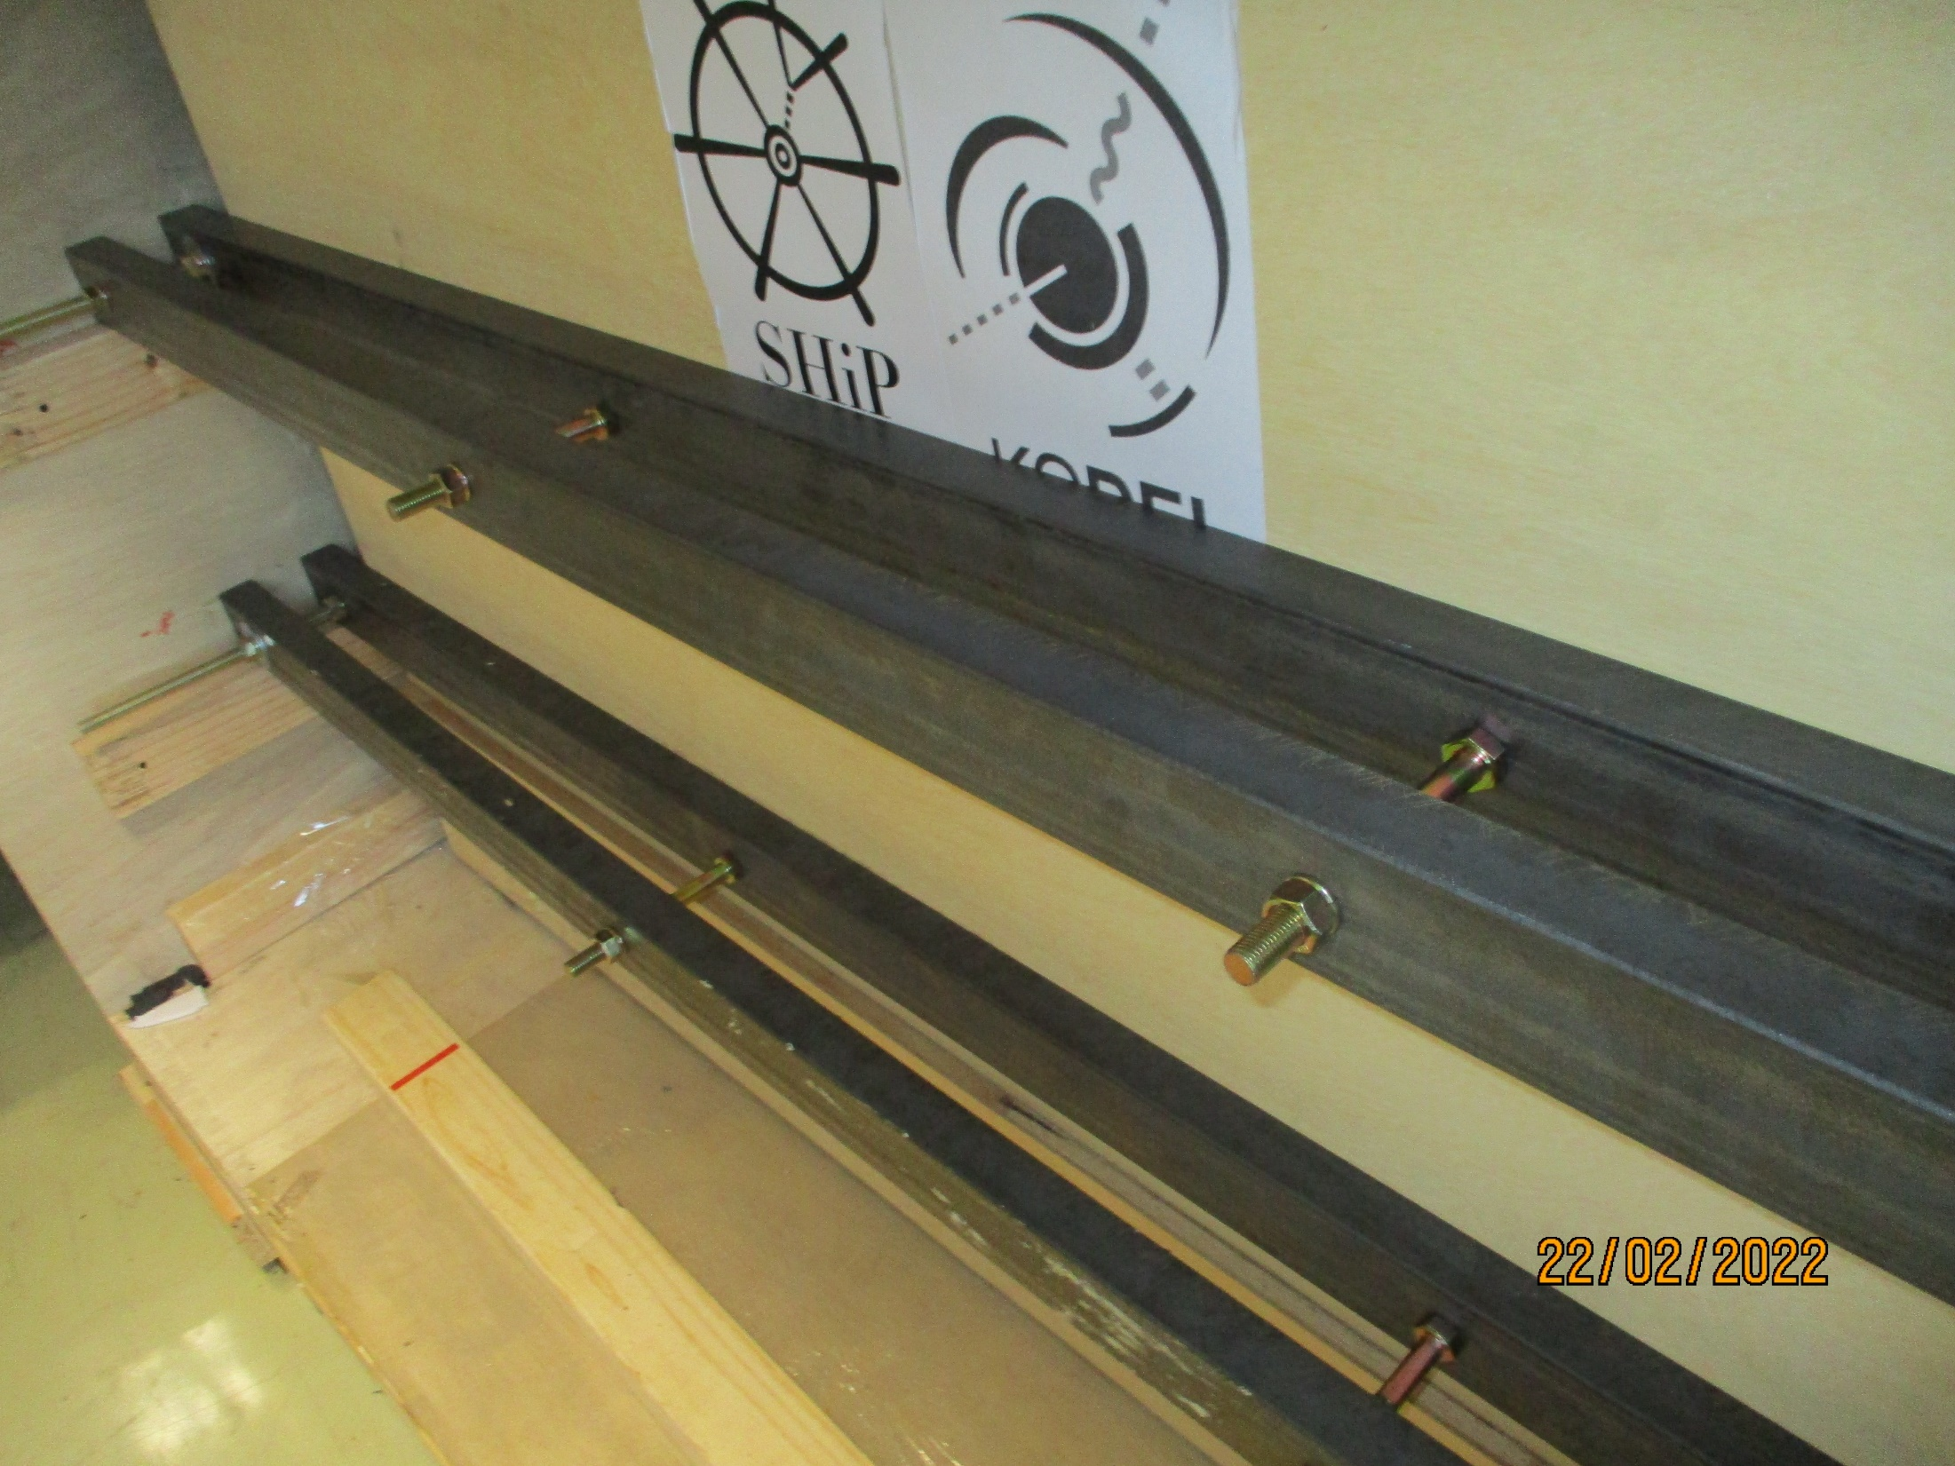
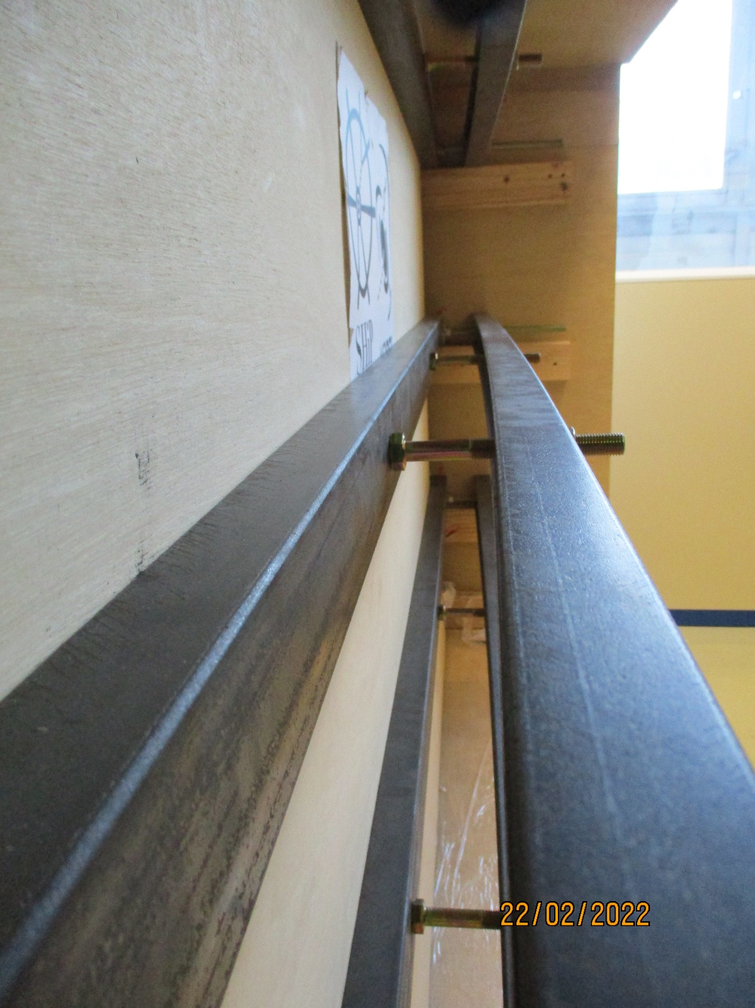
Final version as developed by SHIP
Tie rods M16
Pre-compression bar is bent under the load
From the 2 screws in compression and the tie rods (M16) on the end of the bars. The compression screws are keeping an “evenly” distributed load on the HLP pack through the clamping bars.
Compression screws M16
Pre-compression bars

Slide 12
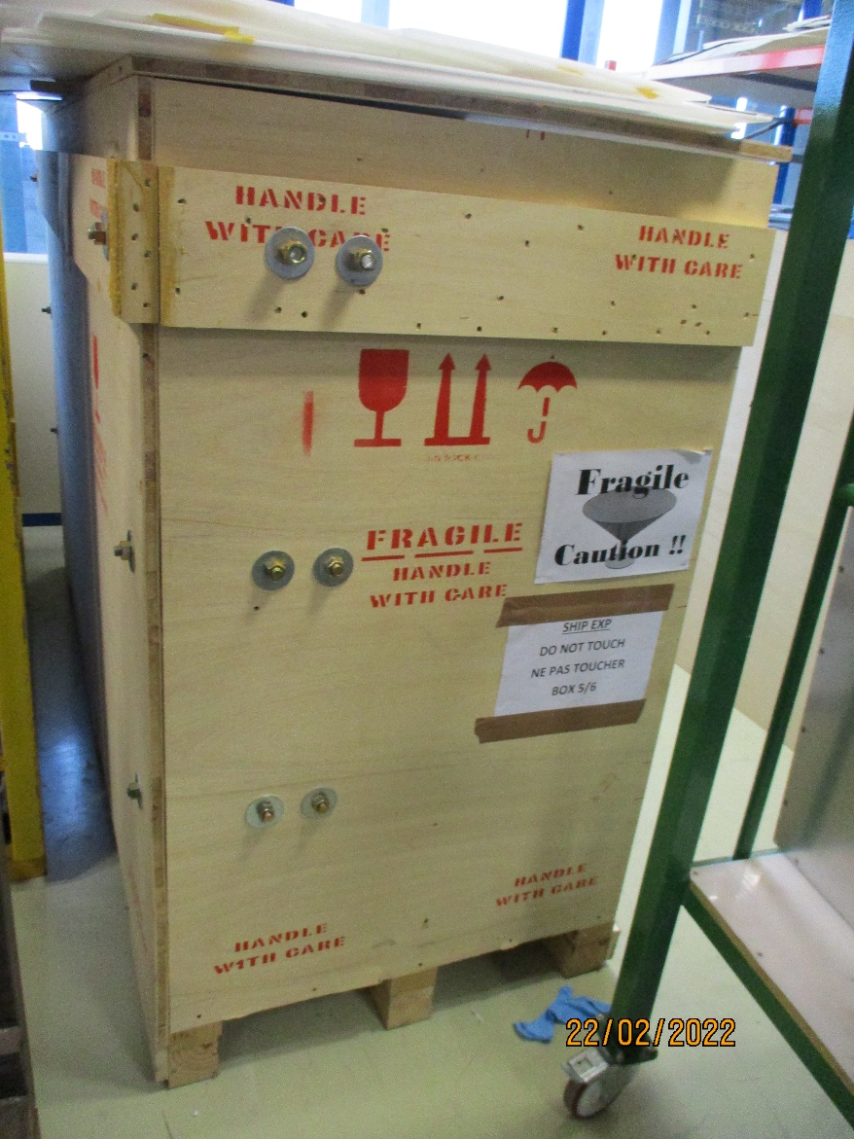
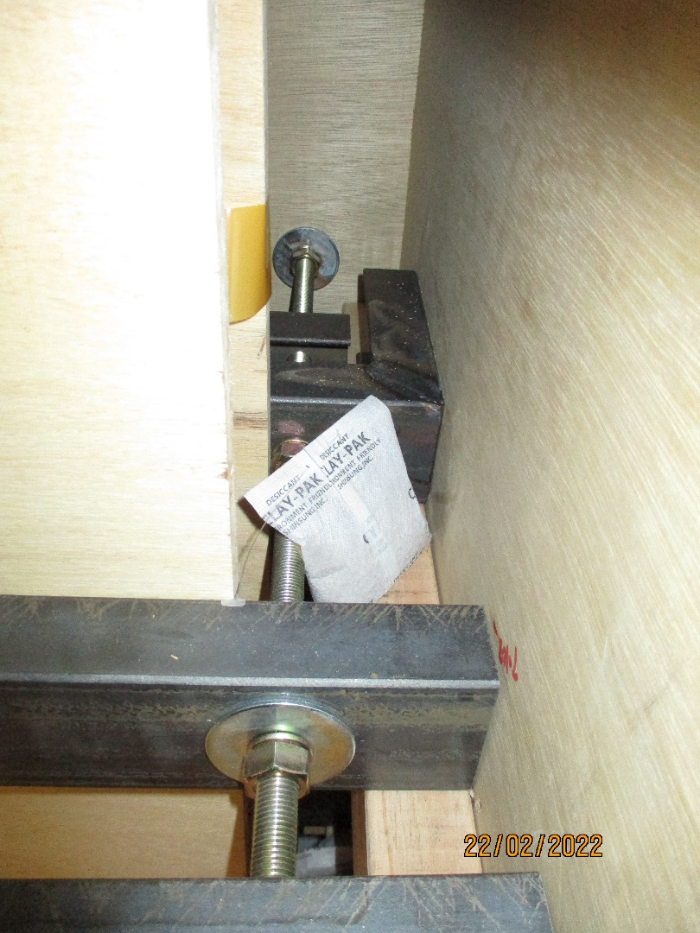
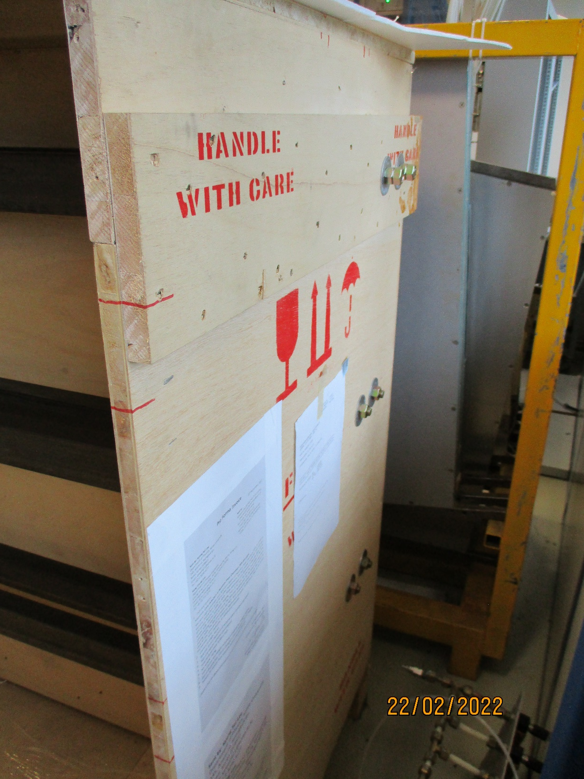
Clamping bar link to Base
Rear clamping bar well secured to the side panel
With M16 srcews
Side and rear panel are not very well secured to base. 4mm wood screws
Tie rod M16

Slide 13
The principle of securing the HPL to the base
Side view
Top view
Rear panel
Side panels
M16 threaded bar
HPL pack
HPL pack
The rear panel and side panels must be well secured to the base to take the shear loads from the horizontal inertial forces from the HPL pack

Slide 14
Clamping principle
These threaded bars , in tension, maintain the clamping bars up against the HPL pack
M16 threaded bar in tension
The principle of clamping the HPL pack so the force is distributed along the length of the pack and not just at the ends.
If only the M16 bars in tension are used then the clamping will bend the clamping bars and squeeze the HPL pack at the outer edges only
Clamping bars
Pre-load bars
M16 threaded bar
Intension
These screws, in compression up against the clamping bars , force them to be parallel up against the HPL pack

Slide 15
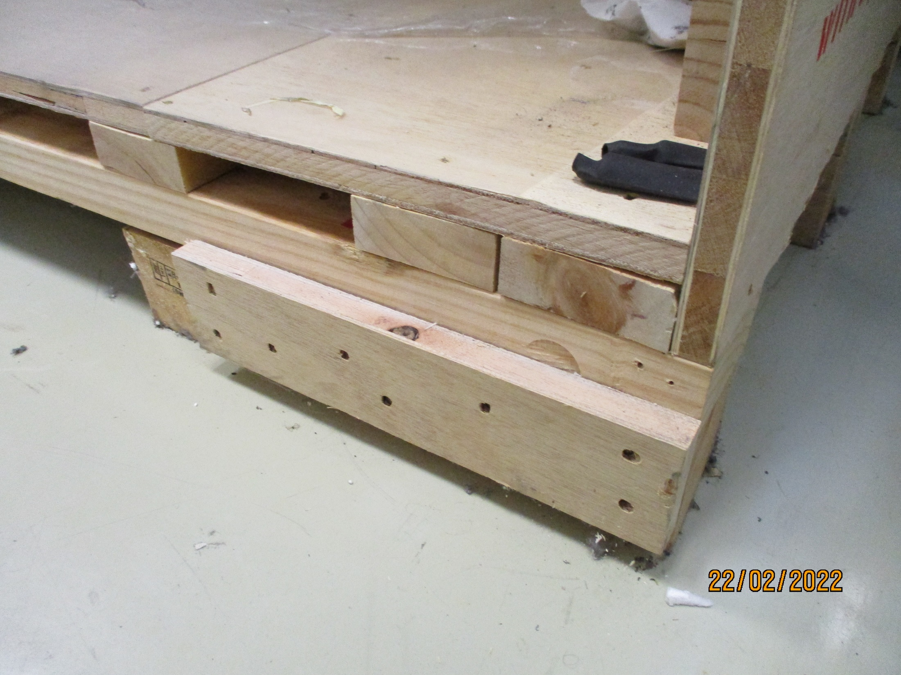
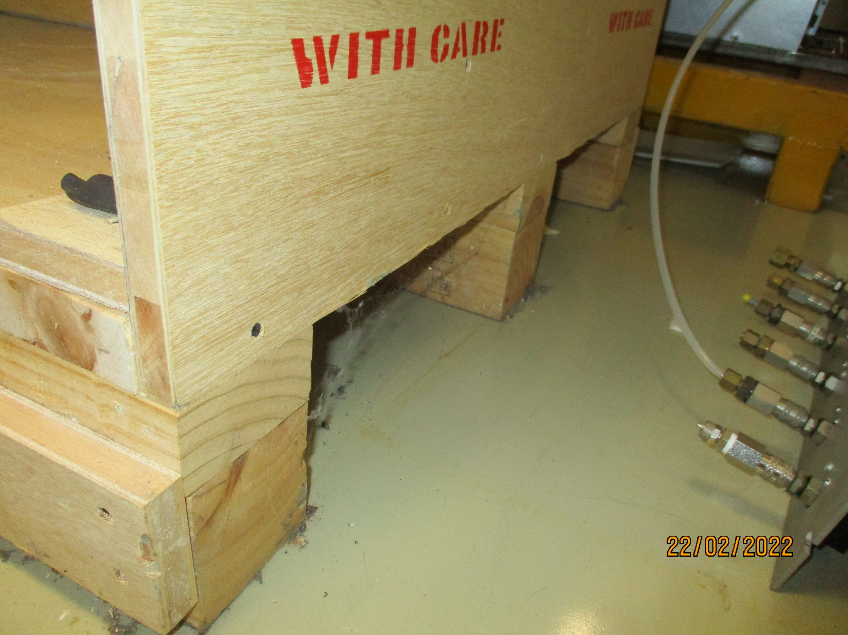
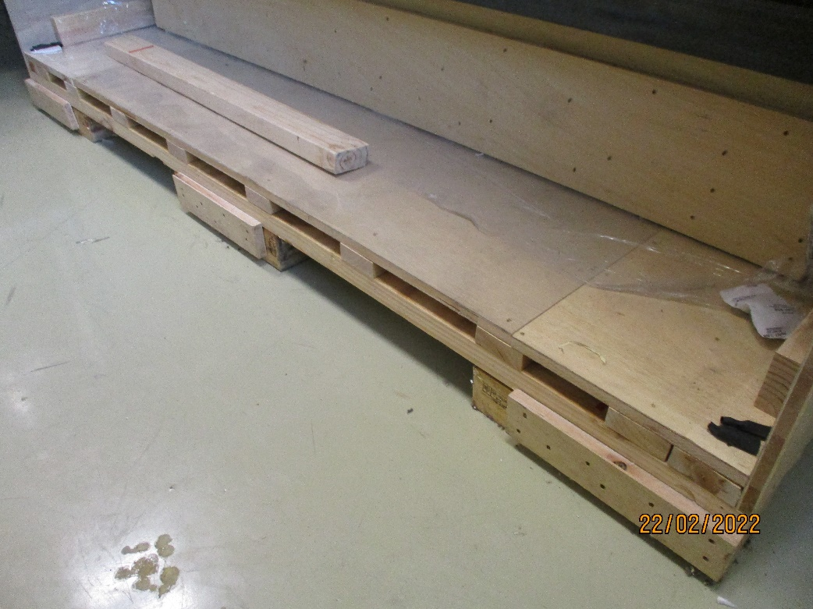
Double floor to protect the HPL from damage during lifting.
Access for lifting forks from both the ends and the sides.
Sufficient height for the transpalette

Slide 16
Put plenty of information of the sender and receiver on the packing.
Warning signs should be used, if rarely read !
All wood must be approved in front of the Phytosanitary regulations.

Slide 17
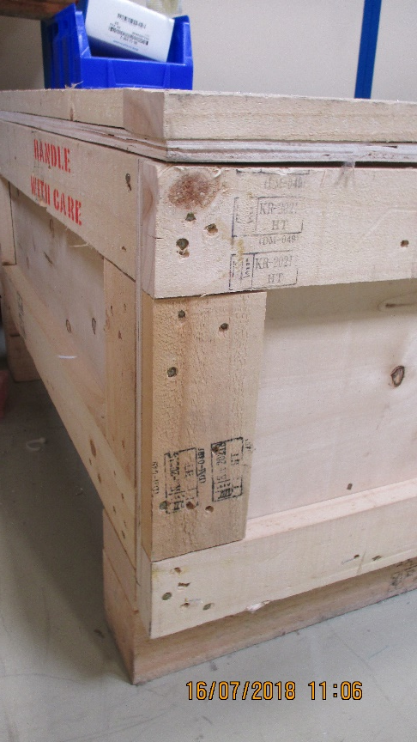
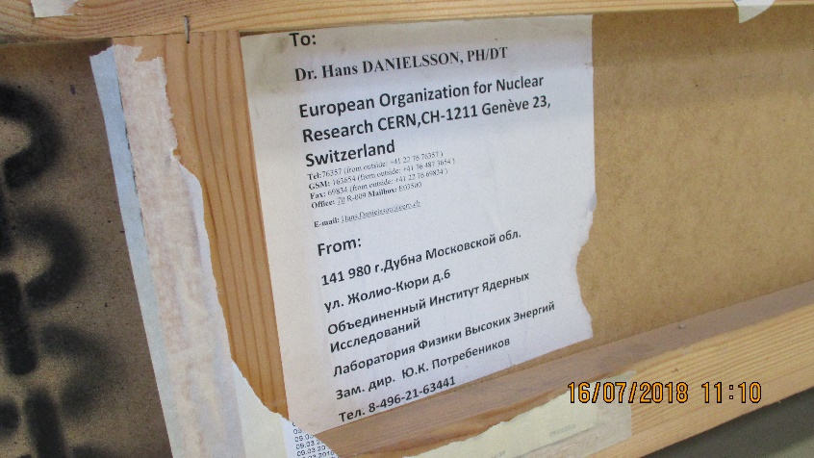
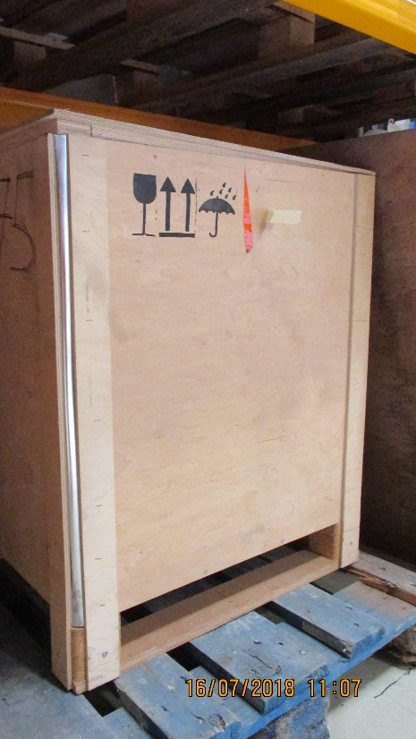
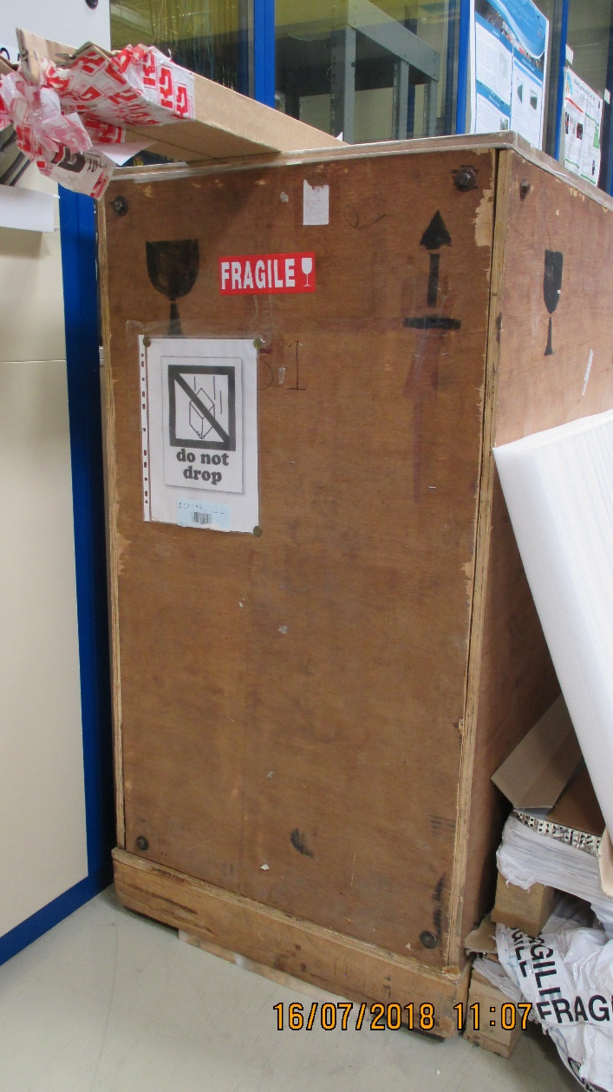
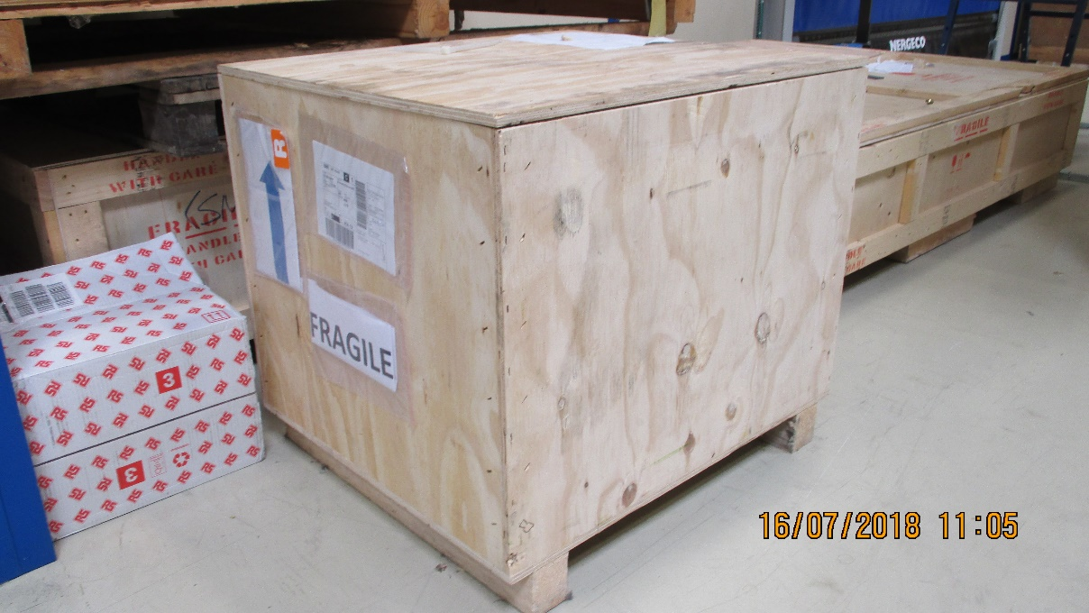
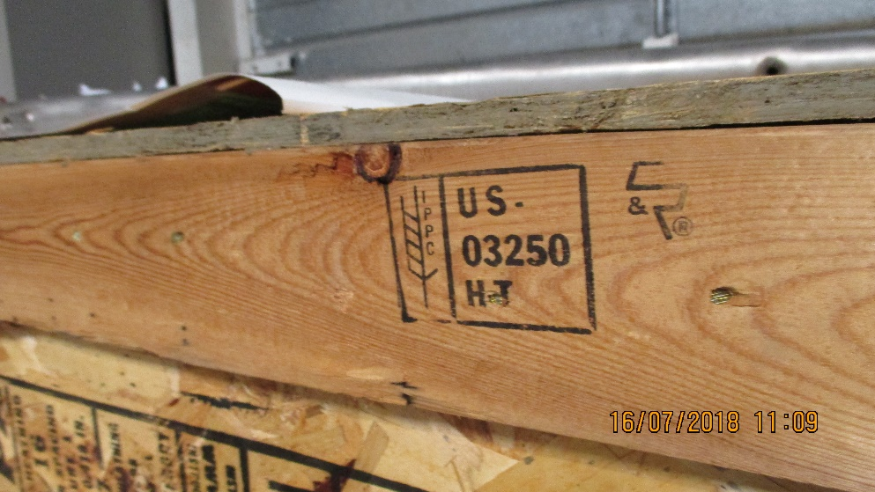

Slide 18

Environmental conditions are rarely what you expect.
Protect your material even inside the box
High humidity while landing in Rome in the morning

Slide 19
Accidents and high “g” loads.
Apparently well packed materials are less well protected than you expected !
Fork lift trucks can do terrible damage. Keep you product away from the box sides, > 10cm.

Slide 20
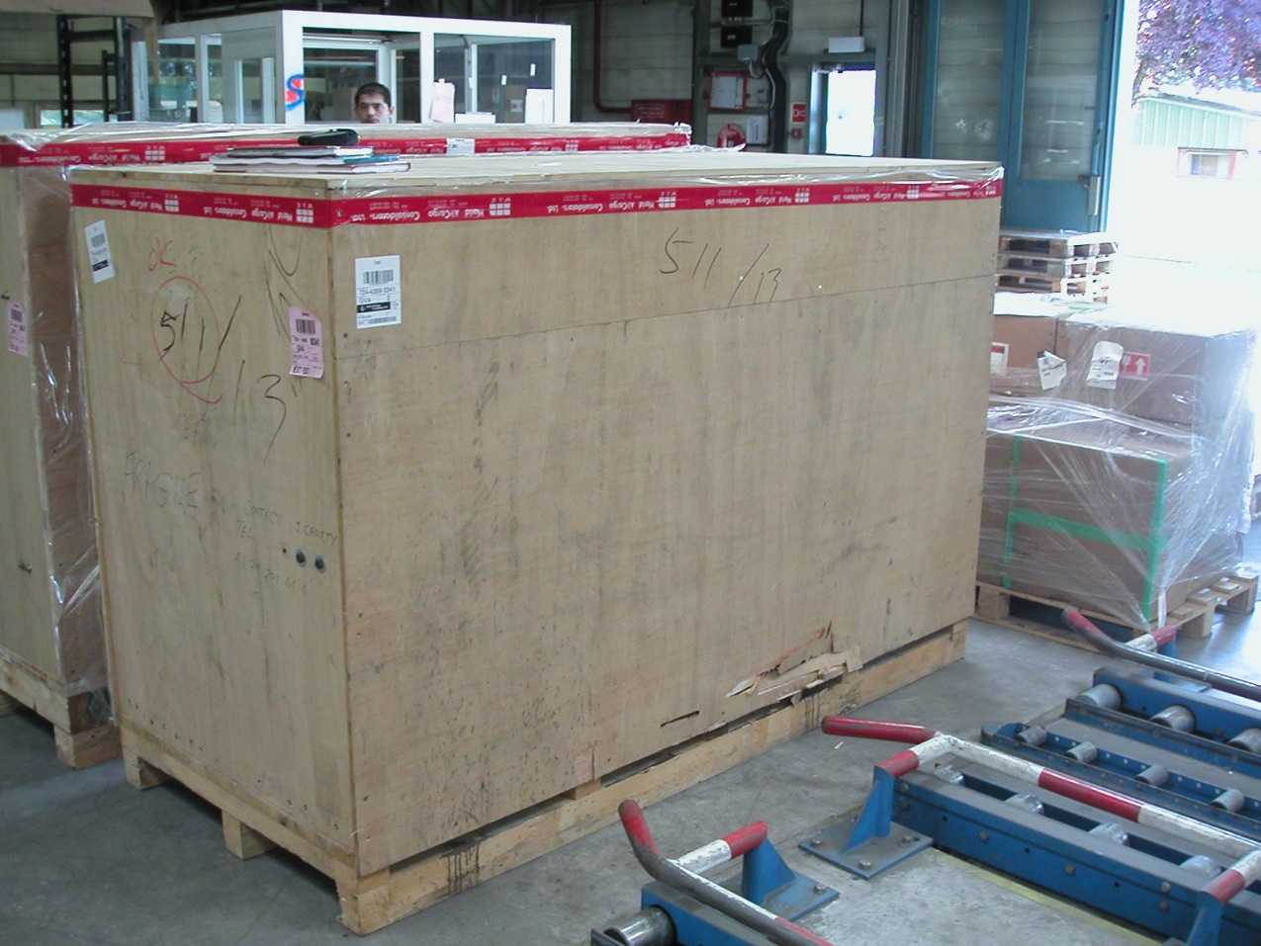
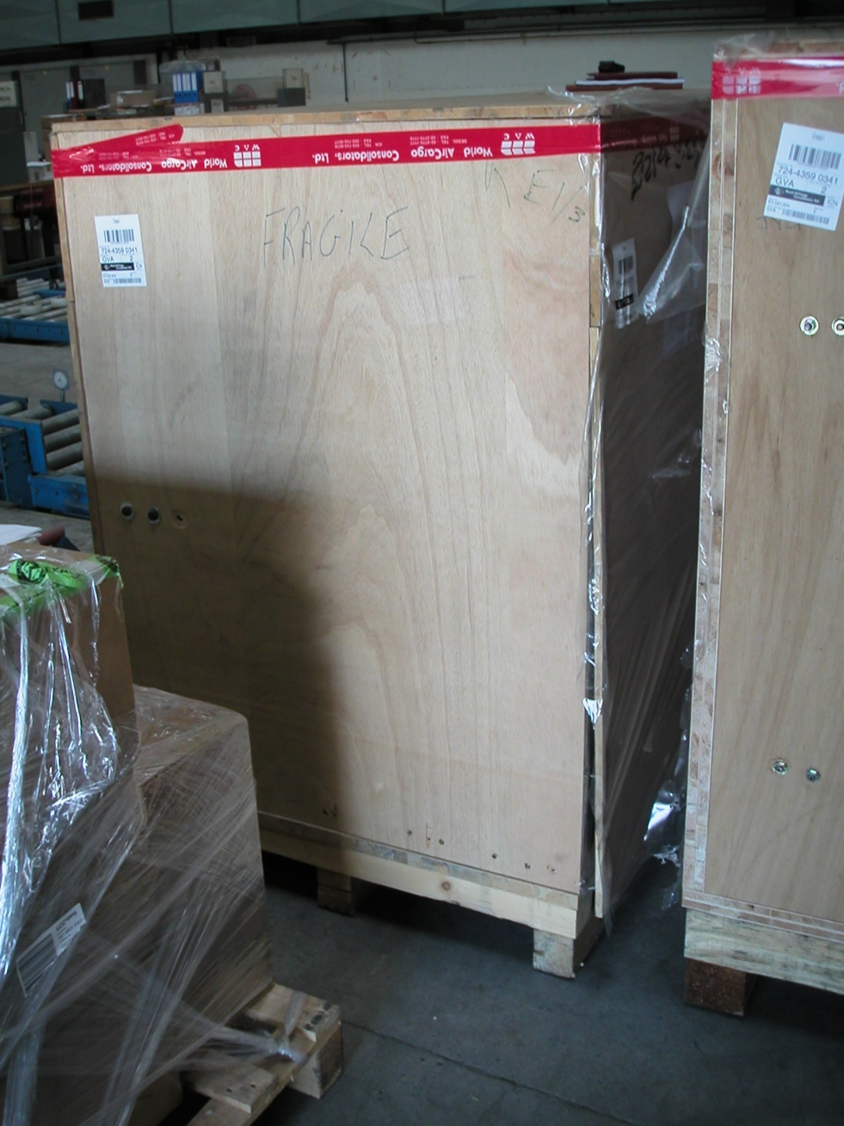
Perforation of the perimeter by the forks and careless operator
Poor design as the forks would rub on te side panel and pull it off !!

Slide 21
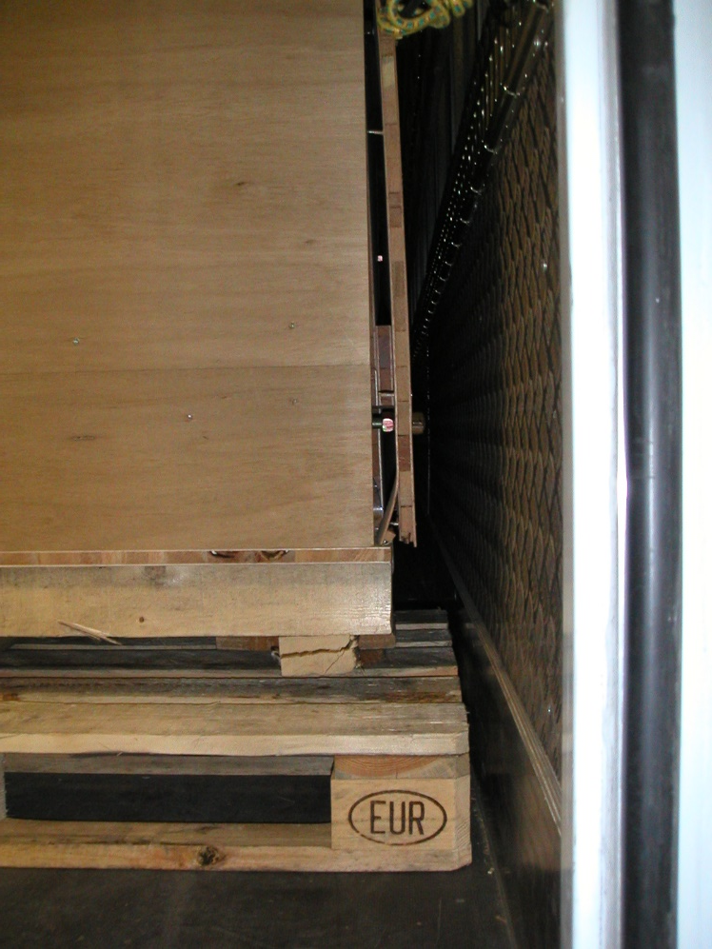
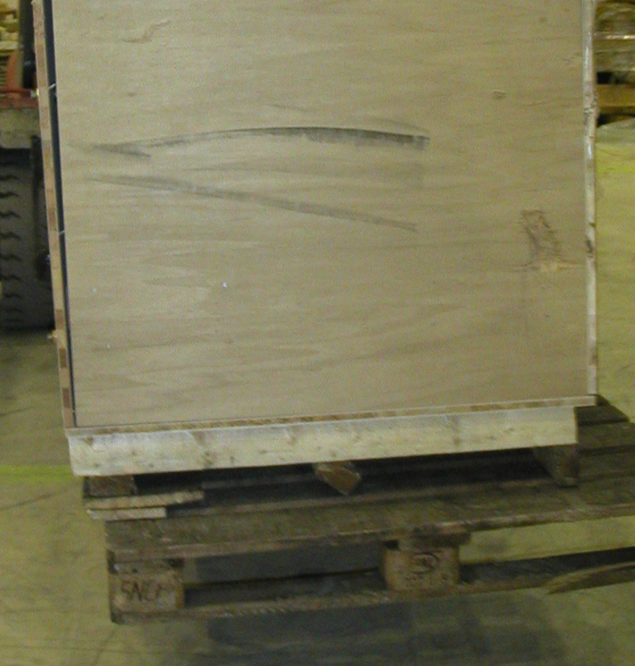

Load shifting in the box as not secured to the base . 600kg of HPL can readily produce 10tons force on the packing. Small screws are NOT sufficient.
Load shifted , destroying base and opening the box.

Slide 22
References used above
http://project-cms-rpc-endcap.web.cern.ch/rpc/Production/Oil%20&%20Bakelite/Packing/Packaging/
http://project-cms-rpc-endcap.web.cern.ch/rpc/Shipping/Shipping/Shipping/FabricationPackingl.docx
http://project-cms-rpc-endcap.web.cern.ch/rpc/Shipping/Shipping/Packaging/WoodPackaging.pptx
Crippling
https://engineeringlibrary.org/reference/column-crippling-air-force-stress-manual

Slide 23
Conclusion
Do a far better job than you think is sufficient,
it will pay in the end.

