Slide 1
Conductive layer
Ian March 2018

Slide 2

https://www.nanowerk.com/nanocatalog/Binary_compound_nanoparticles/StanoStat_CPM10C/details/2823

Slide 3


Slide 4
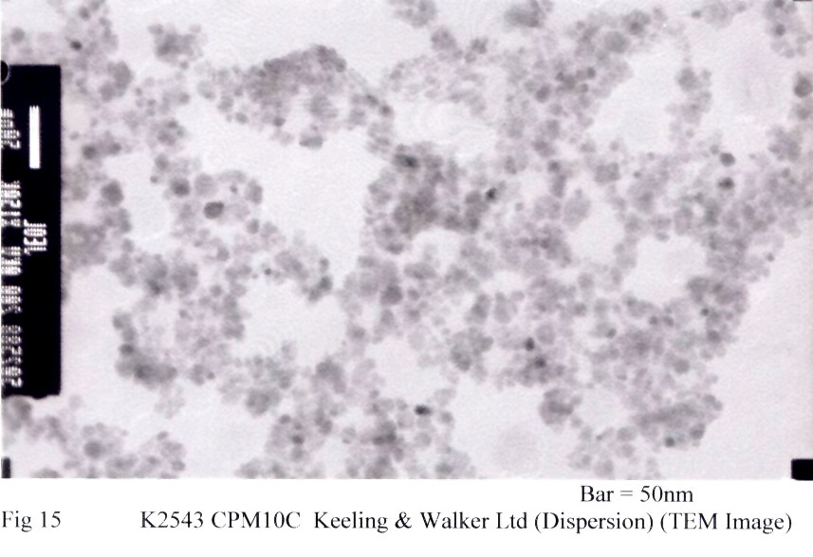

Slide 5
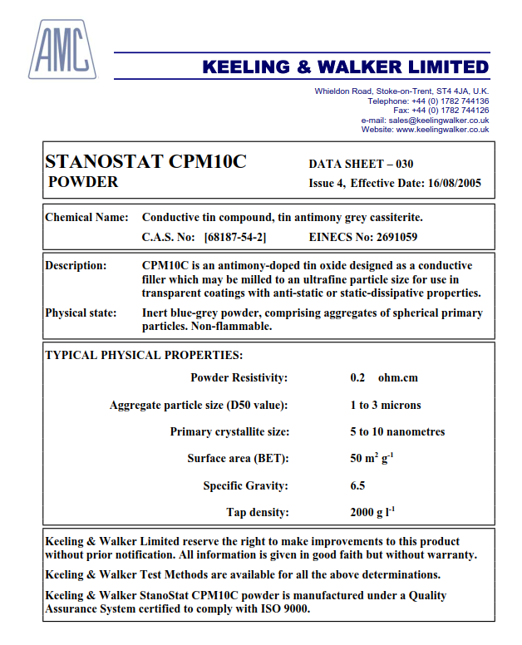
Stanostat CPM10C Colloidal suspension
http://eyoung.bizsac.co.kr/product_sb/CPM10C%20Powder.pdf

Slide 6
Crispin Williams uses this product on glass with a roller and isopropylic alcohol

Slide 7
Graphite
Aquadag E
Graphite 33

Slide 8
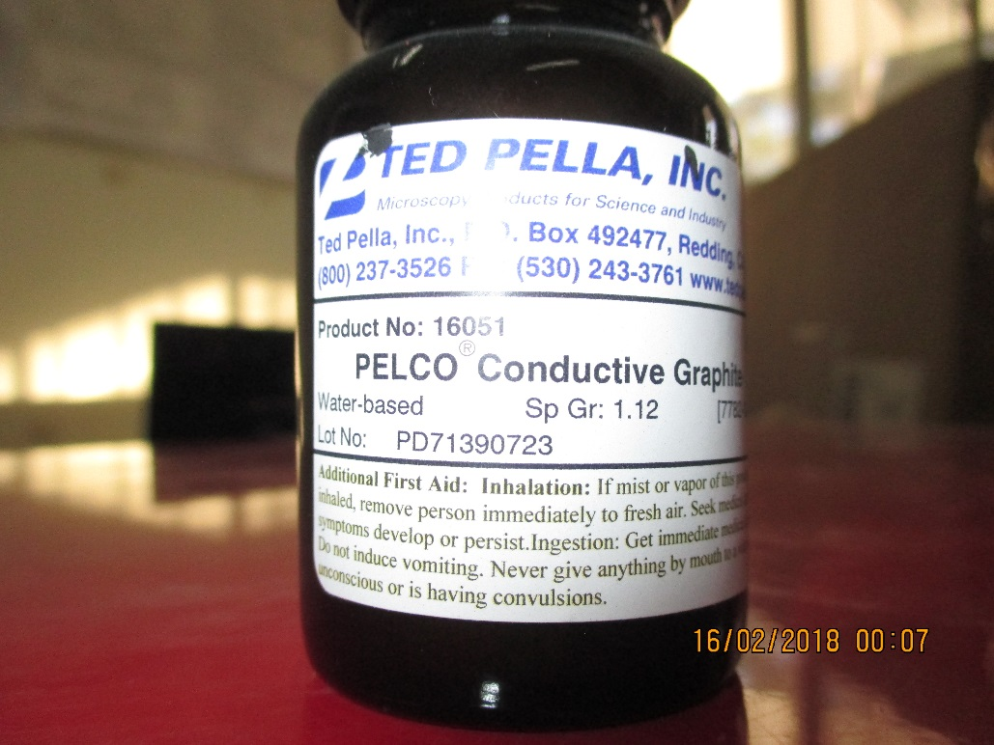
Paint in Mexico ALICE Lab
NotesMadeConductivePaintMunoz.pptx
http://rpc-cms-re4-upscope.web.cern.ch/rpc-cms-re4-upscope/RPC/Chamber%20Institutes/Mexico/Puebla/ALICE/NotesMadeConductivePaintMunoz.pptx

Slide 9
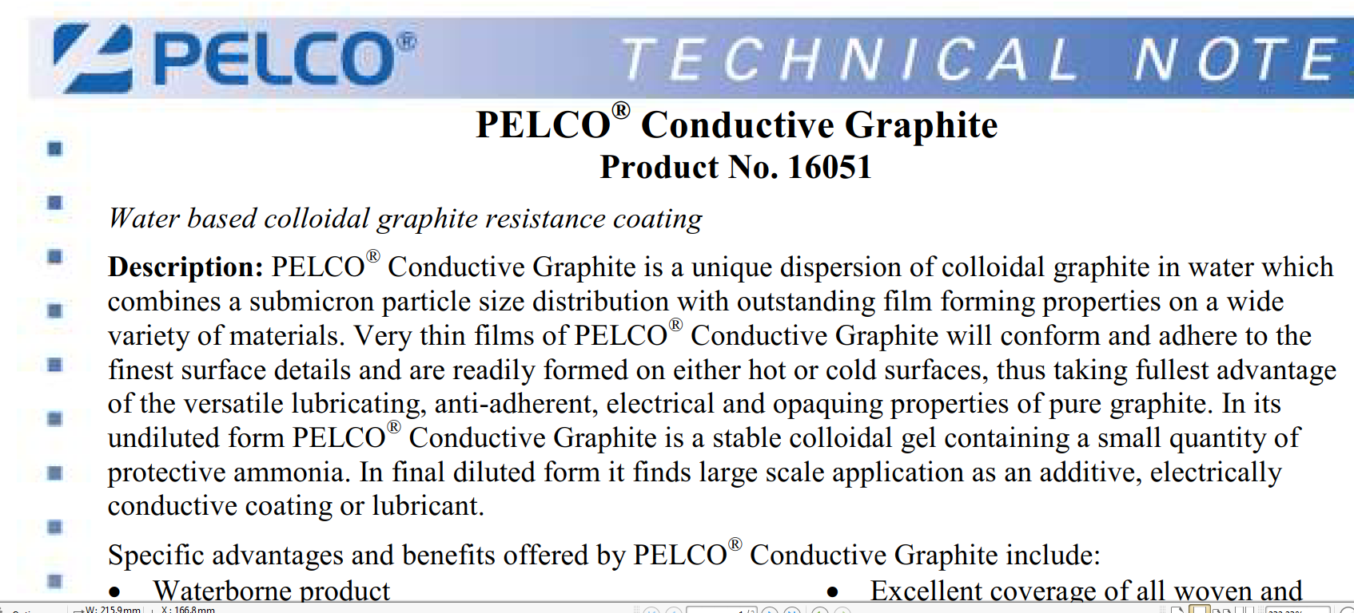
CONDUCTIVE GRAPHITE SHIELD SHIELDING PAINT - REDUCES GUITAR HUM & BUZZ
NEW MAJIC 8-200247-8 11 OZ SPRAY NON STICK GRAPHITE MATTE BLACK PAINT 8222119
https://www.tedpella.com/technote_html/16051TN.pdf

Slide 10
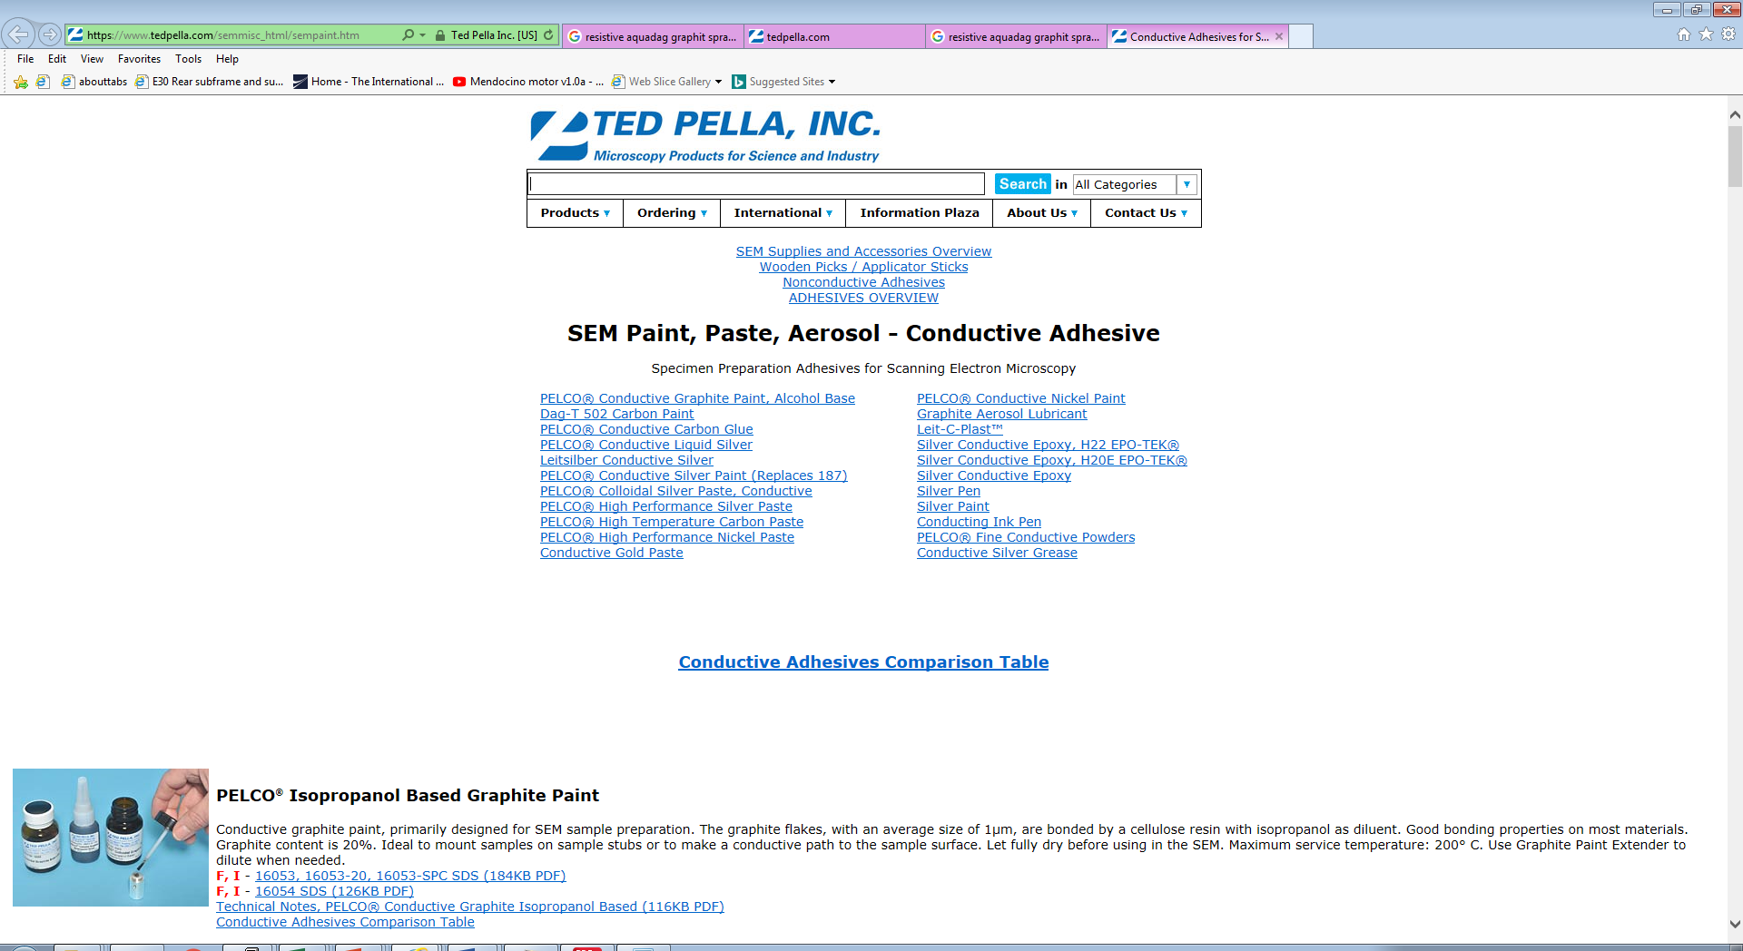

Slide 11
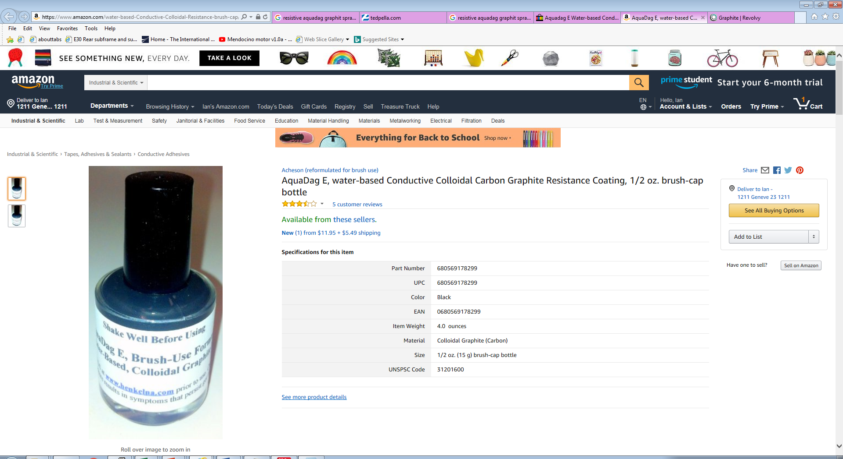

Slide 12
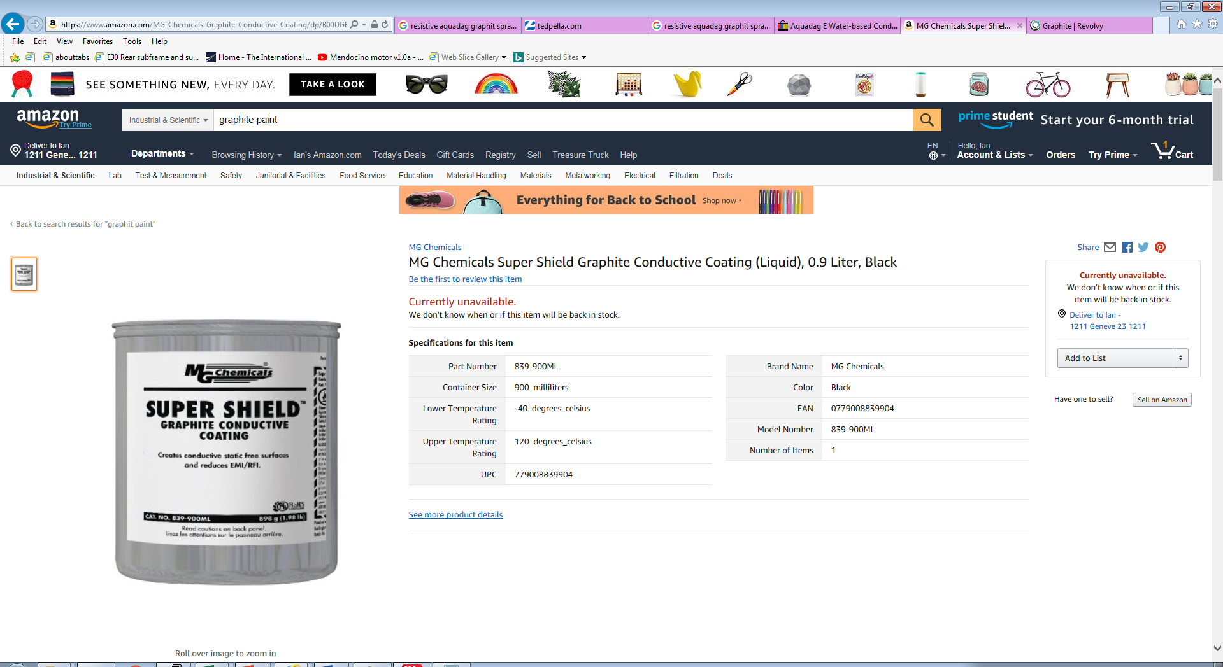

Slide 13
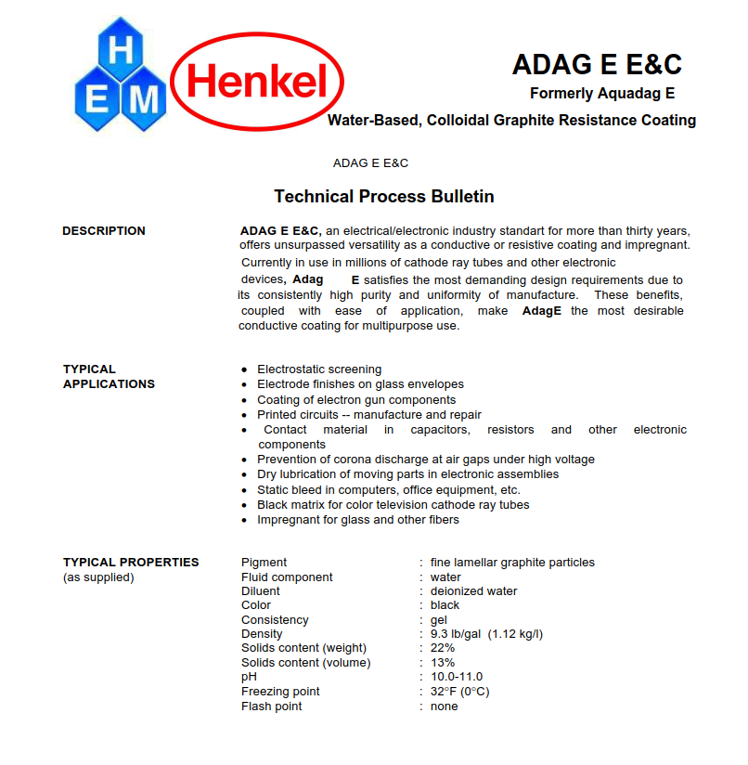
http://www.hitek-ltd.co.uk/media/downloads/5047/Adag%20E%20E&C%20(Formerly%20Aquadag%20E)(2009).pdf

Slide 14

https://www.laddresearch.com/chemicals/sem-conducting-paints/dag-t-502

Slide 15
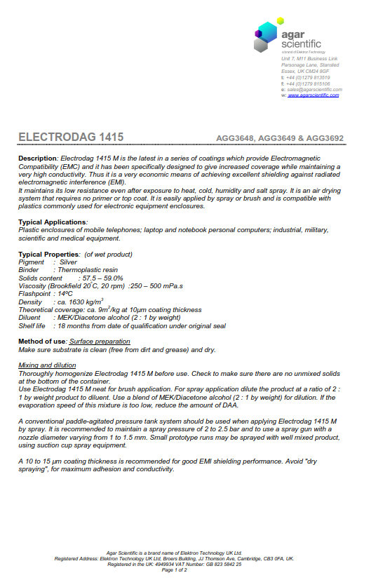
http://www.agarscientific.com/media/import/AGG3648_&_9,AGG3692_Jan14.pdf

Slide 16
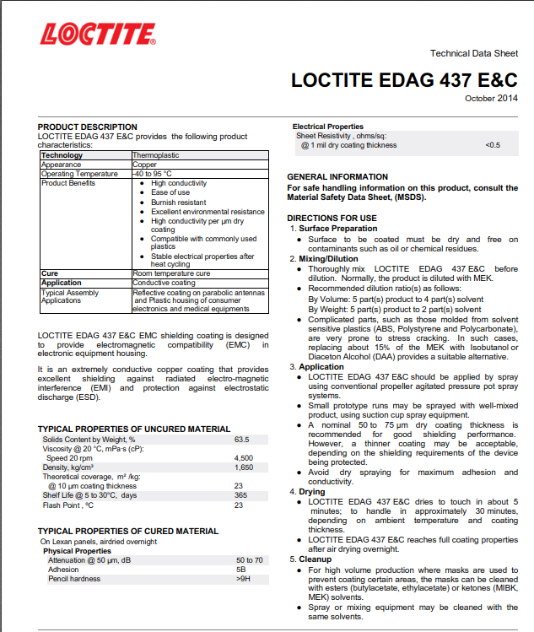
http://www.eptanova.com/sites/default/files/download_products/loctite_edag_437_ec_1.pdf

Slide 17
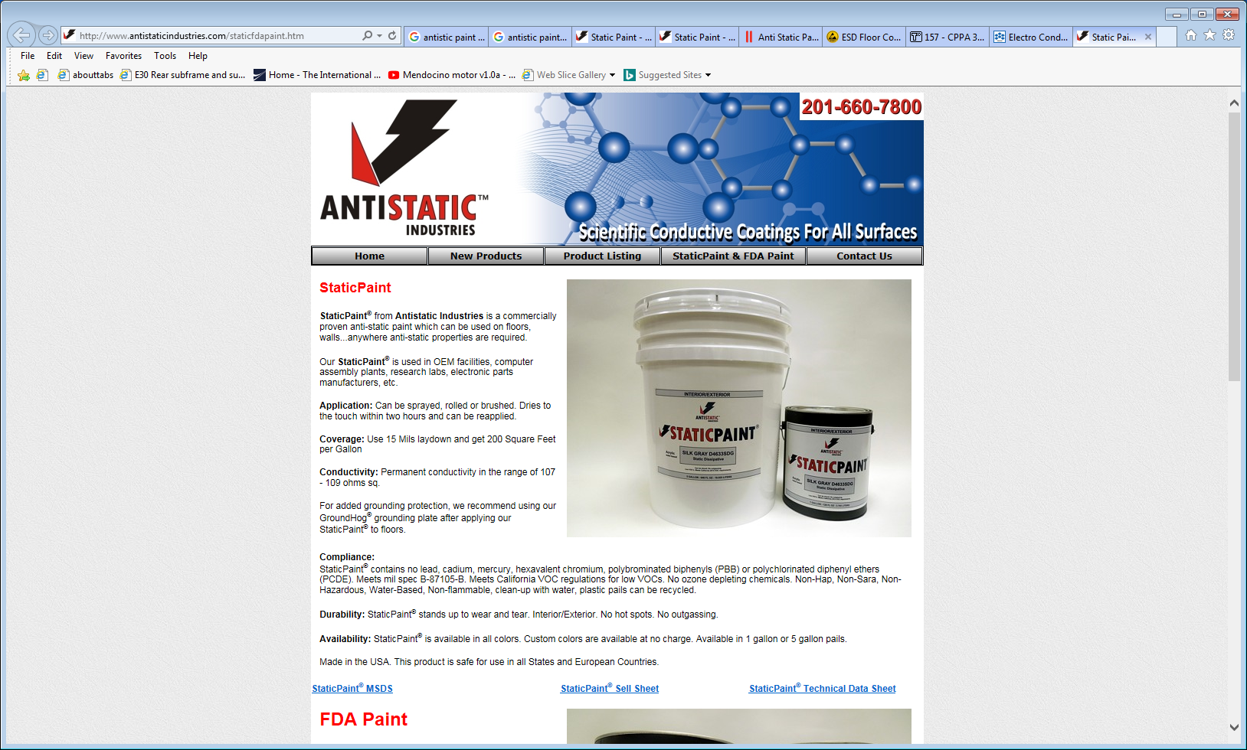
http://www.antistaticindustries.com/staticfdapaint.htm

Slide 18
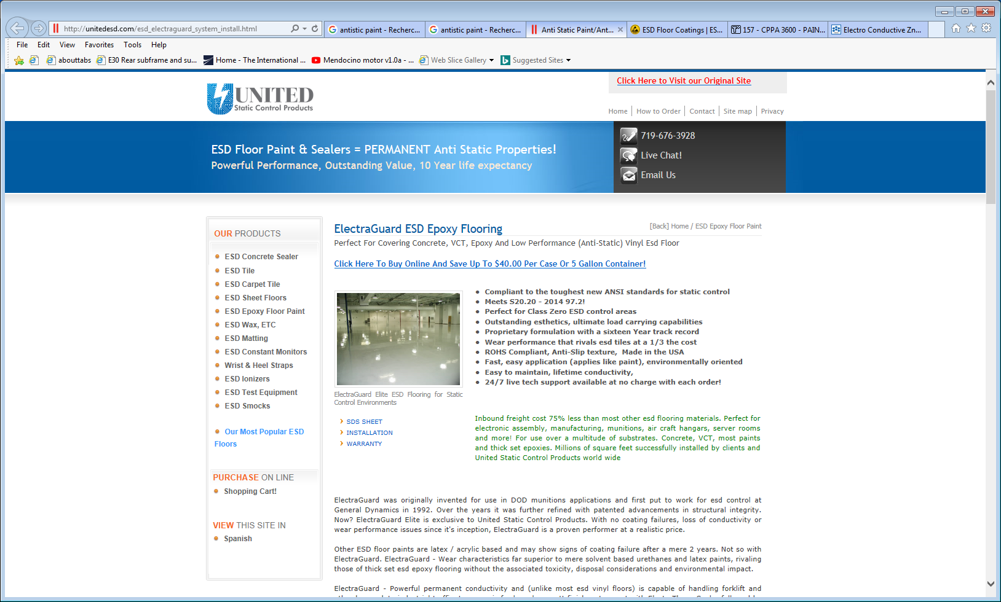
http://unitedesd.com/esd_electraguard_system_install.html

Slide 19
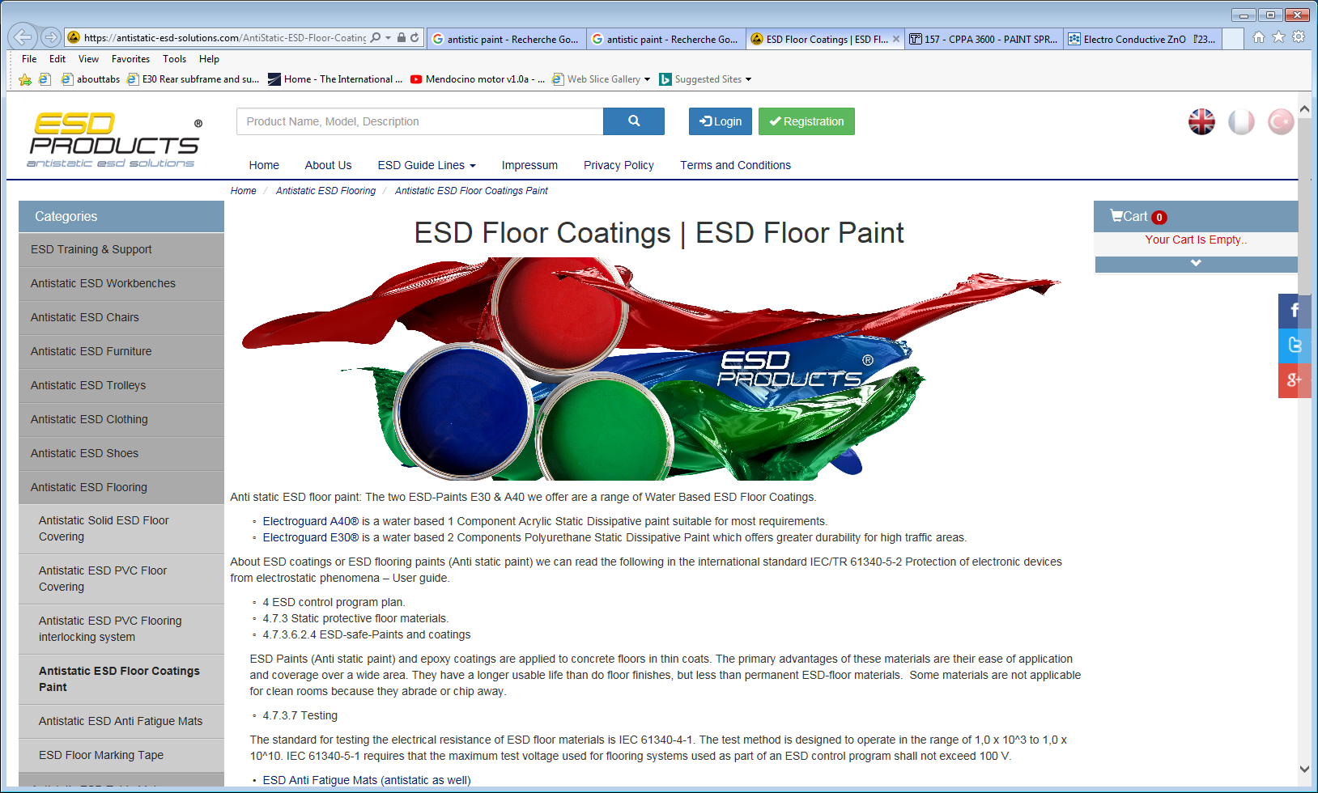
https://antistatic-esd-solutions.com/AntiStatic-ESD-Floor-Coatings-Paint-anti-static-paint.htm

Slide 20
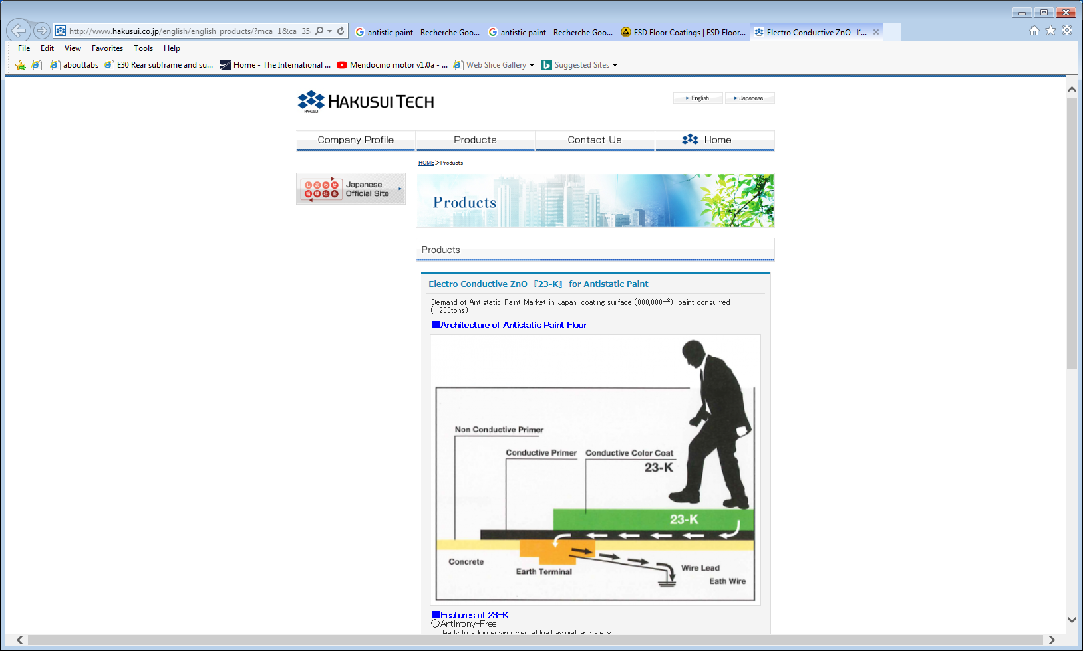
http://www.hakusui.co.jp/english/english_products/?mca=1&ca=35&id=1378512463-761217

