Slide 1
Pick up strips generic China
Ian
10 Nov 2025

Slide 2
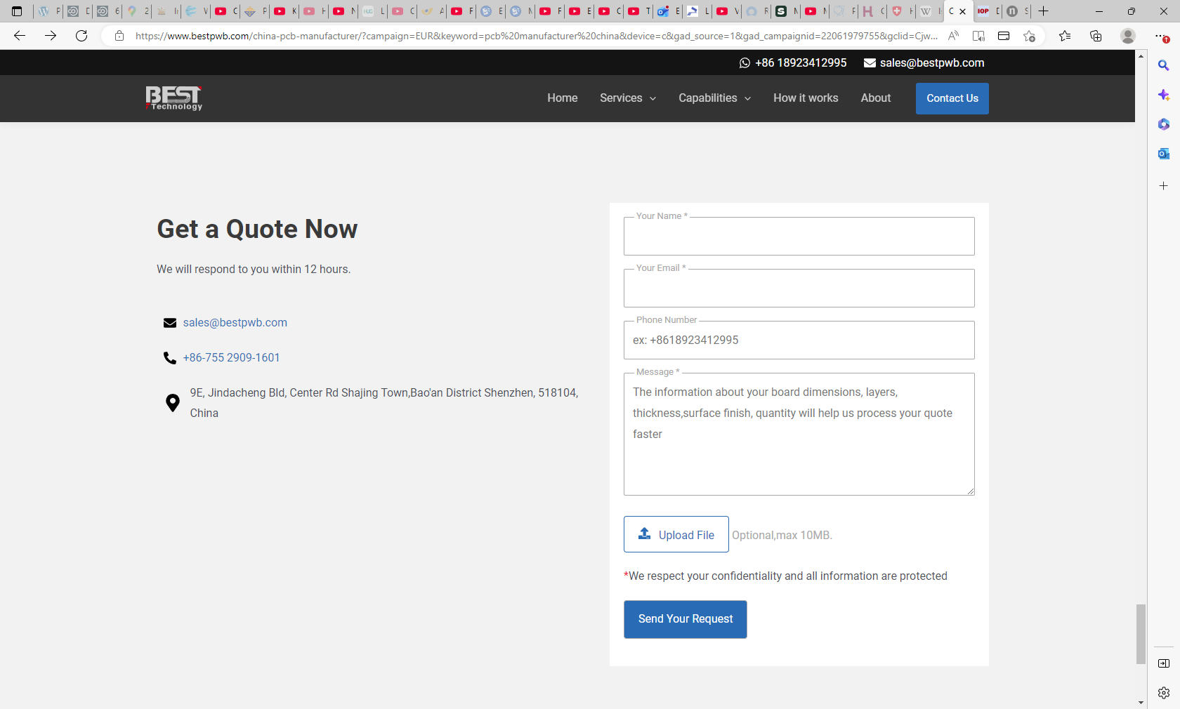
https://www.bestpwb.com/

Slide 3
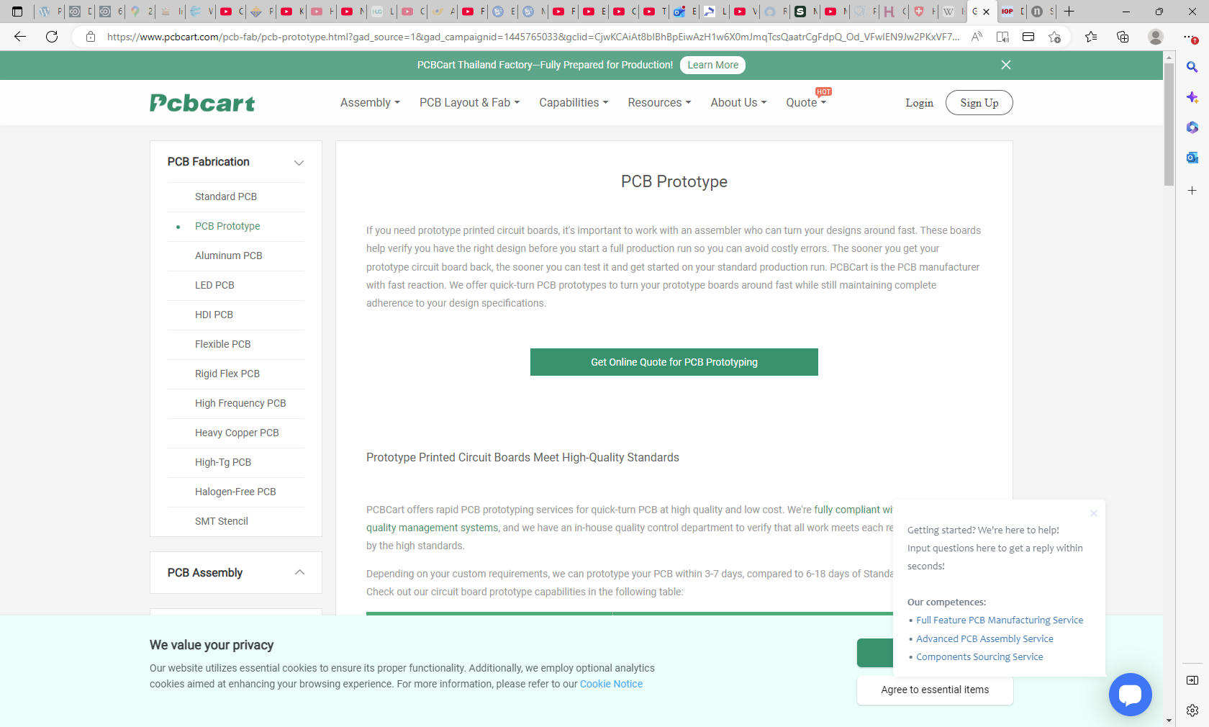
https://www.pcbcart.com/pcb-fab/pcb-prototype.html?gad_source=1&gad_campaignid=1445765033&gclid=CjwKCAiAt8bIBhBpEiwAzH1w6X0mJmqTcsQaatrCgFdpQ_Od_VFwIEN9Jw2PKxVF7_DM6z-9c2u-5BoC1XAQAvD_BwE

Slide 4
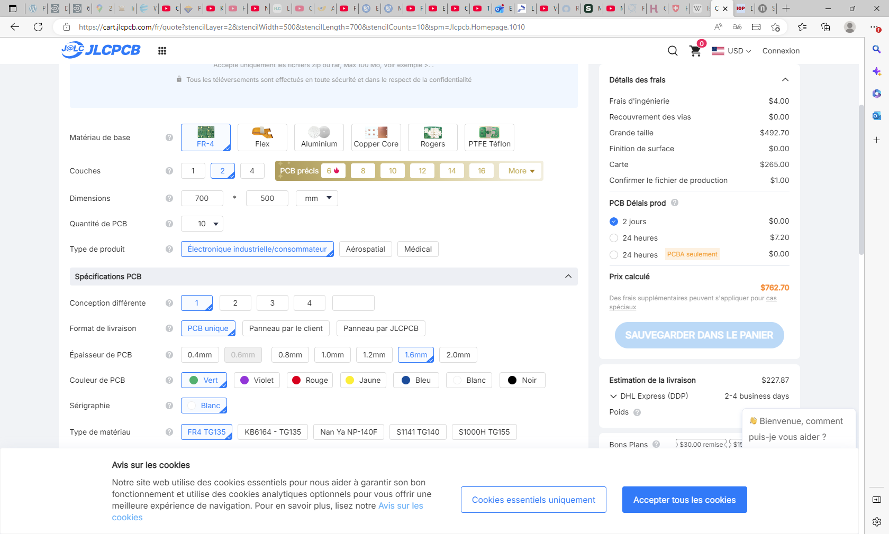
https://cart.jlcpcb.com/fr/quote?stencilLayer=2&stencilWidth=500&stencilLength=700&stencilCounts=10&spm=Jlcpcb.Homepage.1010

Slide 5
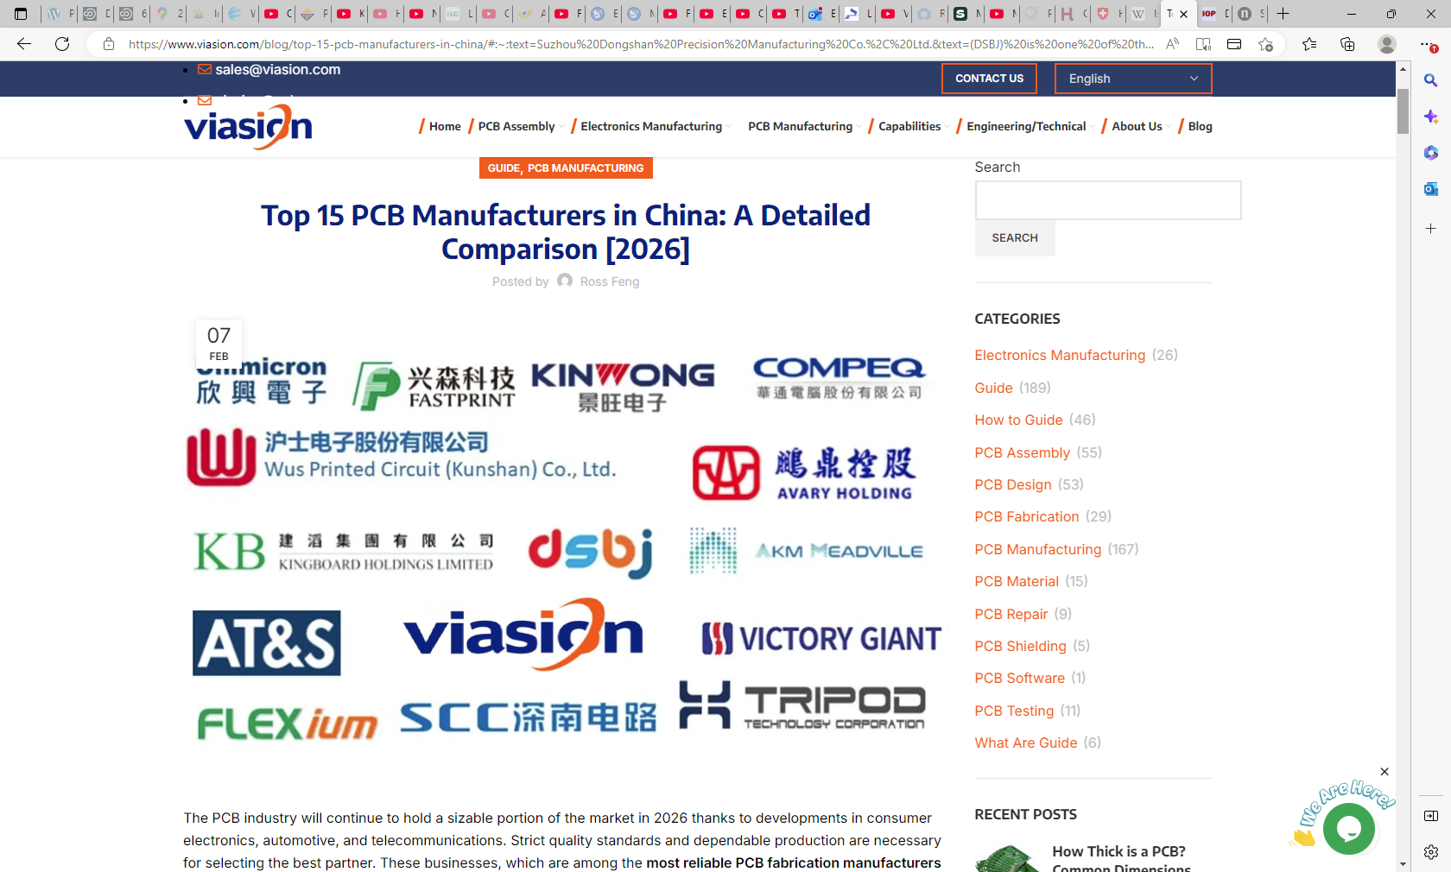
https://www.viasion.com/blog/top-15-pcb-manufacturers-in-china/#:~:text=Suzhou%20Dongshan%20Precision%20Manufacturing%20Co.%2C%20Ltd.&text=(DSBJ)%20is%20one%20of%20the,HDI%20solutions%20to%20global%20customers.

Slide 6
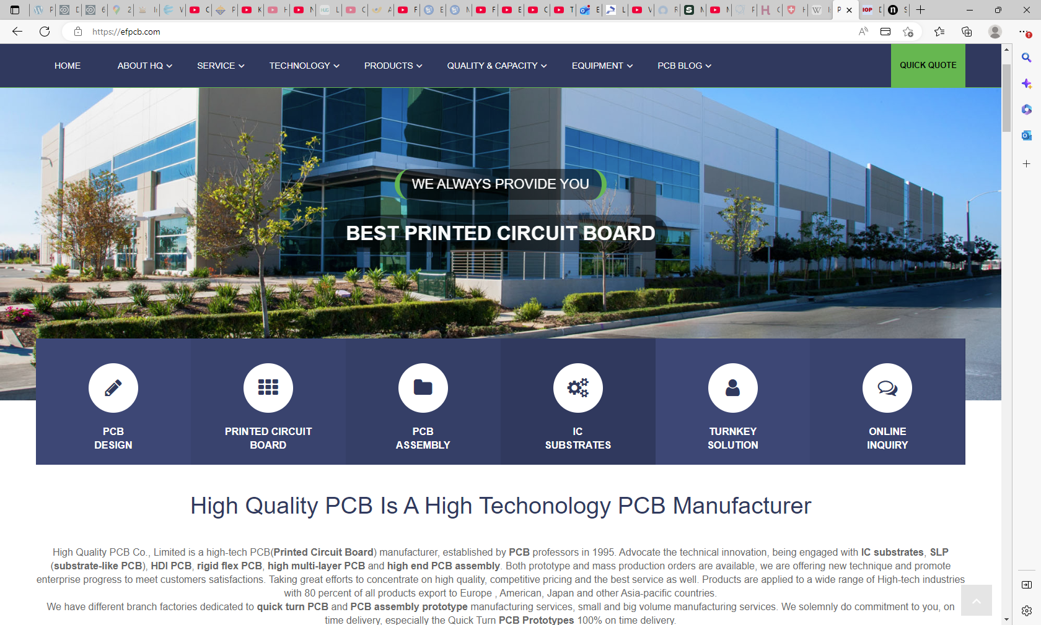
https://efpcb.com/

