Slide 1
FEB by Flavio Loddo
Ian
17 August 2023

Slide 2
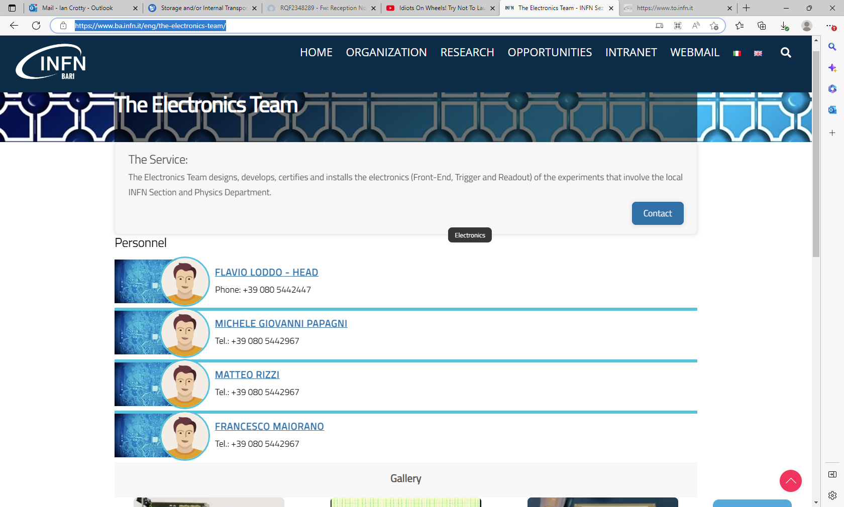
https://www.ba.infn.it/eng/the-electronics-team/

Slide 4
Mail from Isabel

Slide 5
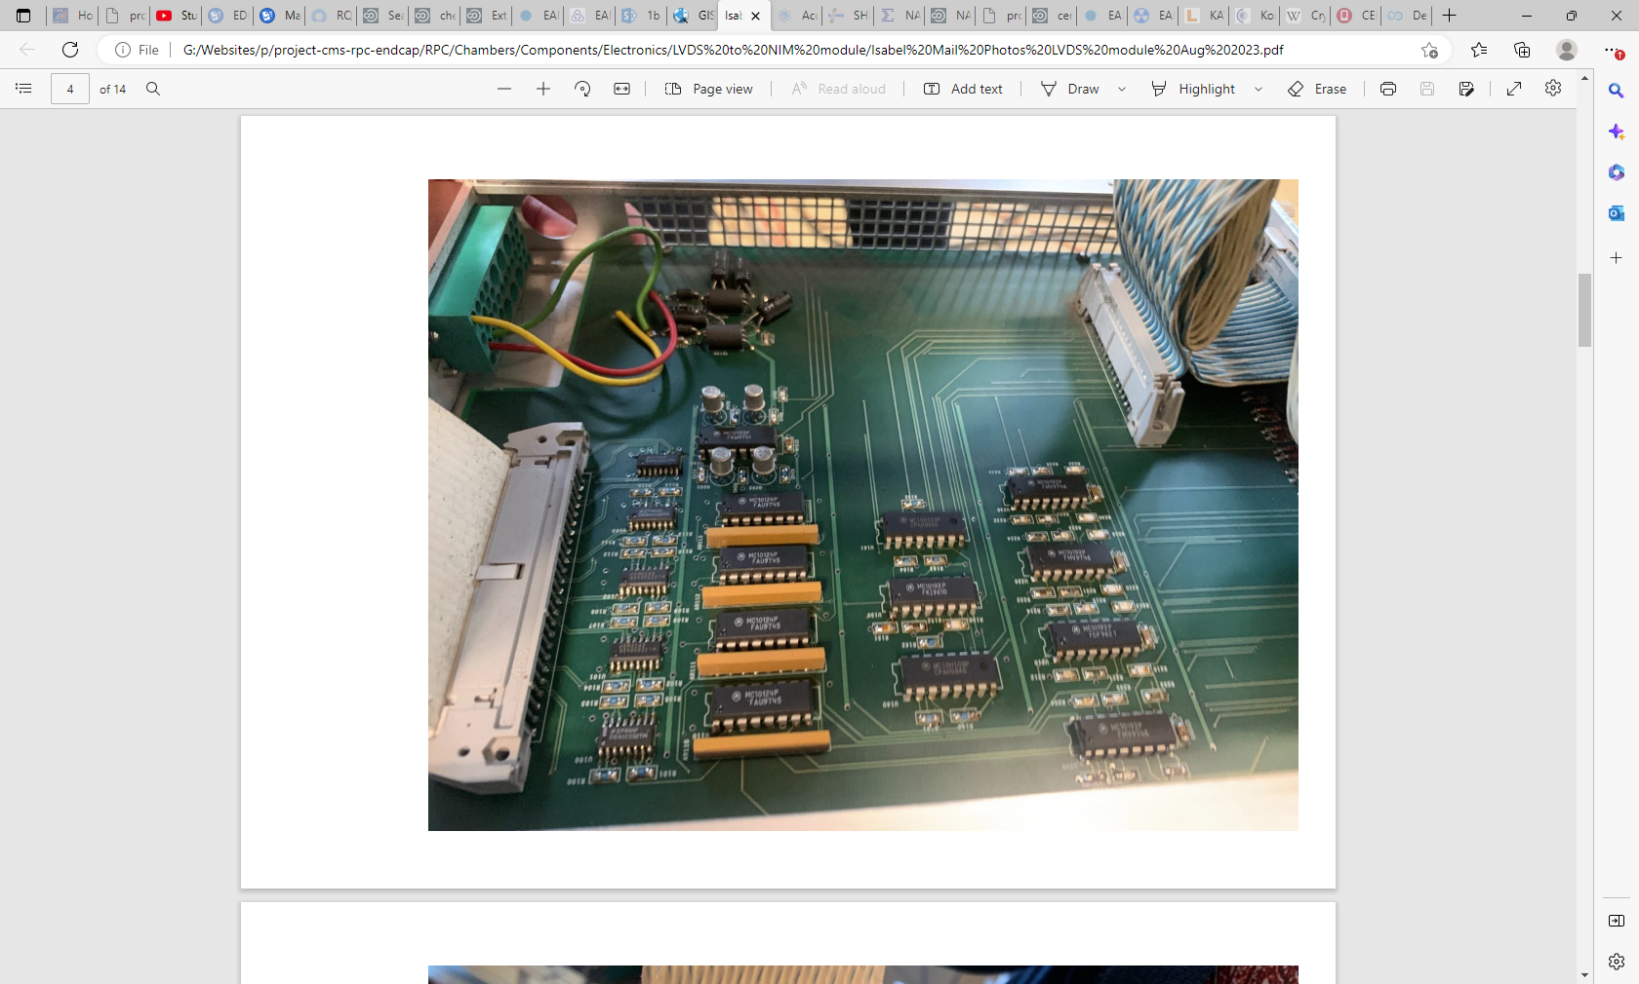

Slide 6
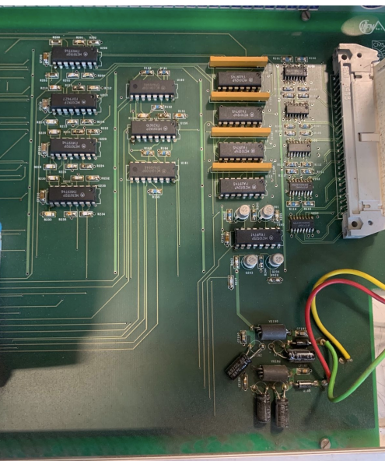
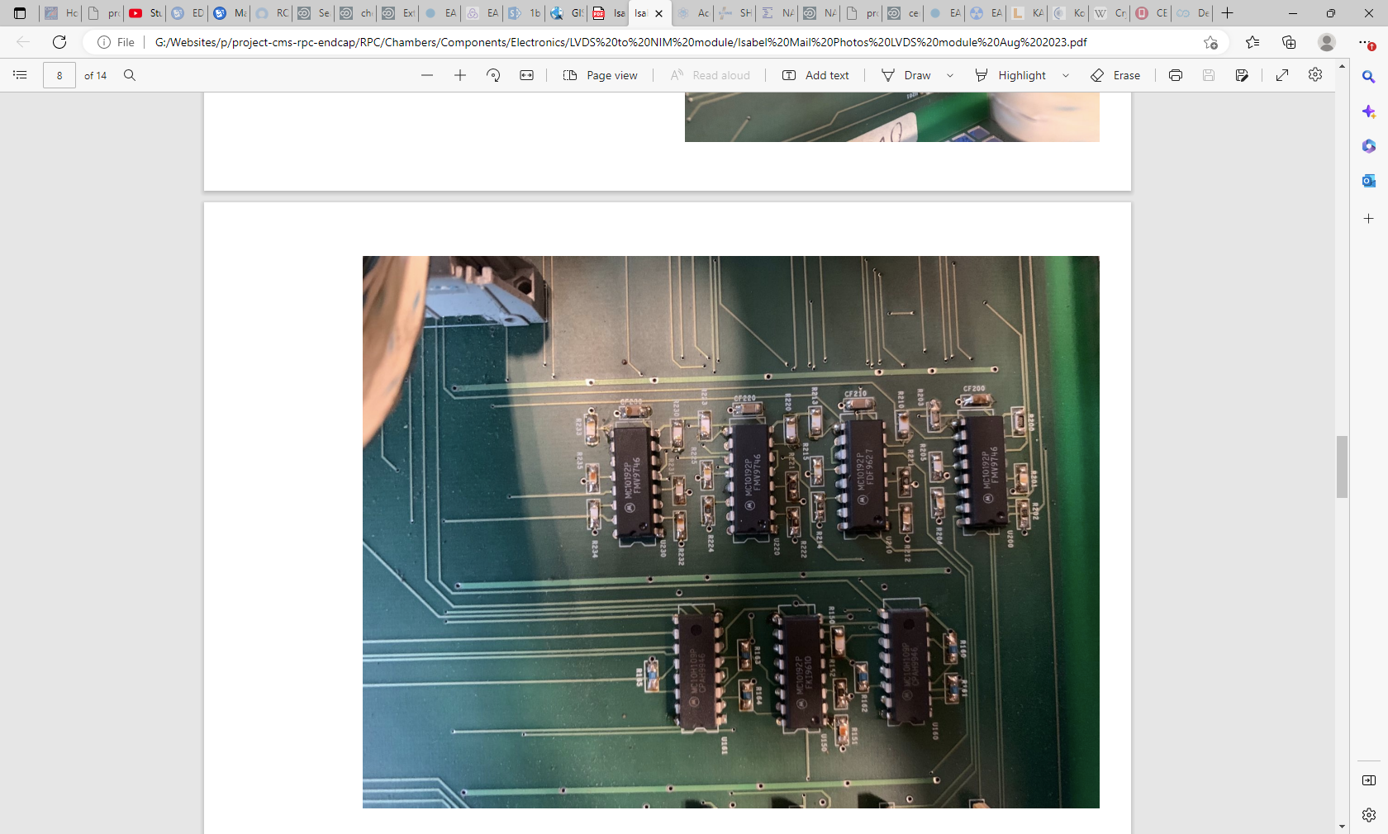

Slide 7
MC10192P
FMV9746 this number changes between same type ASICs

Slide 8
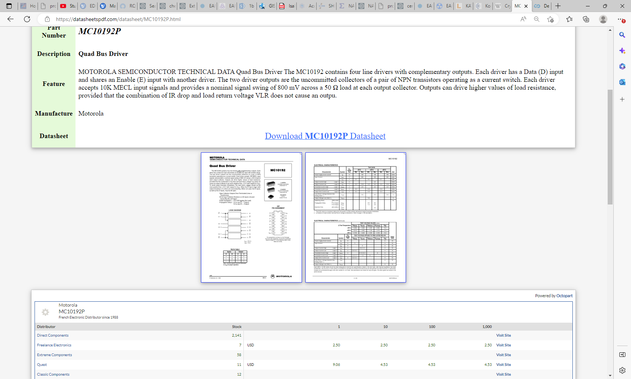

Slide 9
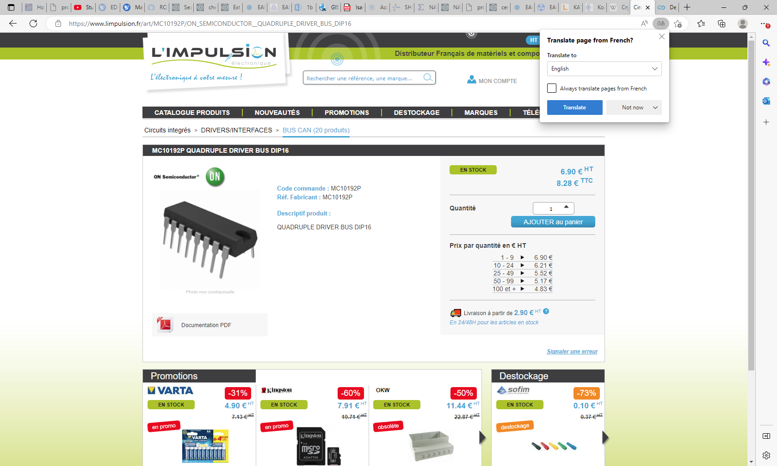

Slide 10
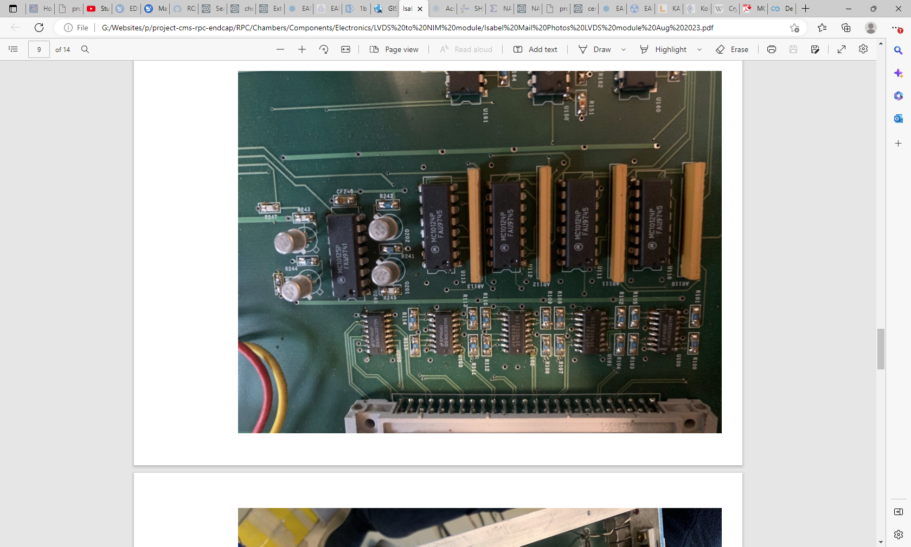

Slide 11
MC10124P
FAU9745
MC10125P
FKW9741

Slide 12
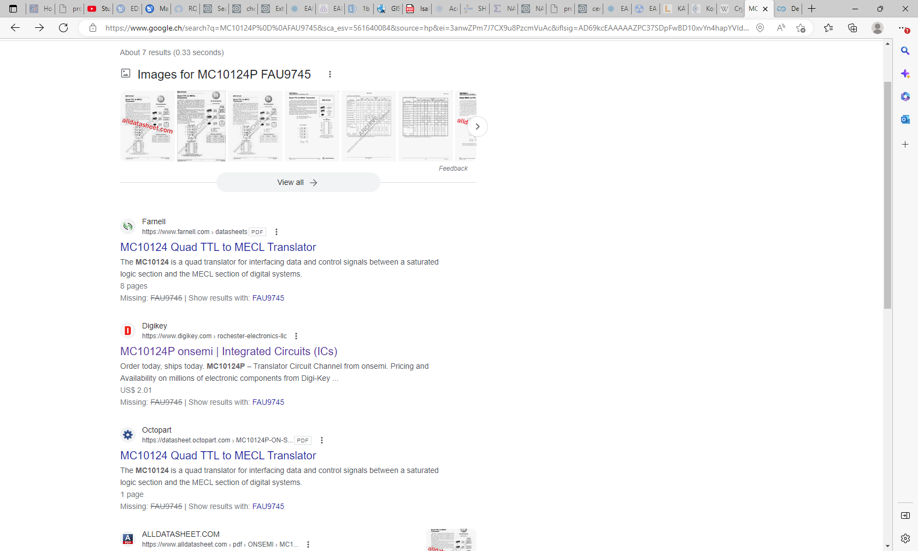

Slide 13
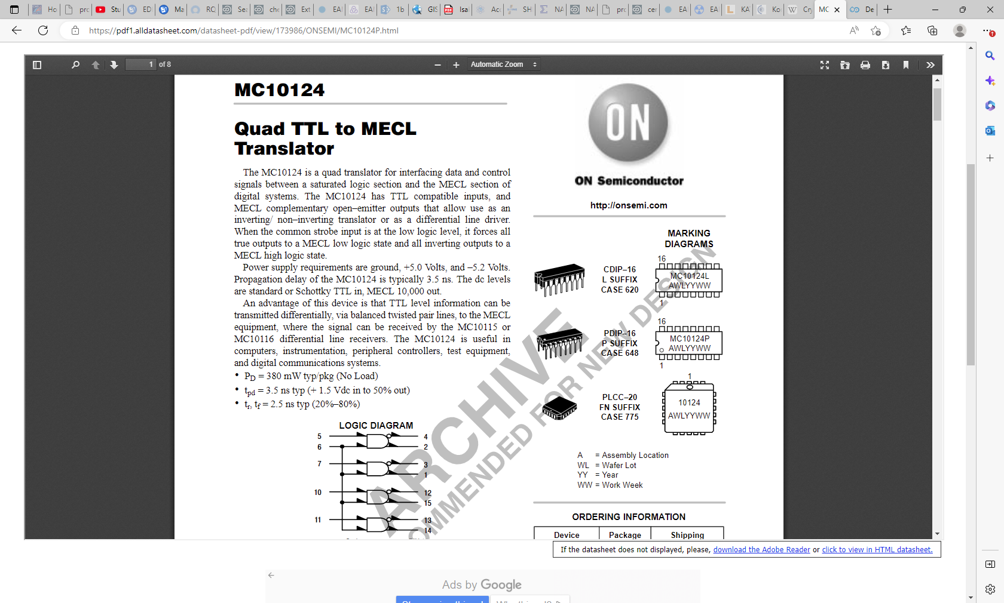
https://pdf1.alldatasheet.com/datasheet-pdf/view/173986/ONSEMI/MC10124P.html

Slide 14
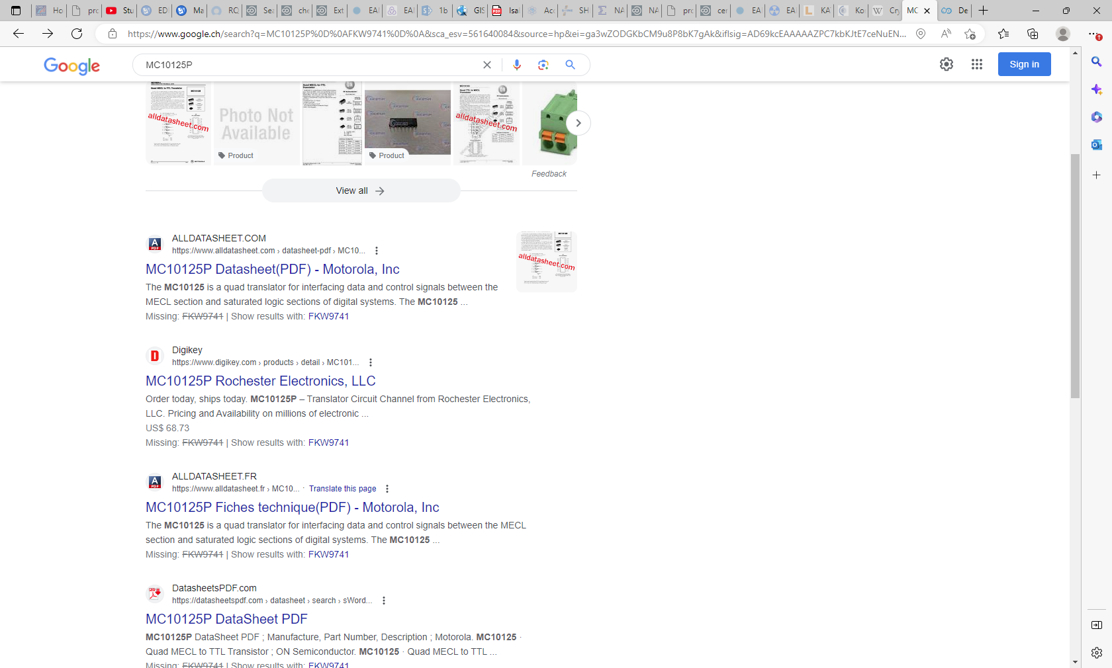
MC10125P
FKW9741
I am not able to access Digikey.com !!

Slide 15
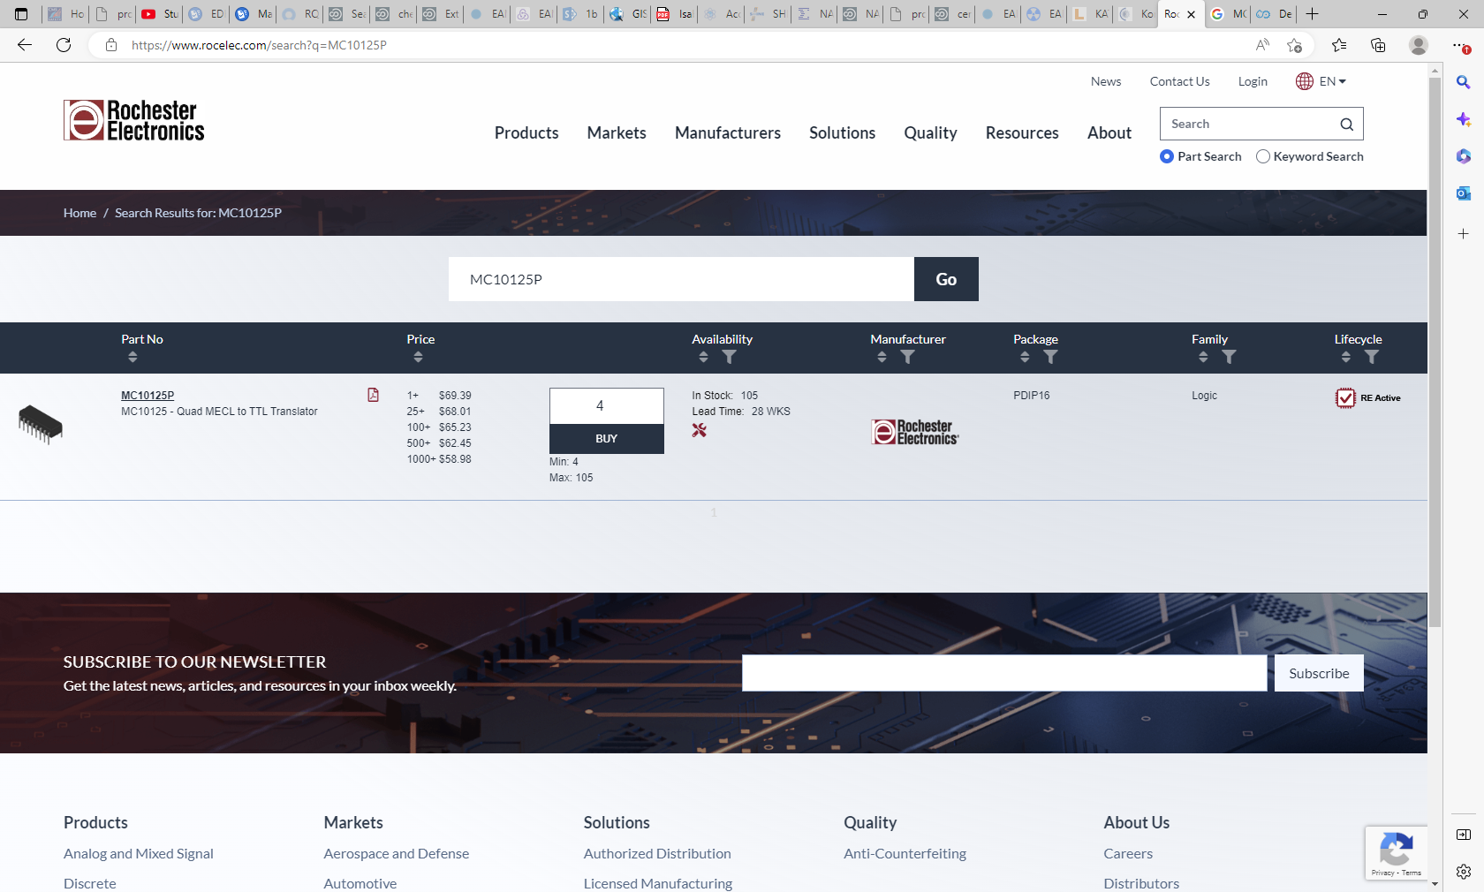
https://www.rocelec.com/search?q=MC10125P

Slide 16
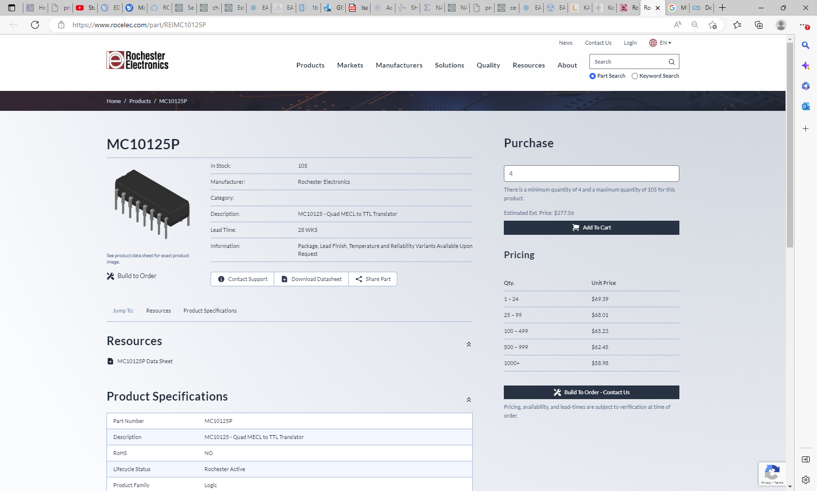

Slide 17
EP96AD
DS90C032TM
EM02AD
DS90C032TM
EM (?)02AD
DS90C032TM

Slide 18
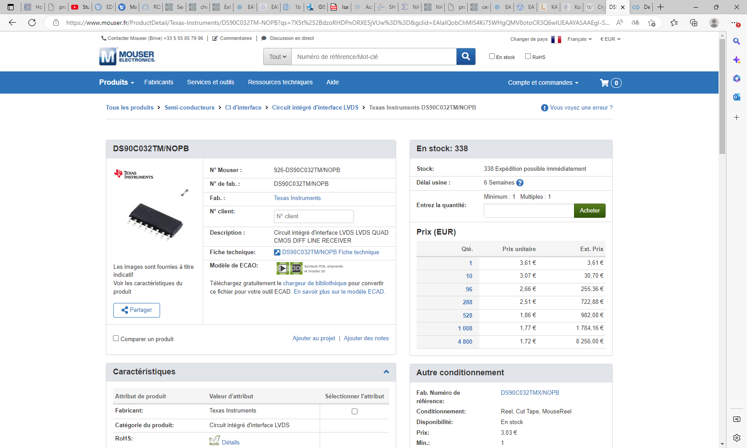

Slide 21
