Slide 1
FEB by Flavio Loddo
Ian
17 August 2023

Slide 2
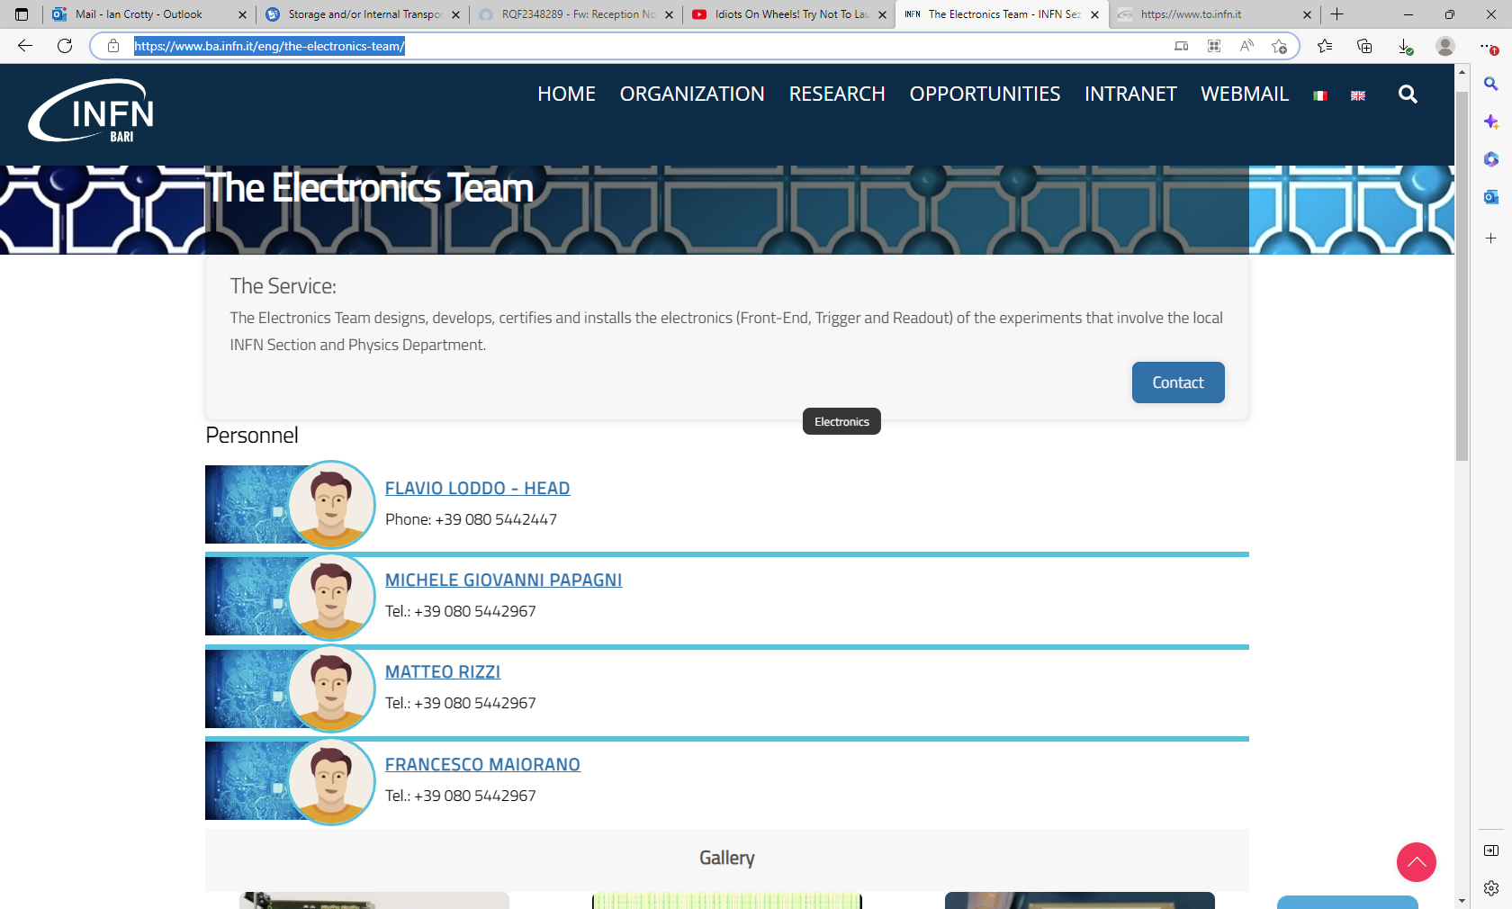
https://www.ba.infn.it/eng/the-electronics-team/

