Slide 1
CER N Box connection difficulties
Ian
9 June 2023

Slide 2
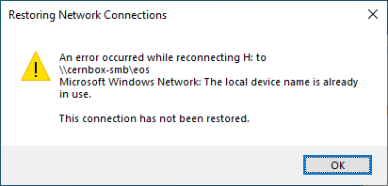
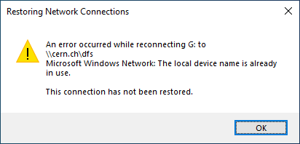

Slide 3
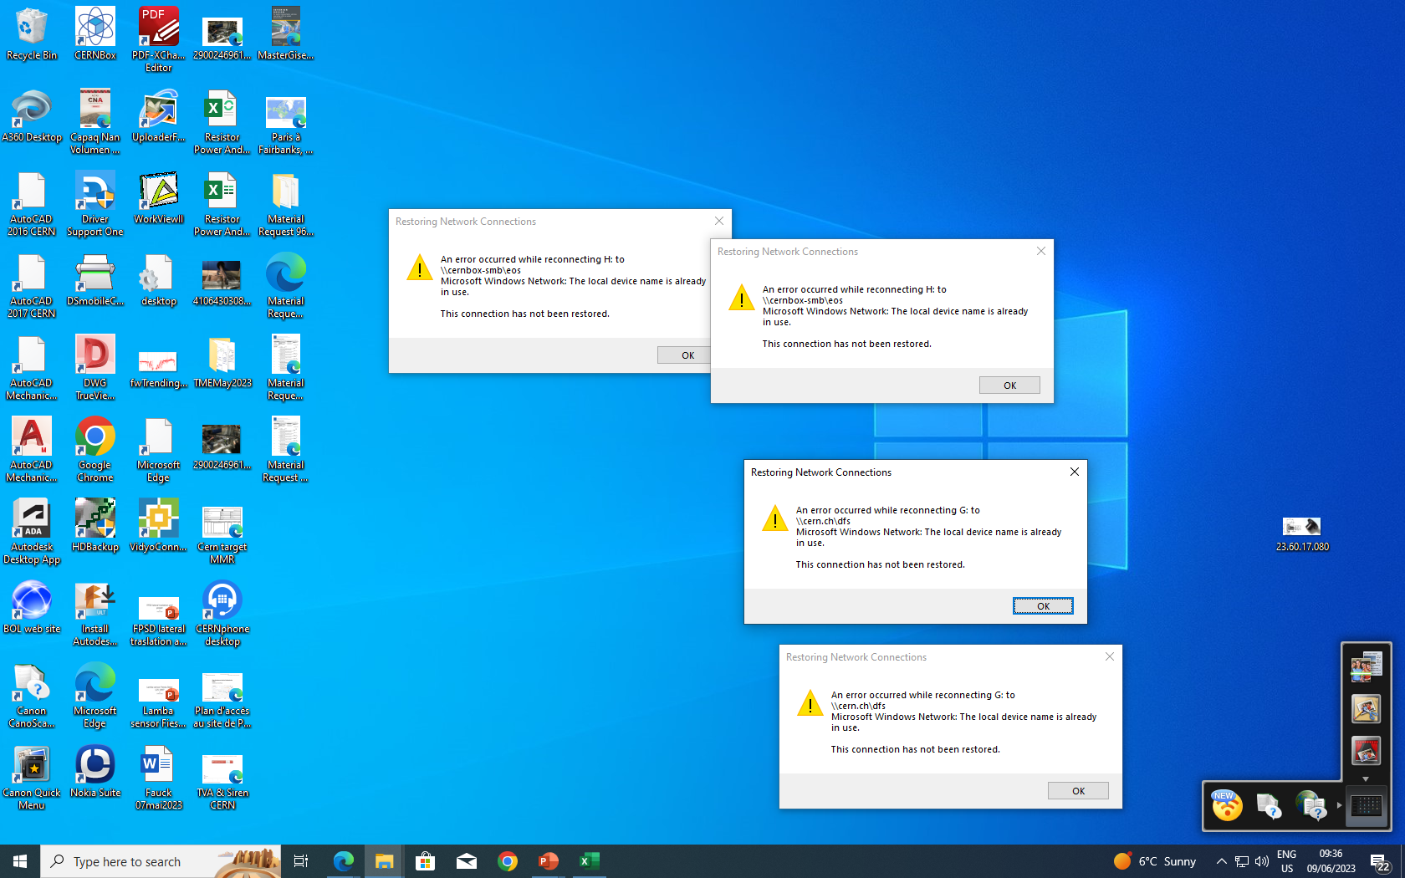
I had already removed numerous, 5-10, EOS windows, these are left

