Slide 1
Pedestrian entry to CERN Prevessin from southern bus stop
Ian
7 June 2024

Slide 2
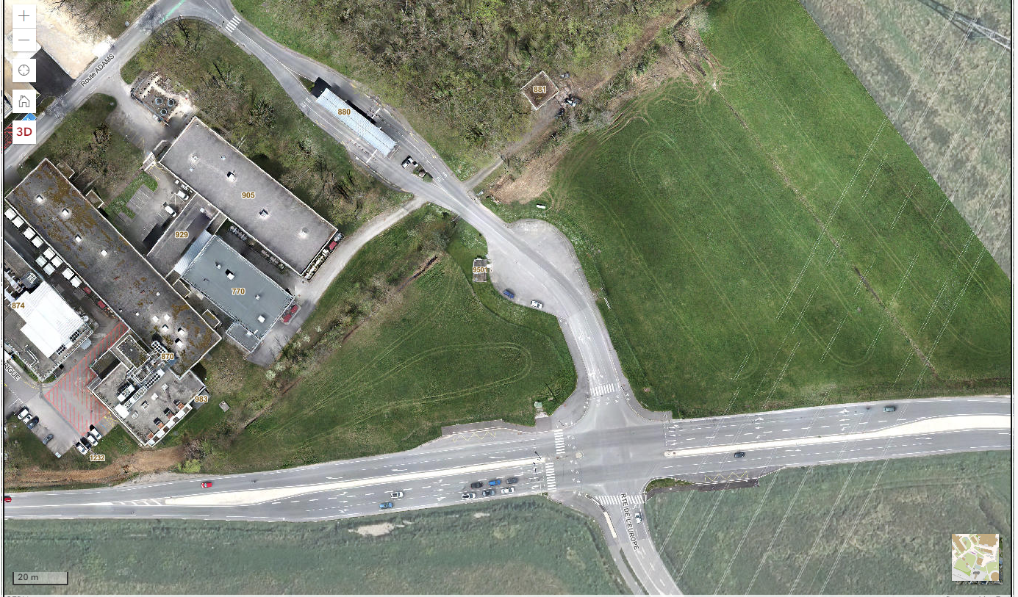

Slide 3
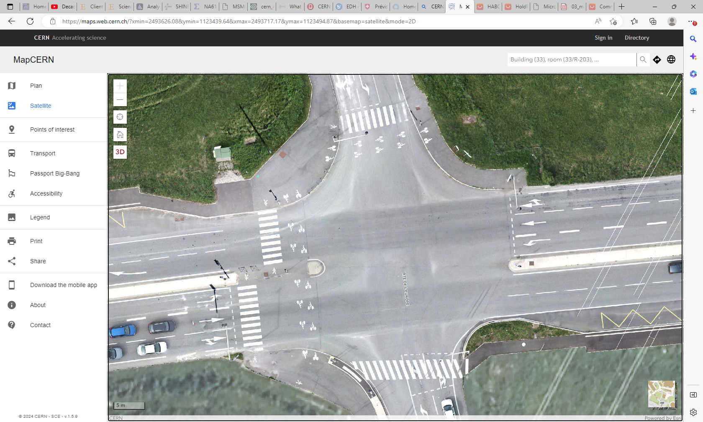
MapCERN
3 road crossings as opposed to 1

Slide 4
See attached video of confusion and so accrued danger at this now “busy” access route

Slide 5
Google maps are not so up to date with no Bus stops shown !

Slide 6
