Slide 1
Panel displacement in 904
Ian
1 march 2022

Slide 2
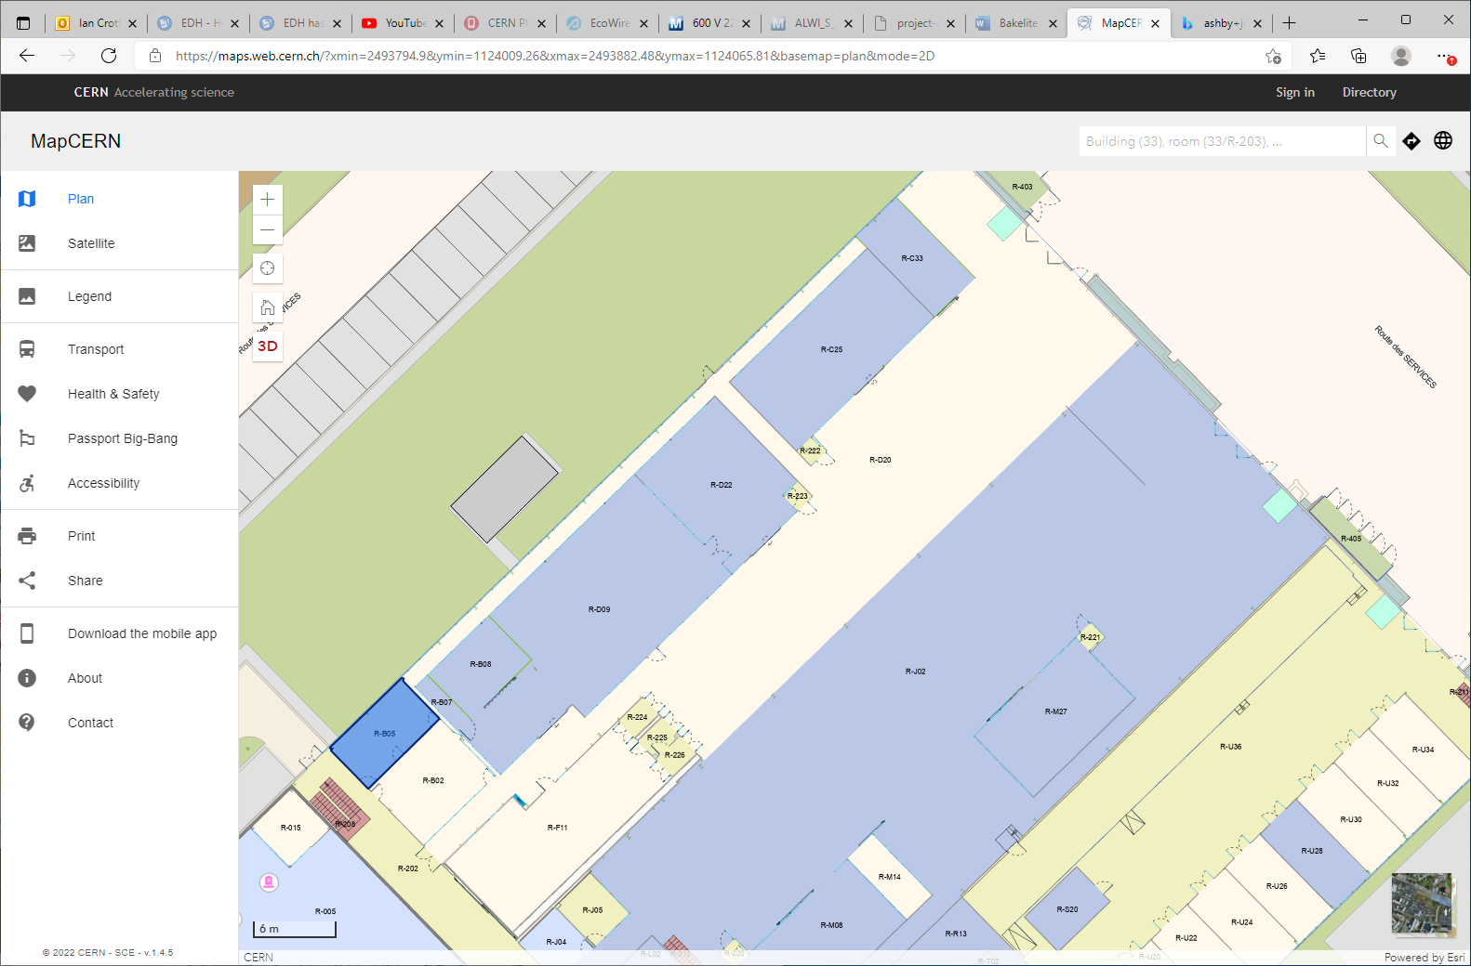
Panels to intervene on
A
B
R-F21

Slide 3
Panels to build
Zone area
Poutre verte
D
6m
7m
C
B
2m
3.5m

Slide 4
Resume work to do
Remove panels at “A”
“B” will be displaced except for wall “C-D”.
“C-D” will be modified with 2 doors.
2 walls to install, 2m and 6m

