Slide 1
Bronze for Drive block of the X-Y table
Ian
18 April 2019

Slide 2
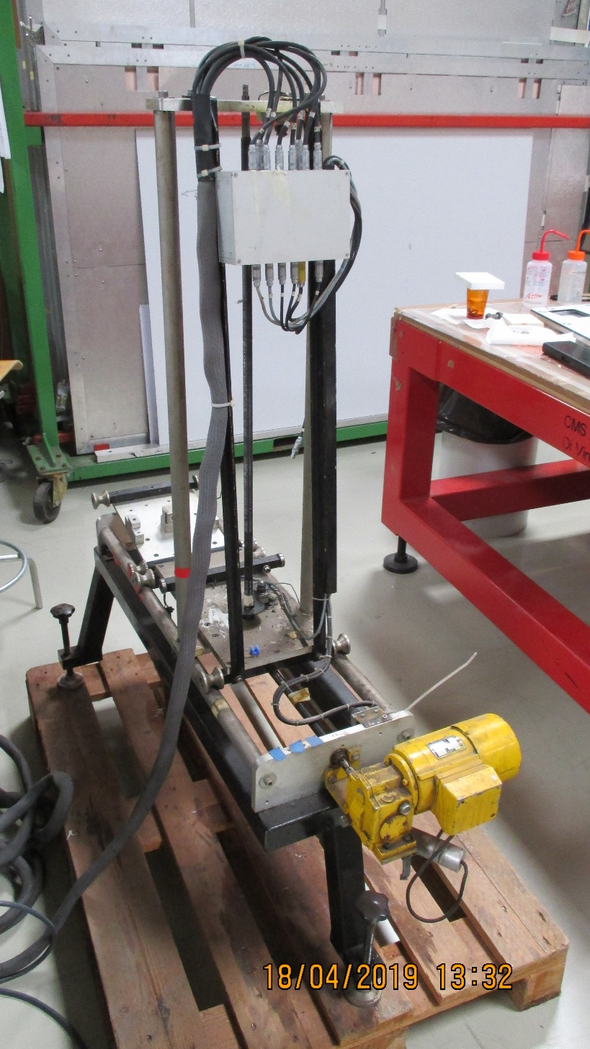
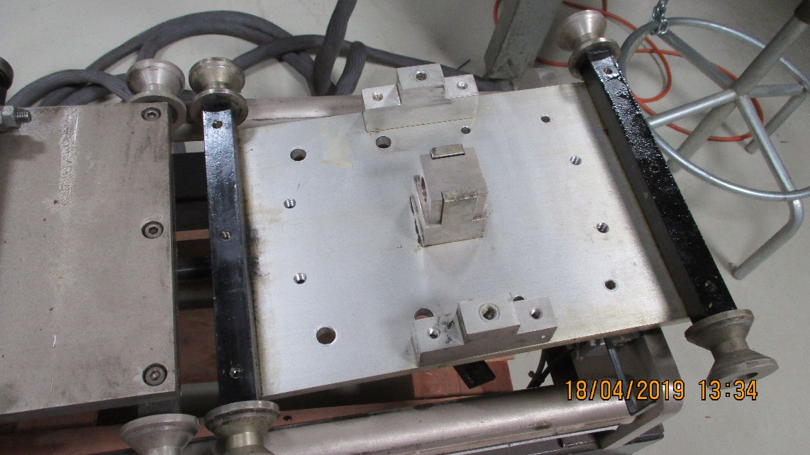
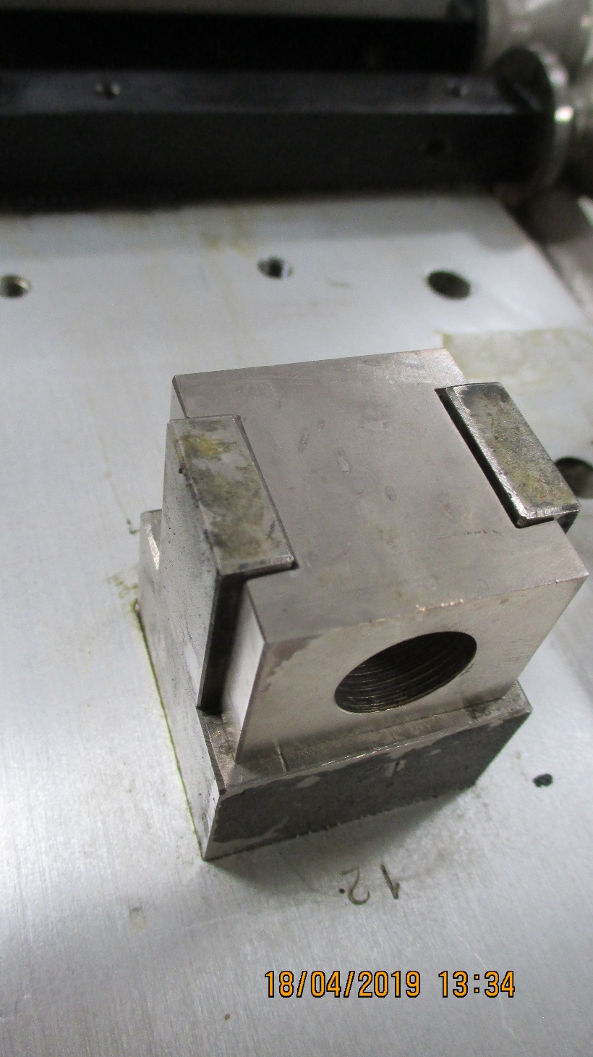
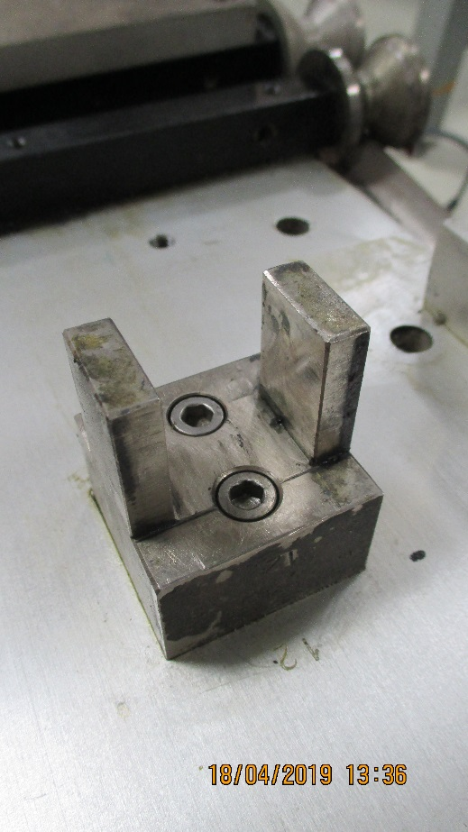

Slide 3
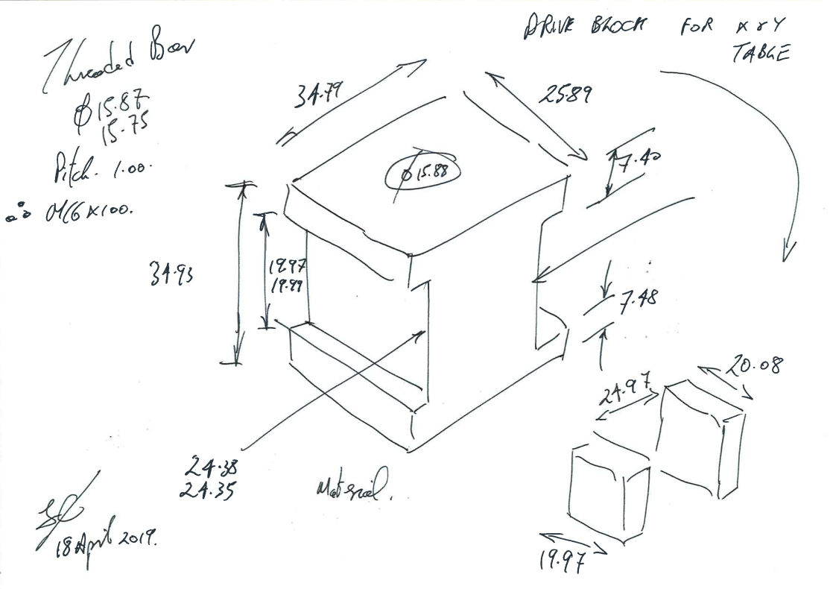

Slide 4
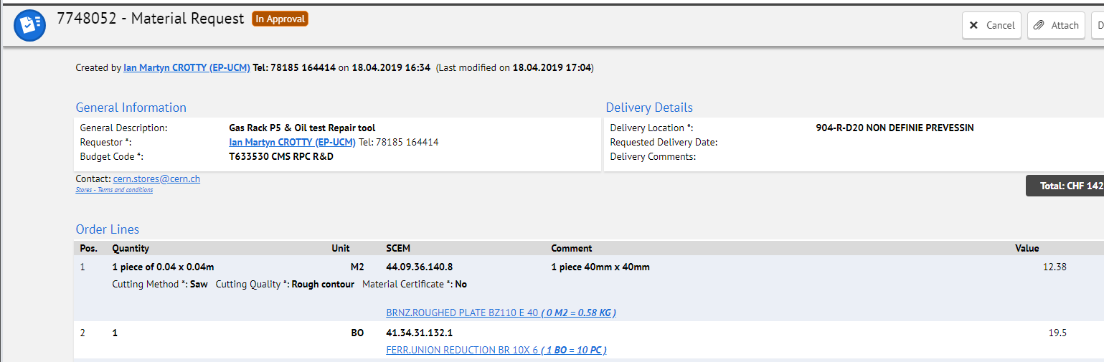
Bronze with lead
SAE 660 ; CuSn7Pb7Zn3 (ISO) ; BS 1400 LG4 (Britannique) ; DIN 1705 Rg7 (Allemand)

Slide 5
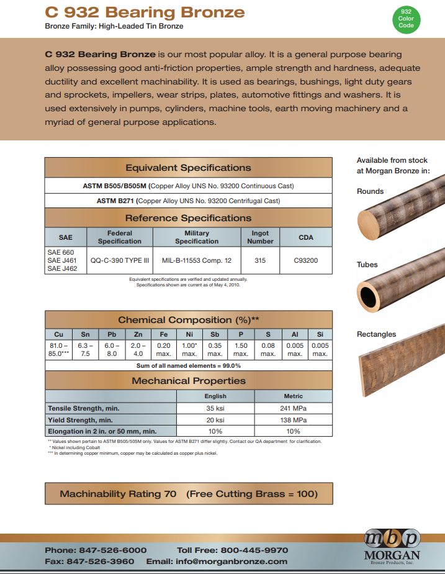
http://www.morganbronze.com/wp-content/uploads/c932_bearing_bronze.pdf

Slide 6
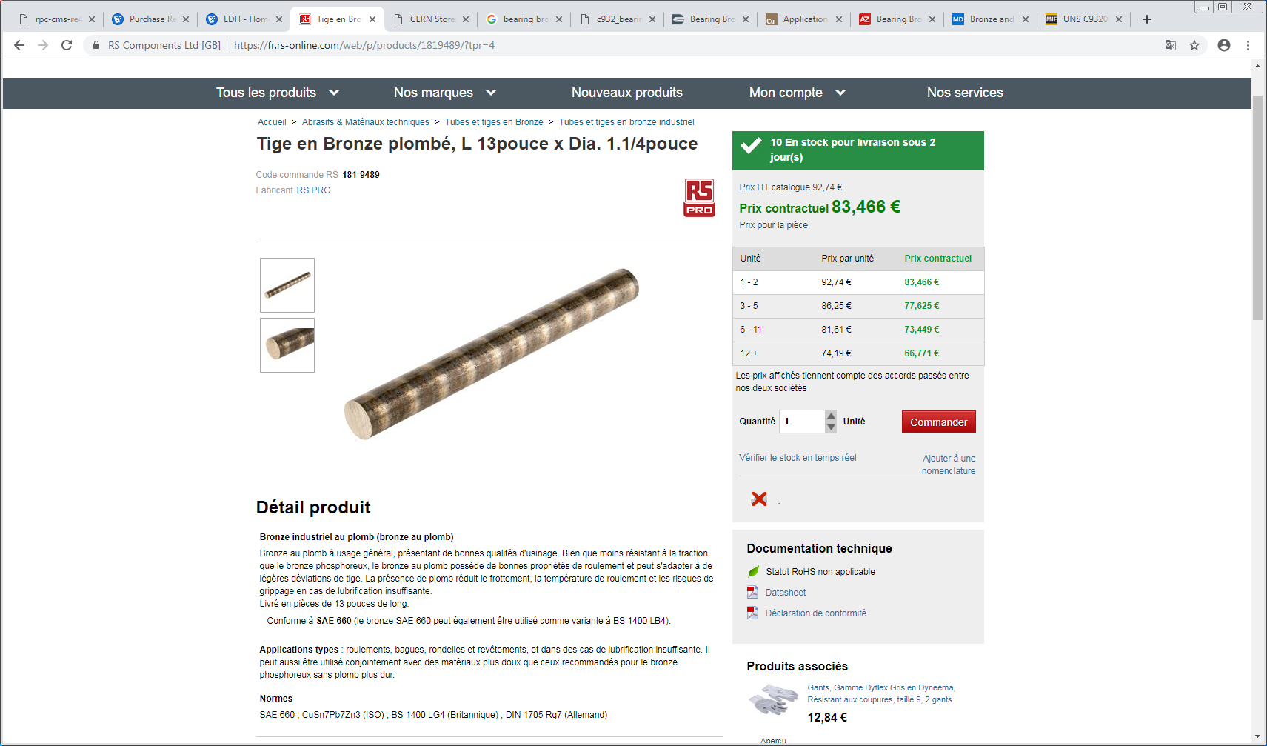

Slide 7
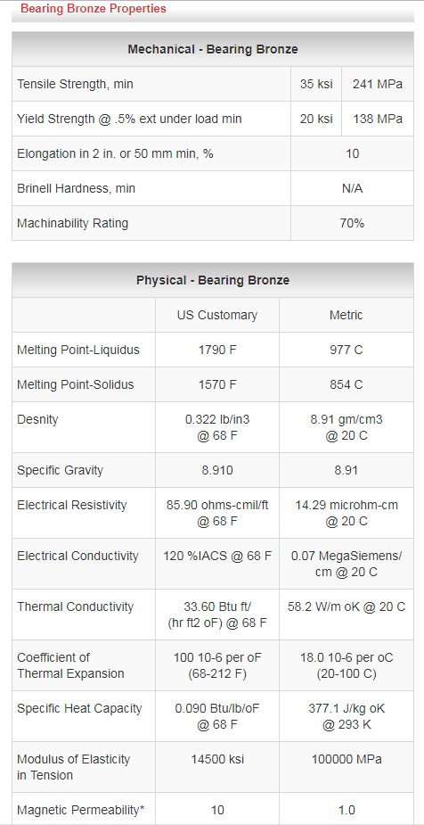
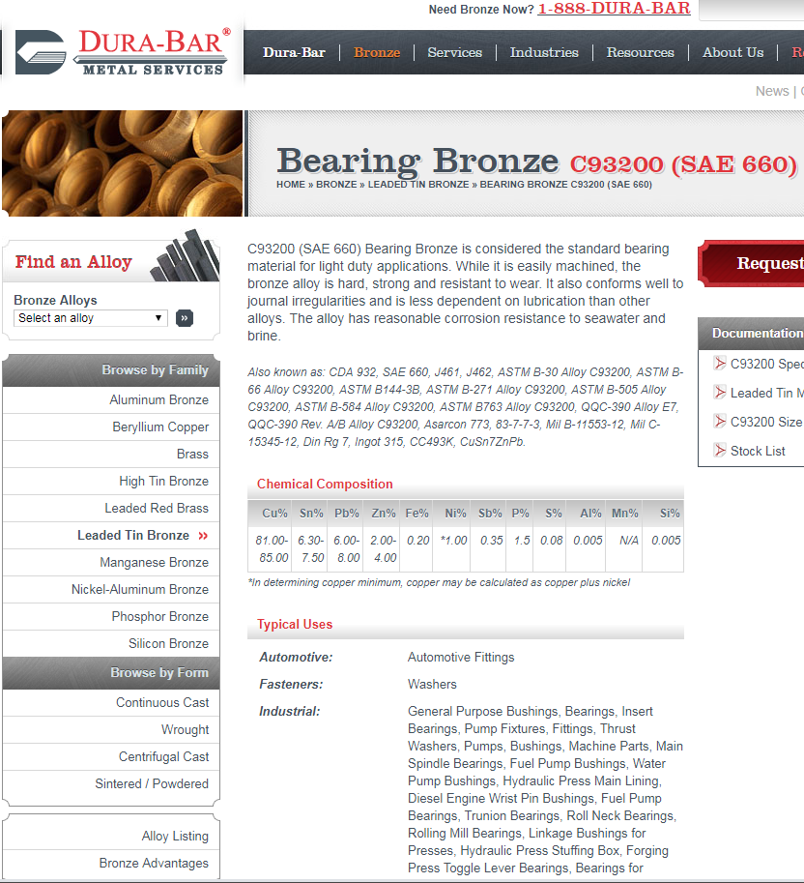
https://www.dura-barms.com/bronze/leaded-tin-bronze/c93200.cfm

Slide 8
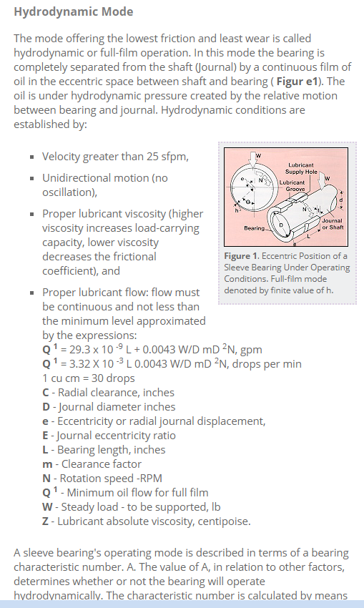
Design of bearings
https://www.copper.org/applications/industrial/bronze_bearing.html
https://www.azom.com/article.aspx?ArticleID=6294
https://www.machinedesign.com/basics-design/bronze-and-copper-alloy-bearings

Slide 9
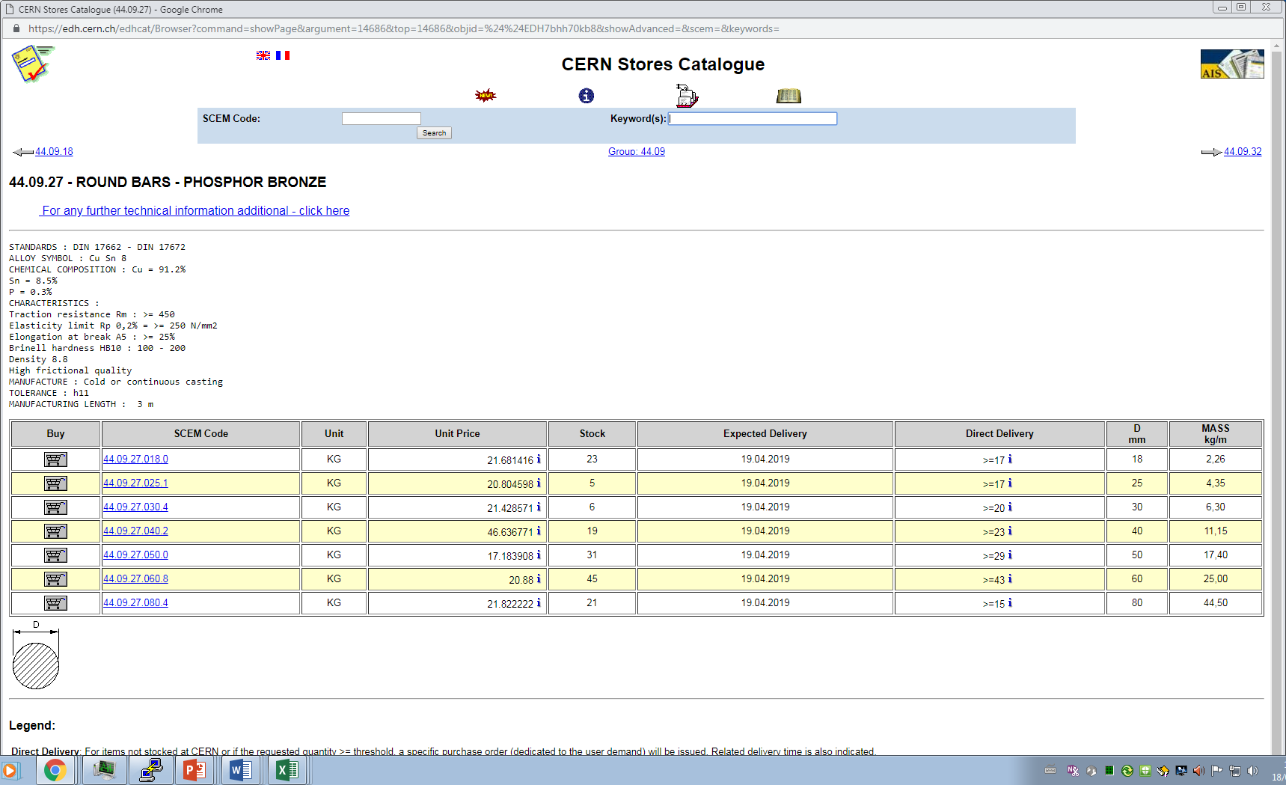

Slide 10
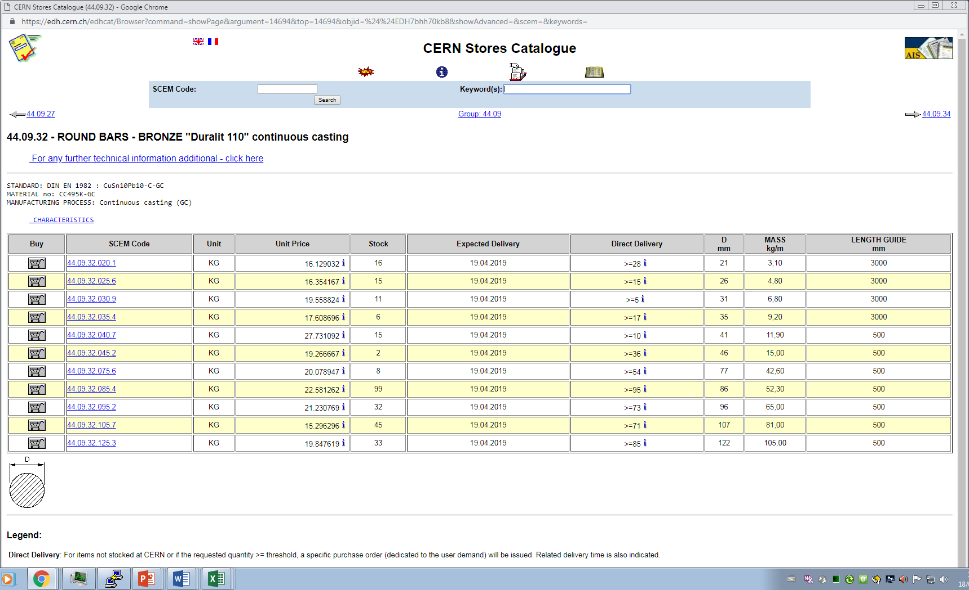

Slide 11
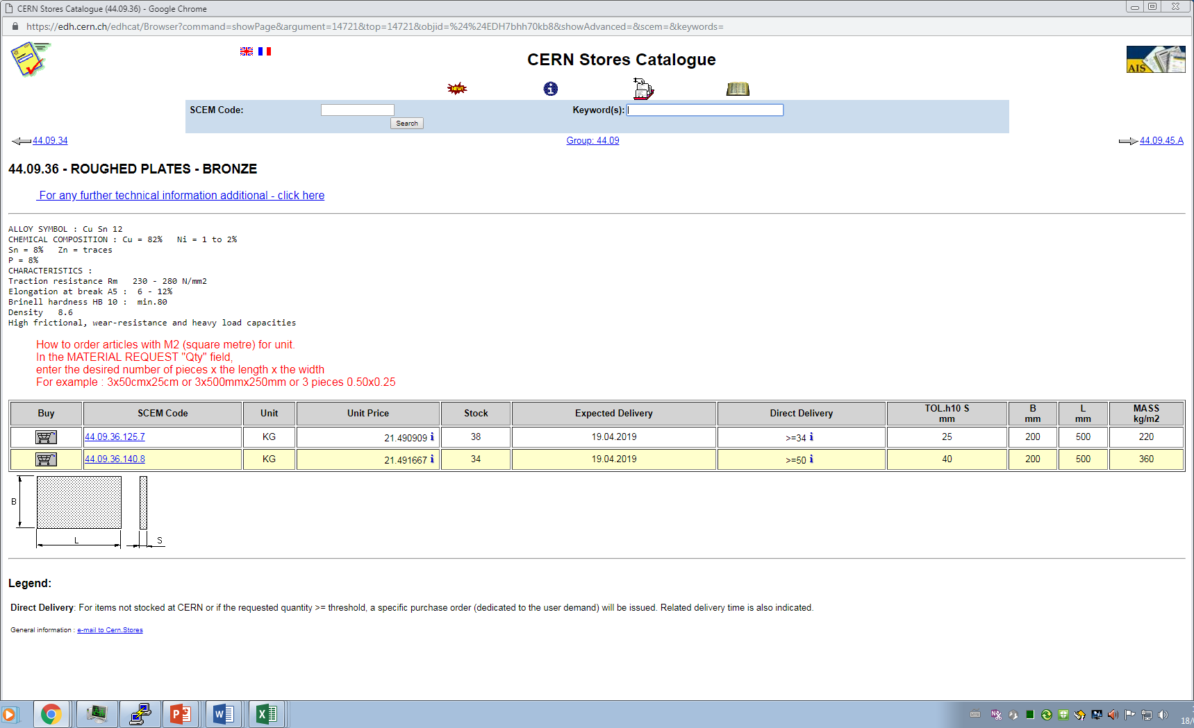

Slide 12
