Slide 1
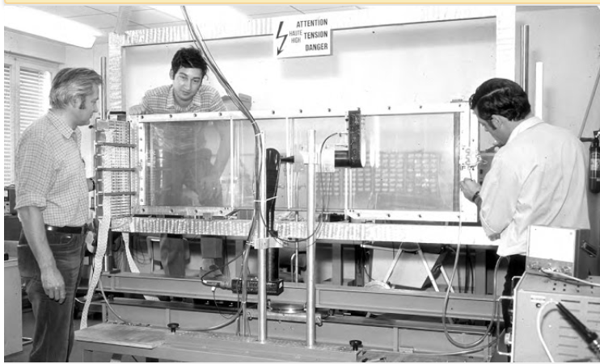
Who is this
Who is this
What is this

Slide 2
Photo taken from the book
Gaseous Radiation Detectors: Fundamentals and Applications
by Fabio Sauli
Page 7
https://books.google.fr/books?id=z-m3AwAAQBAJ&pg=PR9&lpg=PR9&dq=cern+gas+group&source=bl&ots=ZFt4aYx7hQ&sig=ytlQmpRqGri8gt41BR_iKoLr6YM&hl=fr&sa=X&ved=0ahUKEwi7q8Or_-TbAhWHQZoKHcoYBq4Q6AEIbTAM#v=onepage&q=cern%20gas%20group&f=false

