Slide 1
Double glazing
Ian
2 Nov 2021

Slide 2
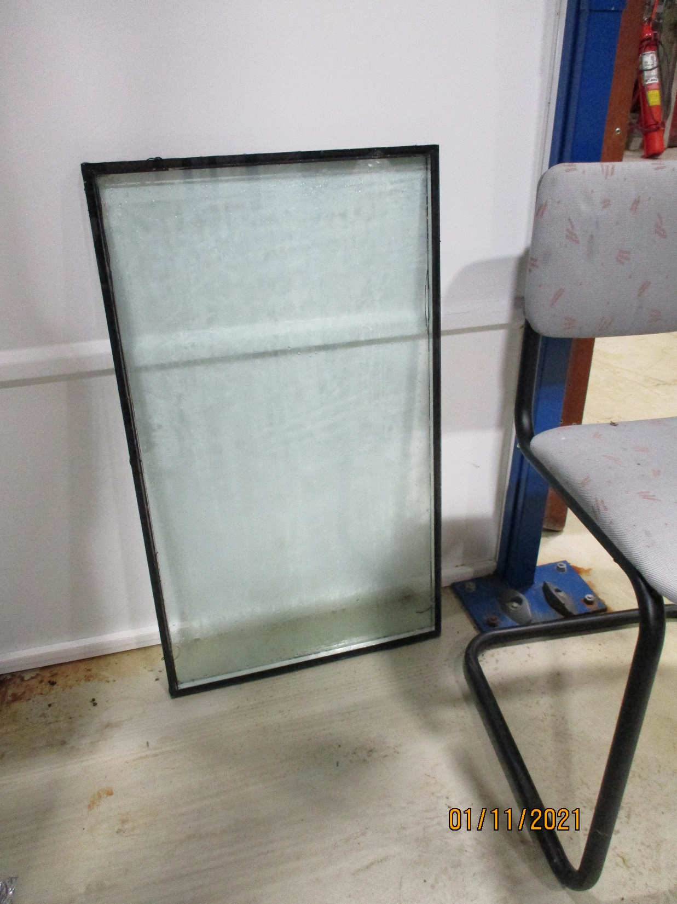
47.5cm
80 cm

