Slide 1
2nd move for Stasis Lab in 904
Ian
9 Sept 2021

Slide 2
All cabinets moved from RPC side to CSC corridor
15 Palettes moved from RPC side to CSC corridor. To go to tent 683
5-10 palettes to be loaded with remaining RPC material, after sorting, to go to CSC side or directly to tent 683.

Slide 3
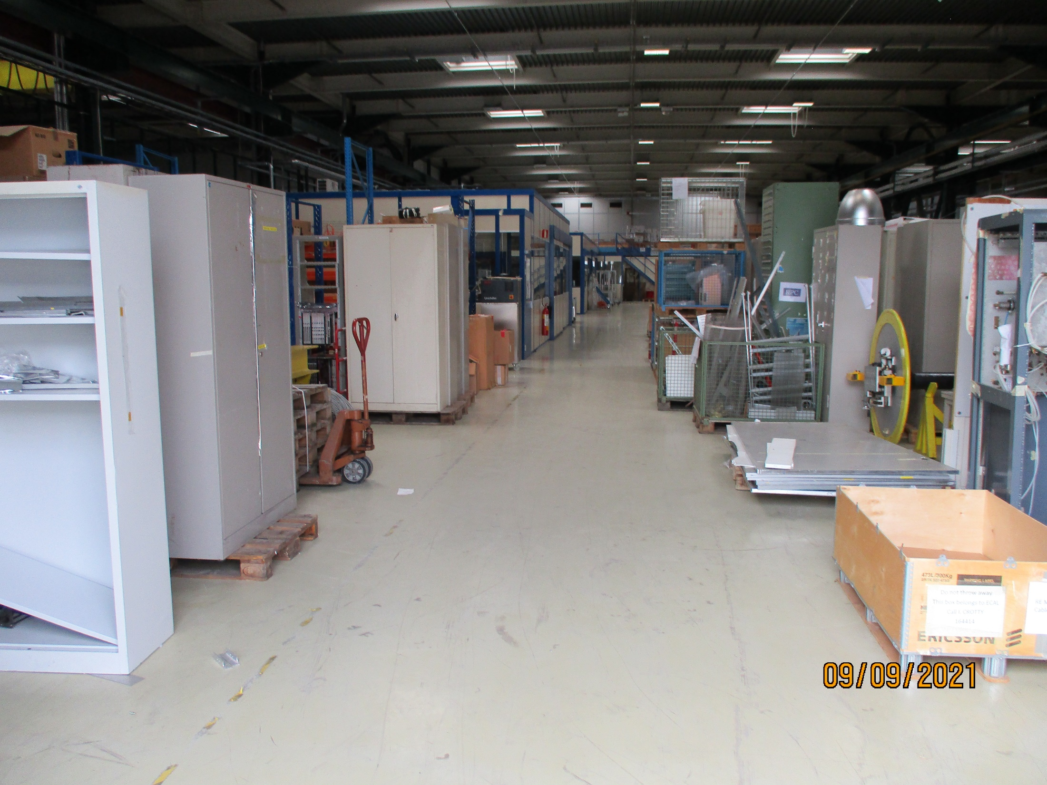
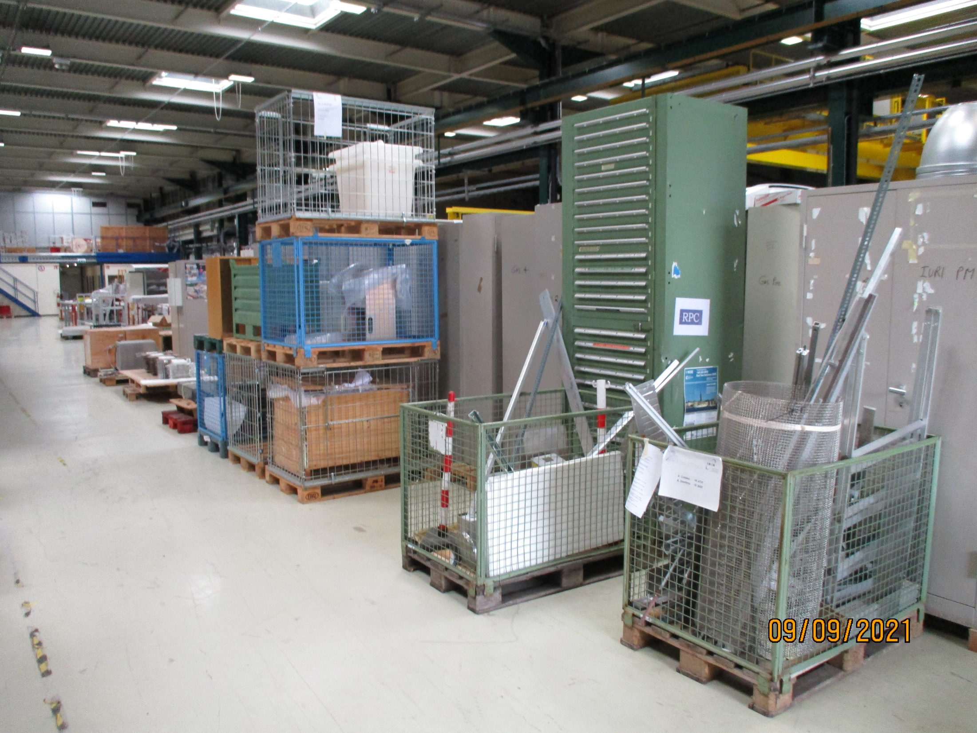
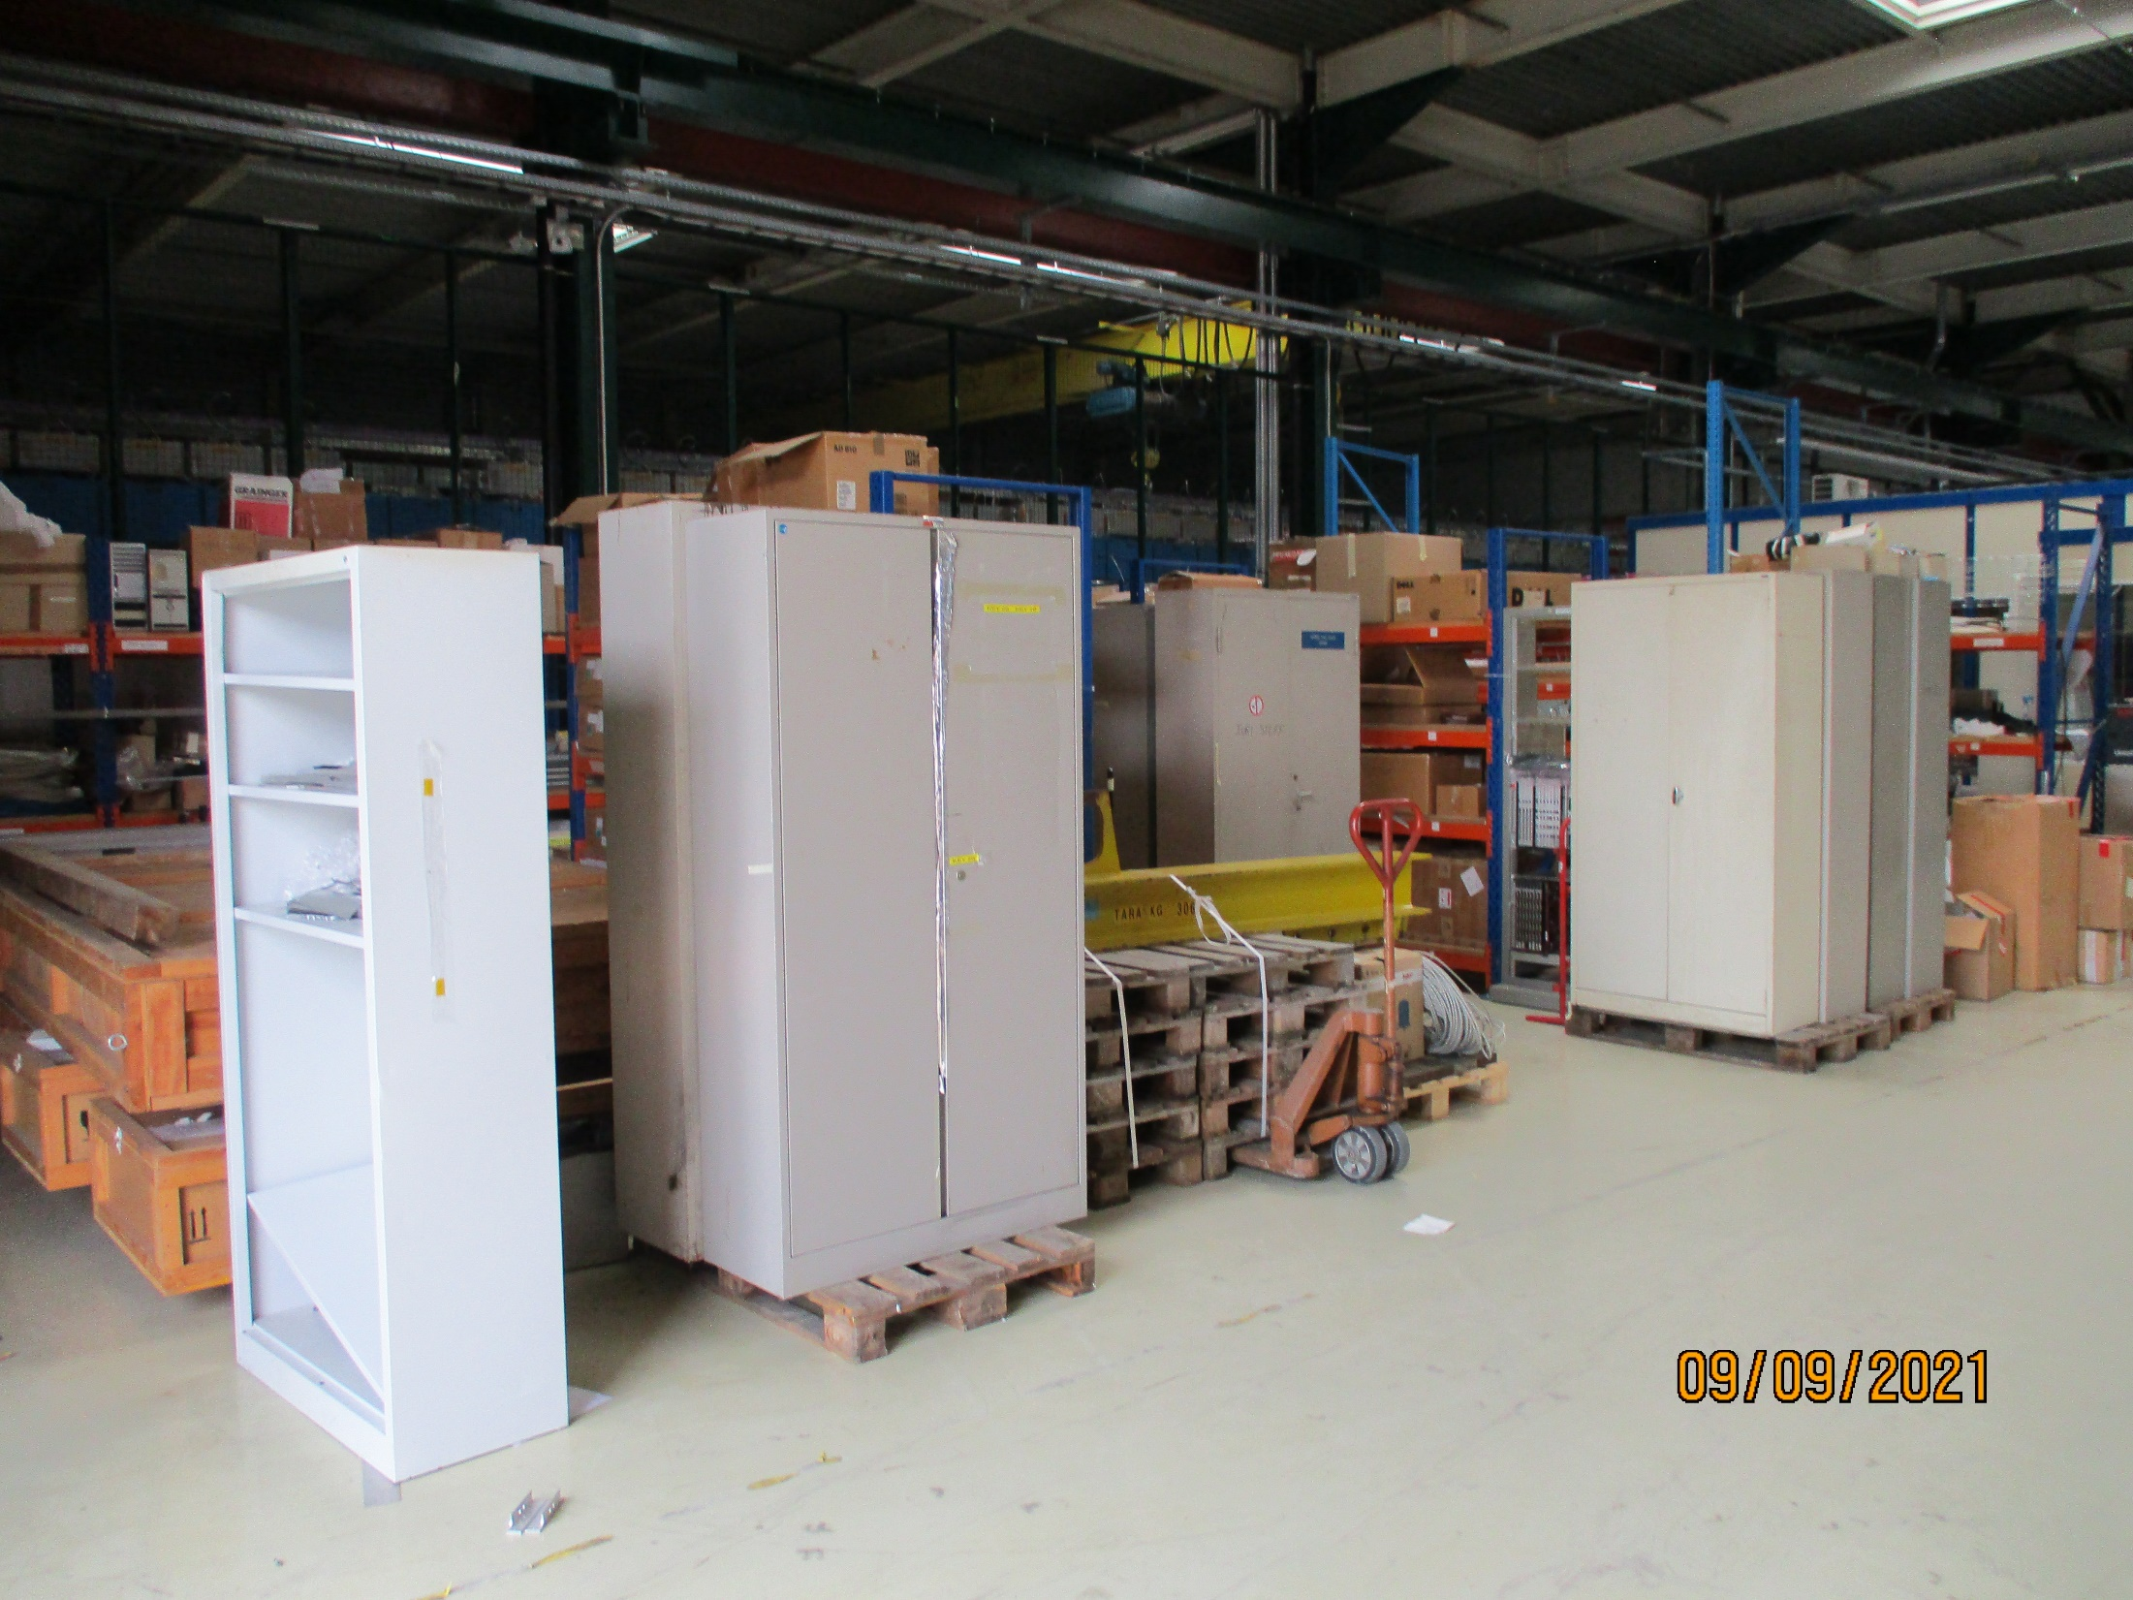
Palletes to go to tent.
Cabinets behind

Slide 4
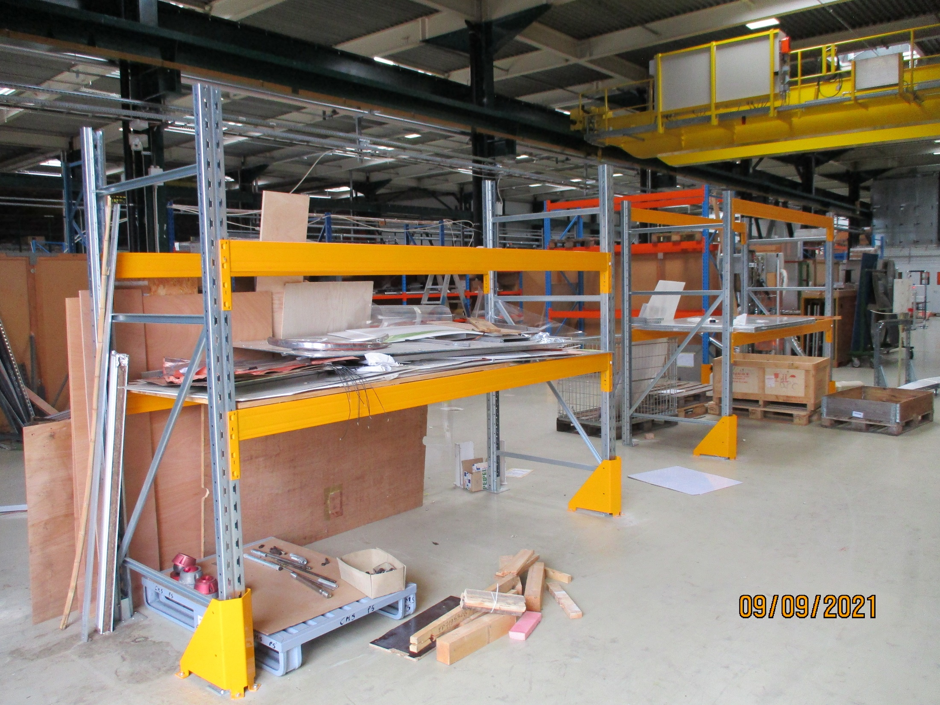
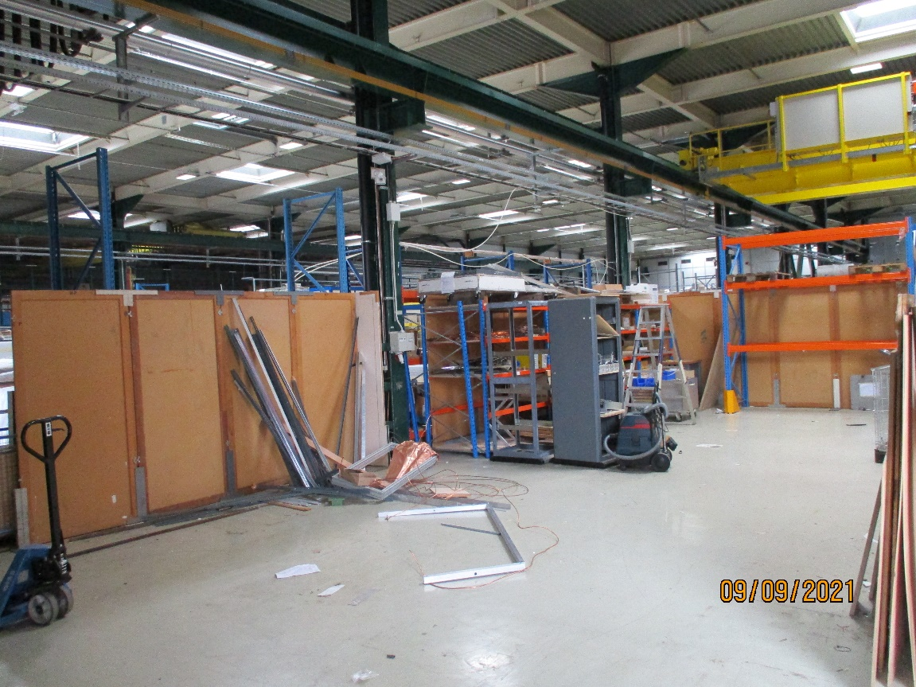
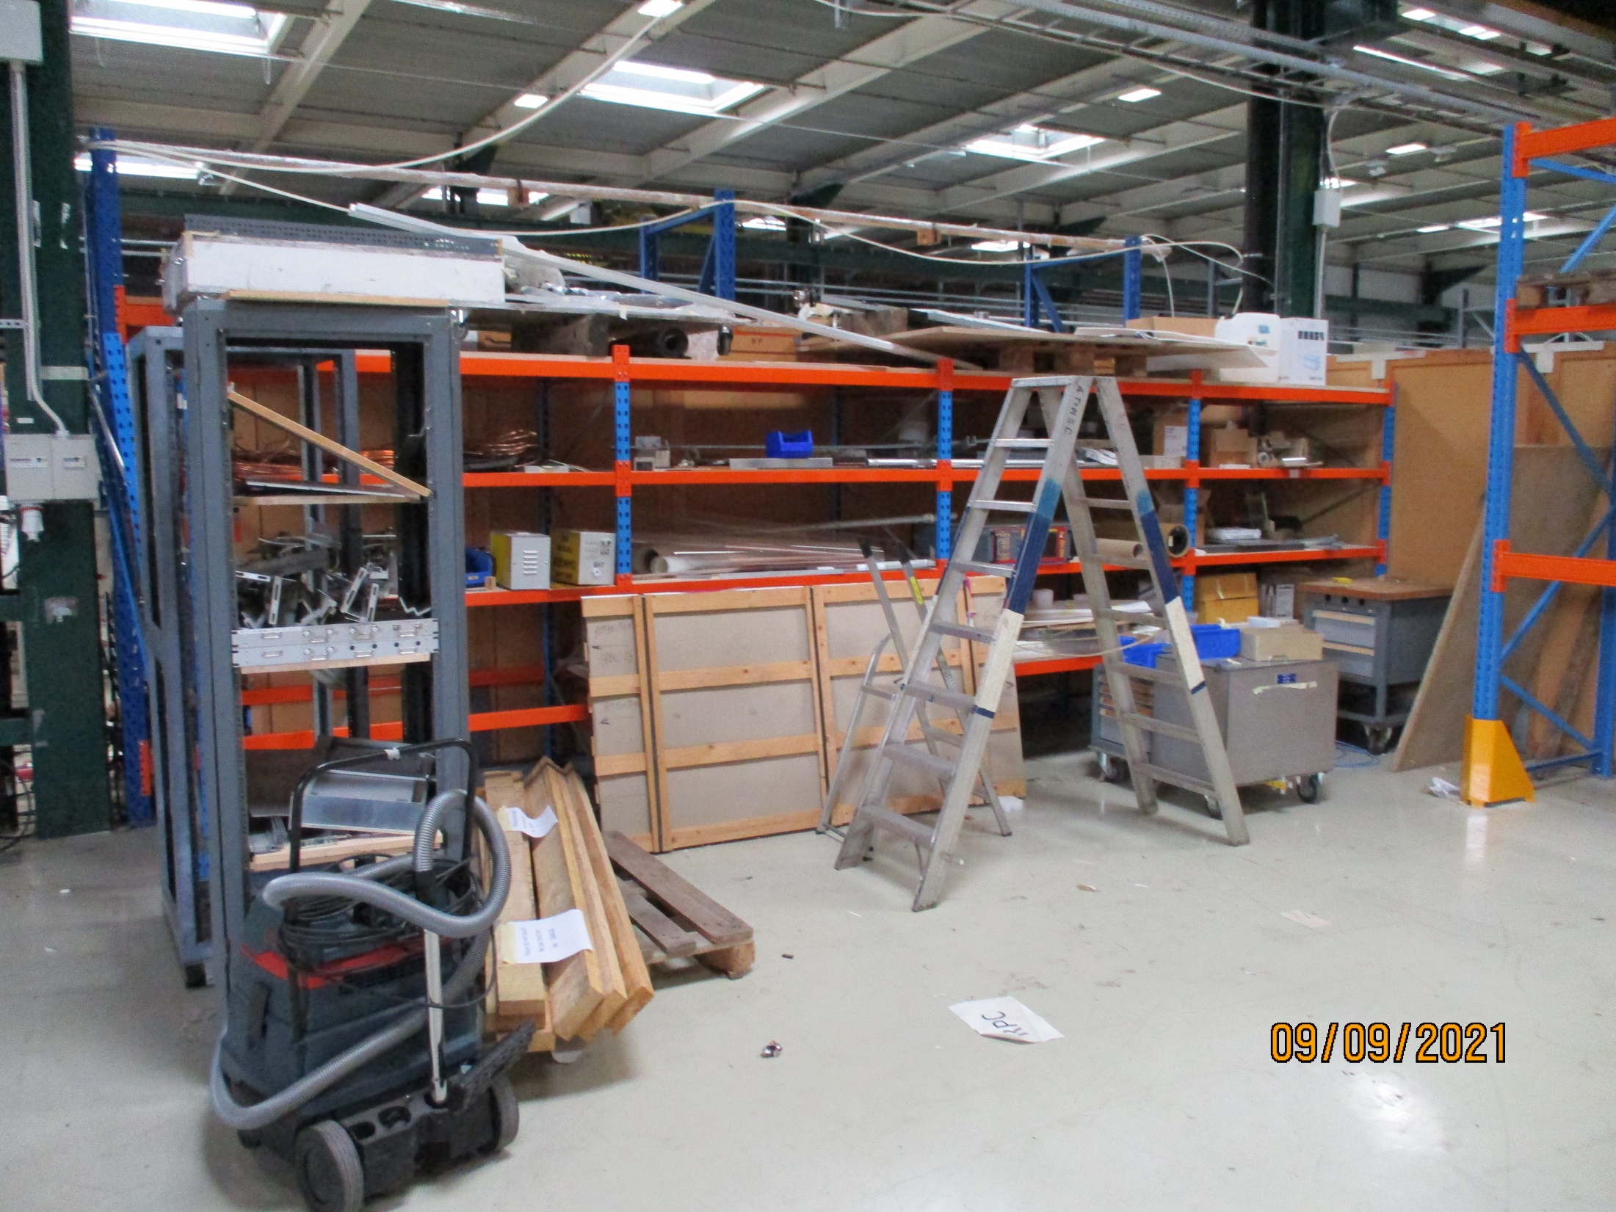
Shelving on the front and side cleared.
Shelving at the back to be sorted and loaded onto palettes.

Slide 5
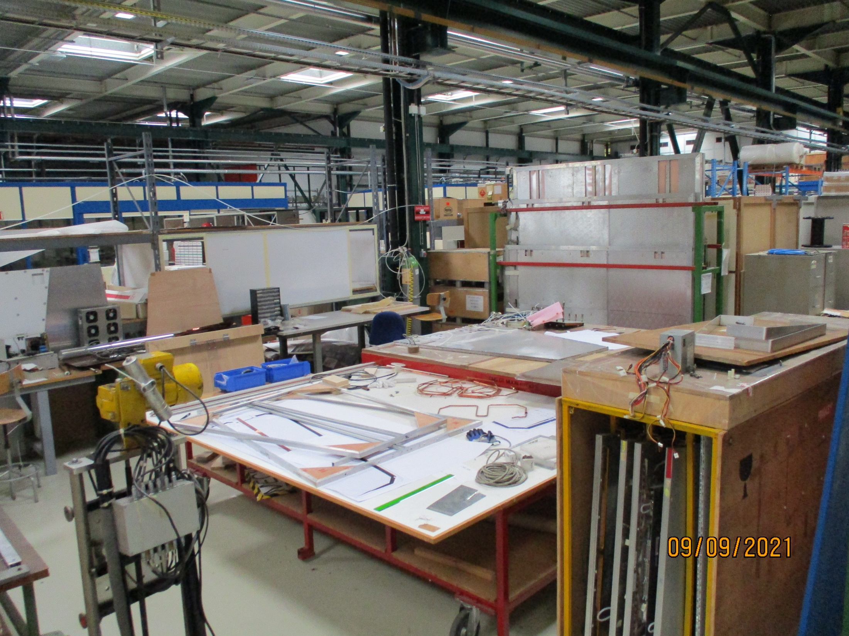
How, Who and When will all this go ?

Slide 6
Actions
Move material from north side to south with the three trolleys EDH8903834
Transport 15 palettes from 904 to tent EDH8903837
Load material onto 5-10 palettes in 904 EDH8903840
Move remaining 5-10 palettes to tent EDH8903842

