Slide 1
Loan radio active source
Ian
15 Jan 2021

Slide 2
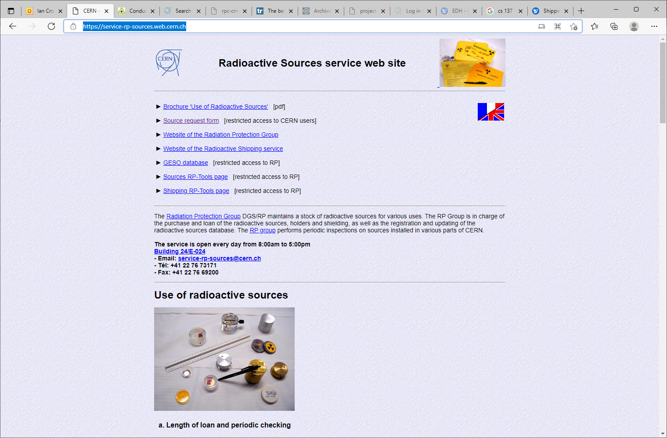
https://service-rp-sources.web.cern.ch/

Slide 3
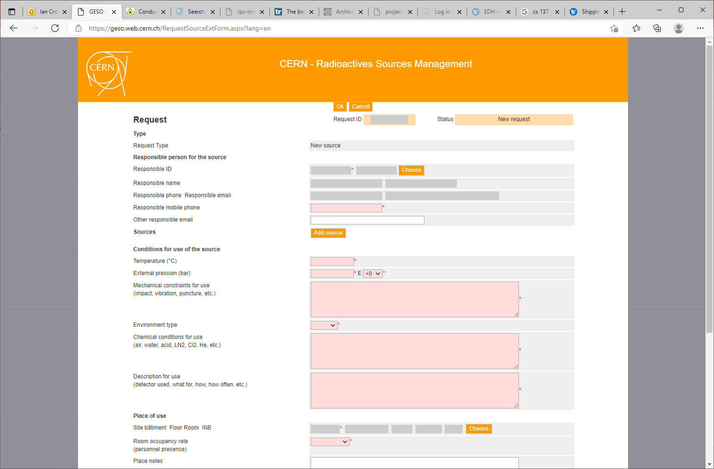

Slide 4
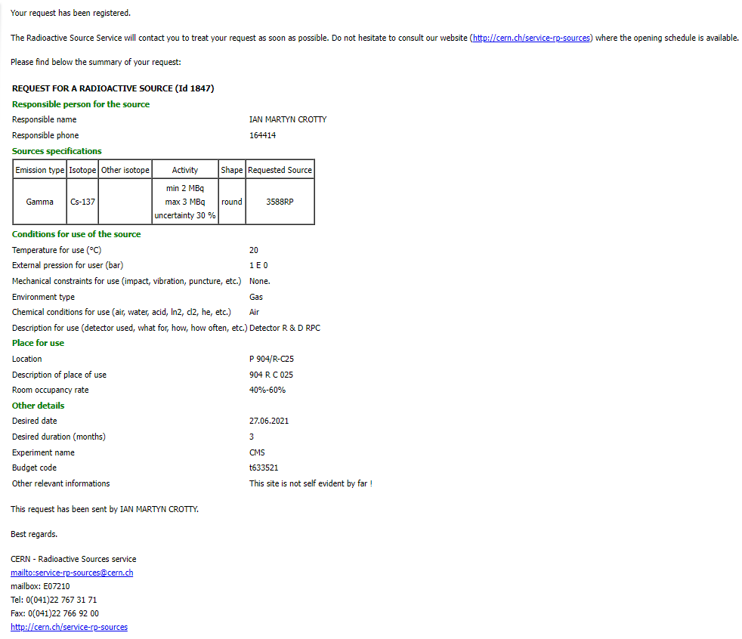

Slide 5
