Slide 1
Locks and handles for metallic cupboards
Ian
29 Nov 2019

Slide 2
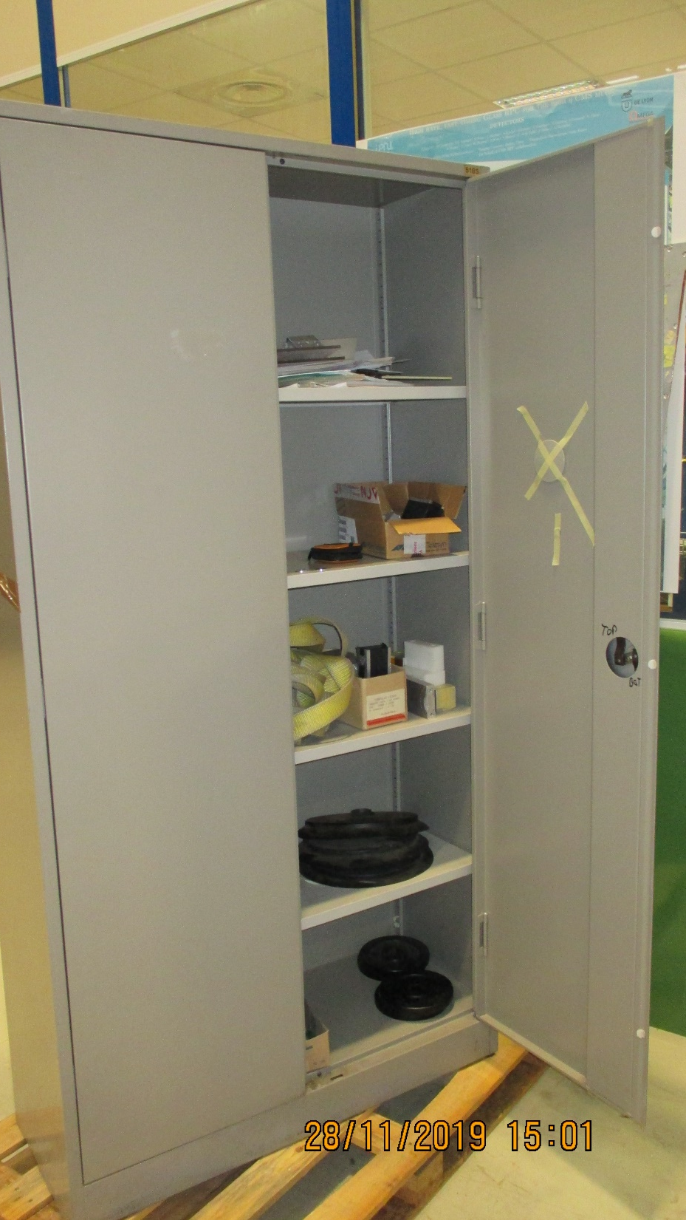
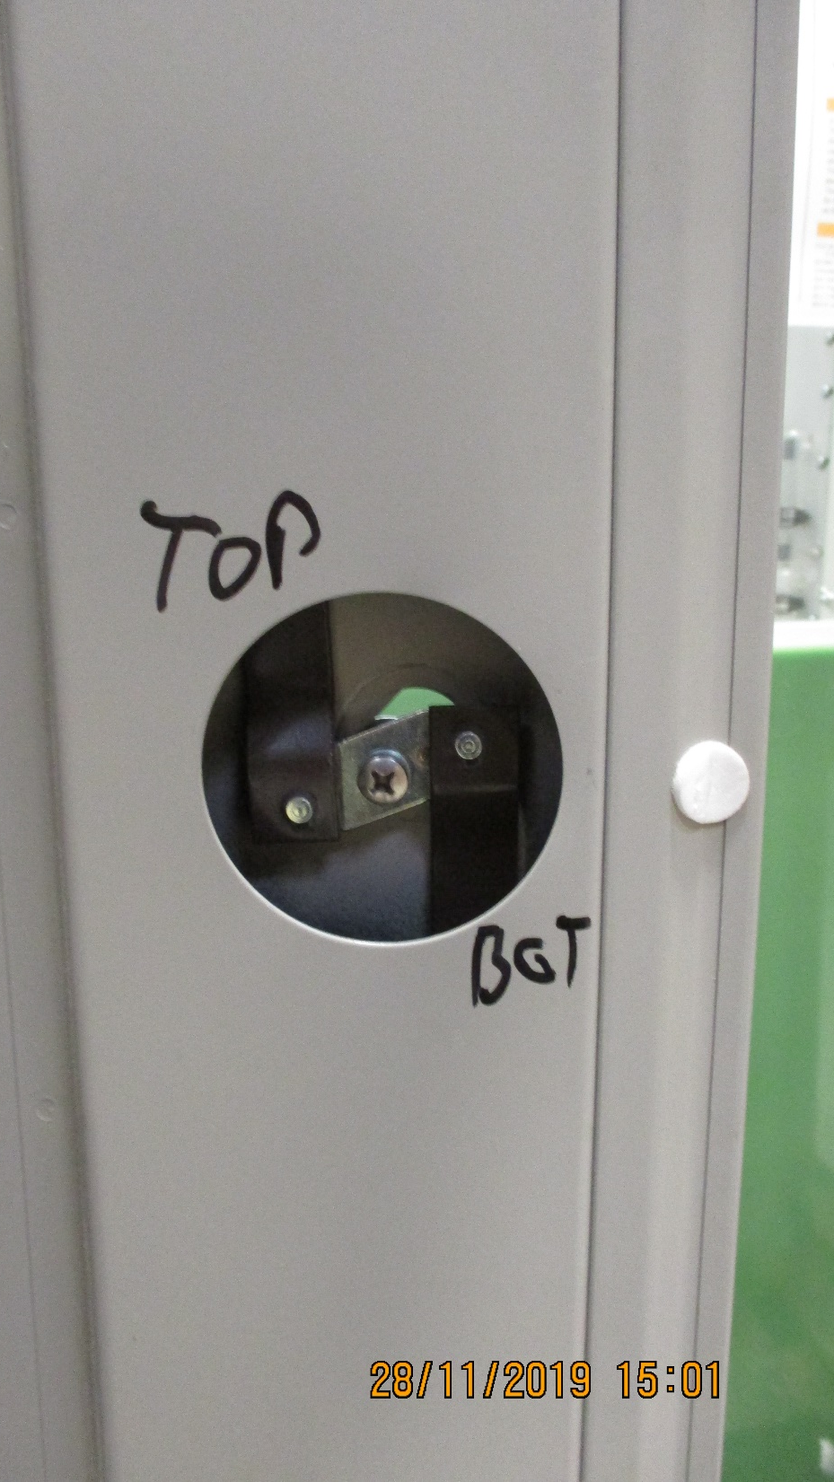
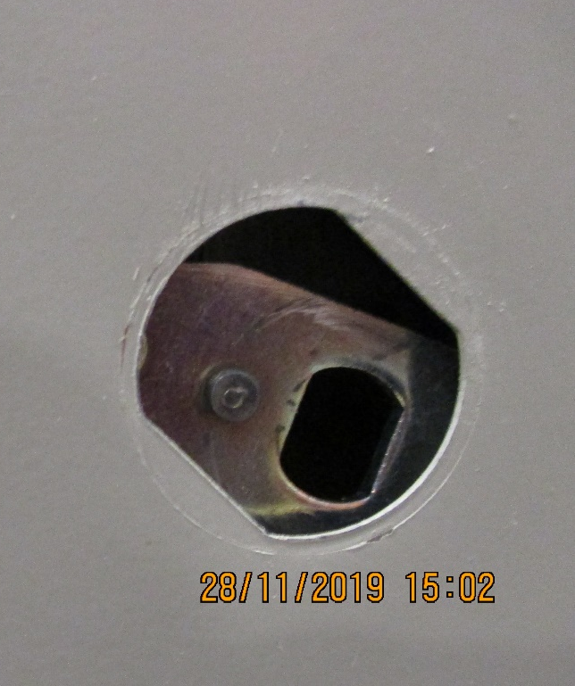

Slide 3
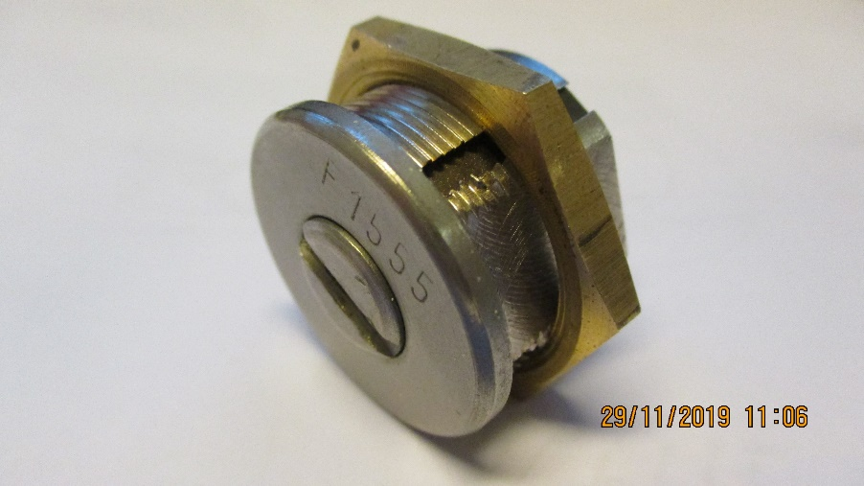
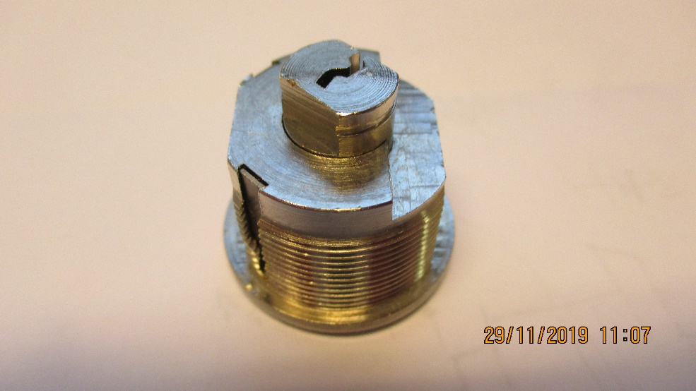
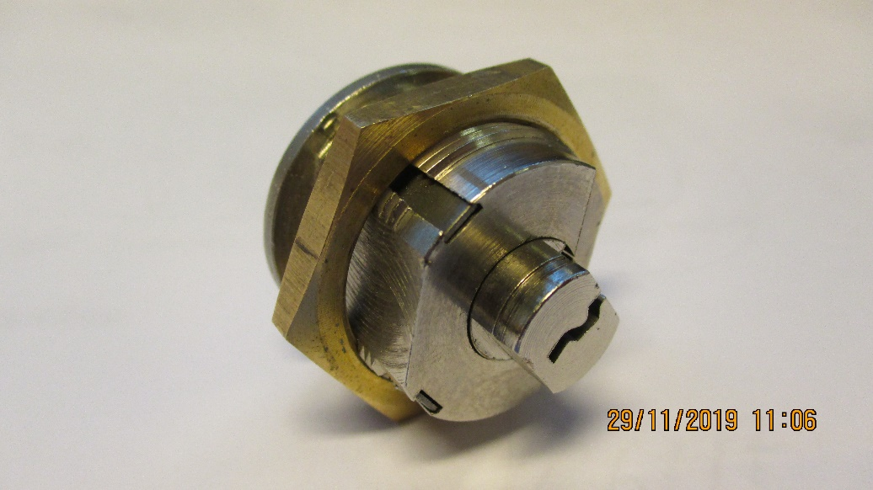
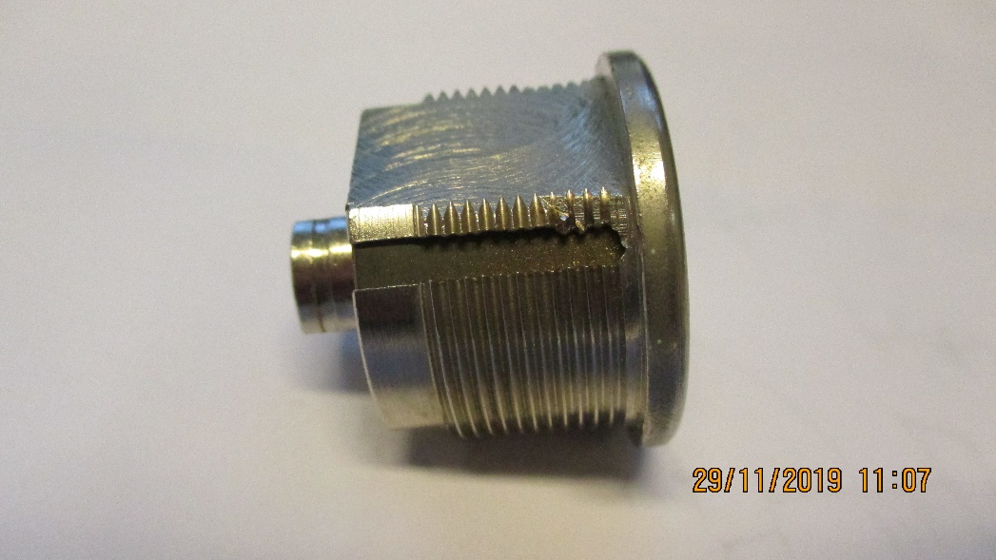
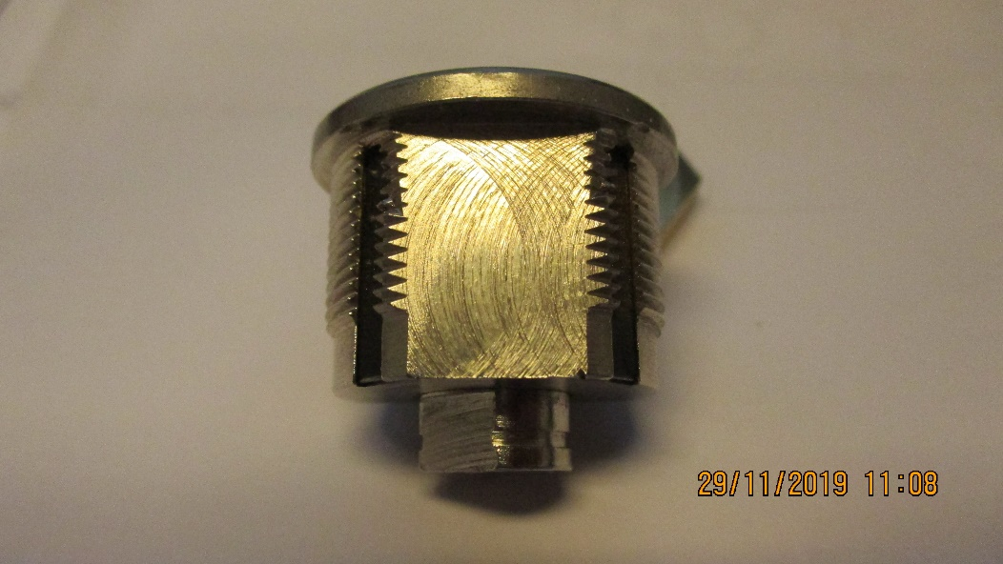
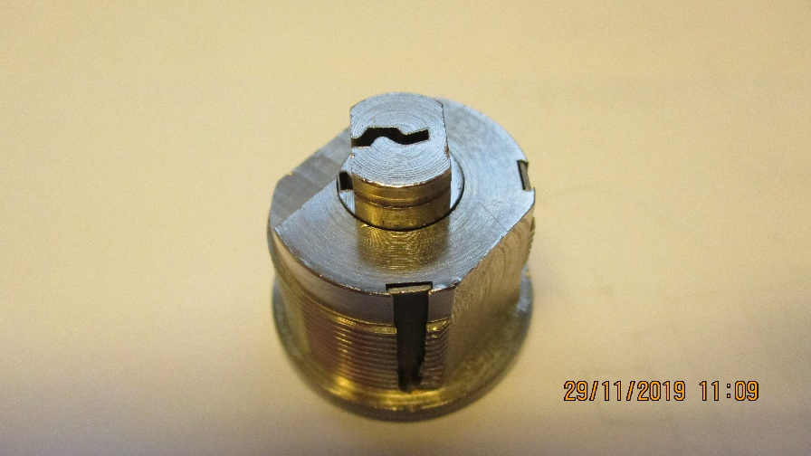
20.8mm
Dia. 28mm
AF 30mm
7.98mm
26mm
M25
Dia. 11mm

Slide 4
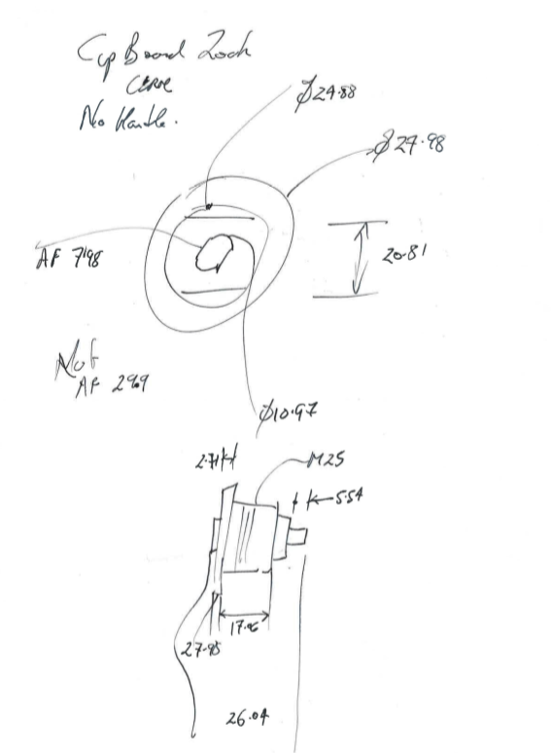
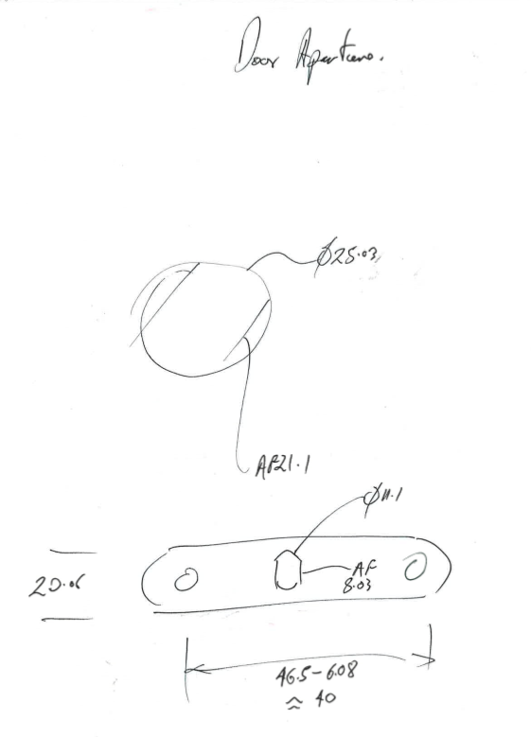

Slide 5
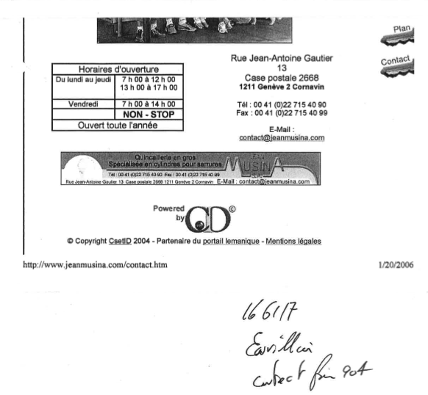

Slide 6
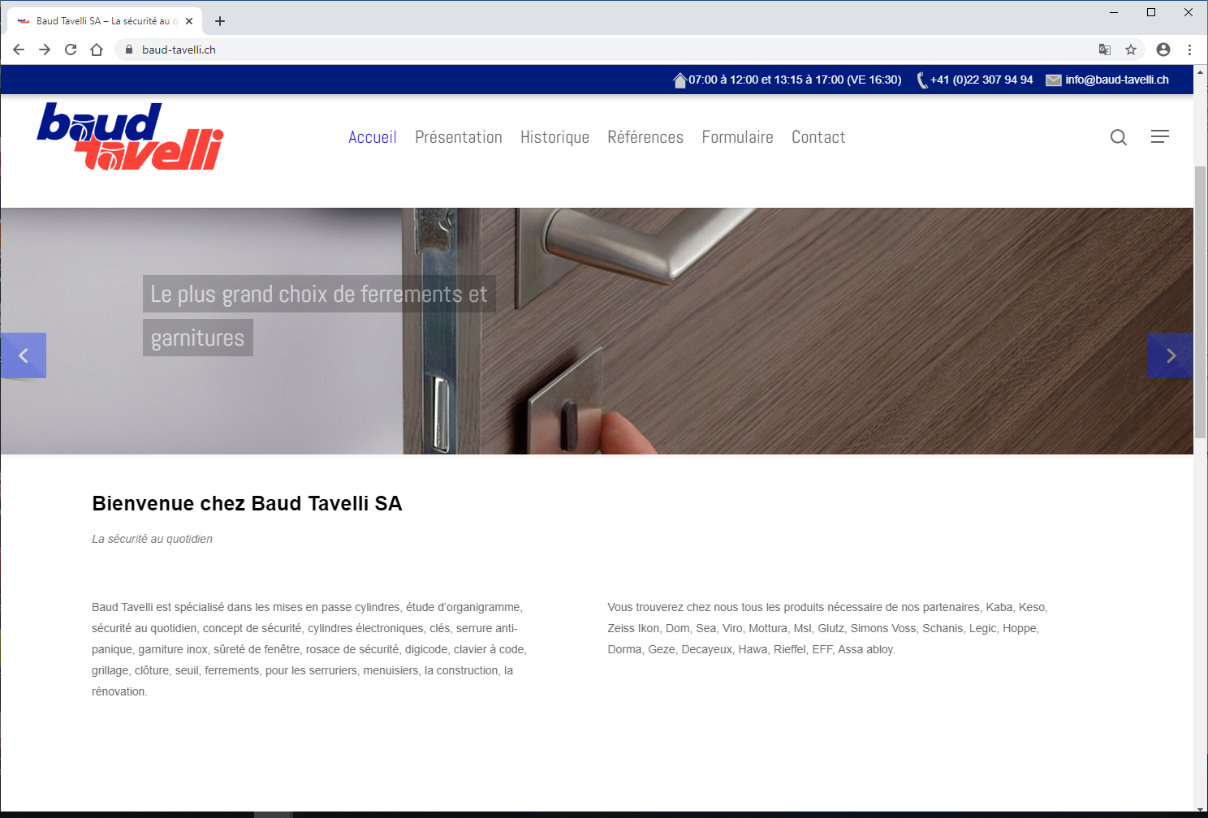

Slide 7
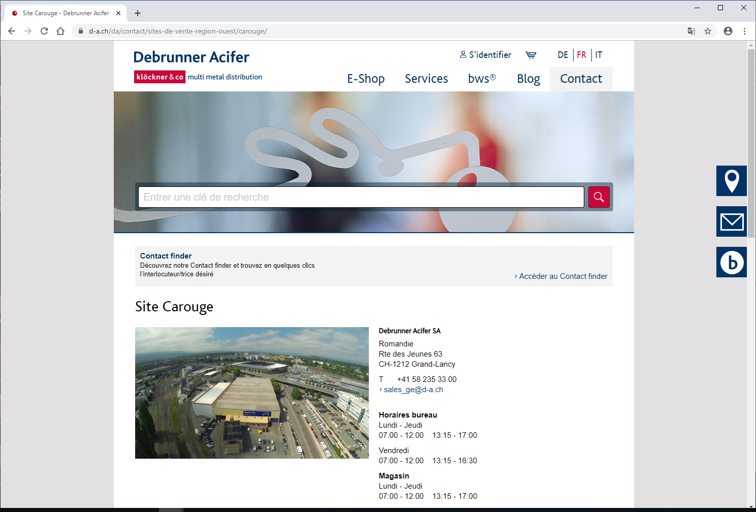

Slide 8
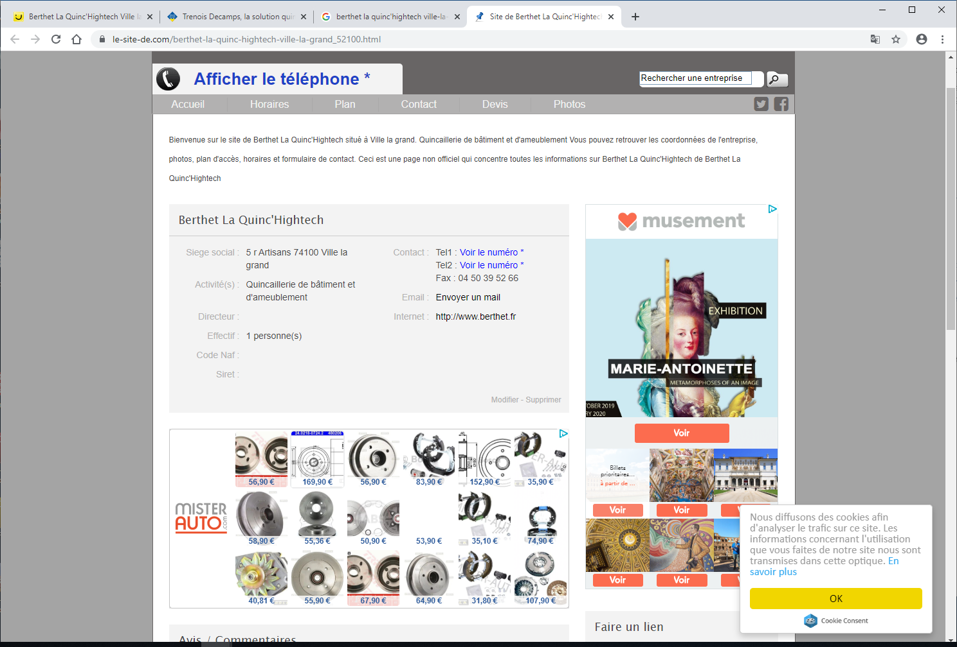
Berthet La Quinc'Hightech
Phone: +33 4 50 95 45 53
https://www.le-site-de.com/berthet-la-quinc-hightech-ville-la-grand_52100.html

Slide 9
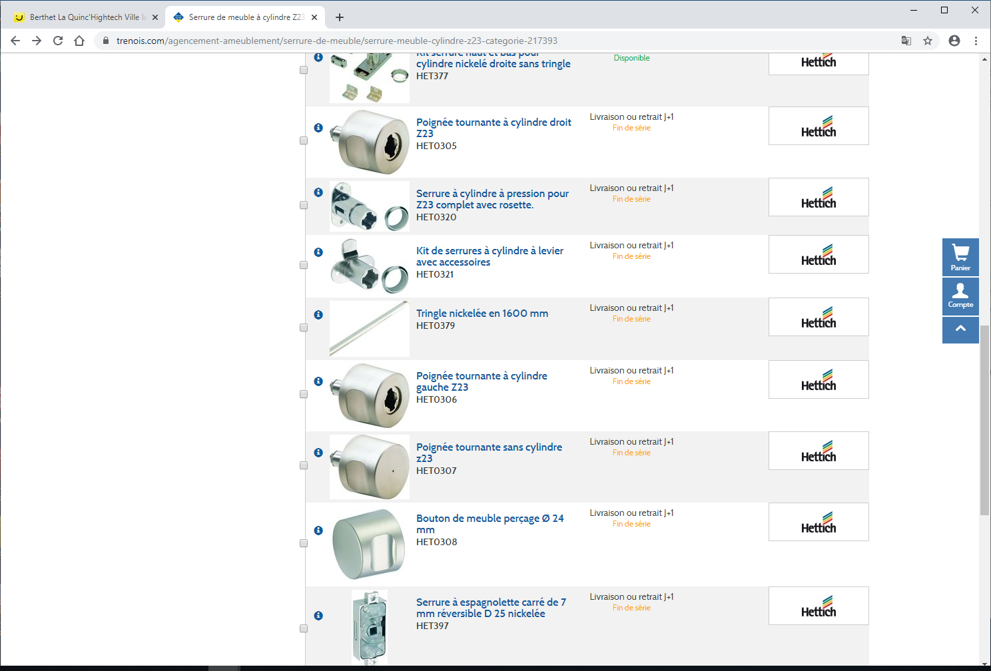
Trenois Decamps
Agence d'Annecy
Z.I. du Pont de Tasset
10 Chemin du Vieran
74960 MEYTHET
04 50 10 73 60
04 50 10 73 61
annecy@trenois.com
https://www.trenois.com/agencement-ameublement/serrure-de-meuble/serrure-meuble-cylindre-z23-categorie-217393

Slide 10
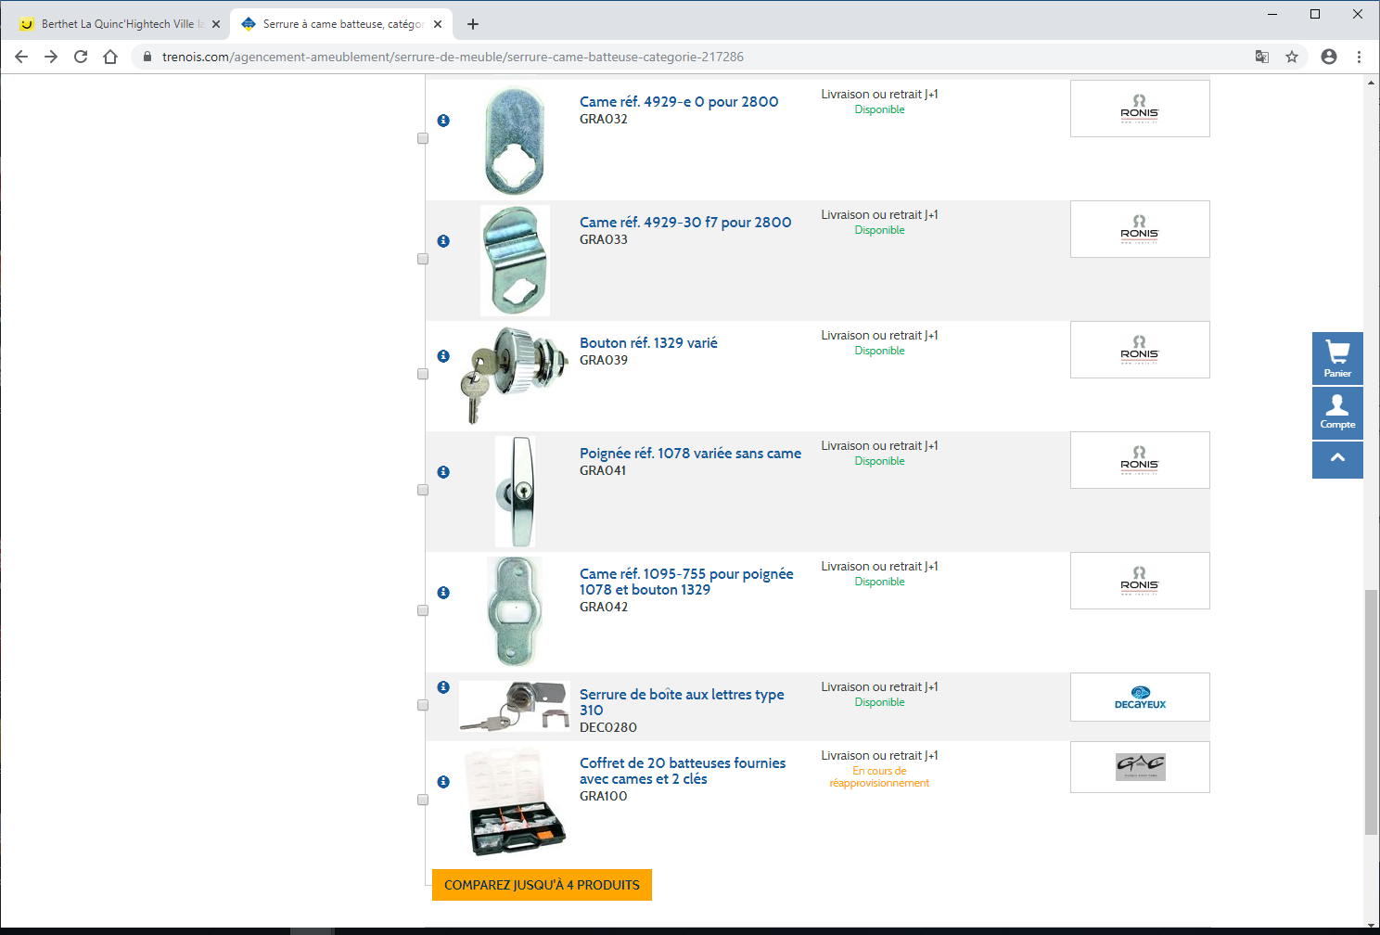
https://www.trenois.com/agencement-ameublement/serrure-de-meuble/serrure-came-batteuse-categorie-217286

Slide 11
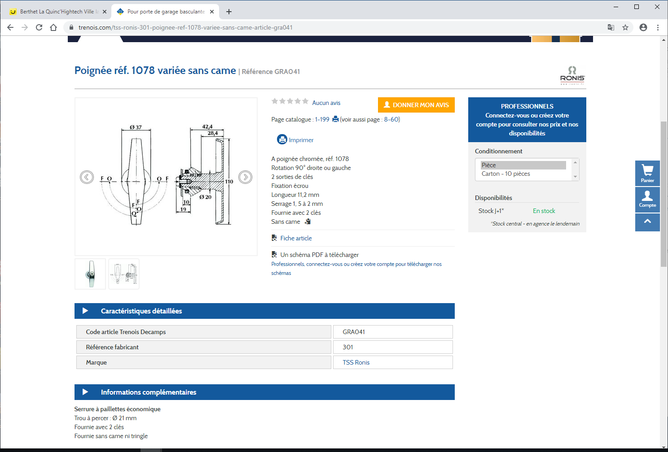
https://www.trenois.com/tss-ronis-301-poignee-ref-1078-variee-sans-came-article-gra041

Slide 12
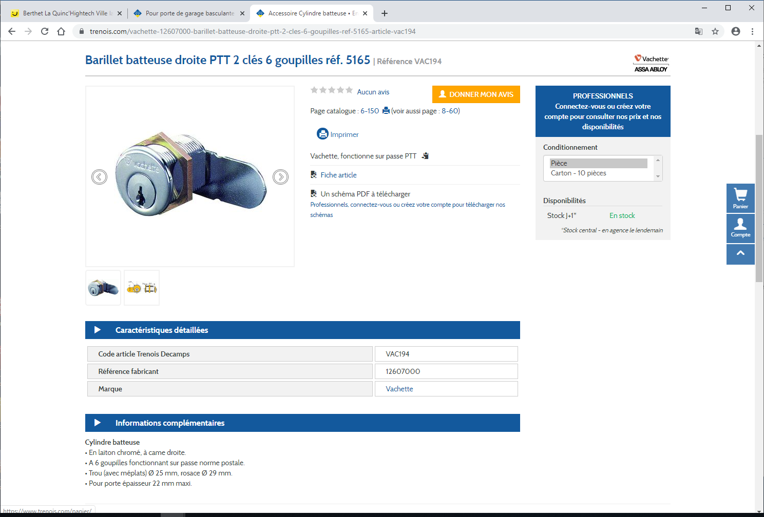
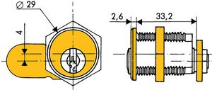
https://www.trenois.com/vachette-12607000-barillet-batteuse-droite-ptt-2-cles-6-goupilles-ref-5165-article-vac194

Slide 13
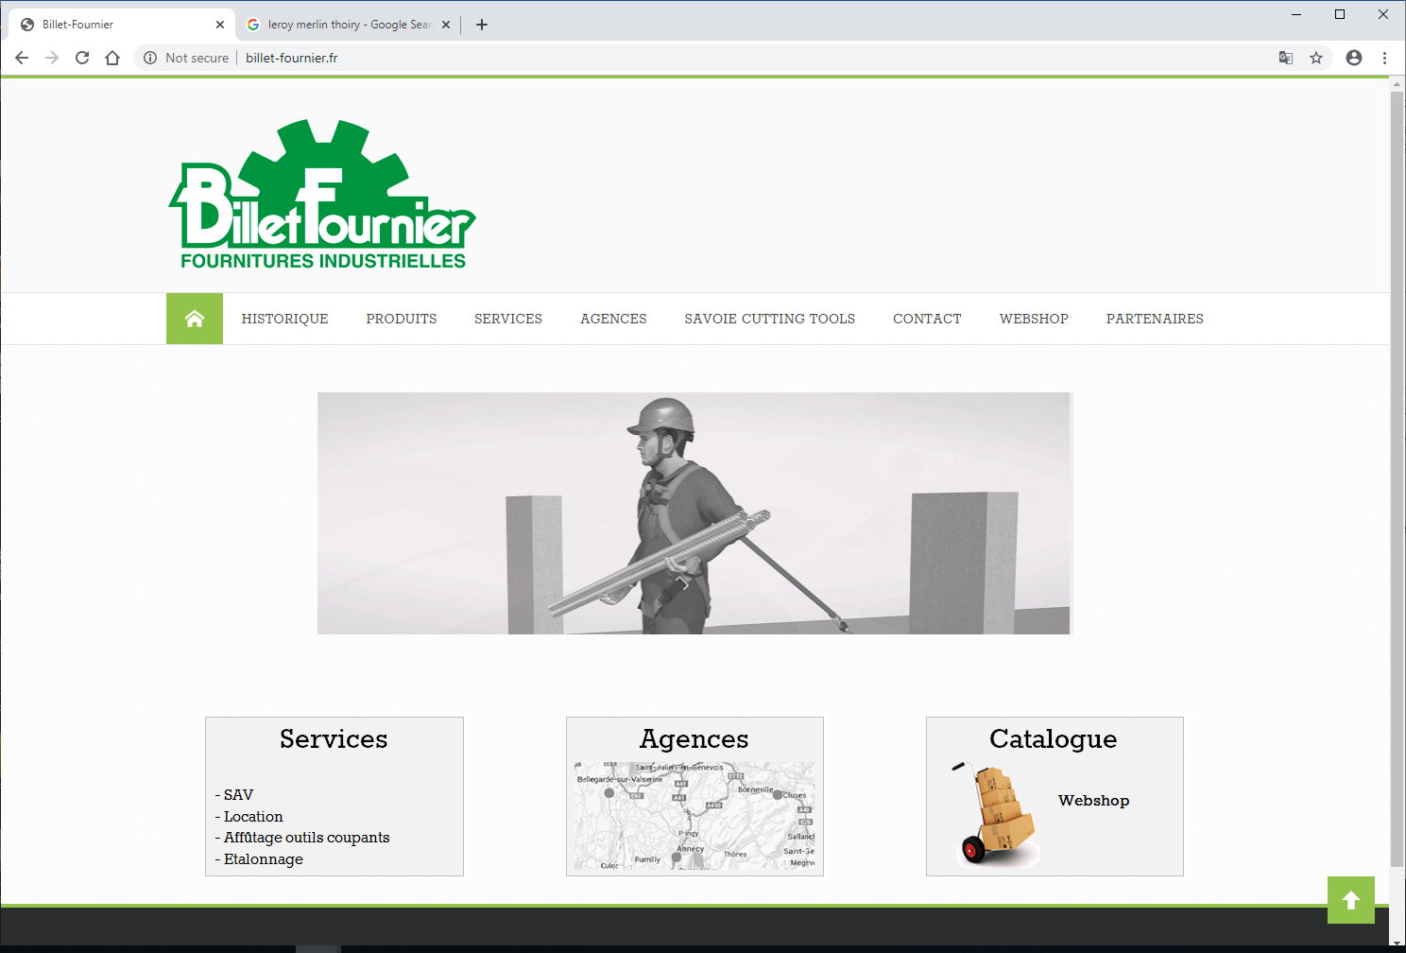
http://www.billet-fournier.fr/

Slide 14
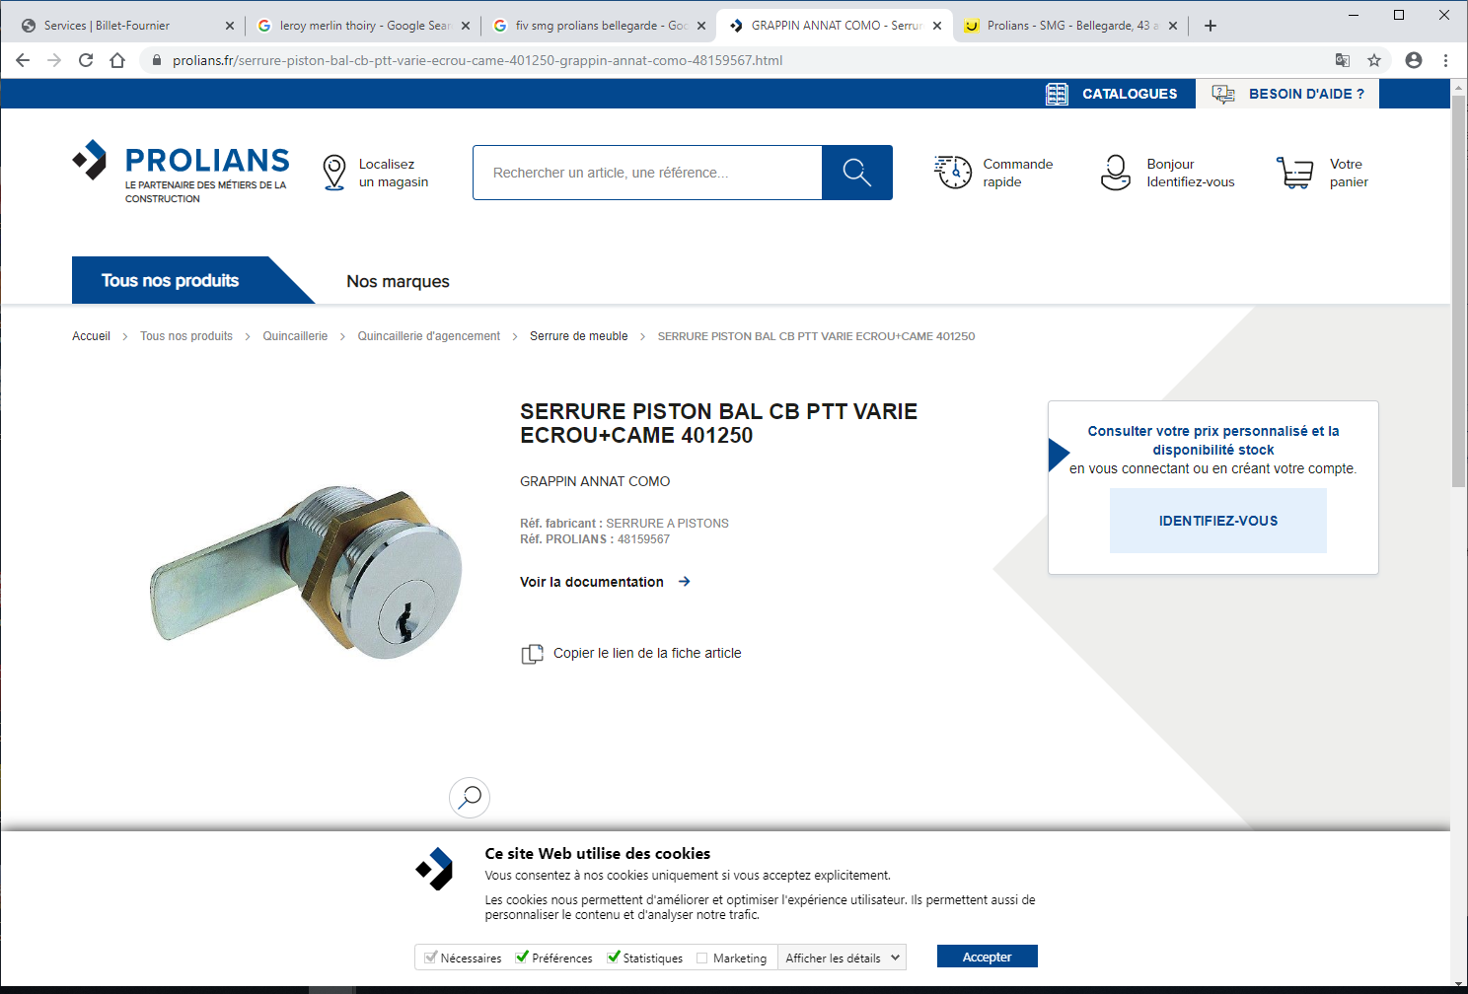
https://www.prolians.fr/serrure-piston-bal-cb-ptt-varie-ecrou-came-401250-grappin-annat-como-48159567.html

Slide 15
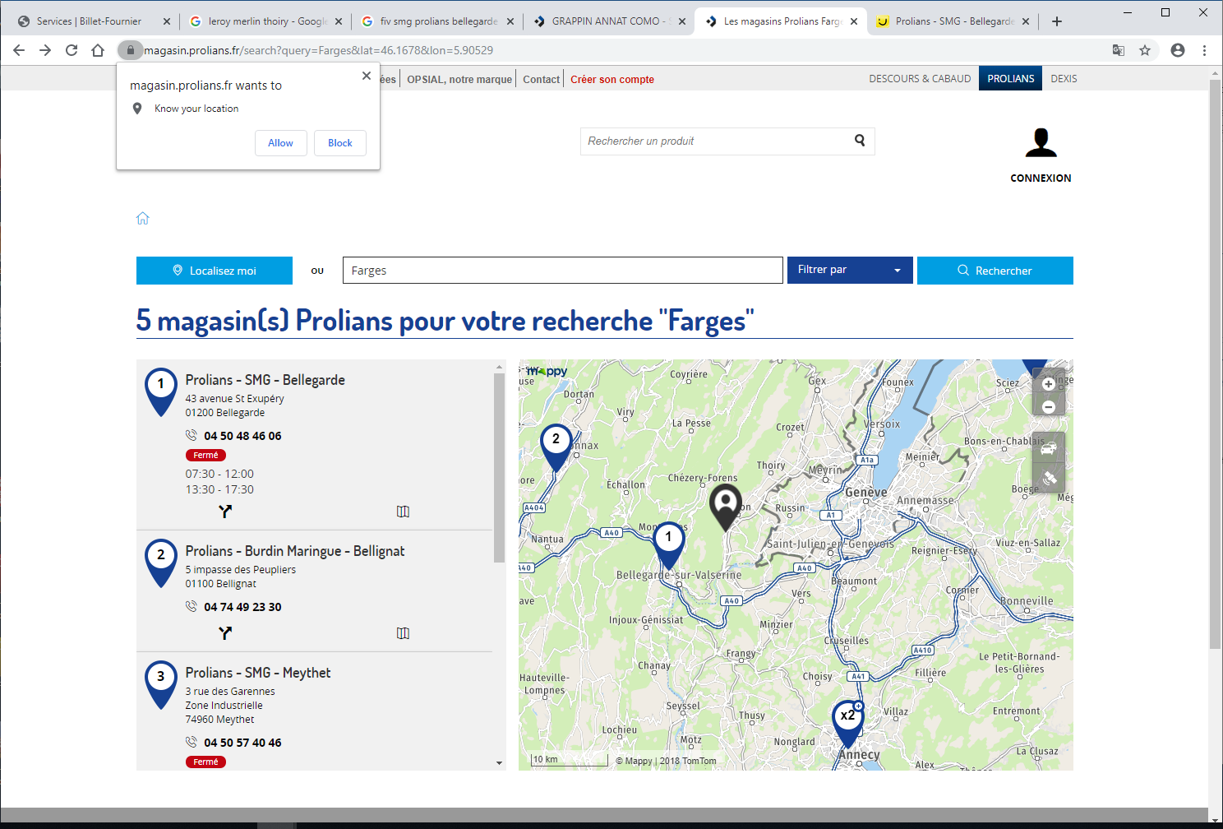

Slide 17
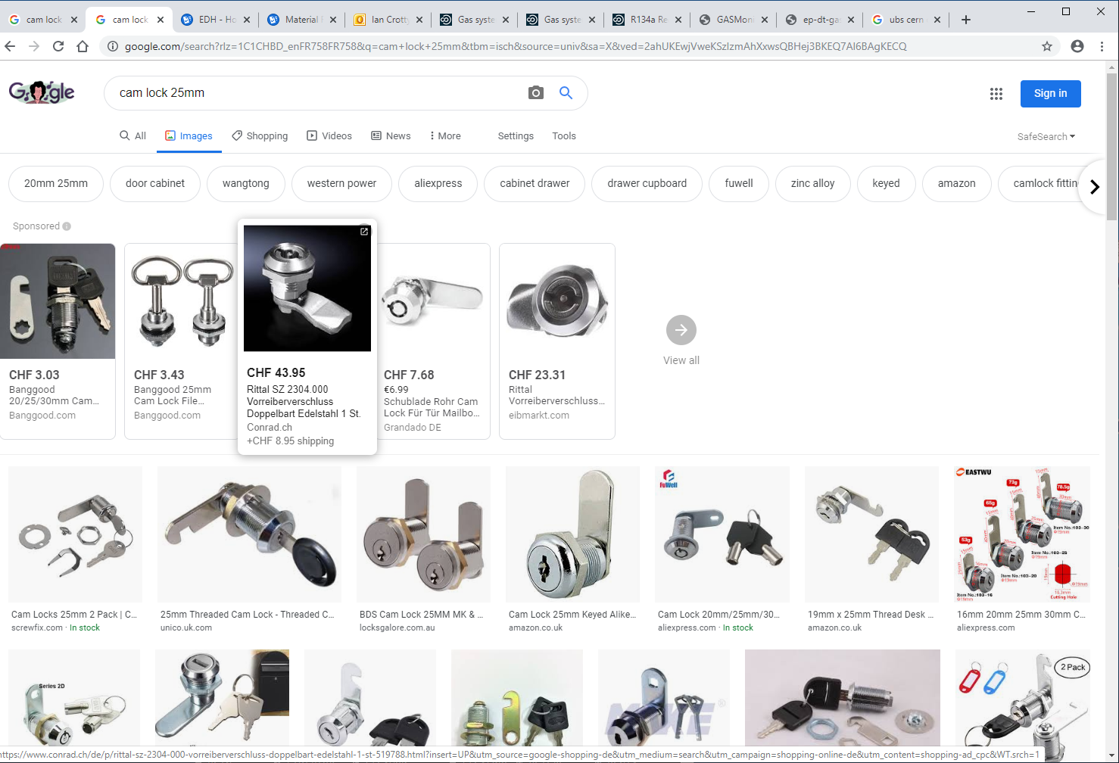

Slide 18
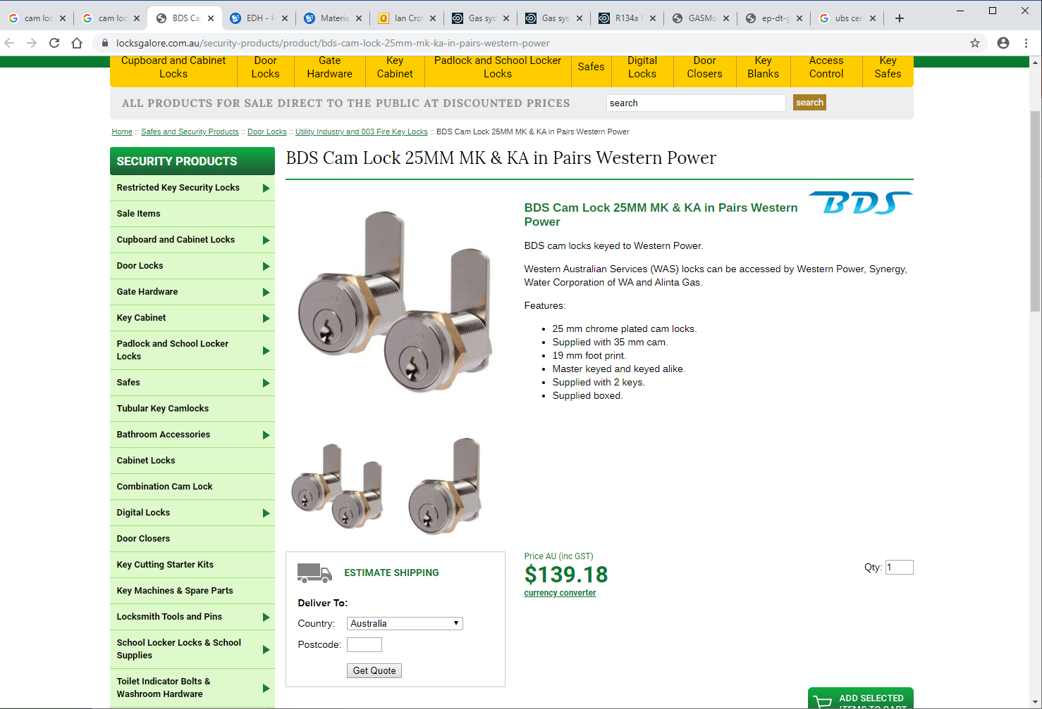
https://www.locksgalore.com.au/security-products/product/bds-cam-lock-25mm-mk-ka-in-pairs-western-power

