Slide 1
Activate ethernet
Fatma and Ian
5 August 2019

Slide 2
05/08/2019
Malike and Daniel have connected to both sockets at the rear of the Fibre Temple (904 XXXXX)
77777 said to send an email to SD to activate the plugs/sockets. Fatma sens mail after 6pm
At the star point CYNET30 ? In the middle of 904, the plugs 2835/01 and 02 are not connected.
06/08/2019
However on checking the reply from SD and the link we see that the sockets are active !!
The PC named PCCMSRPC904 does not make contact with the outside world ……..
We should disconnect the pc thru. The IT web page and reconnect also thru. The IT page ??
1430 pm IT WORKS !!
Must check with both cables/sockets.

Slide 3
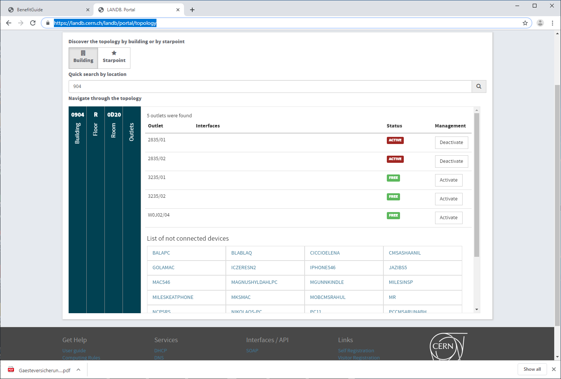
https://landb.cern.ch/landb/portal/topology

