Slide 1
Cocreate registration
Ian
20 Oct 2022

Slide 2
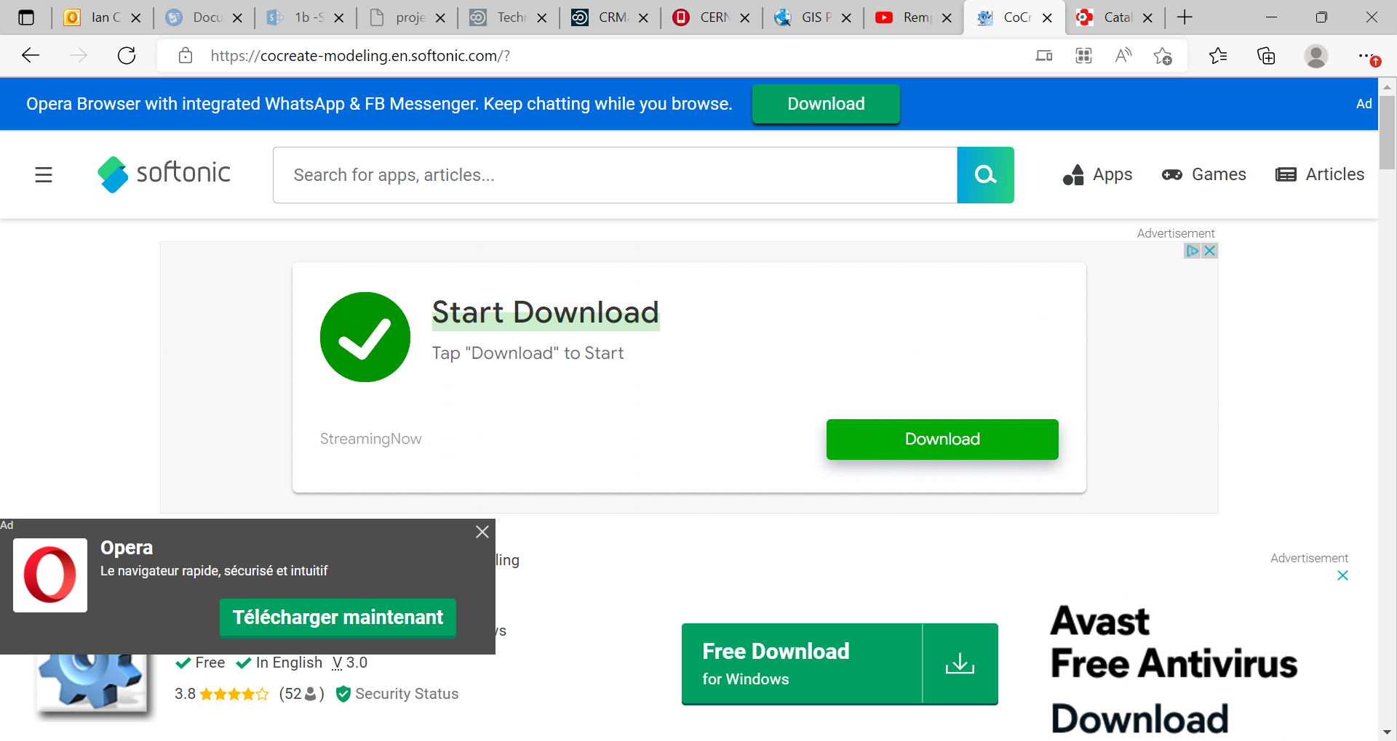
https://cocreate-modeling.en.softonic.com/?

Slide 3
OR

Slide 4
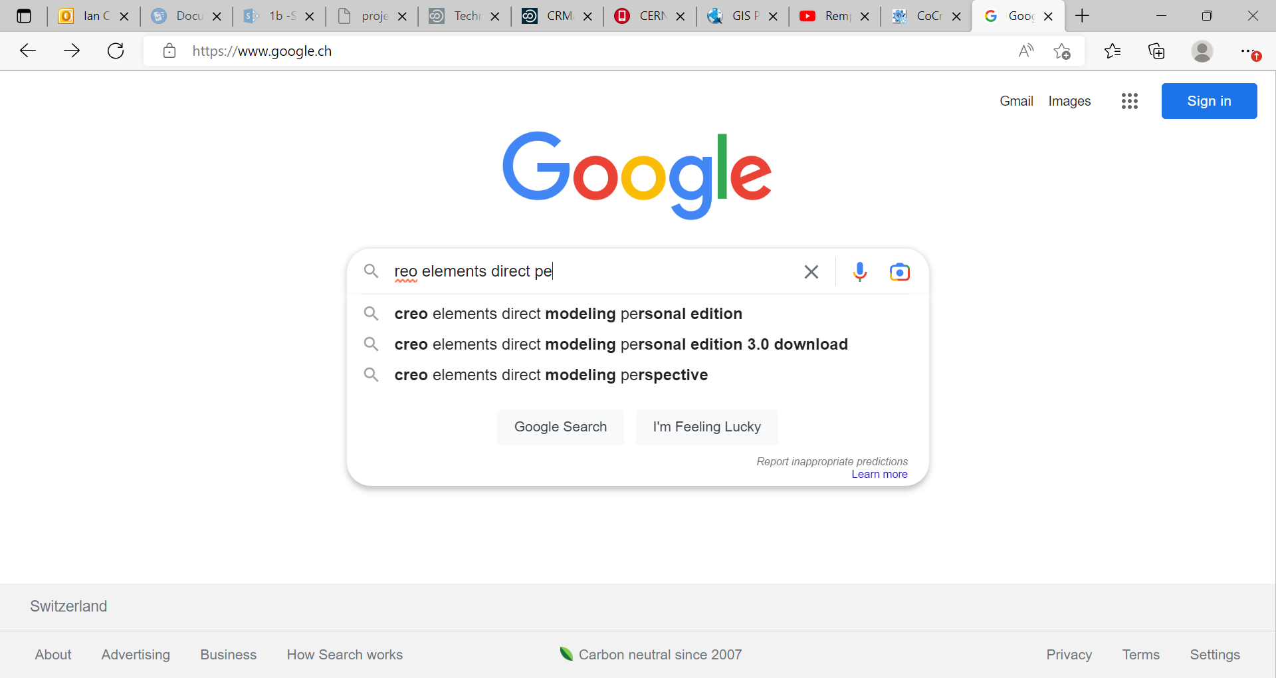
Search with key words;
creo elements direct pe
Gives;

Slide 5
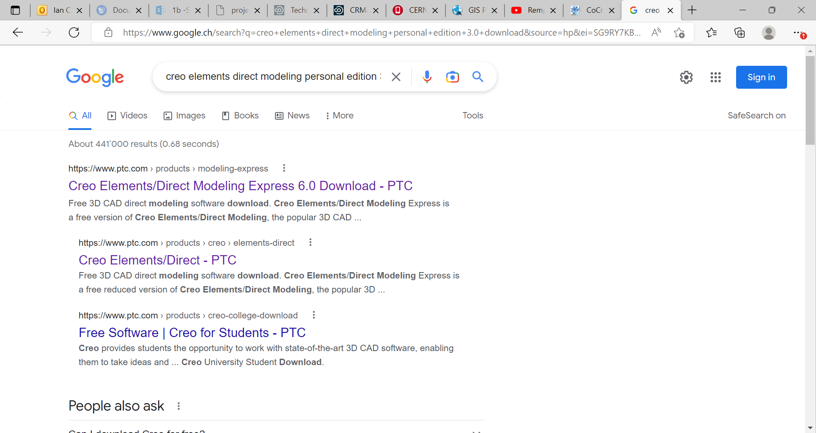
Taking the “express 6.0 Download….”

Slide 6
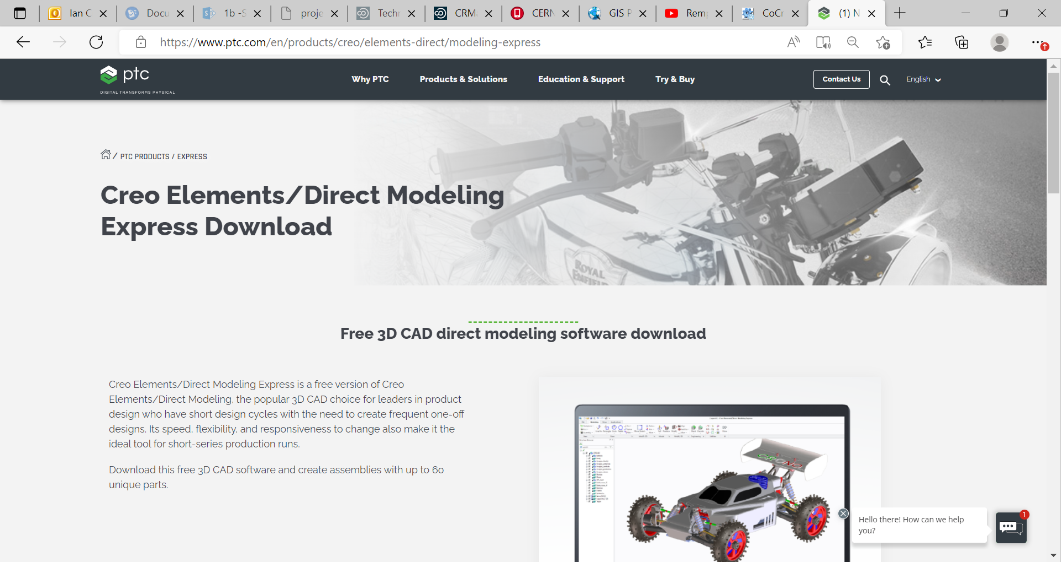

Slide 7
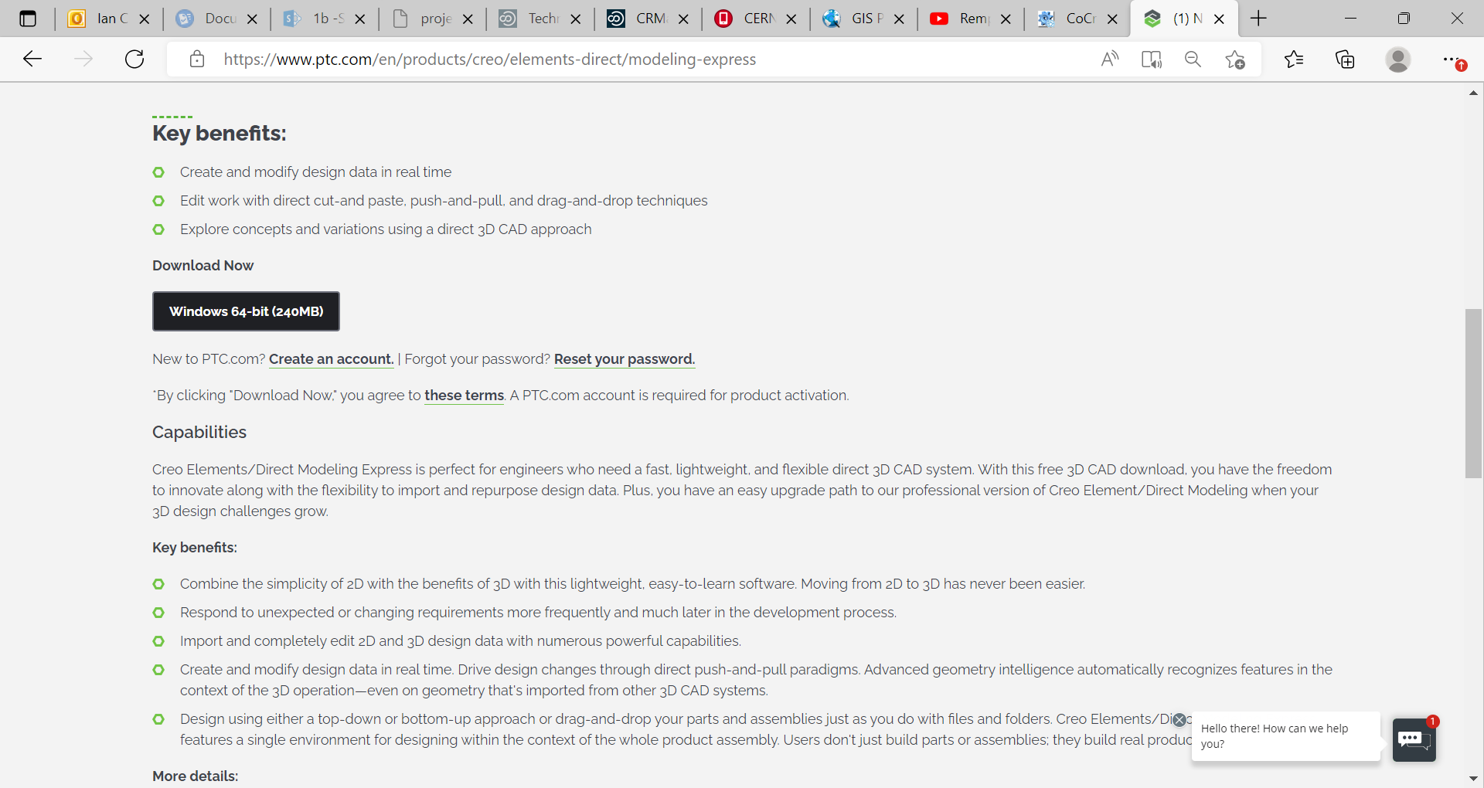
Before doing the download I try to create an account.

Slide 8
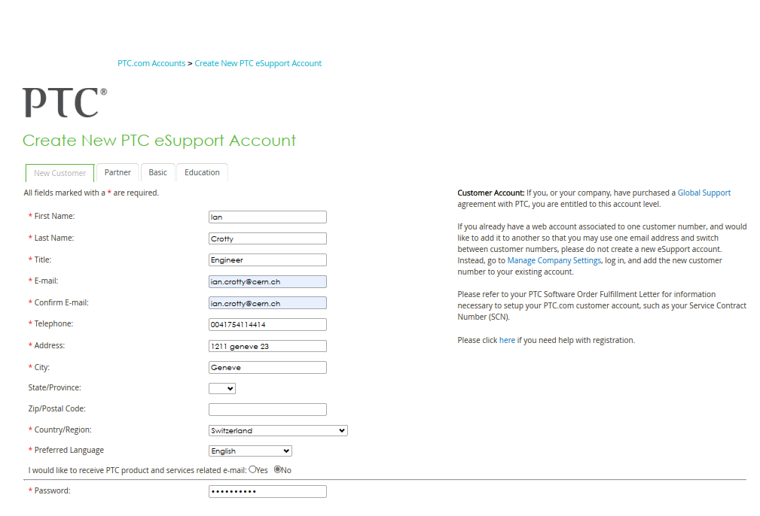

Slide 9
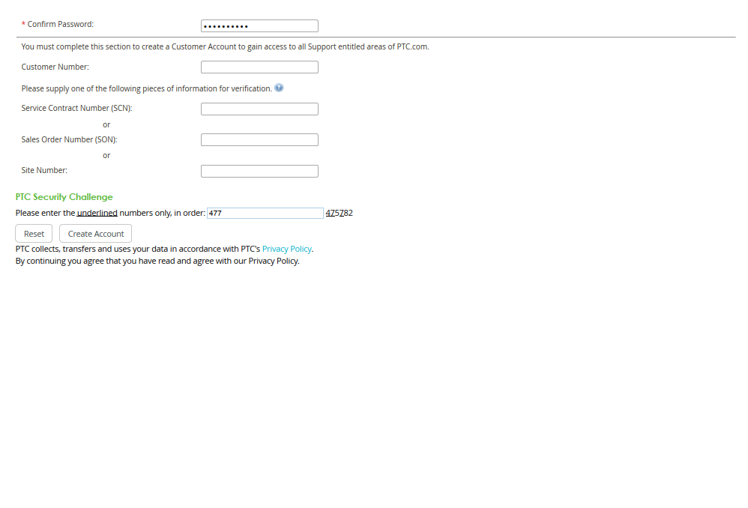
No customer number…………..

Slide 10
Should try the student version ?

Slide 11
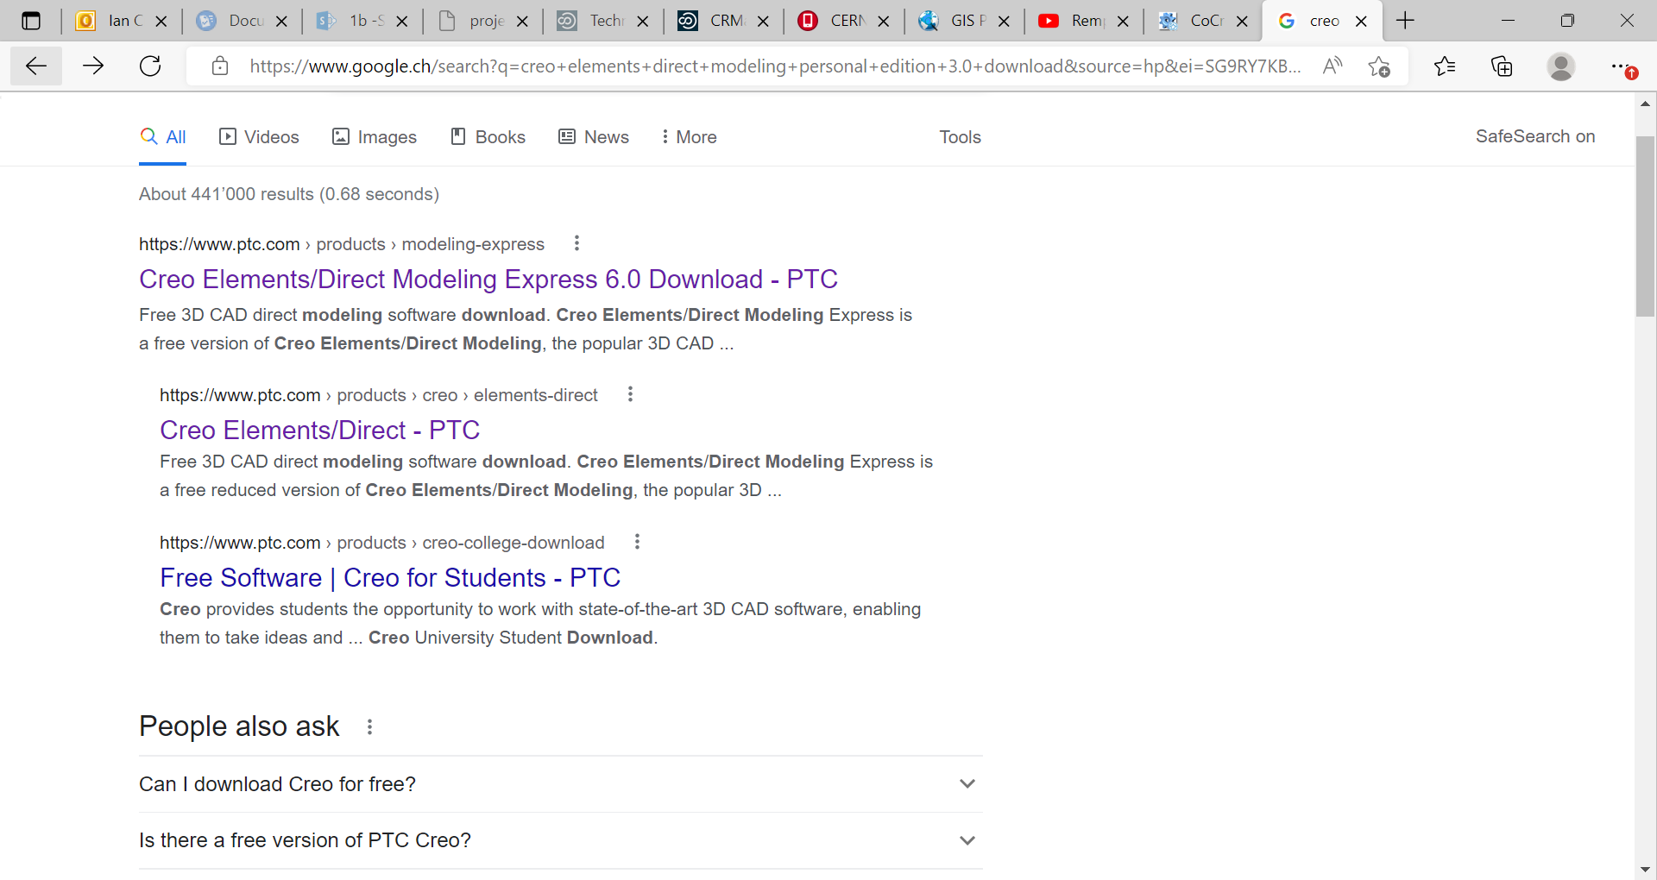

Slide 12
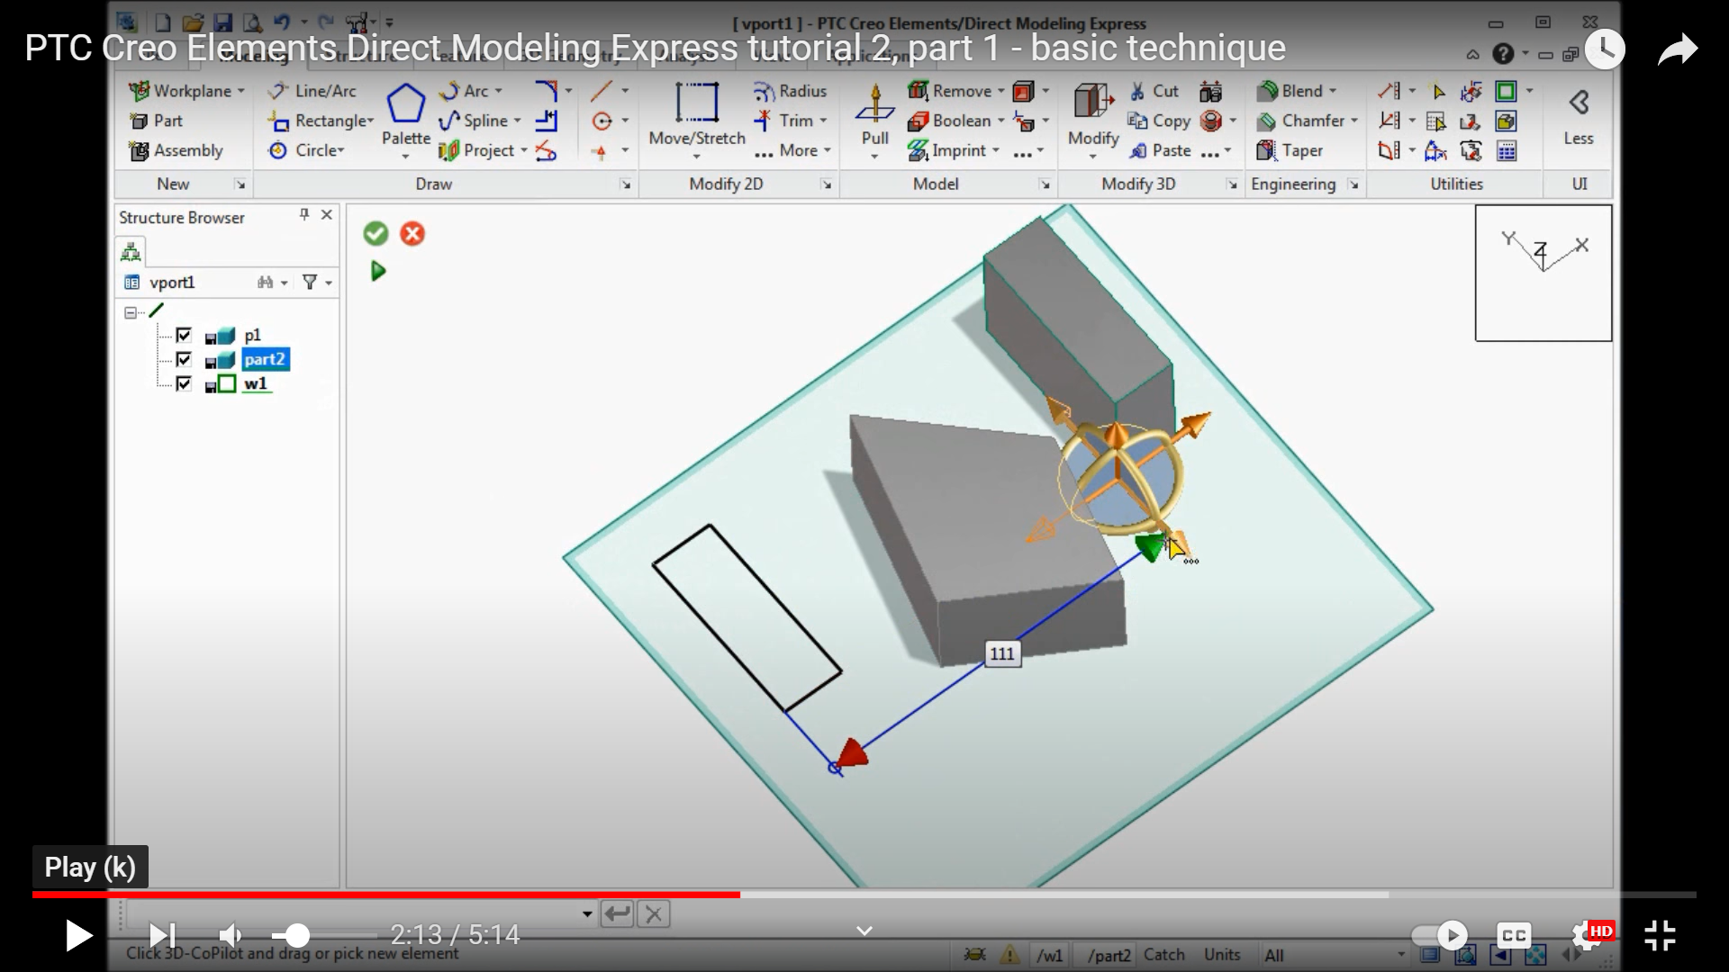
https://www.youtube.com/watch?v=hgqHJnT256A

Slide 13
Create education account NOT customer

Slide 14
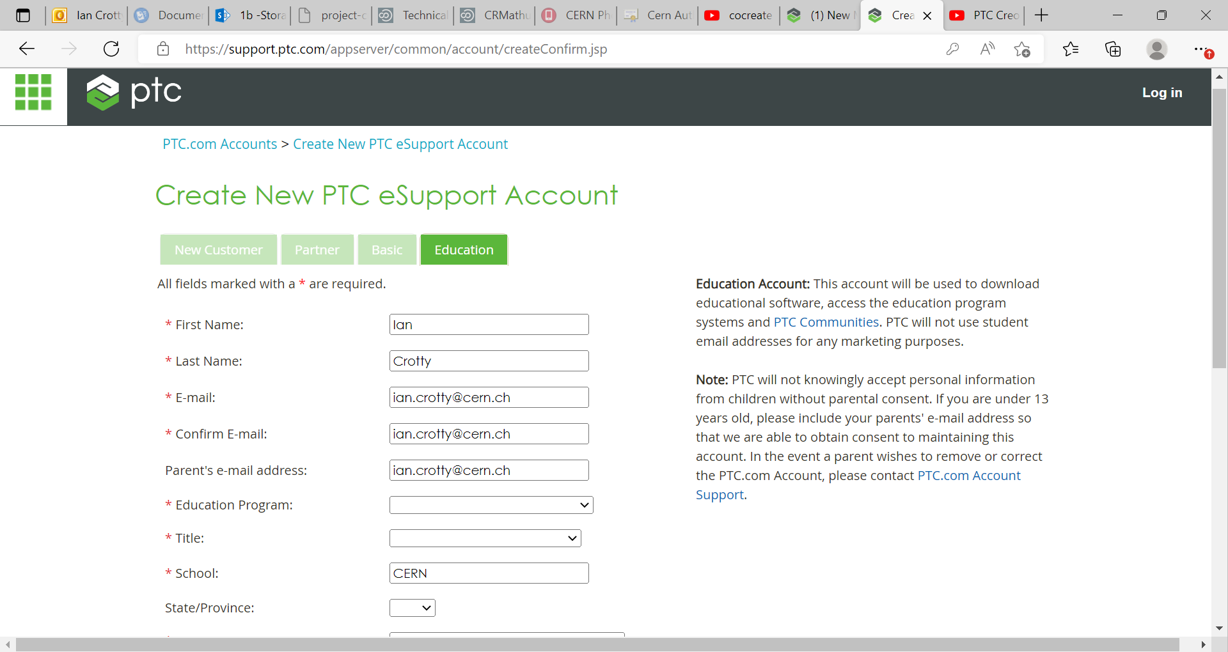
Put “other “ for Education program and Title as “Mentor”
CERN in switzerland

Slide 15
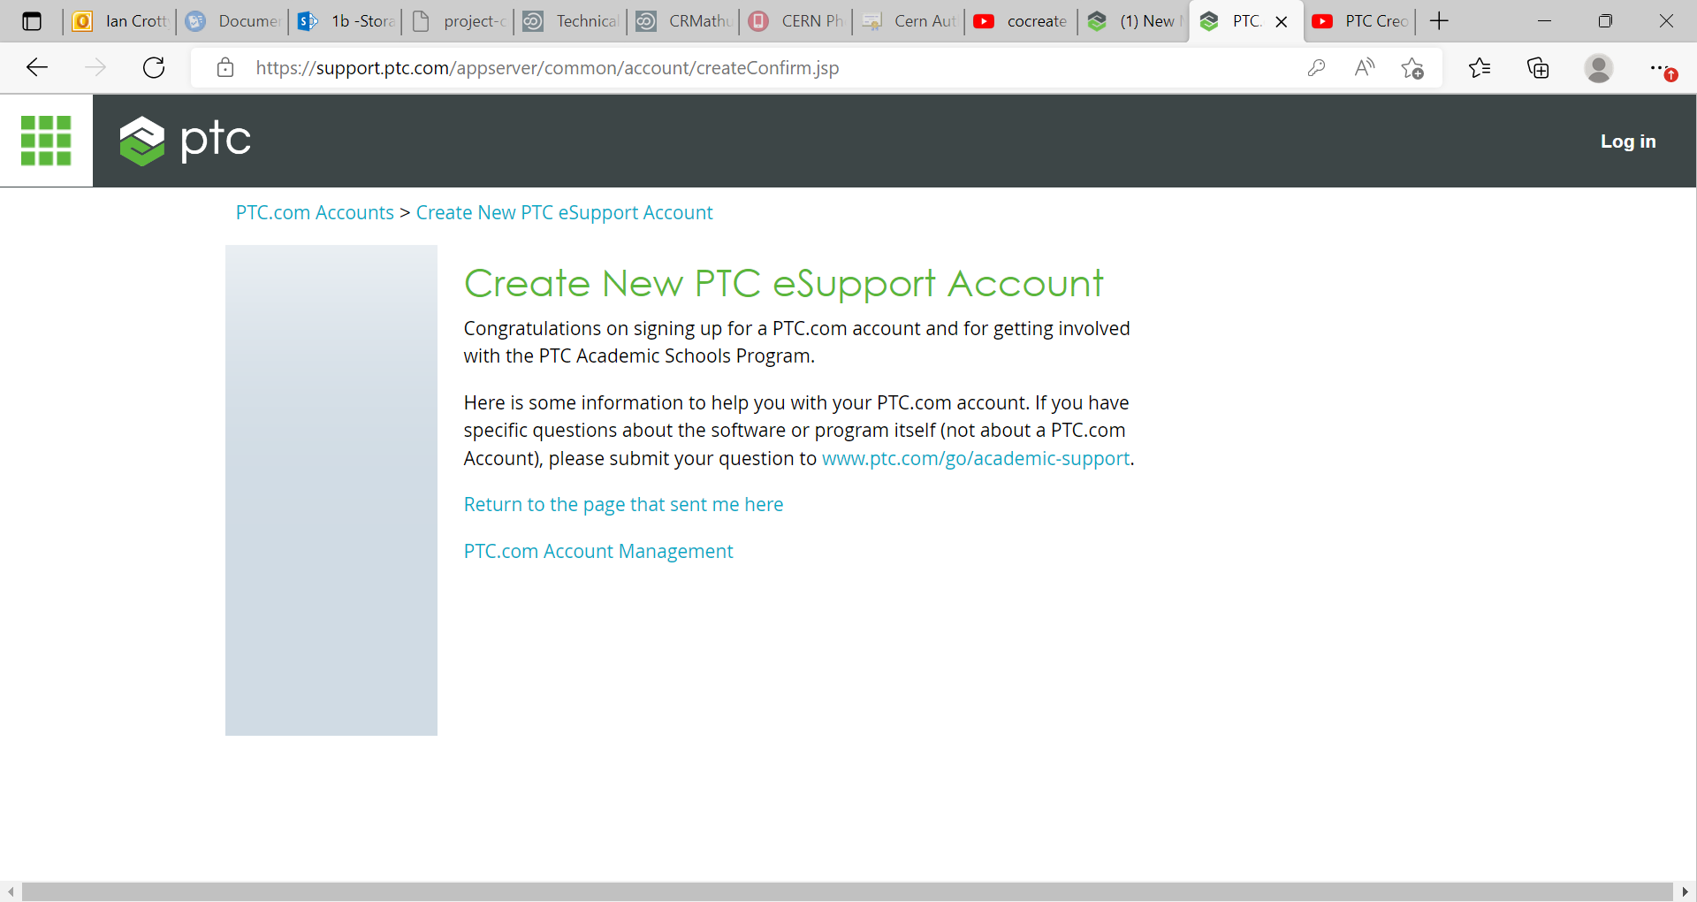
If you have specific questions about the software or program itself (not about a PTC.com Account), please submit your question to www.ptc.com/go/academic-support.

